Slide 1
Tuesday 9th June

Slide 2
Daily Timetable
Daily exercise
French
Spelling
Reading
Maths
Topic

Slide 3
Daily exercise
I am learning to move my body to the beat of a song.
Oti Mabuse 11:30am (strictly dancer) https://www.youtube.com/watch?v=btD_HCO1FT4
Why not try some dancing?

Slide 4
French

Slide 5
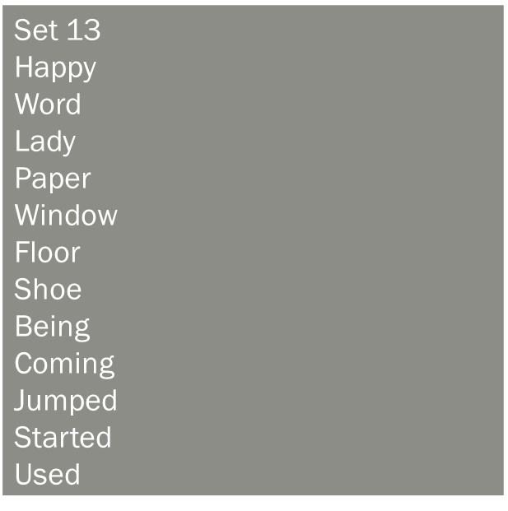
Spelling
I am learning to use various spelling strategies. Select 6 words for Syllabification. Remember each break needs a vowel in it.

Slide 6
Literacy – I can watch a video and create a newspaper article from it.
https://www.bbc.co.uk/bitesize/clips/z7w42hv
I want you to watch the above video about The Dragon Who Ate Our School.
imagine that this event has really occurred and create a newspaper report about the event. You could interview people in the role of various people affected by the school-eating dragon including the head teacher, school students and dinner lady.
Remember a newspaper needs to include:
Newspaper title
Head line (make it eye catching)
First paragraph which draws the reader in that includes the main event.
Then 2-3 paragraphs that tells the story. Remember it is not happening live.
You can include a photo to help with your story.

Slide 7
Maths Starter
3a) round 2345 to the nearest 1000.
3b) round 3547 to the nearest 1000.
3c) round 7654 to the nearest 1000.
3d) round 5432 to the nearest 1000.
1a) half of 122
1b) half of 146
1c) half of 116
1d) half of 86
2a) round 120 to the nearest 100.
2b) round 345 to the nearest 100.
2c) round 569 to the nearest 100.
2d) round 680 to the nearest 100.

Slide 8
Maths Starter answers
1a) 61
1b)73
1c)58
1d) 43

Slide 9
Volume
When measuring volume in liquids we either use millilitres or litres.
For example a litre bottle of Irn Bru holds 1000ml. (millilitres)

Slide 10
Volume – I am learning to convert litres in to millilitres.
To convert litres in to millilitres we need to times by 1000.
We times by 1000 as there is a 1000 ml in a litre.
For example 7.2 litres x (1000) = 7200 ml.

Slide 11
Converting litres to millilitres.
A) 4 litres
B) 4.2 litres
C) 8 litres
D) 6.4 litres
E) 7.8 litres
F) 18 litres
G) 18.9 Litres
H) 1.06 litres
i) 0.2 litres
J) 0.8 litres
K) 0.03 litres
L) 4.53 litres
M) 2. 01 litres

Slide 12
Answers
A) 4000ml
B) 4200ml
C)8000ml
D)6400Ml
E)7800 ml
F) 18000 ml
G)18900 ml
H)1060 ml
I) 200 ml
J)800 ml
K) 30 ml
L) 4530 ml
M) 2010 ml

Slide 13
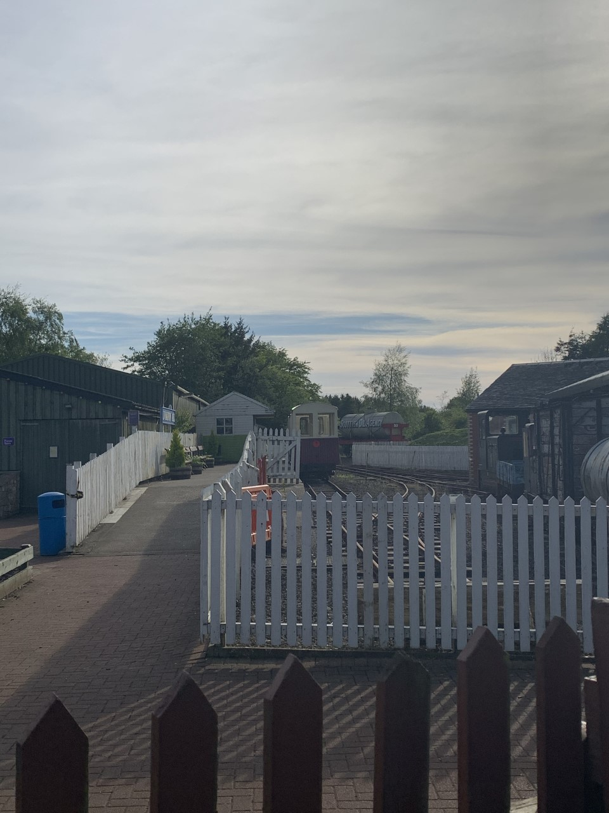
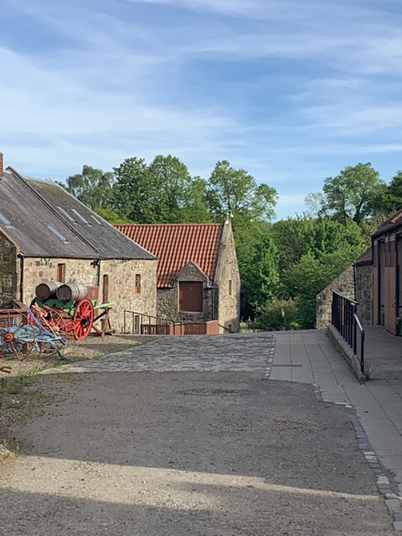
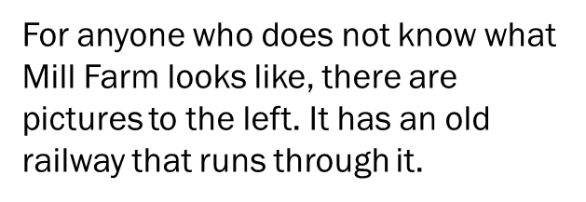
Topic – Mill Farm
Mill farm is also known as Almond Valley Heritage Centre and is situated within West Lothian.
I would like you to research and find out some facts about Mill Farm. Think what it was maybe used for in the past and what it is used for now. You can display your findings in a power point, bullet points or even a fact file.

