Slide 1
Monday 08th June 2020
Good Morning Primary 4!
French: Bonjour la class! Ca Va?
Quelle est la date aujourd’hui?
Aujourd’hui cest Lundi 08th June 2020

Slide 2
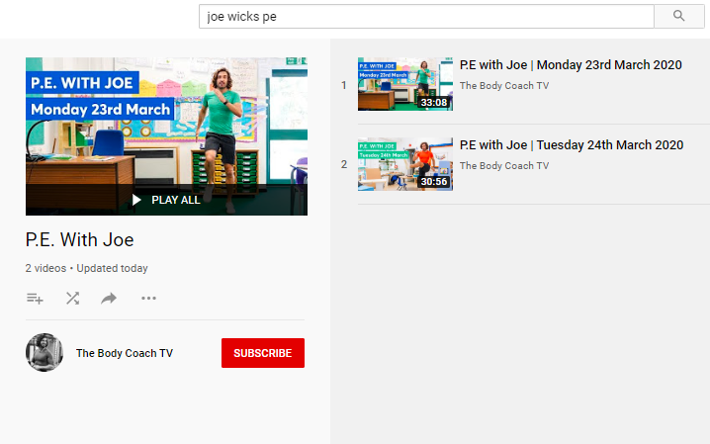
Health and Wellbeing
LI: We are learning to move our body well, exploring how to manage and control it, finding out how to use and share space.
P.E with Joe- Monday 08th June Video
(he is nearly as fun as Mr Martin, not quite, but nearly)
https://www.youtube.com/playlist?list=PLyCLoPd4VxBvQafyve889qVcPxYEjdSTl

Slide 3
Spelling (slide 1)
LI: I am using spelling rules to help me spell words
Before Health Week, we were practising common words. This week, we will look at some more spelling rules. These rules makes it easier to spell certain words.
Rule 1:
Soft ‘g’ – coming before ‘e’ (judge)
Soft ‘g’ – coming before ‘i’ (ginger)
Soft ‘g’ – coming before ‘y’ (gym)
TASK ON THE NEXT SLIDE

Slide 4
Spelling (slide 2)
LI: I am using spelling rules to help me spell words
TASK:
Draw a table in your jotters (example below) and write down as many soft ‘g’ words that you can think of!
Soft ‘g’ before ‘e’ | Soft ‘g’ before ‘i’ | Soft ‘g’ before ‘y’
judge | ginger | gym

Slide 5
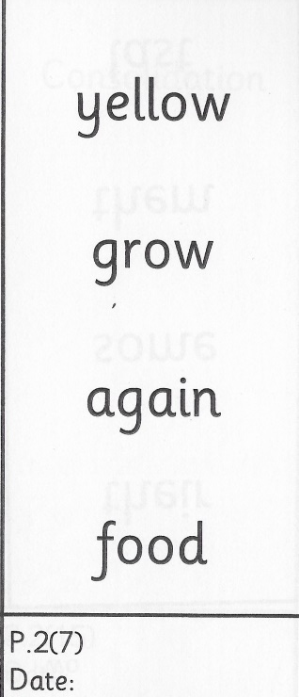
Spelling (David Walliams Group)
TASK:
Keep practising these common words for 1 more week! You’ll get a new set of words next week.
Remember to use the ‘Read, Write and Spell’ strategy to help you practise.
Example of how to practise your common words!

Slide 6
Reading
L.I I am using different reading strategies to help me understand my book
Reading:
David Walliams – t-l-53376-the-making-of-milton-story-powerpoint_ver_4
Making of Milton Reading Comprehension
Roald Dahl – Chapter 5 – Comprehension
Tom Fletcher – Book Review

Slide 7
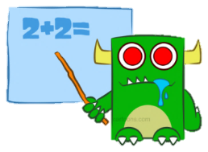
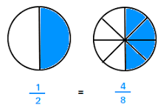
Maths (slide 1)
L.I. I am learning about fractions
Before Health Week, you were learning all about equivalent fractions. Here is an example of an equivalent fraction to remind you:
The amount of space that has been shaded is the same but each circle has been split into a different amount of equal slices! (The denominator / bottom number is different).
Therefore the fraction looks different but they are equivalent / worth the same value.

Slide 8
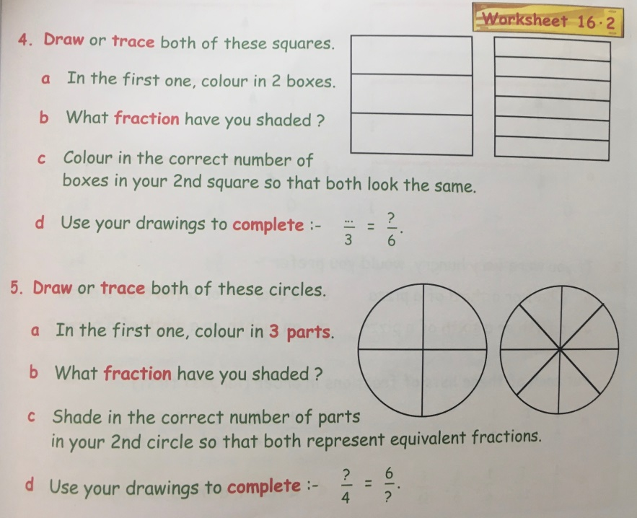
Maths (slide 2)
L.I. I am learning about fractions
TASK:
Practise some more equivalent fractions by completing the activity below in your jotters.
Challenge: Be very neat! Use a ruler to draw the rectangles and find a circular shape to trace around to draw your circles.
Download the page from Teams or the Blog to get a closer look!

Slide 9
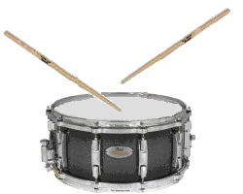
New Topic! (slide 1)
Our new topic is…

Slide 10
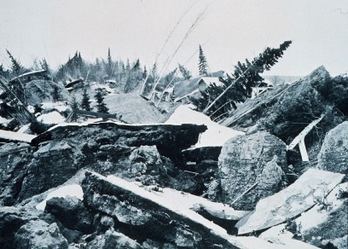
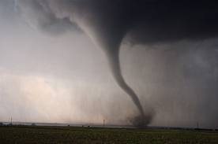
New Topic! (slide 2)
Natural Disasters!
I’m excited about this topic as there are lots of really interesting things that we can learn about! Thank you to Aiden Berry for giving us this topic idea.
Before we get started, how many different types of natural disasters can you think of?

Slide 11
New Topic! (slide 3)
Natural Disasters
Maybe you thought of things like tornados, hurricanes, tsunamis, earthquakes and floods!
Natural disasters are no laughing matter. They can be extremely serious and often cause a great deal of damage and can result in the loss of life, sometimes on a very large scale.
But why do you think that they are called ‘natural disasters’?

Slide 12
New Topic! (slide 4)
Natural Disasters
They are called ‘natural disasters’ because they are caused by natural processes of the earth.
In other words, humans can’t control anything about natural disasters. The only thing that we can do is protect ourselves against them when they do occur.

Slide 13
New Topic! (slide 4)
L.I. I can design a lesson
TASK:
This topic is YOUR topic. It was chosen by YOU so…
Today’s task is to create a lesson for your fellow classmates.
You can choose whatever natural disaster you want to focus on. If anyone creates a really good lesson, then I will use it in one of my PowerPoints this week and your classmates can complete the tasks that you set!
There are some ideas of things you could do on the next slide!

Slide 14
New Topic! (slide 5)
L.I. I can design a lesson
TASK:
Create a PowerPoint to show your classmates information.
Write a quiz so that your classmates can answer lots of questions.
Think of a task that your classmates could do (e.g. write a diary about being involved in a disaster, create a work of art about a natural disaster, create a fact file about a natural disaster etc.)
Complete a science project to find out WHY some of these natural disasters occur.
These are just a few ideas. Write your own lesson plan in your jotters or create a PowerPoint and send it to me on Teams!

Slide 15
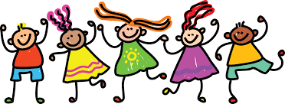
Feel free to leave comments / questions on Teams throughout the day and I will try my best to get back to you. Enjoy your day, Primary 4!

