Slide 1
Monday 8th June

Slide 2
Timetable
French Starter
Daily exercise
Spelling
Reading
Maths
DYWF
Health and well being

Slide 3
French

Slide 4
Daily exercise
Monday is normally a PE day for us so here are some ways you can choose to get
active today:
(Some of these people are almost as fun as Mr Martin, but not quite!)
Joe Wicks 9am live - https://www.youtube.com/watch?v=rAX6Q236CwI
Oti Mabuse 11:30am (strictly dancer) https://www.youtube.com/watch?v=btD_HCO1FT4
Cosmic Yoga (on anytime) https://www.youtube.com/watch?v=flK2Nasd-AI

Slide 5
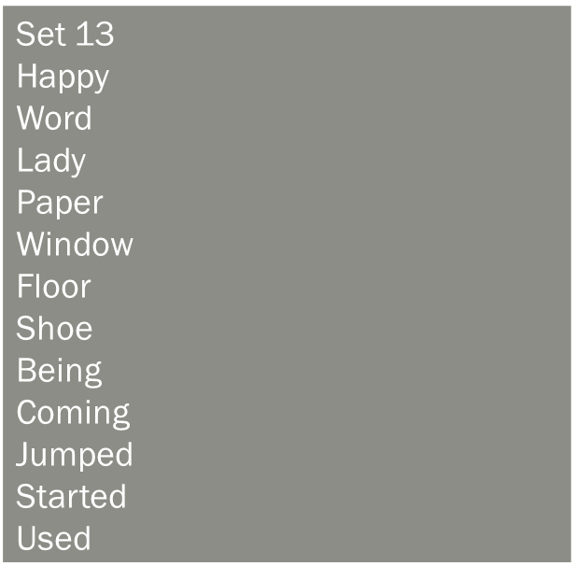
Spelling – I am learning to use various spelling strategies.
Partner spell your words.
Challenge – can you put 4 words in to sentences of your own.

Slide 6
Reading : Prior Knowledge
LI: Strategy 1: Prior Knowledge – I am learning to use my prior knowledge to help
me predict what my book the next chapter will be about.
Success Criteria
Think about what you already know about the characters and main ideas of the last chapter you read. Note down your ideas.
Re- read the last chapter. Add to your notes.
Discuss this with your partner and note down what ideas you had that were the same or different.
When you have done this, read the next Chapter , then write down how your thinking may have changed since before you read the chapter.
Set your work out like this: (on next slide)

Slide 7
Before reading | Before reading | After reading
What I think | What my partner thinks | How it has changed

Slide 8
Volume
I can identify the volume of an object.

Slide 9
Questions (Starter)
Which holds more:
A litre bottle of juice or a can of juice.
If a litre bottle of juice is 1000ml and someone drinks 250ml out of it. How much is left?
John buys a 6 pack of coca cola cans. Each can contains 330ml. How much does 6 cans contain?
Is an extra challenge on Sumdog on Time.(Revision) Will be available till Thursday.

Slide 10
Volume
James really likes doing experiments, similar to us.
Each test tube can hold 600 ml.
Test tube A has 300 ml in it.
Test tube b has 450 ml in it.
Test tube c has 500 ml in it.
How much more is in b than a?
How much less is in b than c?
If he mixed a and b together how much would he have?
How much more would he need to add to a to get to 1 litre in
A –
B –
C-
James needs 6 lots of test tube A for his experiment. How much is that in total?

Slide 11
Answers
Slide 1
A litre of juice
750 ml
1 litre, 980ml or 1.98 litres
Slide 2
150 ml
50 ml
750 ml
A - 700 ml B – 550 ml C – 500 ml
1.8 litres or 1800 ml

Slide 12
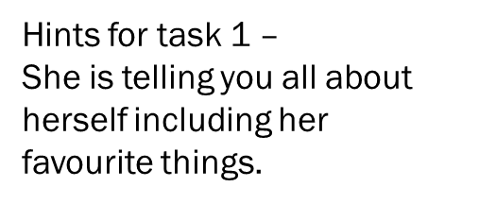
DYWF
Look for the key words to help you work it out.
For example she says Cumbernauld, Scotland.
Do not use google translate to help. Try and work it out yourself.

Slide 13
Health and wellbeing
I want you to think back to last week’s activities.
I want you to tell me one activity that we done for health week that you found interesting and why?
For example:
Estimating how many steps it took you to walk around your kitchen. It was interesting because depending on who you were doing the challenges with the steps changed, even though the room didn’t. This was because …….
If you were to create your own health week challenge, what would it be?
It could be a literacy task, maths task (like above) or a sports one.

