Slide 1
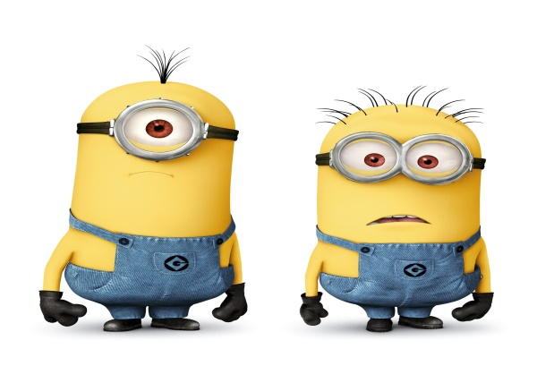
Monday 8-6-20
Good Morning Everyone!

Slide 2
Today’s Timetable
Daily Exercise
French
Sumdog Multiplication Check
Maths Lesson
Grammar on Sumdog
Literacy
R.E.
P.E.
Prayer

Slide 3
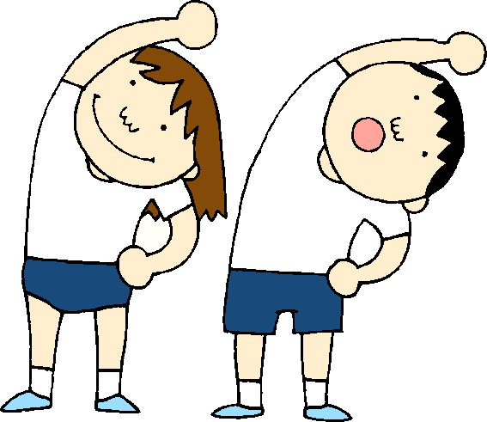
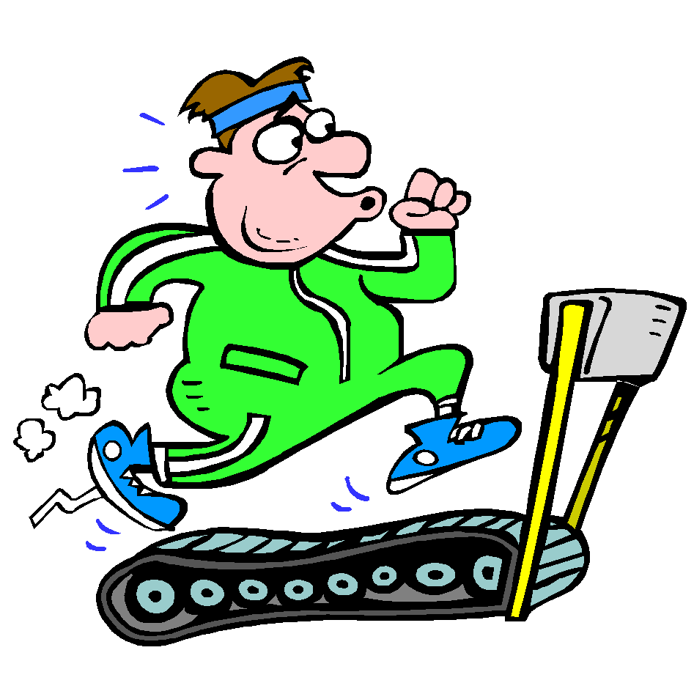
Daily Exercise
Why not try this challenge today:-
https://twitter.com/WLPENetwork/status/1268804304242118659?s=20
Or join the Body Coach at 9am

Slide 4
A little bit of French to start the day
Click on the link below to sing along to the days of the week song in French?
https://www.youtube.com/watch?v=Lpwf5N0rfVE
Can you write today’s date in French?
Quelle est la date aujourd’hui?
C’est ……………………..
Can you also write today’s weather in French?
Quel temps fait-il?
Il pleut/ Il fait beau/ Il fait froid/ Il y a du vent/
Il fait mauvais/ Il y a des nuages/ Il y a du soleil

Slide 5
Morning Starter
Today, I have set a Sumdog Multiplication Check for you to do. You only have today to complete this task. I will set a different challenge for you tomorrow. Well done to those who completed last week’s challenge, I have rewarded you 200 points. Those who started it but didn’t complete it, received 50 points.
If you have log-in details for IDL Maths please continue to access this as normal.
SUMDOG

Slide 6
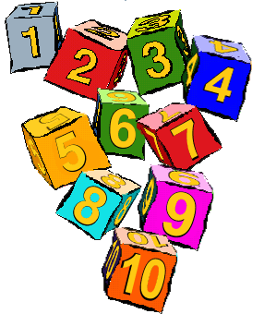
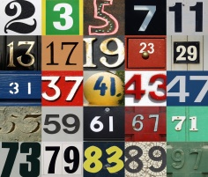
Maths Lesson
Today we are revising Prime and Composite Numbers.
S.C. – To be able to identify Prime Numbers.
- To be able to identify Composite Numbers.
- To be able to answer the attached questions.
Remember that Prime numbers only have 2 factors, in other words they are only divisible by themselves and the number one. Composite Numbers are numbers with more than 2 factors. Watch this short video:-
https://www.youtube.com/watch?v=2hVQLG-QTfI
Please find your task attached to the blog.
Circles – Qu 1 – 4 Squares – Qu 1 – 10 Triangles – Qu 1 - 20

Slide 7
Grammar
Log in to Sumdog for your Grammar task.
Tasks have been set according to your Reading Group.
Group 1 – Red Reading Group,
Group 2 – Blue Reading Group
Group 3 – Green Reading Group
This task is set for the whole week. Try to answer an average of 20 questions per day. The questions target a range of grammar topics.
At the end of the week, I will be able to view how you got on with your work. Well done to all those who completed last week’s task!

Slide 8
Literacy
Today, we’re going to do read the next 4 chapters of ‘Wonder’. [‘Padawan’, ‘September’ ‘Jack Will’ & ‘Mr Browne’s October Precept’]
Click on the link to listen to the story:-
https://www.youtube.com/watch?v=xoftxvPESVg
August is reflecting on how the children in his school react to seeing his face and how that makes him feel.
Your task, today, is to think about what Mr Browne’s October Precept means to you. YOUR DEEDS ARE YOUR MONUMENTS. So you need to think about what a monument is and what are your deeds? Write a short paragraph about what you think this precept means and your thoughts on it.
Red Group: Try to the above task – 4 sentences should be enough. Remember to do your IDL.

Slide 9
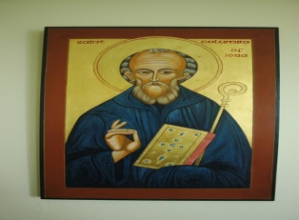
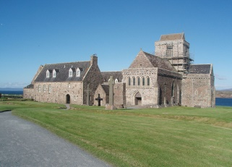
St Columba
Tomorrow, the 9th of June, is the Feast of St Columba.
St Columba, like St Ninian before him, brought Christianity to Scotland. Some of you are now in Columba House at St Kent’s. Watch the following video to learn more about this special saint.
https://www.youtube.com/watch?v=tSGKz3kETCk
Task:- Your task is to draw a Celtic cross like the one which Columba used and which nowadays can be found on Iona and all over Scotland and Ireland. One of the stone Celtic crosses which stands on Iona is over 1000 years old.
You can search the internet for examples of Celtic crosses to draw or watch this video to do a digital version:-
https://www.youtube.com/watch?v=-CEfE_qbP4k

Slide 10
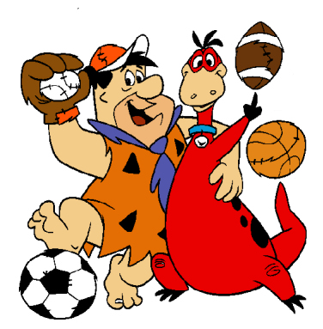
P.E.
Click on the following link for today’s P.E. session
https://www.youtube.com/watch?v=5ALV5ngx8WM
Alternatively, join family members for a walk, run or cycle.

Slide 11
A prayer to end our day
Take a few moments to say a short prayer. You might like to dedicate your prayer to someone in your family who is unwell or who just needs your prayers.

Slide 12
Well done!
Well done for working hard today!

