Slide 1
Good Morning P5/4
Week 12 Home Learning
Monday 8th June 2020

Slide 2
Aujord’hui c’est lundi huit juin.
Je suis content(e)
Je suis d’accord
Je suis mal
Il fait gris.
It is grey.

Slide 3
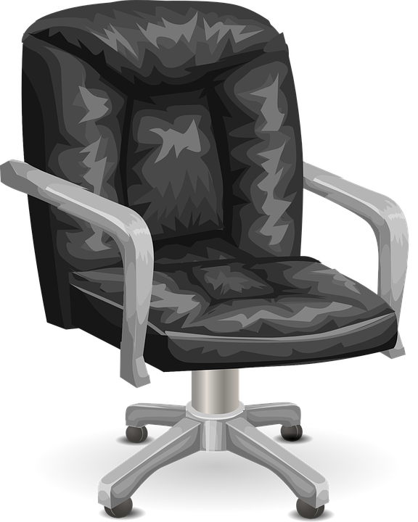
Morning Starter
Start at 1 on a clock.
Make a half turn clockwise.
Where do you finish?
How many right angles are there in this shape?
Sid was driving South East when he came to a roundabout.
He then turned his car through 45 degrees anti-clockwise.
In which direction was Sid then driving?

Slide 4
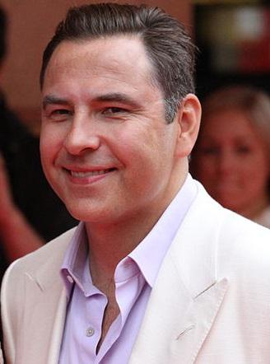
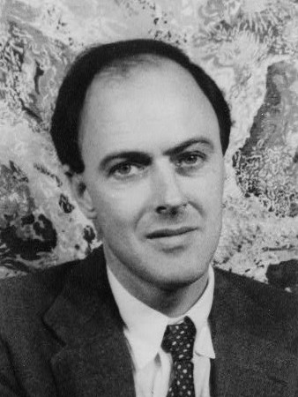
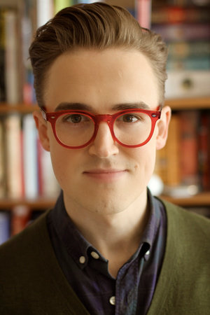
Spelling: Phonics Board
‘ow (owl)’
Read, Write, Spell
Common words
Reading: New Book!
Task – Reading Comprehension
Literacy Task Board
Spelling: Generate phoneme families
Primary 4 – unit 5 ‘oo’ - Extension
Primary 5 – unit 12 ‘ch’ - Extension
Reading:
Task – Comprehension Questions
Spelling: Generate phoneme families
Primary 4 – unit 5 ‘oo’ - Extension
Primary 5 – unit 12 ‘ch’ - Extension
Reading:
Task – Book
Review

Slide 5
Estimating and Measuring Length
Don’t worry if you do not have all the supplies at home, just use what you have.
Measuring Length
Websites for all groups to use:
Measuring Length

Slide 6
French
Watch this video about French body parts:
https://www.youtube.com/watch?v=bChrAwLzoSo
Then try and guess what the French names for different body parts are using the visual clues in the video.

Slide 7
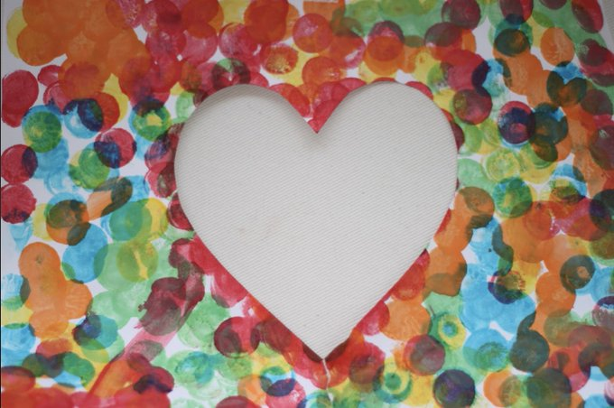
RE
June is the month of the Sacred Heart!
Fold a piece of paper in half and cut half a heart shape. When it is open a full heart is visiable.
Decorate the paper then stick it on another sheet, write a thank you prayer to Jesus.

Slide 8
Survey - Important
Today is the last day that you and your parents/carers have to complete the surveys, the links for both are below. Please take a couple of minutes to provide your feedback, it is greatly appreciated.
Parents | Complete Form here
Pupils (P4-P7) | Complete Form here

