Slide 1
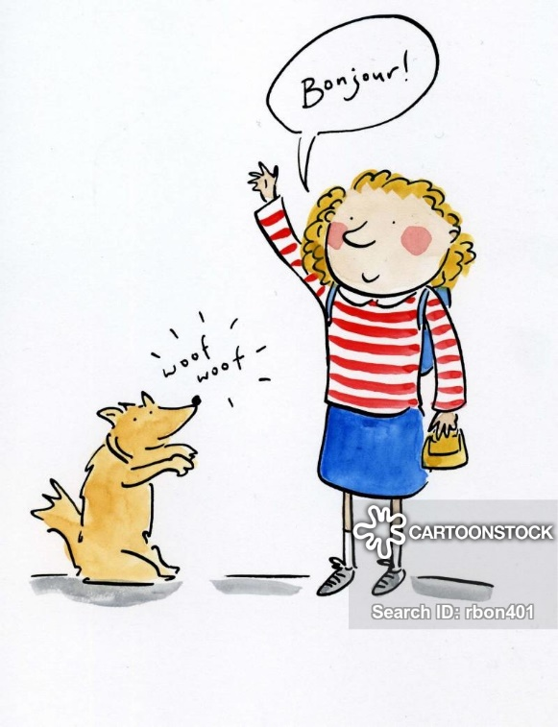
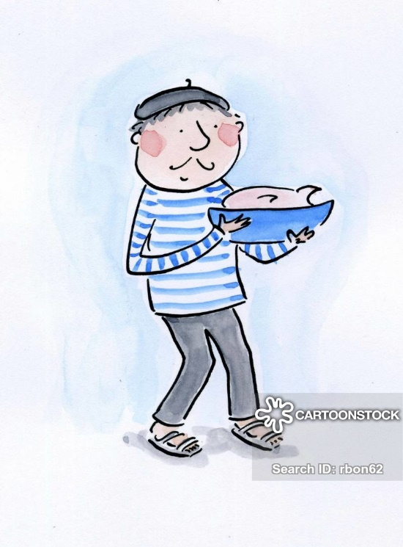

Monday 8th June
Good morning primary 2!
Bonjour la class! ca va?

Slide 2
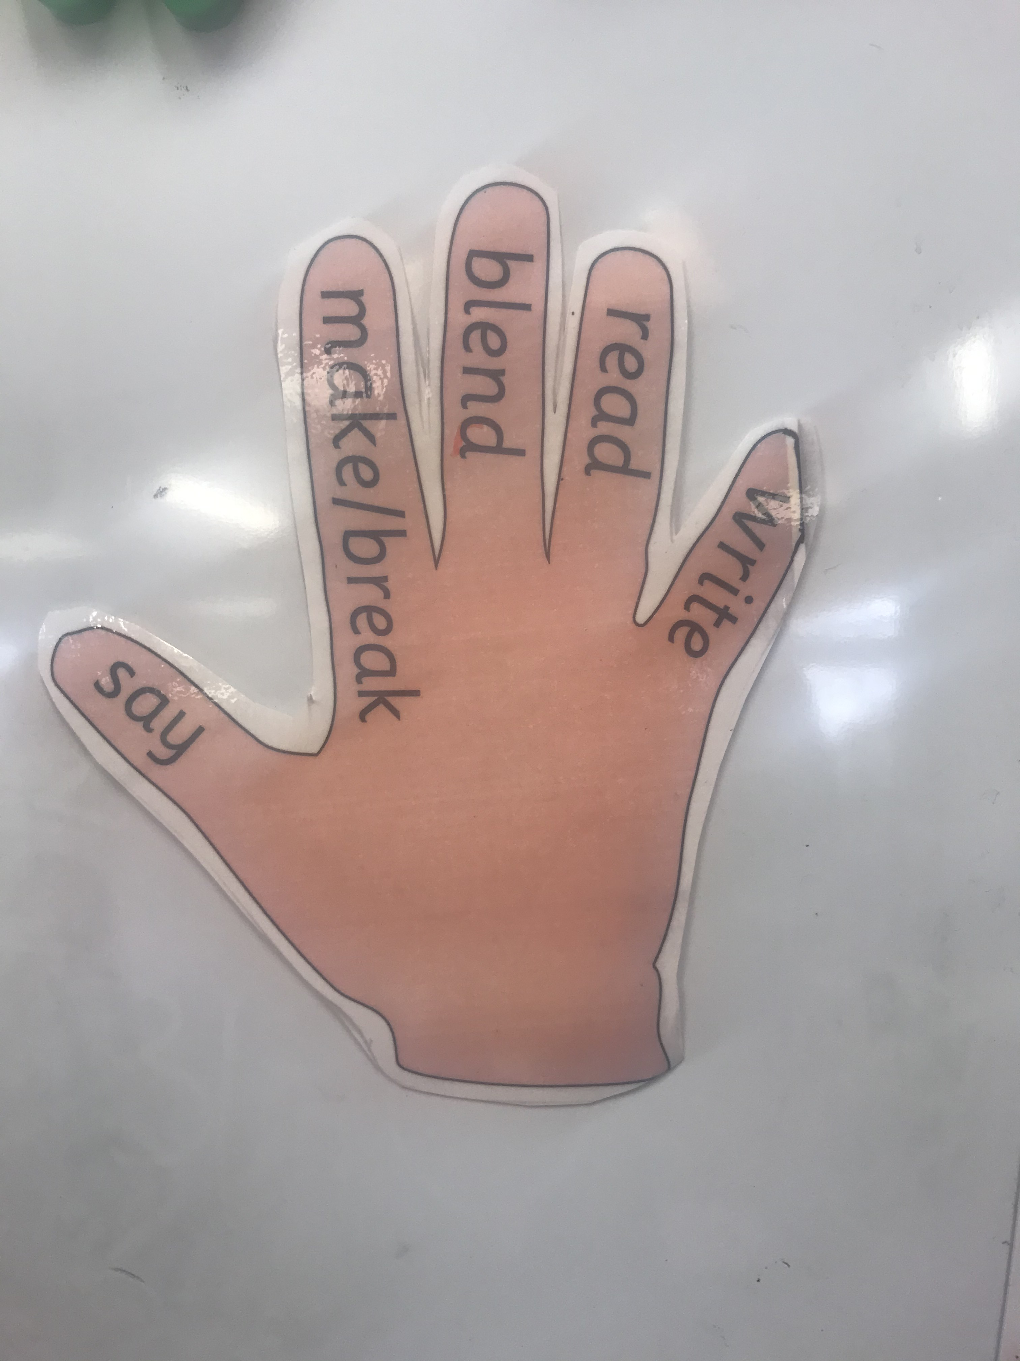
Literacy
L.I - I can recognise, read and make words containing the ‘ll’ phoneme.
Revise letter sounds – https://www.youtube.com/watch?v=KsDMOJbWt_Y
Watch -https://www.youtube.com/watch?v=KG1DVc8E1a8
Task 1 - Read phoneme story and highlight phoneme words
(items found in home learning pack)
Task 2 – Cut up the phoneme word maker and make the following words.
frill
hilly
well
spell
dull
all
doll
pull

Slide 3
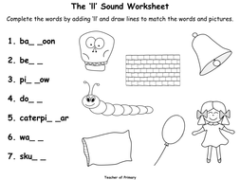
L.I – I can spell words containing the ‘ll’ phoneme.
Task – Can you complete this ‘ll’ activity in your jotter?
*Challenge
Choose an ‘ll’ word and write a super sentences in your jotter.

Slide 4



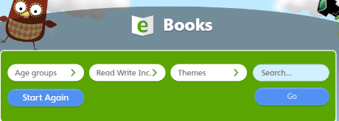
Oxford Owl Ebooks
*Choose a new book to read this week
Login to the following website : https://www.oxfordowl.co.uk/
Click on the following ‘My class login’ at the top of the page
Username: stanothnysp12
Password: Homelearning*1
Click on ‘My Bookshelf’
Click on ‘Series’ button and select Oxford Reading Tree
Scroll down the list of books and choose one suitable for your child. We advise you read one book per week as we sill set ‘read to write tasks’ for your child to complete.

Slide 5

I don’t want to be a frog
https://www.youtube.com/watch?v=mqLB9pbJprU

Slide 6
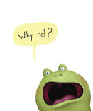
I don’t want to be a frog questions
Why does he not want to be a frog?
Why does the frog want to be a rabbit?
What others animals does the frog want to be?
In the end, why was the frog happy to be a frog?
If you could be an animal, what animal would you be and why?

Slide 7
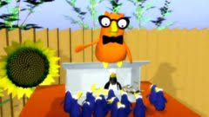
Mathematics
Data Handling
L.I – We are learning to sort items using a pictogram.
Watch – https://www.bbc.co.uk/bitesize/clips/zs4xn39
Task – On the next slide there is a pictogram. Can you use the information from the graph to answer the questions?

Slide 8

 | Number of exercises completed
Max
Tom
Grace
Lilly
Jim
Question 1: Who done the most exercise?
Question 2: Who did the least amount of exercise?
Question 3: How much exercise did Max do?
Question 4: Which children completed the same amount of exercises?

Slide 9
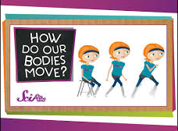
Health and Wellbeing
L.I – We are learning to understand how our muscles work.
There are about 640 muscles in our bodies and the most important muscle is our heart.
Some muscles, like our heart, move without us thinking.
Other muscles, like the ones in our arms and legs, only move when we tell them to.
Watch this short video to find out more - https://www.youtube.com/watch?time_continue=120&v=j918PoWWaB0&feature=emb_title

Slide 10
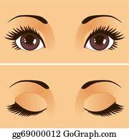
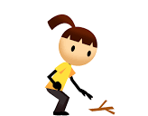
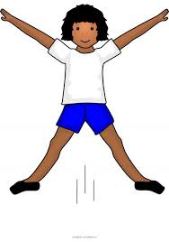
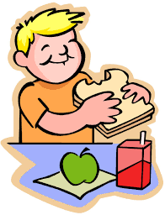
Health and Wellbeing
L.I – We are learning to understand how our muscles work.
Activity
Can you complete all of the simple tasks below?
Whilst you are completing the task, can you work out what parts of your body and muscles you are using?
Do a star jump
Lift an object up from the floor
Chew a piece of food
Close your eyes

