Slide 1
Tuesday 2nd June

Slide 2
Timetable
French Starter
French
Daily exercise
Sports day Challenge
Spelling
Literacy
Maths

Slide 3
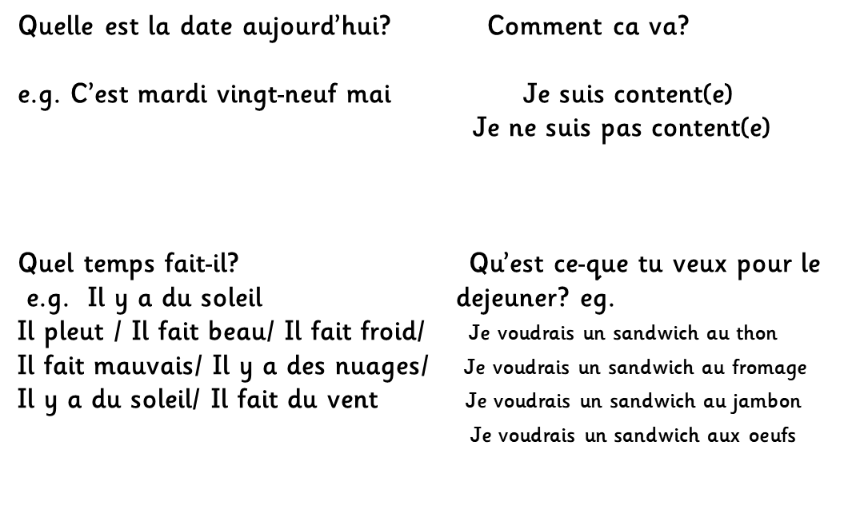
French Starter

Slide 4
Sports day Challenge
Fancy a bit of friendly virtual competition, as well as the chance to win points for your house? Here’s how you can:​
​
Every day, a video will be at the end of the Powerpoint with the title ‘Sports Day Challenge’, each video will be presented by a Mrs Moffat and in it I will explain and demonstrate an activity that you can do from home.​​
All you have to do is:​
State what house you are in in the film - no pupil names please​
Film yourself doing the activity​
Say how many points you got​
Post your video either to teams or the blog​​
Mrs Moffat and Mr Paterson will tally up all the points from each challenge each day and announce the winning house on Friday 5th June!​
​
Have fun!

Slide 5
Daily exercise
(Some of these people are almost as fun as Mr Martin, but not quite!)
Joe Wicks 9am live - https://www.youtube.com/watch?v=rAX6Q236CwI
Oti Mabuse 11:30am (strictly dancer) https://www.youtube.com/watch?v=btD_HCO1FT4
Cosmic Yoga (on anytime) https://www.youtube.com/watch?v=flK2Nasd-AI
Or try and get outside for some fresh air.

Slide 6
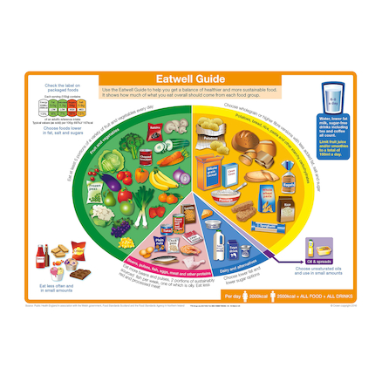
Food and Health - nutrition​ L.I. - I can identify which foods belong in each section of the Eatwell guide and use this information to create a healthy lunch. You may need an adult help with lunch.
Using the picture to the side can you create your own healthy lunch.
Think what you would need from each section?
If you cannot make your lunch, you could list all the foods that you would need to make it.
You could also try the EatWell Challenge
https://www.foodafactoflife.org.uk/11-14-years/healthy-eating/eat-well/#EC

Slide 7
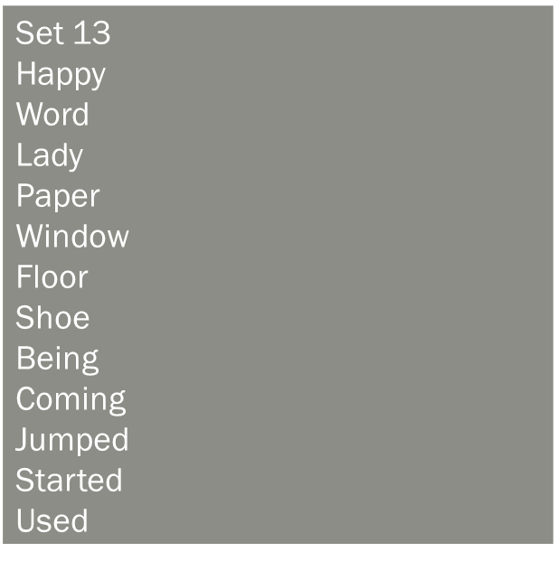
Spelling – I am learning to use various spelling strategies.
Week 1 – Tuesday – Partner spell.

Slide 8
Literacy – L.I. I can write a biography about a sports personality.
Choose your favourite sports personality, research them online and write a biography about their life and achievements.​
​
Here are a few suggestions of people if you are struggling:​
Mo Farah, Eilish McColgan, Lewis Hamilton, Andy Murray, Lauren Steadman, Lionel Messi, Stuart Hogg

Slide 9
Maths Starter
https://mathsbot.com/questionGenerator

Slide 10
Maths starter answers

Slide 11
Maths
I am learning how to calculate the area of a right angled triangle.
To calculate the area of a right angled triangle, we use two steps:
Step 1 – area = l x b
Step 2 = Area ½ of answer in step 1 =
6 cm
8 cm.
Example
Step 1 – Area = l x b
Area = 8 x 6 = 48cm 2
Step 2 = ½ of answer in step 1.
Area = ½ of 48 = 24cm2

Slide 12
4cm
3cm
12 cm
6cm
8cm
6cm
5cm
9cm

Slide 13
Answers
Area = l x b
Area = 6 x 3 = 18 cm²
^{½ of 18 = 9}cm²
Area = l x b
Area = 12 x 4 = 48cm²
^{½ of 48= 24}cm²
Area = l x b
Area = 9 x 6 = 54 cm²
^{½ of 54 = 27}cm²
Area = l x b
Area = 8 x 5 = 40 cm²
^{½ of 40 = 20}cm²

Slide 14
Sports day Challenge 2
It is on the blog.

