Slide 1
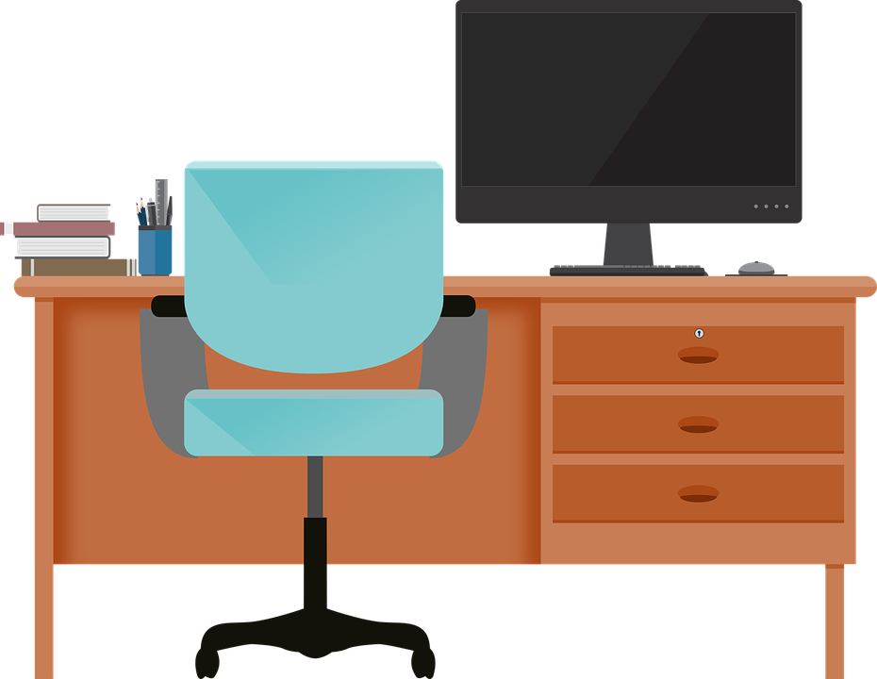
Good Morning P5/4
Week 11 Home Learning
Health week 2020
Tuesday 2nd June 2020

Slide 2
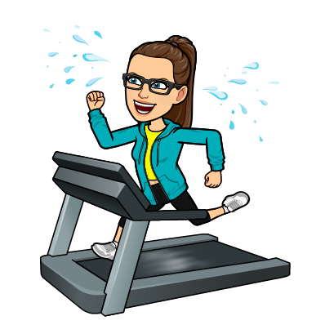
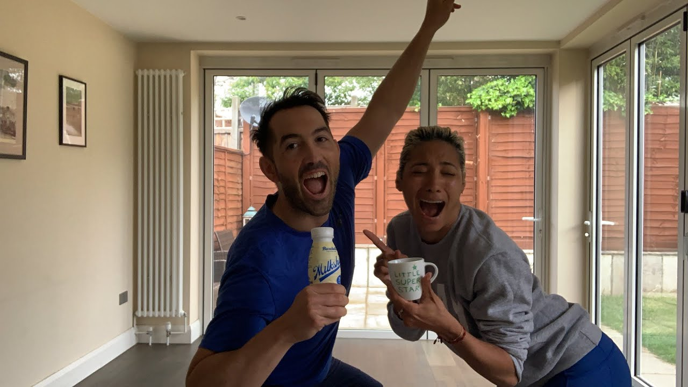
Morning Starter
Today’s Get Fit starter is from someone that those of you who watch Strictly will like, its professional dancer Karen Hauer!
She and her partner have been going live at 10 for Cardioke! However they have taken a little break just now, although all the videos they have done are saved to her Youtube, so just click on one that says 'Cardioke'.

Slide 3
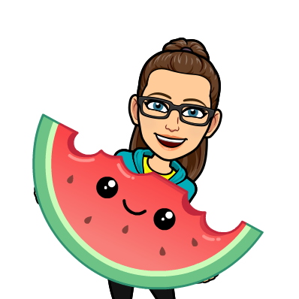
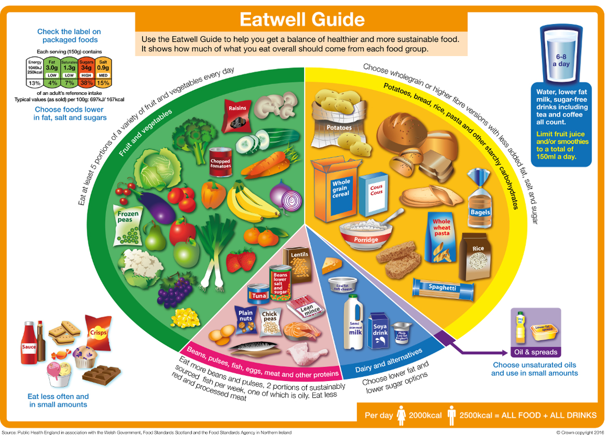
Food and Health - nutrition
L.I. - I can identify which foods belong in each section of the Eatwell guide and use this information to create a health lunch. You may need an adults help with lunch.
Using the eatwell guide below, complete this food sorting activity.
Also, there is a link in the first
slide which will take you to an
Eatwell guide game where you
can test your sorting skills.

Slide 4
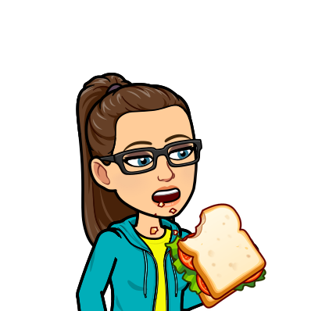
Literacy
L.I. I can write instructions for how to make a healthy sandwich and review it afterwards.
Use this template, you can print it out if possible, if not you can just write each heading into your jotters and write your information underneath.
First page is your instruction writing, the second page is you reviewing your sandwich making skills.

Slide 5
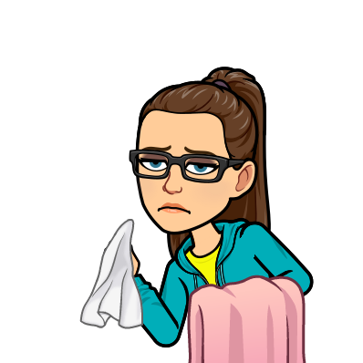
Substance Misuse
L.I. I can apply my knowledge to explain when and why I would take or use medicine in a safe way and say how it would help me.
Have a look at these talk cards and discuss each scenario with someone at home.
Once you have had a good discussion about how to take and use medicine safely, including how to store medicines safely, create a poster to promote medicine safely.
Here is a template that you can use if you are able to print it off.
.

Slide 6
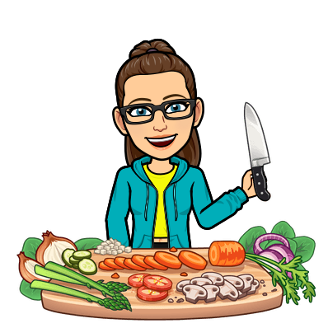
Maths
L.I. I can estimate the amount of fruit makes 1 portion.
As you will have learnt through the Eatwell guide, we are told that we should have 5 portions of fruit and vegetables each day.
However, have you ever wondered how much fruit or vegetables makes one portion, for example, one grape is not one portion.
Now it you chance to research this.
Challenge:
Using your recently acquired knowledge, work how many portions of fruit and
vegetables you have to including Breakfast, lunch, dinner and any snacks.

Slide 7
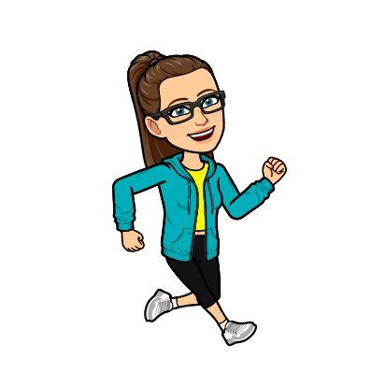
Daily Exercise
As stipulated by the government, you are allowed out of your house once a daily for daily exercise with people from your household.
Using this chance, during health week I thought it would be great to get us back doing the daily mile. Now you can walk, jog or run your daily mile but the rules are as follows:
You have 15 minutes to see how far you can either walk, jog or run.
The average person, walking at a moderate pace should be able to walk a mile in 15 to 20 minutes, so it is doable.
You could keep track of your progress over the week, do you manage to cover more distance over the same time period, maybe you get faster.
If you wish you walk for longer (you have up to an hour for your daily exercise) then you can do so.
Let me know how you get on.

Slide 8
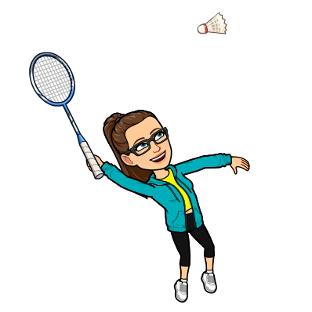
Sports Day Challenge
Fancy a bit of friendly virtual competition, as well as the chance to win points for your house? Here’s how you can:
Every day, a video will be at the end of the Powerpoint with the title ‘Sports Day Challenge’, each video will be presented by a myself and in it I will explain and demonstrate an activity that you can do from home.
All you have to do is:
State what house you are in in the film - no pupil names please
Film yourself doing the activity
Say how many points you got
Post your video either to teams or the blog
Myself and Mr Paterson will tally up all the points from each challenge each day and announce the winning house on Friday 5th June!
Have fun!

