Slide 1
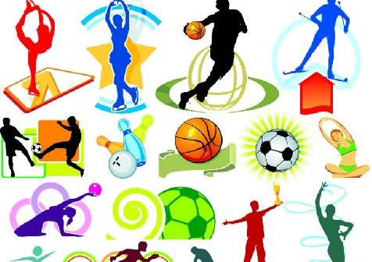
Monday 1-6-20
Good Morning Everyone!

Slide 2
Today’s Timetable
Health Week – Daily Challenge
French
Morning Starter
Maths Lesson
Spelling
Literacy
R.E.
Sports Challenge
Prayer

Slide 3
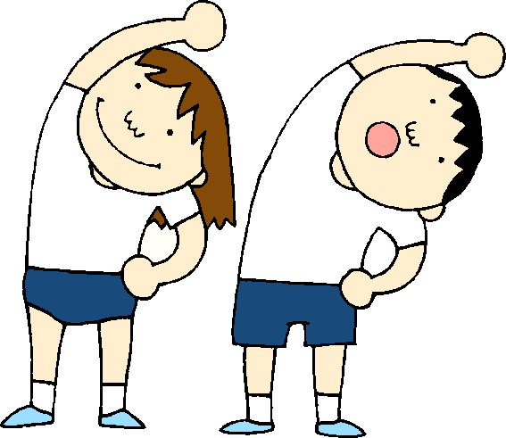
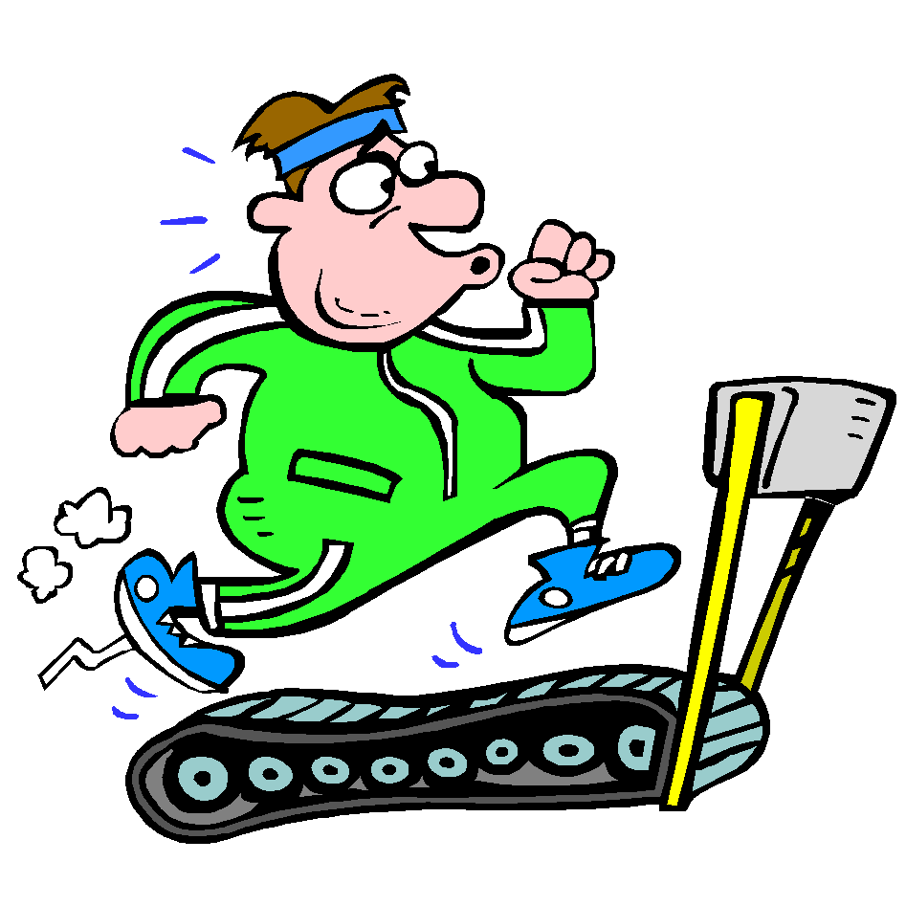
Health Week Daily Challenge
Sorry, the file is too large to include on the powerpoint.
Please see your challenge listed separately on the blog.

Slide 4
A little bit of French to start the day
Click on the link below to sing along to the months of the year song in French?
https://www.youtube.com/watch?v=7_u2SigckNQ
Can you write today’s date in French?
Quelle est la date aujourd’hui?
C’est ……………………..
Can you also write today’s weather in French?
Quel temps fait-il?
Il pleut/ Il fait beau/ Il fait froid/ Il y a du vent/
Il fait mauvais/ Il y a des nuages/ Il y a du soleil

Slide 5
Morning Starter
Today, I have set a Sumdog Challenge for you to do. Try to do15-20 minutes. The challenge is to complete 80 correct answers by Thursday so pace your work. Well done to those of you who are doing your Sumdog tasks. I can see who is working on Sumdog through the weekly report. I will be rewarding every students who logs on for at least 15mins with 50 coins. The top 3 students [students who spend the most time] will get 100 coins.
If you have log-in details for IDL Maths please continue to access this as normal.
SUMDOG

Slide 6
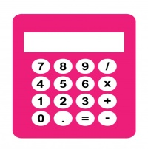
Maths Lesson
Today we are learning to find the mean.
To find the mean is to find the average. Finding the mean of a set of data is something which is used in so many aspects of life. For sports men and women, they will use the mean, for example, to work out the average time to run/cycle/swim a certain distance.
To find the mean, we add up all the data and then divide it by the number of pieces of data eg. . The mean of 2,3,,4,7 is 2+3+4+7 = 16 16$÷4=4 The mean is 4$
Please find your task attached to the blog.
Circles – Qu 1 – 4 Squares – Qu 1 – 10 Triangles – Qu 1 - 20
You can use a calculator for this task. If you have any problems, please get in touch on Teams.

Slide 7
Spelling
Log in to Sumdog for your spelling task.
You will need to make sure you click on the task set for your group.
Group 1 – Red Reading Group, Group 2 – Most of the Class
Group 3 – Super Spellers
This task is set for the whole week. If you find the words too hard, drop down a group and if they’re too easy, try the next group up. The words are based on your spelling lists.
At the end of the week, I will be able to view how you got on with your work. Well done to all those who completed last week’s task.

Slide 8
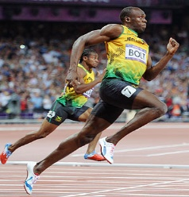
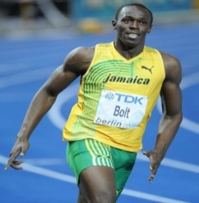
Literacy
Today, we’re going to learn about Usain Bolt.
The Reading Comprehension is attached to the blog
There are 3 versions of the Reading Comprehension. Please complete the correct one for your group, however if you find it too easy, do the next one up or if it is too difficult, do the simpler version.
Red Group – 1st version
Blue Group – 2nd version
Green Group – 3rd version
Red Group: Please also do your IDL
The answers sheets are also attached.

Slide 9
The Fruits of the Holy Spirit
Yesterday, at Mass we celebrated the Feast of Pentecost. This is when the disciples were filled with the Holy Spirit, enabling them to out and spread the good news throughout the world.
When we are filled with the Holy Spirit, we receive the gifts of the Holy Spirit. Those gifts helps us to live a life filled with goodness. We know that the Holy Spirit is in our lives because our lives should bear the fruits of the Holy Spirit. So when we let the Holy Spirit into our lives we see Love, Joy, Peace, Patience, Kindness, Generosity, Faithfulness and Self-Control.
Draw a tree [this represents you/your life] and put the fruits of the Holy Spirit on your tree.

Slide 10
P.E.
Click on the following link for today’s P.E. session
https://www.youtube.com/watch?v=gVN5Lg-q5zA
Alternatively, join family members for a walk, run or cycle.

Slide 11
A prayer to end our day
Take a few moments to say a short prayer. You might like to dedicate your prayer to someone in your family who is unwell or who just needs your prayers.

Slide 12
Well done!
Well done for working hard today!

