Slide 1
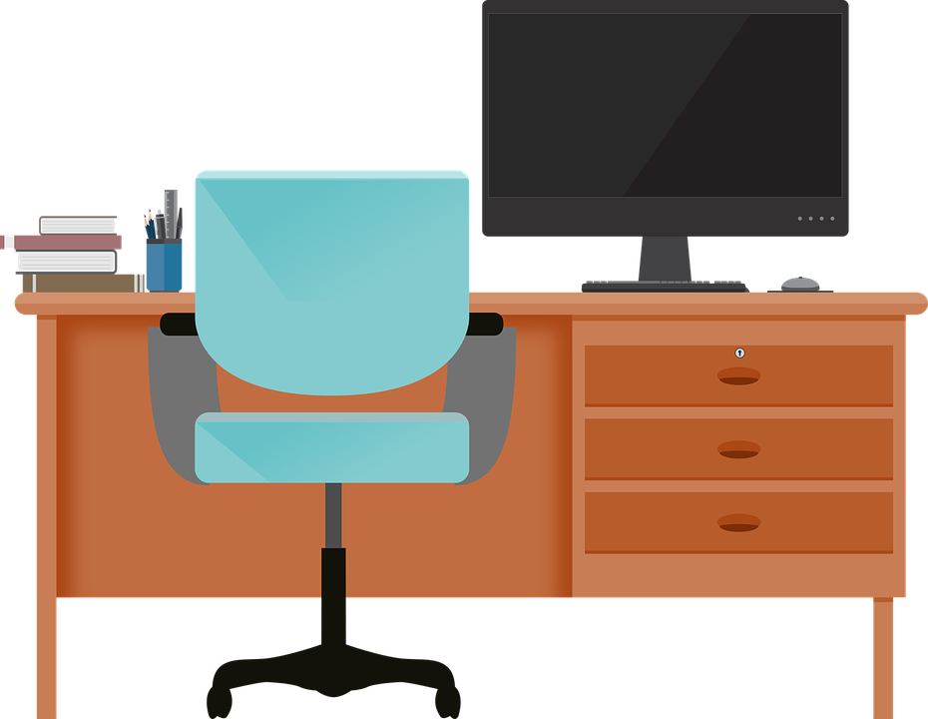
Good Morning P5/4
Week 11 Home Learning
Health week 2020
Monday 1st June 2020

Slide 2
If we were at school, we would be having Health Week this week so why not have one virtually.
There will be multiple activities throughout the week all focusing on Health and Wellbeing.
Each day there will also be a Sports Day Challenge. More information will follow on that slide.

Slide 3
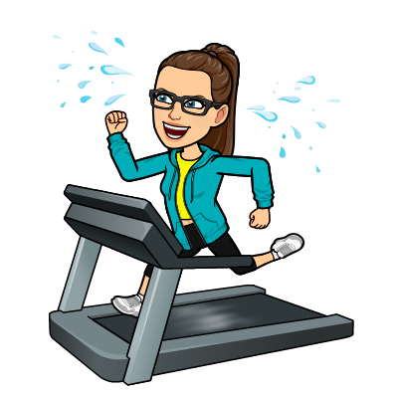
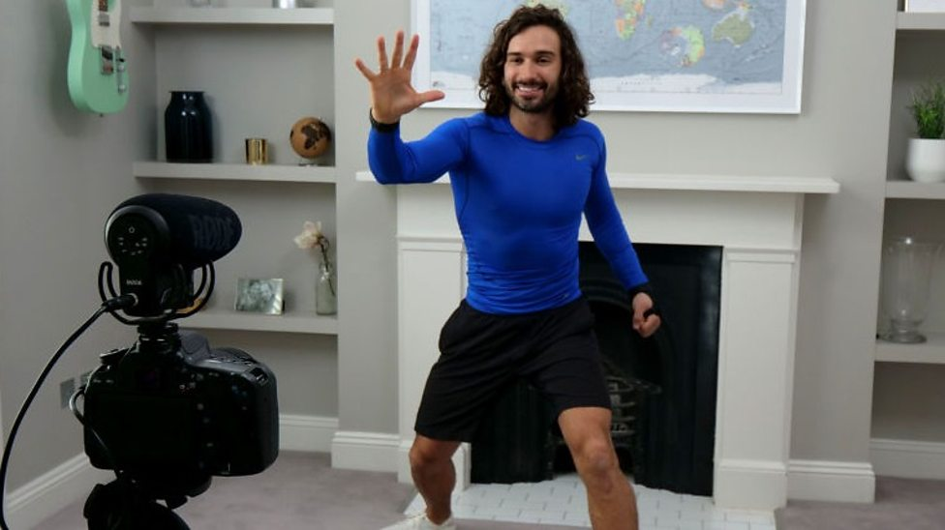
Morning Starter
Every Morning there will be a ‘Get Fit Starter’. This will be a link to a video that will help you get moving and get fit!
Today we are starting with someone who you have probably already watched during Lockdown...Joe Wicks!
He goes live at 9 (however, you can watch it later). Click on his picture to take you to his youtube.

Slide 4
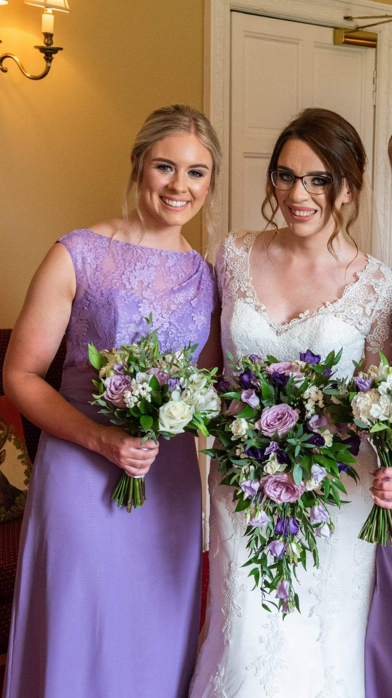
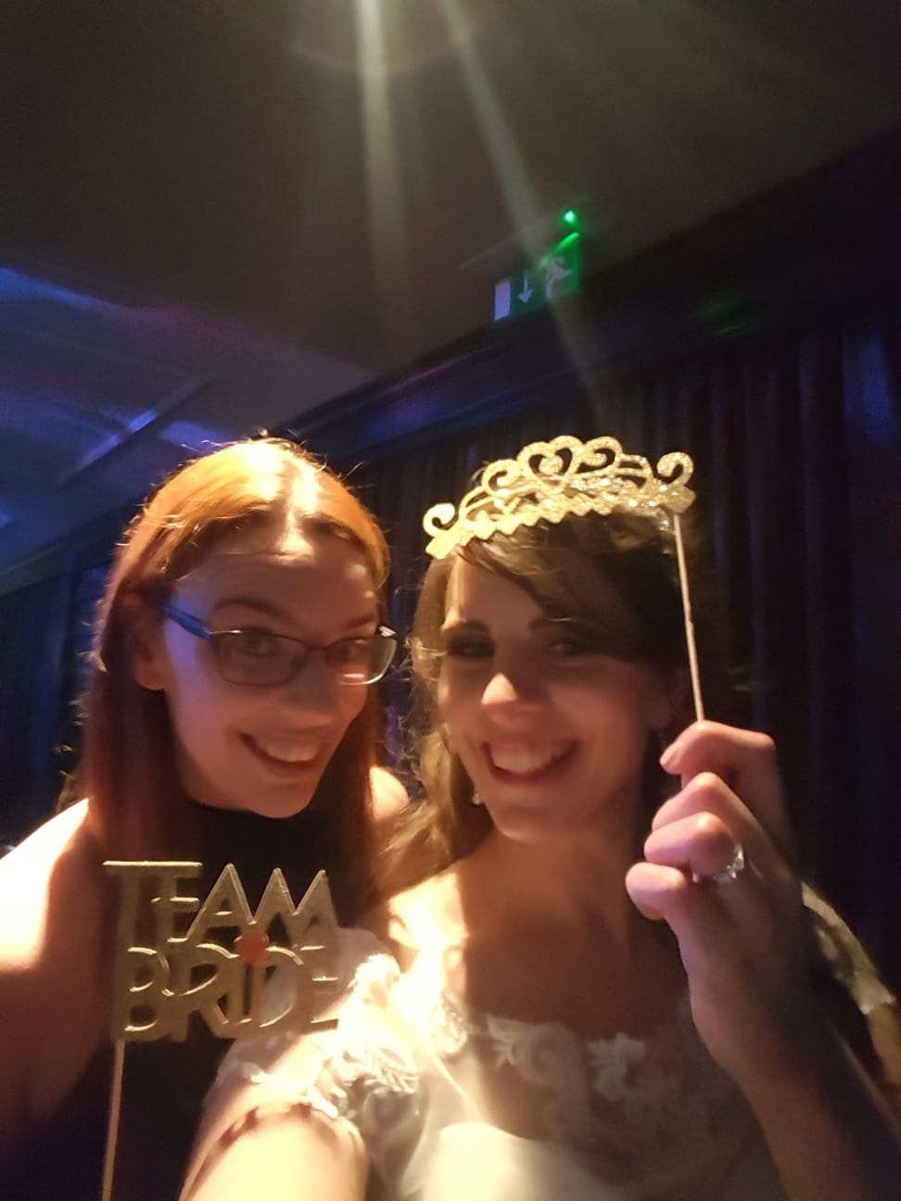
Relationships:
L.I. - I can explain the importance of friends in my life.
During these difficult times, it may seem likes ages since you seen your best friend, so we are starting off Health Week by doing a task all about them!
Answer the following questions about your best friend, below is my example, I have two and couldn’t choose between them (I have their permission to use their photographs).
Name: Mrs Robson
Age: 29
Occupation: Primary Teacher
Year we met: 2017
How we met: Worked at the same school
How we became friends: Everyone thought that we were twins and looked really alike, turns out we have the same birthday! (different years).
Qualities: Caring, Intelligent, Loyal, Funny
Favourite memory: This is a hard one - I will say I loved the fact she did a reading at my wedding.
Name: Miss Penny
Age: 26
Occupation: Primary Teacher
Year we met: 2012
How we met: University
How we became friends: We were asked to pair up during a PE lesson and we chose each other.
Qualities: Kind, Compassionate, Sociable
Favourite memory: Another hard one - I will say watching our favourite programme together until midnight without realising the time, oops!

Slide 5
Reading Comprehension about Mental Health Week.
L.I. I can use correct sentence structure to answer the questions.
Click on the links and it will take you to your reading comprehension:
Please check teams if you are unsure of what reading comprehension group you are in:
Group 1: Mental Health Reading Comprehension
Group 2: Mental Health Reading Comprehension
Group 3: Mental Health Reading Comprehension
Group 4: Mental Health Reading Comprehension

Slide 6
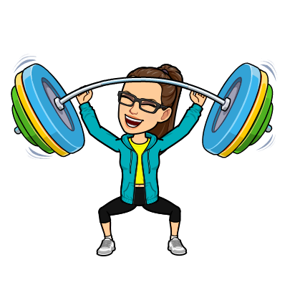
PE - Balance and Control
L.I. I am developing my core stability and balance
Log rolls – Partner up with someone in your house. One partner lies down and tightens their body. The 2nd has to try to roll their partner over. If they are successful they get 1 point. They take turns and whoever has the highest score wins.
Point Balance is where you have so many ‘points’ touching the ground. For example, a handstand with be 2 points as two hands are touching the group.
You are to work individually on a mat (if available) to create a small sequence
(between 3 and 6 balances per sequence).
You can add more balances if you feel able to.
You could even try and put your sequence to music.
.

Slide 7
Maths
L.I. I can estimate the time it will take to do an activity.
Estimate how many steps it would take to walk around your kitchen, bedroom or livingroom (or you could do all three).
Then count how many steps it would take to walk around these areas.
Calculate how many times you would have to walk around a room to reach 10,000 steps (daily step target).
Ask someone in your house to do the same thing. Are the numbers of steps different?
If so, why might this be?

Slide 8
Daily Exercise
As stipulated by the government, you are allowed out of your house once a daily for daily exercise with people from your household.
Using this chance, during health week I thought it would be great to get us back doing the daily mile. Now you can walk, jog or run your daily mile but the rules are as follows:
You have 15 minutes to see how far you can either walk, jog or run.
The average person, walking at a moderate pace should be able to walk a mile in 15 to 20 minutes, so it is doable.
You could keep track of your progress over the week, do you manage to cover more distance over the same time period, maybe you get faster.
If you wish you walk for longer (you have up to an hour for your daily exercise) then you can do so.
Let me know how you get on.

Slide 9
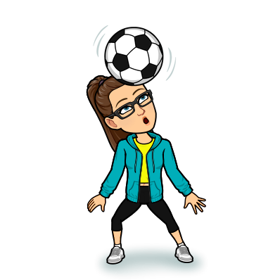
Sports Day Challenge
Fancy a bit of friendly virtual competition, as well as the chance to win points for your house? Here’s how you can:
Every day, a video will be at the end of the Powerpoint with the title ‘Sports Day Challenge’, each video will be presented by a myself and in it I will explain and demonstrate an activity that you can do from home.
All you have to do is:
State what house you are in in the film - no pupil names please
Film yourself doing the activity
Say how many points you got
Post your video either to teams or the blog
Myself and Mr Paterson will tally up all the points from each challenge each day and announce the winning house on Friday 5th June!
Have fun!

Slide 10
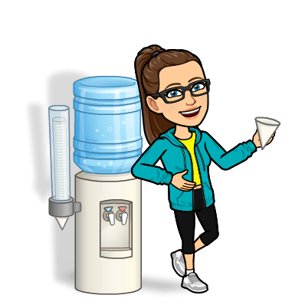
Water
L.I. By applying my knowledge and understanding of current healthy eating advice I can contribute to a healthy eating plan.
In the Health Week folder on teams, there are two worksheets that I encourage you to use throughout this week.
The first one will track how much water you have, every time you have a whole glass of water, colour one of the cups in.
Health authorities advise that we should be drinking at least 2 litres of water
every day. This is roughly the same amount at 8 average sized glasses of water,
which is why there are eight glasses for each day on your worksheet.
To help encourage you, I am also going to fill out a water tracker worksheet
for this week to keep my intake of water high and we can share our results
with each other on Monday next week!

Slide 11
Exercise
L.I. I understand the importance of exercising and can keep track of how often I am exercising each day to ensure I am keeping active for enough time.
In the Health Week folder on teams, there are two worksheets that I encourage you to use throughout this week.
The second one is similar to the Ibike activity we did a few weeks ago where you were to see how much time you spent being active each day.
Health authorities advise that we are active for at least 60 minutes each day.
So just like the water tracker, I would like to encourage you to use the exercise tracker to keep track of how active you are throughout the day. Again, I will also fill one out and we can compare with each other on Monday.

