Slide 1
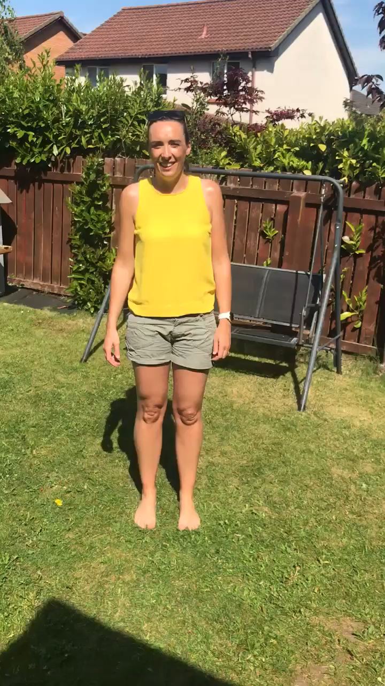
Monday 1st June
Good morning Boys and Girls!
Wake up and dance along with Mrs McGill!!
Every day this week an infant teacher will be greeting you with a new dance!!

Slide 2
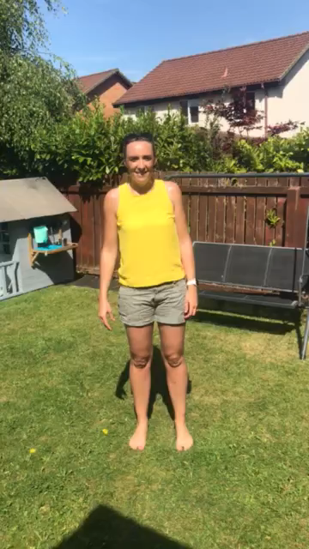

Slide 3
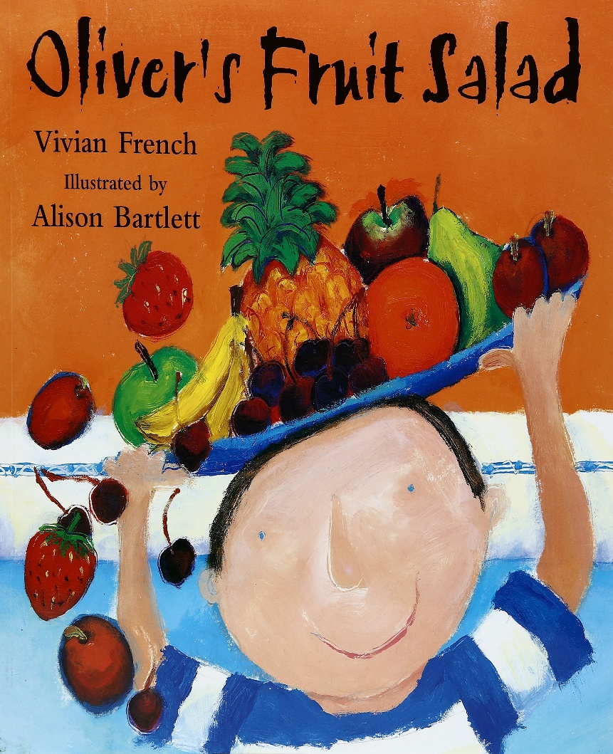
Oliver’s Fruit Salad
https://www.youtube.com/watch?v=jcTprkImlmI

Slide 4

Literacy
L.I - I can use my knowledge of sounds and blends to make new words.
Oliver’s Fruit Salad
Task - Can you use the words in the title of the book to make smaller words?
lid

Slide 5

Sounds Revision
L.I. I can use knowledge of sounds, letters and patterns to read words.
sh ch th ph
ea oo ai oy
oi oa ow igh
au ou ew

Slide 6


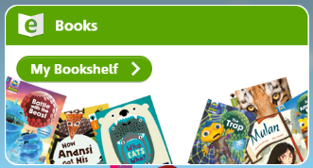
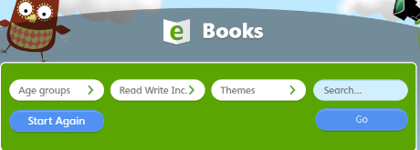
Oxford Owl Ebooks
*Choose a new book to read this week
Login to the following website : https://www.oxfordowl.co.uk/
Click on the following ‘My class login’ at the top of the page
Username: stanothnysp12
Password: Homelearning*1
Click on ‘My Bookshelf’
Click on ‘Series’ button and select Oxford Reading Tree
Scroll down the list of books and choose one suitable for your child. We advise you read one book per week as we sill set ‘read to write tasks’ for your child to complete.

Slide 7
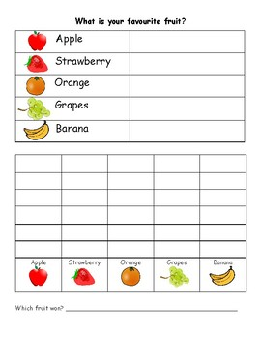
Mathematics
Tally charts and graphs
L.I – I can count items and record using tally marks
Watch -https://www.bbc.co.uk/bitesize/clips/z7r9jxs
Task – You are about to see lots of different fruit on the next slide. Can you record how many of each you see using tally marks?

Slide 8
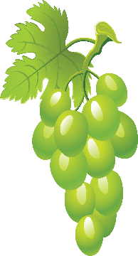


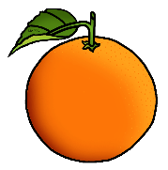

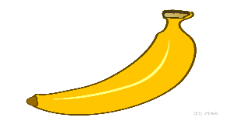





Slide 9
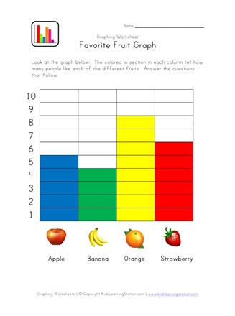
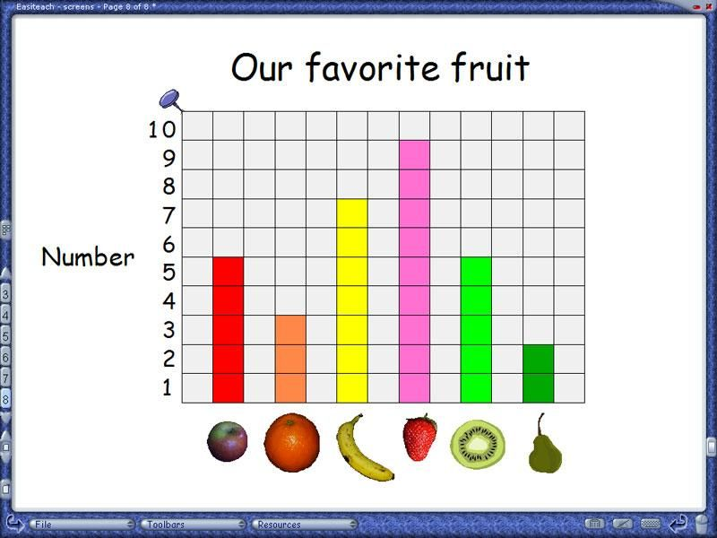
Watch - https://www.youtube.com/watch?v=oYXmY5axC2I
Task - Using the information you have collected create a graph showing your results
Here are some examples of what your graph could look like.
Once you have made your graph you should be able to see which type of fruit was the most popular.

Slide 10

Health and Wellbeing
Challenge - Can you design a healthy packed lunch?
L.I – We are starting to learn the importance of a balanced diet
Watch - https://www.youtube.com/watch?v=JgM9bXNVV5U
Complete this task in your jotter
What is in your healthy pack lunch box?

Slide 11
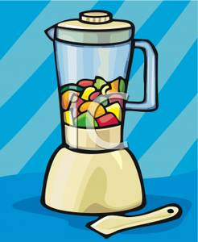
Health and Wellbeing
L.O. To design and make a smoothie.
Can you make a smoothie and share with your family as a healthy snack?
My smoothie is called -
List the names of the fruit you used:

