Slide 1

Friday 29th of May
Good Morning Primary 2/3!
French: Bonjour la class! Ca Va?
Quelle est la date aujourd’hui?
Aujourd’hui cest V______ 29th Mai 2020
L.I To say where I live in French
Ou habites -tu?
Where do you live?
J’habite a Armadale en Ecosse.
I live in Armadale in Scotland

Slide 2


Literacy
LI: To use my phoneme and common word knowledge to spell accurately.
Spelling Day 5 : Sentence Dictation
Choose a dictation sentence from the list in the pack
Read aloud the sentence to your child first, for them to listen to it
in full.
Then re-read sentence again slowly, word by word(sounding out where necessary), allowing the child to write down each word independently.
Please encourage your child to:
- Have a go.
Think about what sounds can they hear in the word and chunk it into sounds they know.
Remember their core writing targets- full stops, capital letters, finger spaces.

Slide 3
Reading- Stage 2 Common Words
miss never these four
I miss being at school. I never thought I would miss it. These days all I get to do is stay in my house. It feels like it has been four months!

Slide 4
Reading- Stage 3 Common Words
list most must high late
High in the sky the moon appears. It must be getting late. I put on my pyjamas and get ready to say my bedtime prayer. In my prayer I list all the most important things I have in life and I thank God.

Slide 5
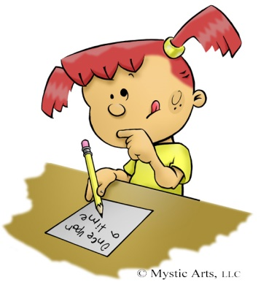
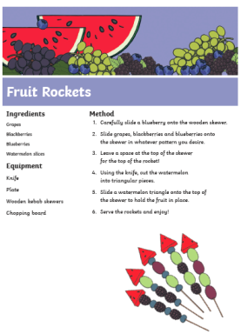

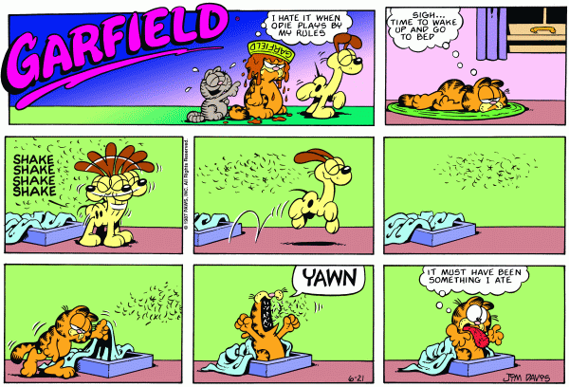


Literacy-Free Writing Friday
LI: To create a text of my choice
Set 15 minutes on a timer. Maybe your adult could do free writing at the same time as you?
Decide what type of writing you would like to do.
Collect all the writing tools you need to complete the task in time.
When the timer is up, share what you have done with each other.
Don’t forget you can send a picture of your work to our twitter! I would love you to share what you have written with me on our school twitter page!

Slide 6

Kindness Counts
https://www.youtube.com/watch?v=E_-QFAfKZ3s

Slide 7
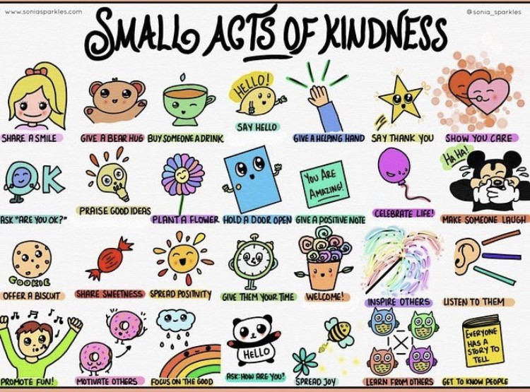
Health and Wellbeing
L.I - I am aware of others feelings and can show acts of kindness.
Can you choose another small act of kindness from above and show someone you care?

Slide 8
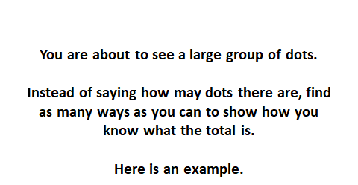
Numeracy – Warm Up
LI: To use mental strategies to solve maths problems and be able to explain my strategy

Slide 9
2 + 3 + 2 = 7
2 + 3 + 2 = 7
4 + 4 – 1 = 7
9 – 2 = 7
5 + 2 = 7
3 + 3 + 1 = 7

Slide 10
www.stevewyborney.com

Slide 11
www.stevewyborney.com

Slide 12
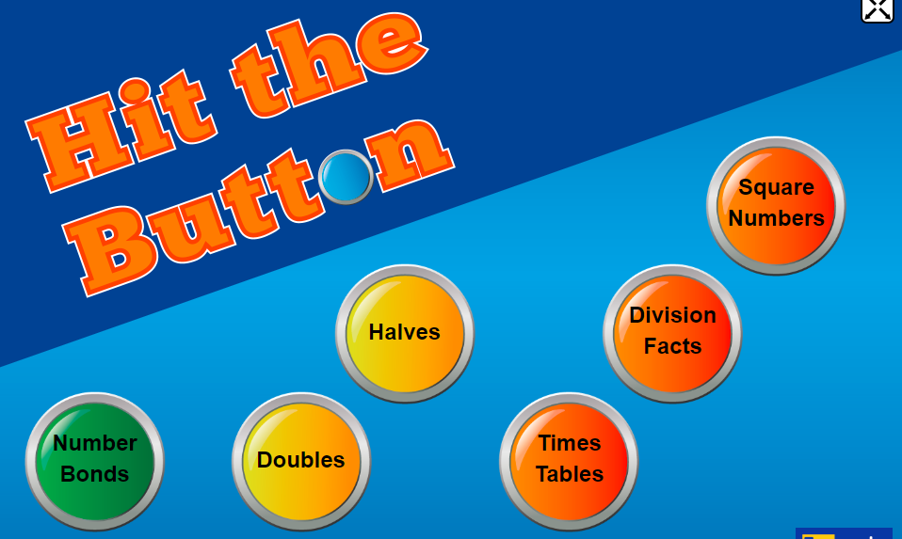
Hit the Button
Choose which one you want to practise today
https://www.topmarks.co.uk/maths-games/hit-the-button

Slide 13

Well Done Primary 2/3 families!
You have completed another week of online learning!
Enjoy your weekend everyone.
I will be ready to welcome you back on Monday morning.
Mrs Doghudje

