Slide 1
Friday 29th May
Good Morning Primary 4!
French: Bonjour la class! Ca Va?
Quelle est la date aujourd’hui?
Aujourd’hui cest Vendredi 29th Mai 2020
Listen to the days of the week song!
https://www.youtube.com/watch?v=Lpwf5N0rfVE

Slide 2
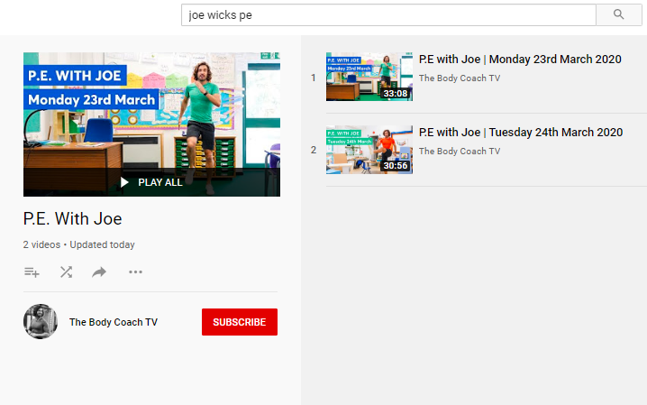
Health and Wellbeing
LI: We are learning to move our body well, exploring how to manage and control it, finding out how to use and share space.
P.E with Joe- Friday 29th May Video
(he is nearly as fun as Mr Martin, not quite, but nearly)
https://www.youtube.com/playlist?list=PLyCLoPd4VxBvQafyve889qVcPxYEjdSTl

Slide 3
Handwriting
L.I. I can use joined up handwriting
Download the handwriting sheets from Teams or the Blog and practise in your jotters.
Some of the letters in this style of handwriting are a little bit different to our last activities but try them and decide which style you find the best! The differences are very small (e.g. the letter l goes straight up rather than looping at the top!)
PLEASE ONLY DO THE FIRST 2 SHEETS TODAY (THE LETTER ‘a’).

Slide 4
BIG MATHS… BEAT THAT CHALLENGE!
LI: We are learning our times tables
On the next slide, you will find a link to an online timer and you will see a big version of a Big Maths Beat That challenge!
2. Your challenge is to answer as many questions as you can, as quickly as you can! Write down the answers in your jotter.
3. You should work out the answers in your head! (no cheating) If you are stuck on one, move onto the next one!
4. Once you have answered all the questions that you can, stop the timer and write your time down next to your answers.
5. Finally, use a calculator (https://www.online-calculator.com/) to check that your answers are correct. If any are wrong, correct them! If you got stuck on some, work them out!)
DID YOU BEAT YOUR TIME FROM LAST WEEK?

Slide 5
Time yourself!
https://www.online-stopwatch.com/

Slide 6
Art
L.I. I can follow a set of instructions to create a picture
As the weather has been so nice, I’ve been eating my lunch outside most days and have seen lots of butterflies fluttering by!
Today’s art task is to watch the YouTube video and follow the instructions to draw a Monarch Butterfly! You could even do this task outside (but make sure you get permission to use your iPad / laptop in the garden!)
Extension – can anyone find out some facts about Monarch butterflies?
https://www.youtube.com/watch?v=NLWNOafqfh0

Slide 7
HAVE A GREAT WEEKEND, PRIMARY 4! WELL DONE FOR WORKING SO HARD. MR P

