Slide 1



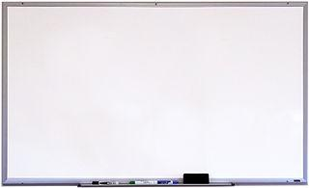








Good Morning P5/4
Week 9 Home Learning
Friday 29th May 2020

Slide 2



Aujord’hui c’est vendredi vingt neuf mai.
Je suis content(e)
Je suis d’accord
Je suis mal
Il fait beau.

Slide 3

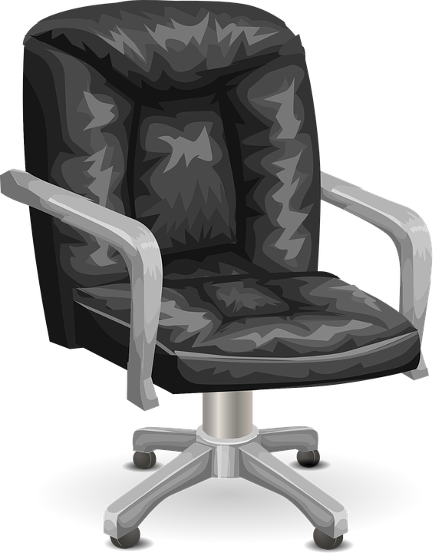
Morning Starter
Maths Quiz in Teams!
You can choose to do Green, Amber or Red.
Remember, scores will show as 0 until I correct them so if you want to put a message in teams that you have completed a quiz, I can hopefully mark it quicker.

Slide 4
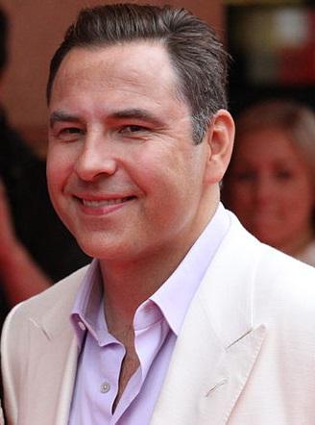
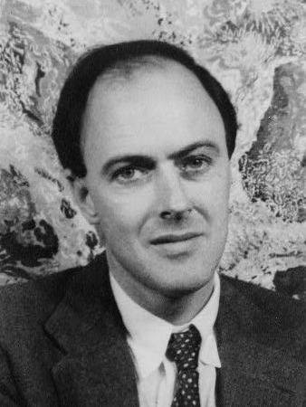
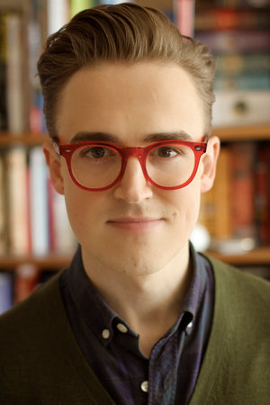

Dictation
Handwriting
Dictation
Handwriting
Literacy Task Board
Dictation
Handwriting

Slide 5
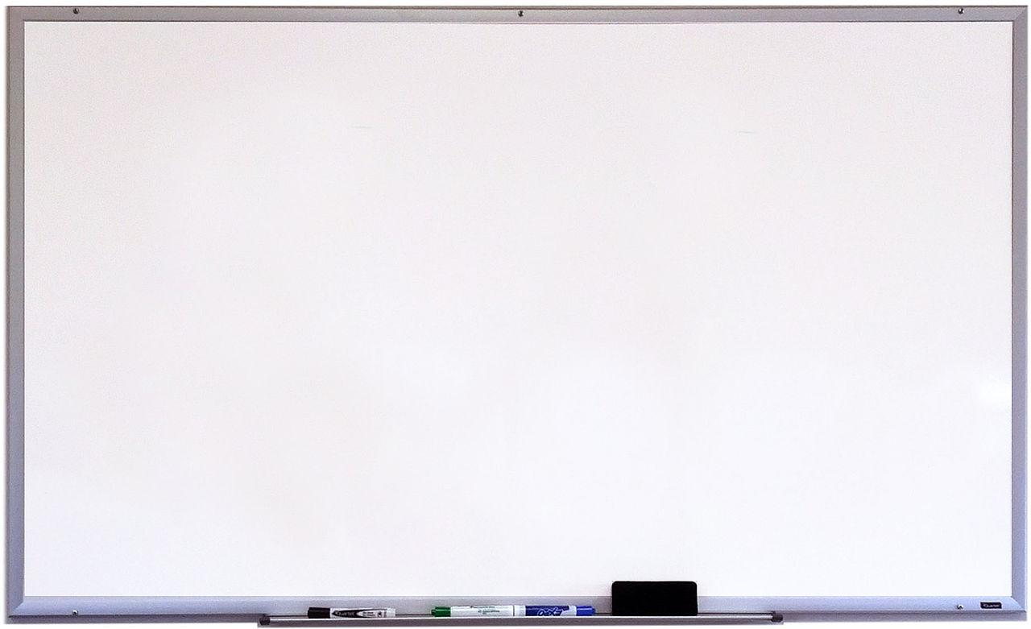





Maths Task Board
Maths Quiz
Big Maths
Websites for all groups to use:
Maths Quiz
Big Maths
Maths Quiz
Big Maths

Slide 6


Dictation
Remember you can pause the audio if you need more time to write.
‘ew’ Dictation -
‘unit 5 - oo’ Dictation –
‘unit 12 - ch’ Dictation -

Slide 7
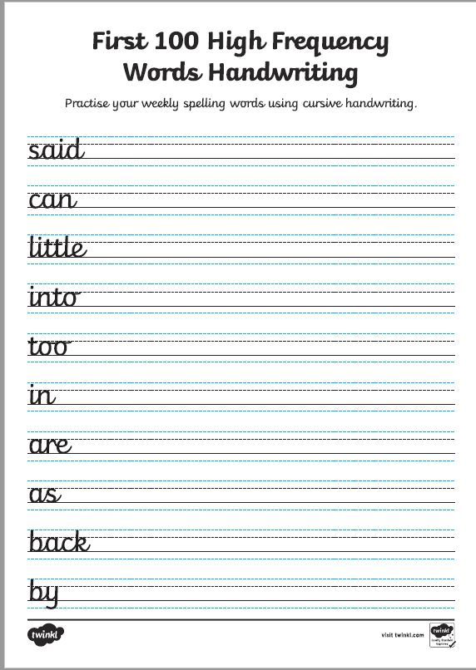

Handwriting

