Slide 1
Friday 29th May

Slide 2
Timetable
French Starter
Daily exercise
Maths Quiz
Reading
Health and wellbeing

Slide 3
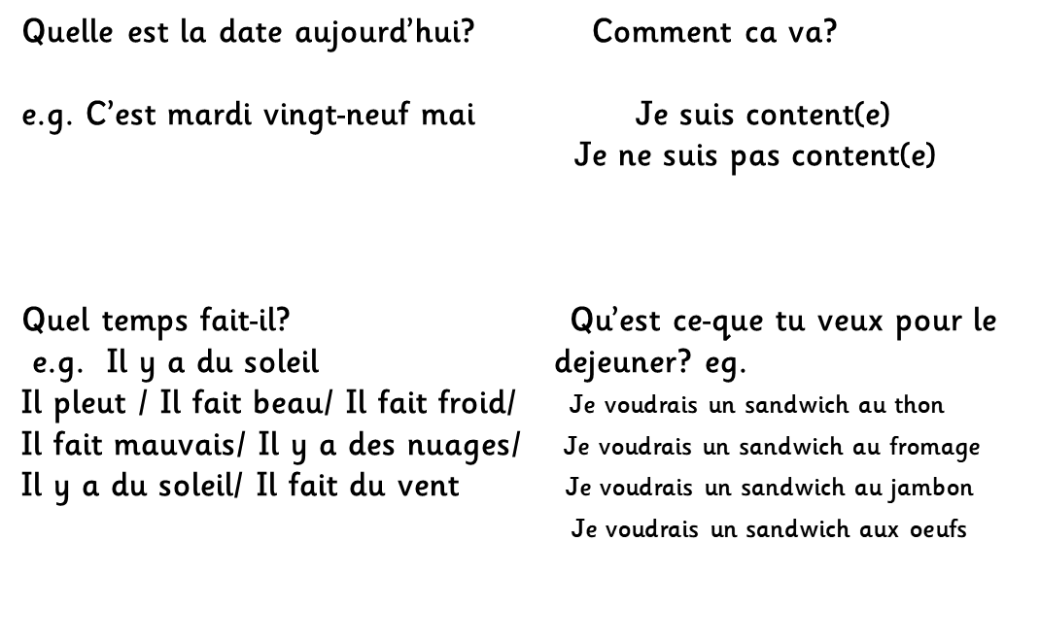
French Starter

Slide 4
Daily exercise
(Some of these people are almost as fun as Mr Martin, but not quite!)
Joe Wicks 9am live - https://www.youtube.com/watch?v=rAX6Q236CwI
Oti Mabuse 11:30am (strictly dancer) https://www.youtube.com/watch?v=btD_HCO1FT4
Cosmic Yoga (on anytime) https://www.youtube.com/watch?v=flK2Nasd-AI

Slide 5
Maths Quiz
Select one of the columns from the maths quiz to complete.
Remember you can also log in to sumdog to complete games or if you have IDL.

Slide 6
Reading
LI: Strategy 1: Prior Knowledge – I am learning to use my prior knowledge to help me predict what the next chapter will be about.
Success Criteria
Think about what you already know about the characters and main ideas of the last chapter you read. Note down your ideas.
Re- read chapter. Add to your notes.
Discuss this with your partner and note down what ideas you had that were the same or different.
When you have done this, read the next Chapter, then write down how your thinking may have changed since before you read the chapter.
Before reading | Before reading | After reading
What I think | What my partner thinks | How my thinking has changed

Slide 7
Health and wellbeing
I am learning about how to be active and promote it to others.
Prepare a two minute talk to deliver at home and to share on teams to support the idea that walking it or wheeling it to school can promote independence/ confidence/road safety awareness/ general health & wellbeing.
If sharing on teams, just post your notes.

Slide 8
Well done!
Well done Primary 6, have a super weekend!

