Slide 1
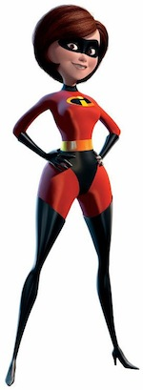
Friday 29-5-20
Good Morning Everyone!

Slide 2
Today’s Timetable
Morning Exercise
Big Maths
Free Writing
Science/Topic
Art
P7 Sumdog Group Competition
Prayer

Slide 3
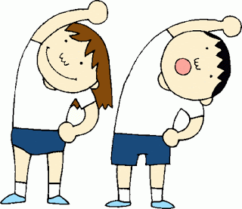
Daily Exercise
Try to do some form of exercise to start the day. This could be a walk or run with a family member or a work-out in the house. Check with your parents that it is ok for you to do this.
Why not join the body coach on Body Coach TV on Youtube at 9am

Slide 4
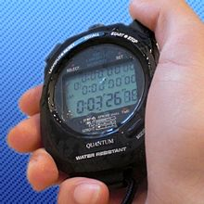
Big Maths Beat That
Use your Big Maths sheets to try and beat your previous score. Please remember to photocopy more sheets. If this is not possible, spare copies are available from the stationery trolley in the school car park [12-1.30pm]
Ask someone in your family to time you or if you don’t want to be timed, try to work as quickly as possible to complete your task.

Slide 5
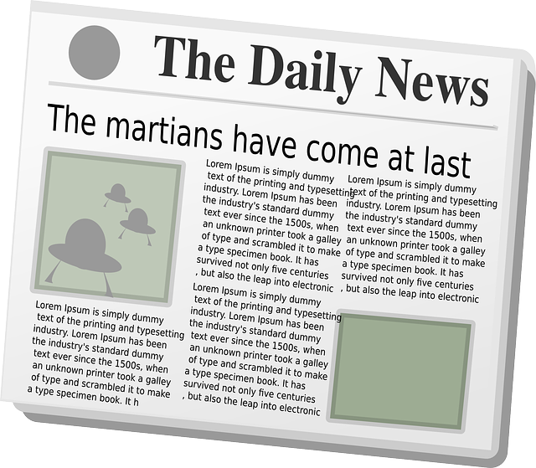
Free Writing
Use your free writing jotter or spare paper to write something of your choice.
This can be a comic strip, an adventure story, a diary entry, a letter, a murder- mystery, a recipe, a recount of a favourite time or memory , a poem or a limerick. The list is endless!

Slide 6
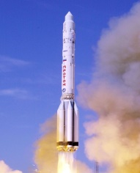
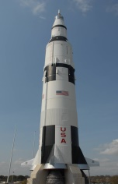
Space X Launch
Astronauts were due to travel into space on Wednesday 27th May. Your task is to do some online research and find out the following facts:-
What is the name of the rocket?
Where was it launching from?
How many astronauts were on board?
Why was the launch postponed?
What is the purpose of their mission?
Extra: - The new launch date is this Saturday at 8.22pm. If the sky is clear, you may be able to see the rocket pass the right side of the moon approx 15mins after the launch. Why not try to see it.

Slide 7
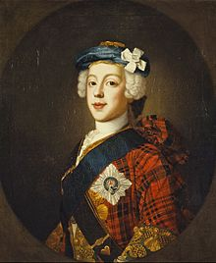
The White Cockade
The white cockade, a little white Scottish rose was worn to show support for the Jacobite cause.
Remember, it was dangerous to publicly declare support for the Jacobites so all sorts of symbols were used to show support, including the wearing of the white cockade.
Today, your task is to make a white cockade.
I have attached an instruction sheet to help you make your own white cockade.

Slide 8
Sumdog Competition
The Fan Dabby Dozi Group, Friends, The Spicy Chicken Wings and The Legends. Who will be the champions?
Log on to Sumdog Maths Competition to help your group win. The competition closes at 2pm.
Good luck !

Slide 9
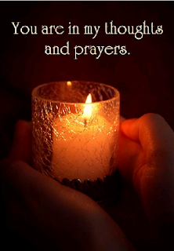
A prayer to end our day
Take a few moments to say a short prayer for all your family.

