Slide 1
Friday ^{29th} of May
Good Morning Primary 1!
Bonjour la class! Ca Va?
https://www.bbc.co.uk/teach/supermovers/ks1--ks2-mfl-french-greetings-with-ben-shires/zdpdvk7
L.I – I can say some simple greetings in French

Slide 2
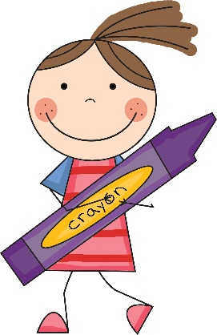
Literacy
L.I – We are learning to use our knowledge of common words and phonemes to spell, write and read words.
Watch - https://www.youtube.com/watch?v=aJXWEKaPo_c
Activity -Jumbled sentences
1.
2.
Put the words in the correct order.
Tip –Write the sentence onto a piece of paper and cut it up.
Watch out for capital letters and full stops these will help you find the first and last word in the sentence.
a | cook. | is | good | My | dad
foot. | her | My | hurt | mum

Slide 3
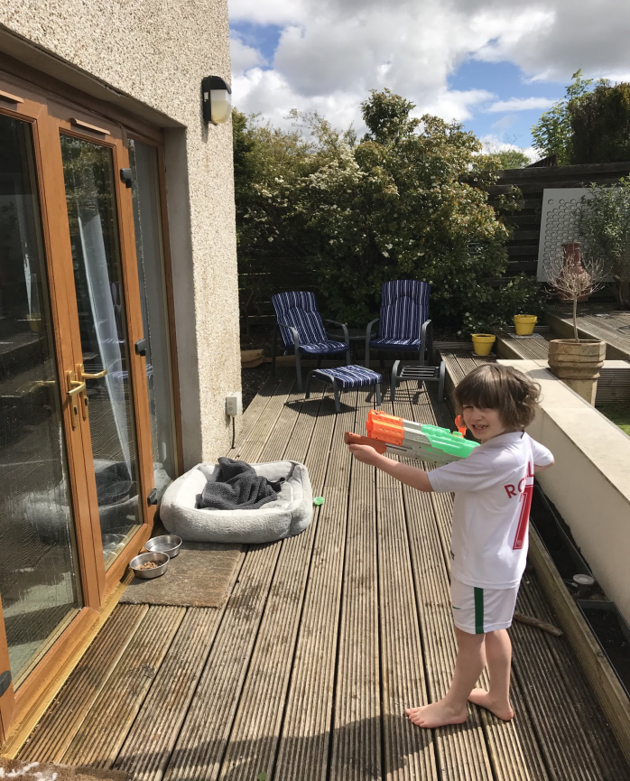
Spelling Challenge
I love these ideas!!!
Lets get creative
Here your friends have came up with fun ways to write or make their words.
What can you use/do outdoors to help you learn this weeks words?.
If you can think of something new then share it with us on Twitter to feature in next weeks spelling challenge.
play no look

Slide 4
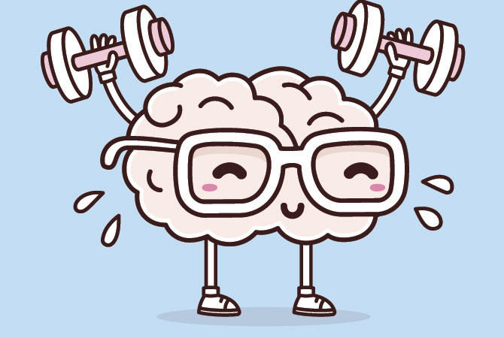
Mathematics Number Talk
Estimation- On the next couple of slides you are to estimate (sensibly guess) how many balls are in the glass.
As it is a number talk, tell your adult why you think it is the number that you are guessing each time.

Slide 5
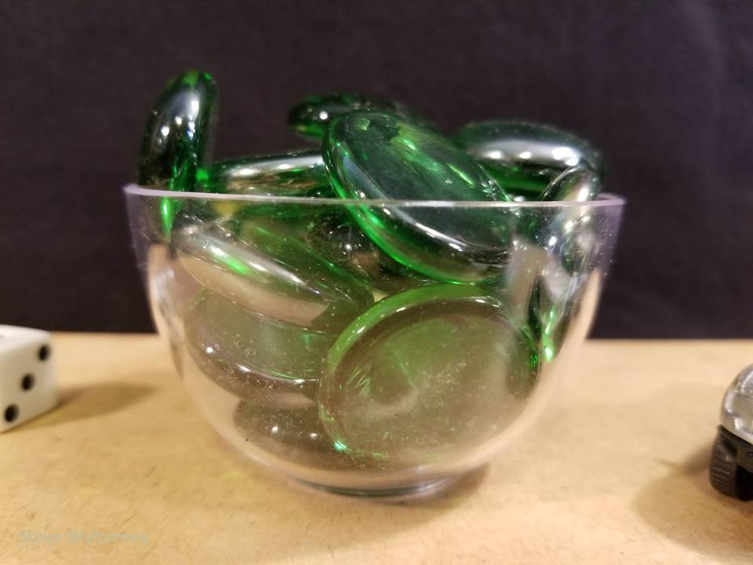
How many glass gems are in the bowl?
The Reveal
21 glass gems
www.stevewyborney.com

Slide 6
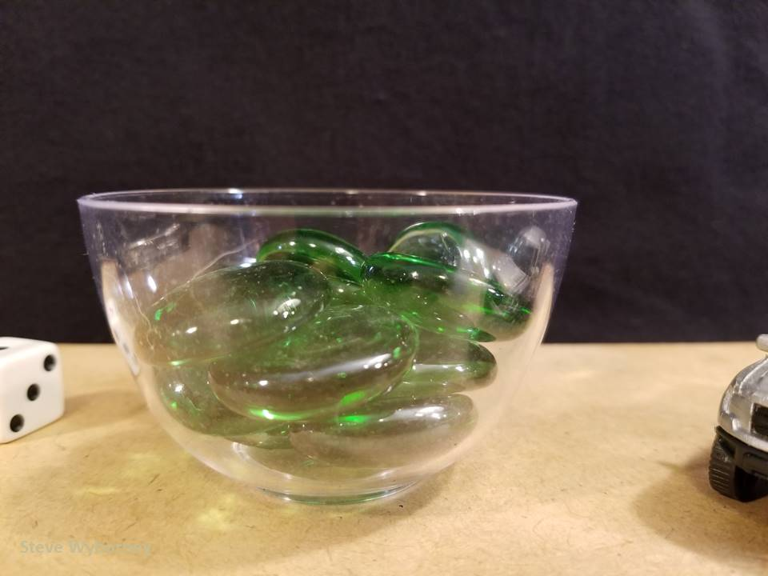
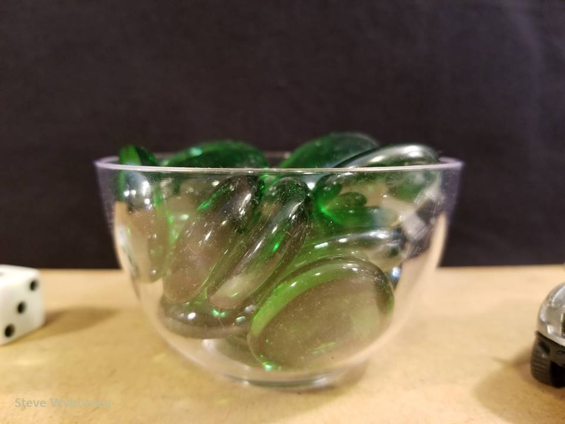
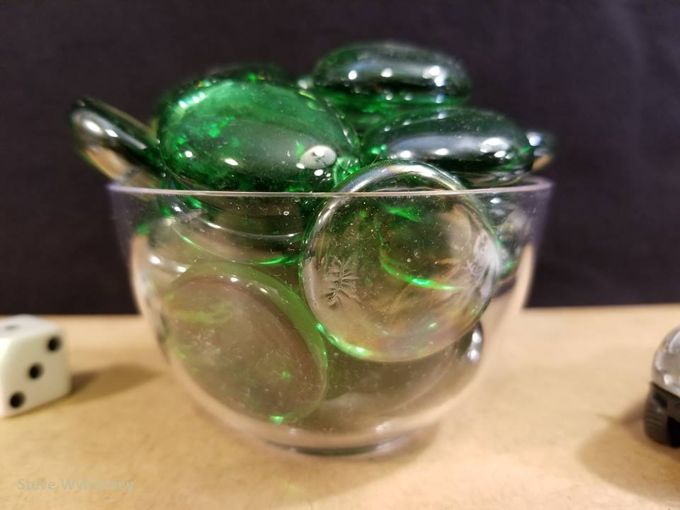
21 glass gems
10 glass gems
The Reveal
16 glass gems
The Reveal
27 glass gems
The Reveal
www.stevewyborney.com

Slide 7
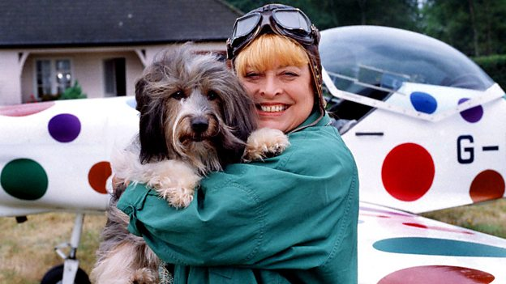
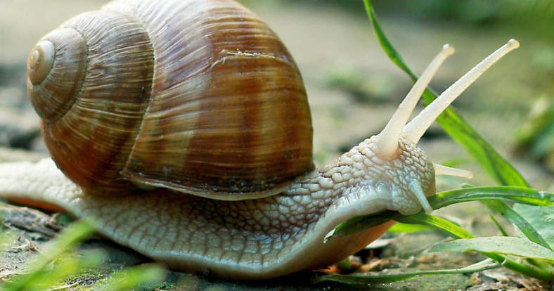
IDL
Falling our story of the “Snail and the Whale” last Friday, today we are learning all about snails
Watch the clips then see if you can spot any snails when you are outside.
Facts about Snails
https://www.youtube.com/watch?v=pLCtVGB1mFw
Come Outside
https://www.youtube.com/watch?v=ki97nLa2rjk&t=2s

Slide 8
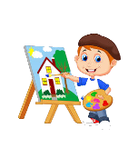
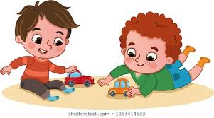
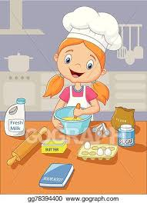
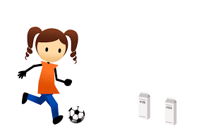
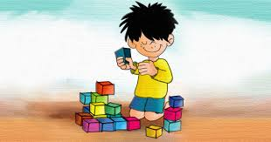
Fun Friday Activities
Article 31 – I have the right to play and relax.

Slide 9
Have a lovely weekend and we will be back with more activities and lessons on Monday!

