Slide 1
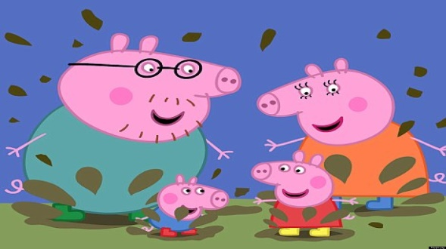
Thursday 28-5-20
Good Morning Everyone!

Slide 2
Today’s Timetable
Morning Exercise
French
Maths Lesson
Spelling
Writing Task
Health and Wellbeing
French Main Lesson
Topic
Prayer

Slide 3
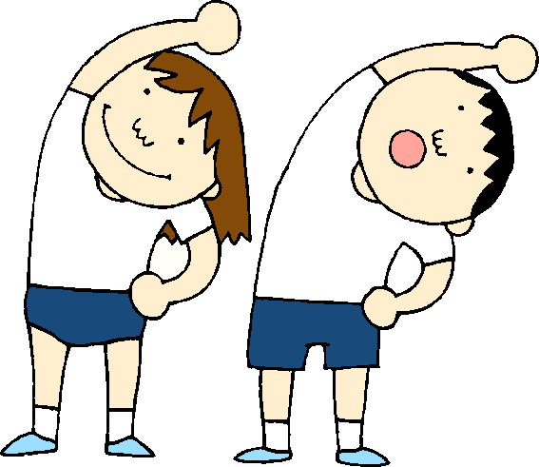
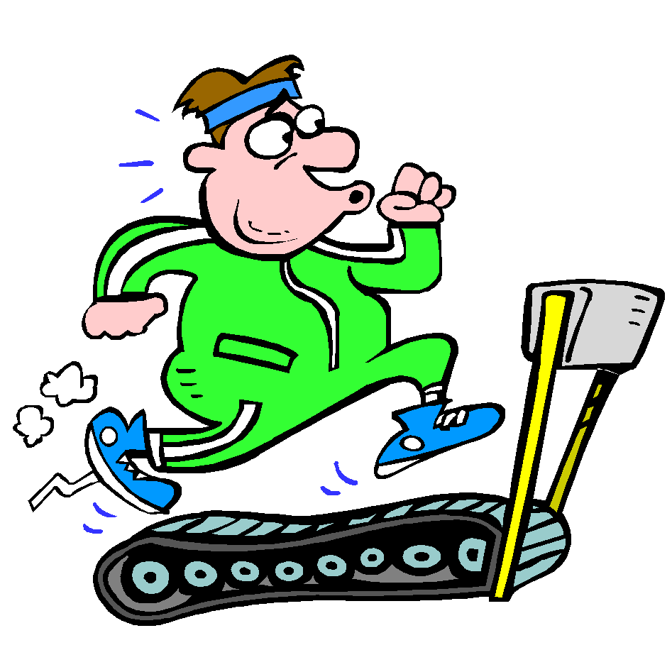
Daily Exercise
Try to do some form of exercise to start the day. This could be a walk or run with a family member or a workout in the house. Check with your parents that it is ok for you to do this.
Why not try this circuit workout this morning :-
https://www.youtube.com/watch?v=_97QFX3w1E4

Slide 4
A little bit of French to start the day
Quelle est la date aujourd’hui? Comment a va?
e.g. C’est mercredi vingt-sept mai Je suis content(e)
Je ne suis pas content(e)
Quel temps fait-il? Qu’est ce-que tu veux pour le
e.g. Il y a du soleil dejeuner? eg.
Il pleut / Il fait beau/ Il fait froid/ Je voudrais un sandwich au thon
Il fait mauvais/ Il y a des nuages/ Je voudrais un sandwich au fromage
Il y a du soleil/ Il fait du vent Je voudrais un sandwich au jambon
Je voudrais un sandwich aux oeufs

Slide 5
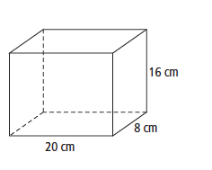
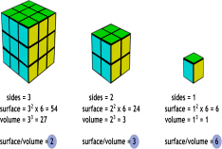
Maths Lesson
L.I. - Today, we are learning about Volume.
S.C. – To understand what we mean by volume.
- To know the formula for calculating volume.
- To be able to calculate volume problems.
If you need to watch the powerpoint on volume again ,I have attached it the blog. Remember the formula:-
Volume = length x breadth x height, V = l x b x h.
[Breadth and width are the same thing].
Task :- Please find today’s task attached to the blog.
Circles – Qu 1-3 Squares – Qu 1-10 Triangles – All
[Tip:- Remember that the length, breadth and height of a cube are all the same]
The answers sheet is attached.

Slide 6
Spelling
Log in to Sumdog for your spelling task. You should be getting really good at spelling your words now.
Please make sure you click on the task set for your group. However if it is too easy, try the next group up or if it is too hard, drop down a group.
Please try to write your words down on paper without help or get someone to test you.
Group 1 – Red Reading Group, Group 2 – Most of the Class
Group 3 – Super Spellers

Slide 7
Writing
Task:- Your task is to write a newspaper report about someone in your class. THIS IS A COMPULSORY TASK.
This is a really important task as I will be putting your story into a short presentation for the whole class to see as a wee momento of Primary 7 and St Anthony’s. I will send you an assignment with the name of the person you are to write about. DO NOT TELL ANYONE WHO YOU ARE WRITING ABOUT!!!
If you do, you will spoil this for everyone.
S.C. - You must think of a short catchy title for your newspaper
- Your introductory paragraph must tell the reader the most
important facts of your story – who, what, where, when
When you have completed your task, you need to save your finished piece of work. I will let you know when to send it to me. I will then correct the spelling etc and copy it into the newspaper template.
I have attached a checklist for writing a newspaper report as well as a wordmat to help you.

Slide 8
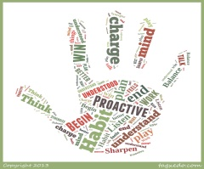
Health and Wellbeing
Once again, I am encouraging you to choose an activity which you find relaxing and calming which does not involve technology eg. computer screens, games or phones. If possible, try to do this activity outside.
Drawing/colouring–in
Gardening/planting.
Go for a walk to collect several different objects and observe/describe how each feels, smells etc.
Sit or lie in your garden [if you have one], close your eyes and listen to the sounds of nature or think of a happy memory.
Try a yoga session [you can use your phone for this]
Or think of your own mindfulness activity.

Slide 9
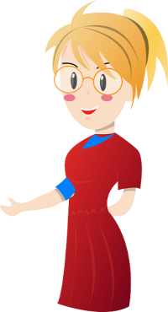
French
Today, as a starter, we’re going to revise the words for pets in French. Use Linguascope - go to the section on ‘Mes animaux’ and play 3 games. Please do the Presentation first.
https://www.linguascope.com/
Transition task:- If you have not have already completed your new mini Transitions Booklet, please return it to me today. I need to send them to St Kent’s soon.
Today’s task:- Please complete the page ‘Je me presente – True or False [Catriona MacDonald]’ in the original paper Transition booklet. You can use the S1 vocabulary booklet which I gave you, to help you with this task. If you have any problems, please let me know on Teams.
Extra: - Enter the St Kent’s Rainbow Competition

Slide 10
Bonnie Prince Charlie raises the standard at Glenfinnan
Bonnie Prince Charlie arrived on the island of Eriskay from France. He then travelled to Glenfinnan, in the West of Scotland and raised the Jacobite standard[flag] on 19th of August 1945. This marked the start of another rebellion to reclaim the throne. This was to become the most famous rebellion.
He asked the clans to join him.
Clan chiefs had to decide whether to support Bonnie Prince Charlie and the Jacobites or King George II and the British army.
Clan Cameron was the first clan to pledge its support to Bonnie Prince Charlie.
Your task is to imagine that you are the clan chief of your family. Would you support The Jacobites or The British Army? Design your own coat of arms and motto. Who will you pledge your loyalty to?
For inspiration, here is some information on Clan Cameron
https://en.wikipedia.org/wiki/Clan_Cameron
Please post pictures of your coat of arms and motto on Teams
Extra:- Design your own tartan.

Slide 11
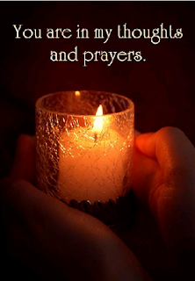
A prayer to end our day
Take a few moments to say a short prayer for all the key workers who are keeping all our vital services going.

Slide 12
Well done!
Well done for working hard today!

