Slide 1
Good Morning P5/4
Week 9 Home Learning
Wednesday 20th May 2020

Slide 2
Aujord’hui c’est jeudi vingt-huit mai.
Je suis content(e)
Je suis d’accord
Je suis mal
Il fait beau.

Slide 3
Morning Starter
Look at this cube.
a. How many edges does it have?
b. Have many corners?
Look at this cylinder.
a. How many corners does it have?
b. How many edges does it have?
c. How many faces does it have?
The cuboid.
a. How many faces does it have?
b. What shape is each face?
c. How many vertices does it have?
d. How many edges does it have?

Slide 4
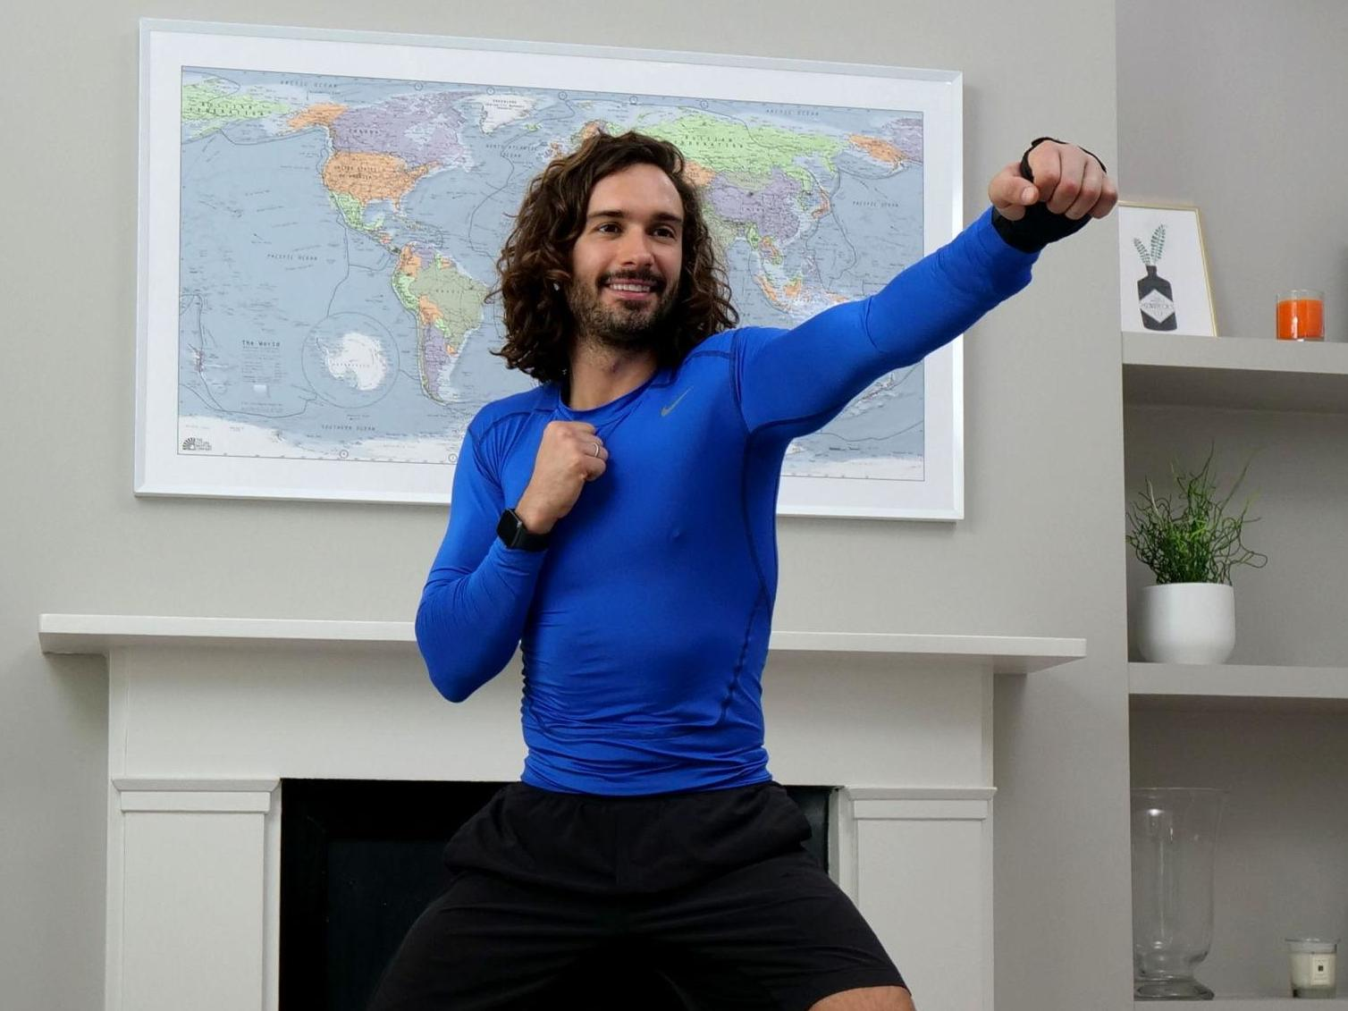
PE tasks
Thursday is normally a PE day for us so here are some ways you can choose to get
active today:
9am – Joe Wicks PE lesson –
11:30am – Dance Lesson with Oti Mabuse (Strictly professional) –
Any time – Cosmic Kids Yoga –

Slide 5
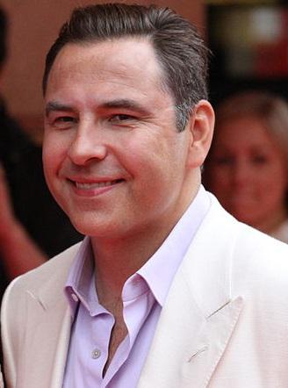
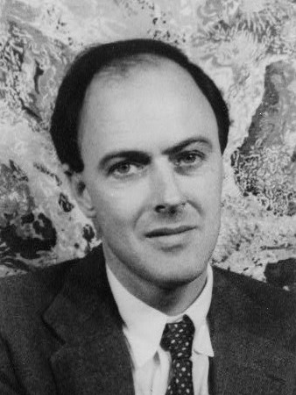
Spelling: Phonics Board
‘ew’
Read, Write, Spell – common words
Reading: Book!
Task – Recycled desk organiser craft.
Literacy Task Board
Spelling: Elkonin Boxes
Primary 4 – unit 5
Primary 5 – unit 12
Reading:
Task – Inference
Spelling: Elkonin Boxes
Primary 4 – unit 5 Primary 5 – unit 12
Reading:
Task –
Prior
Knowledge

Slide 6
Writing Task
Thursday is normally our writing day, so here is a writing task for you to do:
Genre: Report
L.I. – I can create a persuasive piece of writing persuading the advantages of online learning.
Success Criteria – Primary 5
Understand the purpose and audience.
Decide on the form of the writing and
decide if it needs a title.
Write an opening paragraph that tells of
my response to the situation (Response).
Write 3 or 4 paragraphs which present
your points of view. Each point should
be supported by evidence, facts or statistics.
Use emotive and powerful vocabulary
to influence the reader. Use complex
connectives e.g. although, furthermore, in fact
Write a final paragraph which summarises
the main points and links the opening to the end.
Use appropriate photos/graphics/labelled
diagrams with captions if appropriate to reinforce
your point of view and persuade the reader further.
Success Criteria – Primary 4 and David Walliams Group
Understand why I am writing and who
will read my report (audience and purpose).
Include a title to interest/inform the reader about
the subject.
Write an opening paragraph that tells of my reason
for writing and my point of view (Exposition).
Write 2 or 3 paragraphs which present your points of
view using thinking verbs e.g. feel, believe, hope.
Use connectives to join sentences and give points of
view e.g. however, yet, as a result of this.
Use powerful vocabulary to convince the reader you are right
e.g. probably the best book in the world.
Write a final paragraph that rounds up the main points and
links the opening to end.
Use photos/graphics/labelled diagrams with captions to
persuade the reader of your point of view.

Slide 7
Maths Task Board
Teejay 1b – pg. 212 - 213
.
Websites for all groups to use:
Teejay 1a – pg. 188
Teejay 1a – pg. 141
.

Slide 8
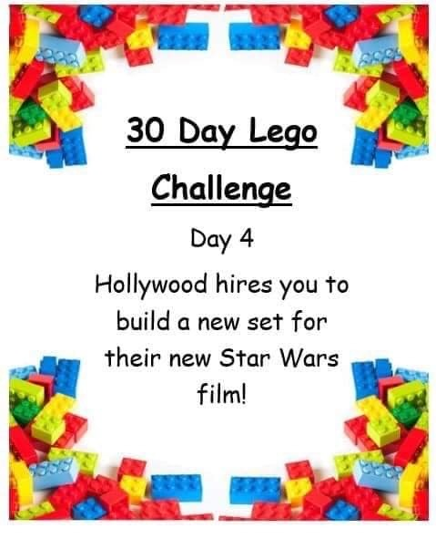
Lego Challenge
If you don’t have lego, you can use any other building resources you have or you can draw your design.
If you haven’t watched star wars you could build a new set for another film you have seen, for instance, build another type of castle for a Disney movie e.g. Elsa’s castle in Frozen – redesign it.

