Slide 1
Thursday 28th May

Slide 2
Timetable
French Starter
Daily exercise
Spelling/ Literacy starter
Writing
Maths

Slide 3
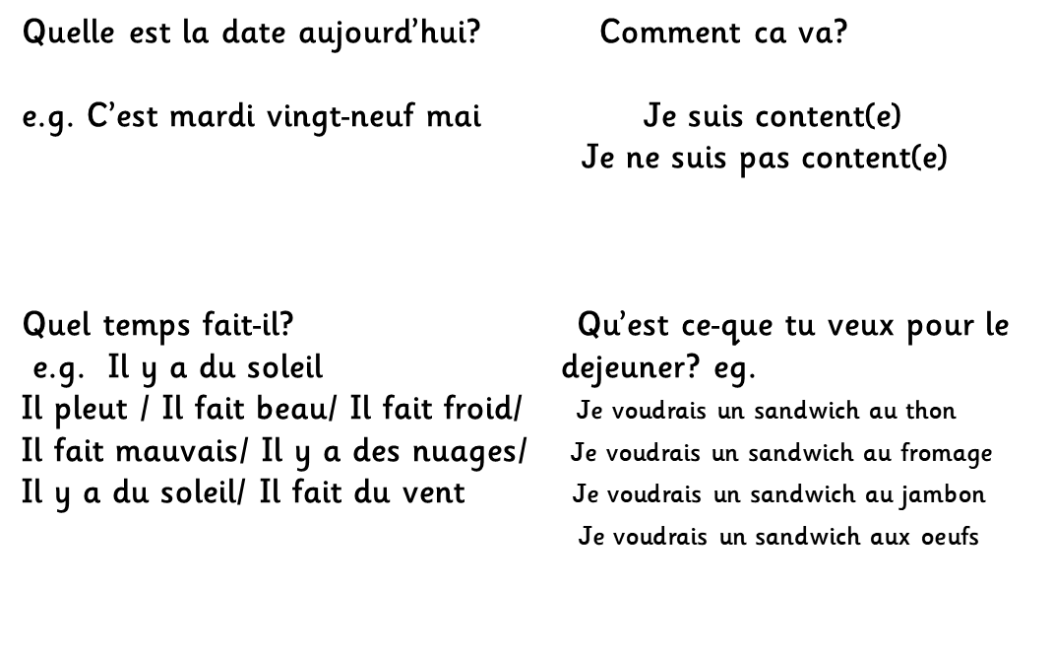
French

Slide 4
Daily exercise
(Some of these people are almost as fun as Mr Martin, but not quite!)
Joe Wicks 9am live - https://www.youtube.com/watch?v=rAX6Q236CwI
Oti Mabuse 11:30am (strictly dancer) https://www.youtube.com/watch?v=btD_HCO1FT4
Cosmic Yoga (on anytime) https://www.youtube.com/watch?v=flK2Nasd-AI

Slide 5
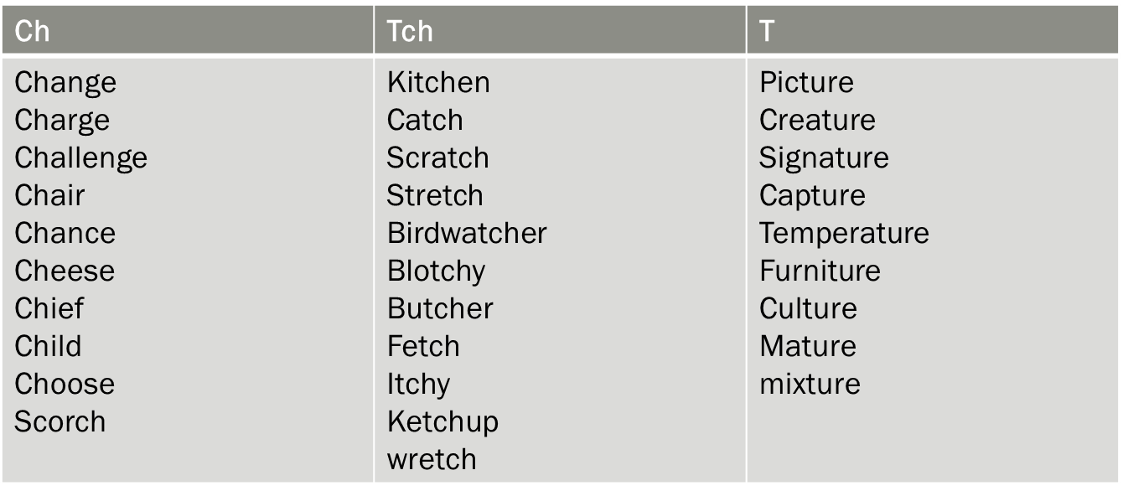
Spelling/ Literacy
Diacritically mark 10 of your spelling words. Select a different ten from the week before.

Slide 6
Writing
Li – we are learning to gather notes.
Last week we did something slightly different to mark out door classroom day. We are going to continue with our leaflets to adopt and not shop. I have attached the writing instructions in a word document.

Slide 7
Maths Starter
You have a times table challenge on Sumdog. If you do not want to complete it on Sumdog, complete one of the Speed times table sheets.

Slide 8
Theme Park Maths
We have been working our way through the Theme park maths. We are now on Task 6 in the work booklet. I have attached this for you to complete.

