Slide 1
Wednesday 27th of May
Good Morning Primary 2
French: Bonjour la class! Ca Va?
Aujourd’hui cest Mercredi 27th Mai 2020
L.I- To introduce myself in French.
Bonjour! Comment tu t’appelle?
Bonjour! Je m’appelle _________.
Quelle age a tu?
J’ai _______ ans.

Slide 2
Reading- Common Words
These are some common words you had at the beginning of
P.2. Can you remember them?
how where now too
round found wish men
Choose a book, a comic , a newspaper etc
To see if you can find them in the text.
Using your reading book from Oxford Owl think about these questions and try and answer them. Don’t write them down just tell someone what you think.
Do you know the name of the Author?
Do you know the name of the illustrator?
What did you like about the book?
Is there anything you didn’t like about the book?
What was your favourite part?
Today why don’t you do your reading outside?

Slide 3
Today’s Story- A Perfect Hug https://www.youtube.com/watch?v=ShxwjCkp5qU

Slide 4
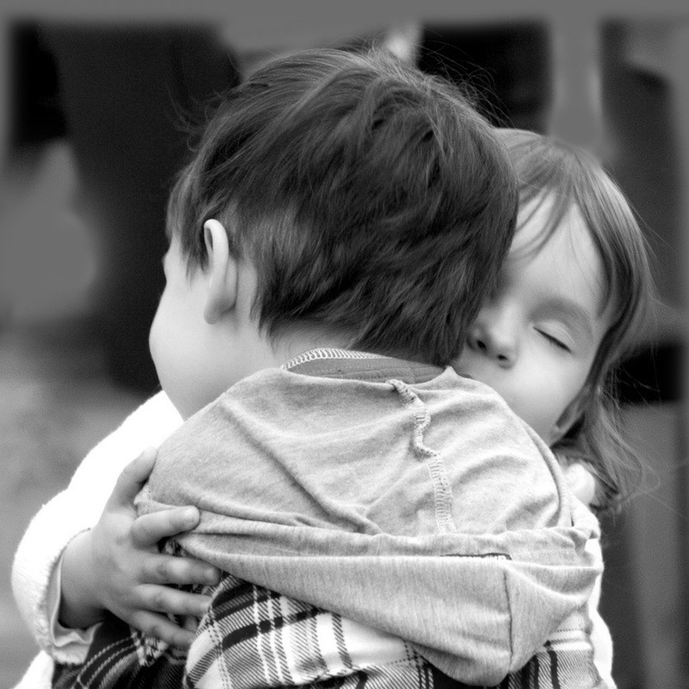
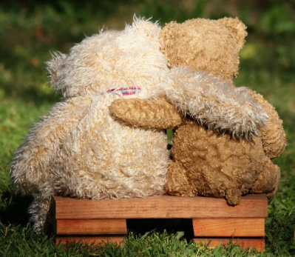
Today you are going to write about why you like hugs and who you like to hug. L.I.- I can write about my feelings. At the moment we have to be careful who we hug as we can only hug the people in our house. But thinking of hugs can cheer us up. Close your eyes and think about who or what you like to hug. When you like to hug and how does it feel. How do we make others feel when we give them a hug. Draw a picture to help you plan your piece of writing.
Writing- I Love Hugs
Think about WHO WHAT WHERE WHEN WHY,
as you are composing your fact file.
Share YOUR IDEAS before you start.
Get help with tricky words but DON’T WORRY give the words a go!
Remember CAPITAL LETTERS, FULL STOPS AND FINGER SPACES

Slide 5
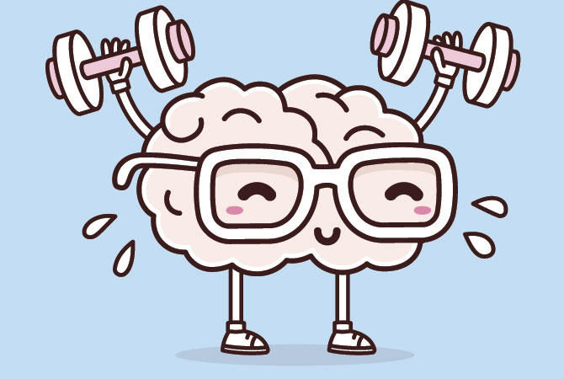
Mathematics Number Talk
Estimation- On the next couple of slides you are to estimate (sensibly guess) how many balls are in the glass.
As it is a number talk, tell your adult why you think it is the number that you are guessing each time.

Slide 6
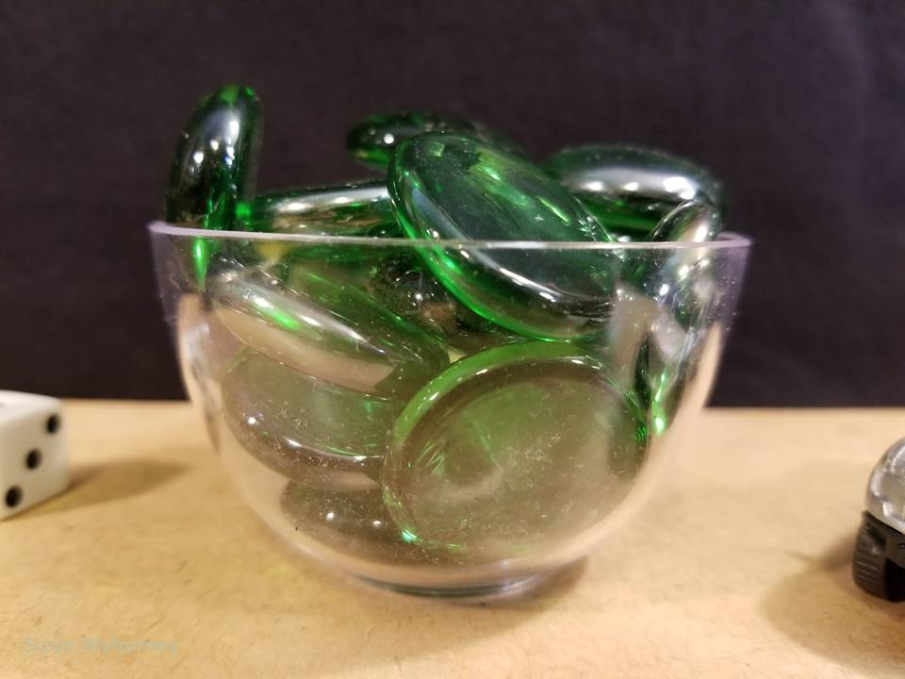
How many glass gems are in the bowl?
The Reveal
21 glass gems
www.stevewyborney.com

Slide 7
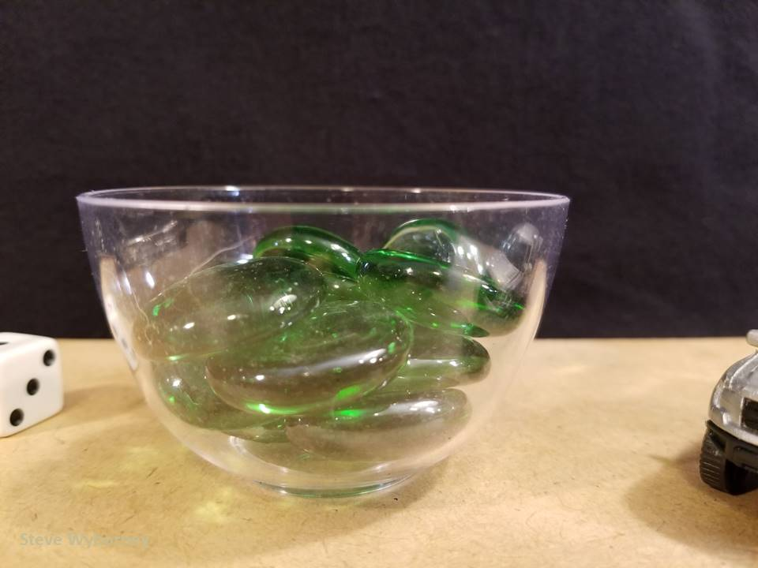
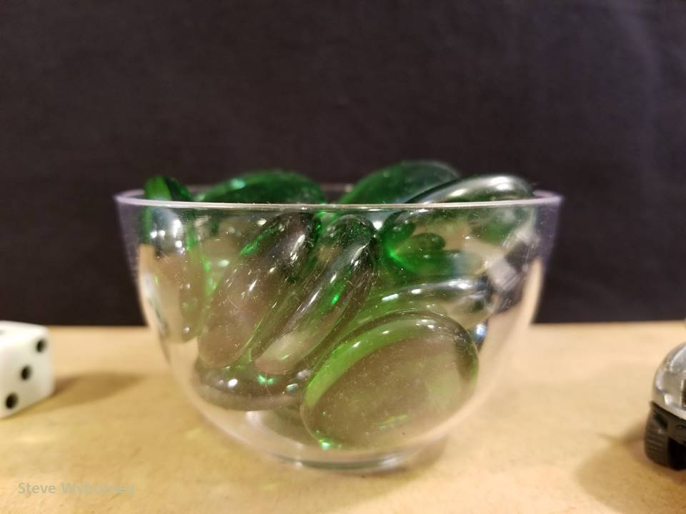
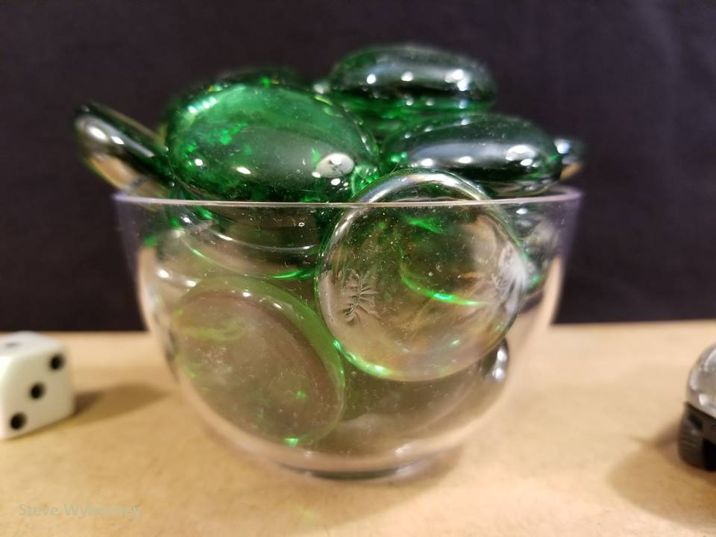
21 glass gems
10 glass gems
The Reveal
16 glass gems
The Reveal
27 glass gems
The Reveal
www.stevewyborney.com

Slide 8
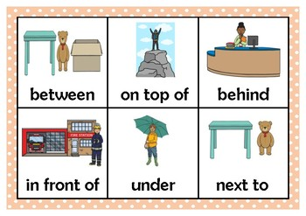
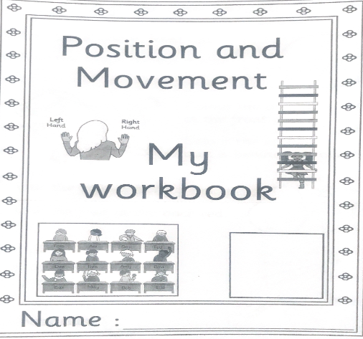
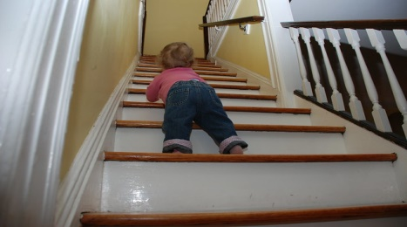
Mathematics Position and Movement
L.I – I can describe the position of an item using the correct language
Watch https://www.youtube.com/watch?v=sZ_-6gs08EY
Position and Movement workbook – Complete page 306 in your workbook.
Challenge
Put numbers 1- 20 on your stairs or if you don’t have
stairs put them in a row. Now get someone to ask you to start at a
number and then move up or down. Guess which
number you will finish at before you move.
i.e. start at number 5 go up 6 steps. Which number
will you land on? Guess before you move. (this challenge can be done
outside if the weather is nice.)

Slide 9
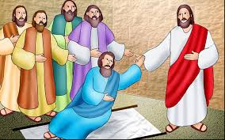
R.E.- Acts of Kindness
Jesus showed many act of kindness to others.
In this story four friends brought a man who was paralysed to see Jesus so he could be healed. Jesus healed the man to bring praise to God, not Himself. When we are kind, we should do it for others , not ourselves. For example, let's say you give some food to the food bank. God wouldn’t want us to brag about our generosity.
https://www.youtube.com/watch?v=OIvmqxUVQGA

Slide 10
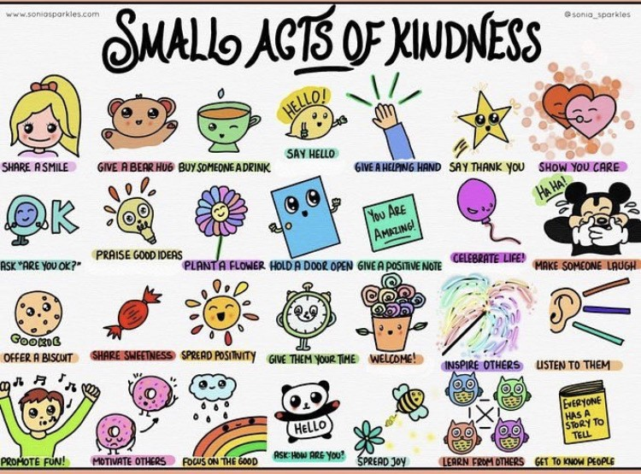
Health and Wellbeing
L.I - I am aware of others feelings and can show acts of kindness.
Can you choose a small act of kindness from above and show someone you care? It can be someone different from Tuesday.

Slide 11
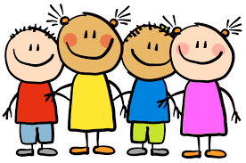
Enjoy the rest of your day Primary 2!
Go outside and enjoy the sunshine.

