Slide 1
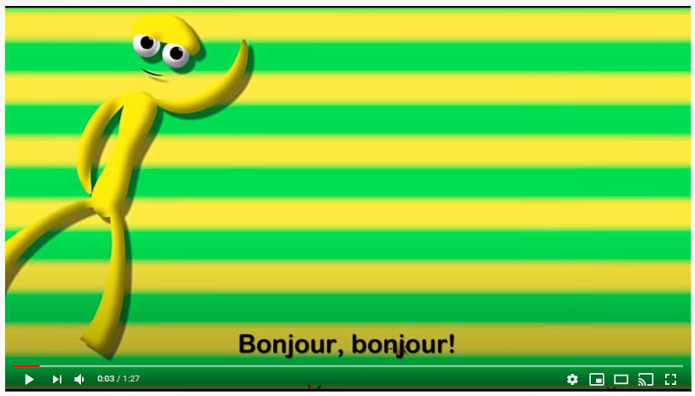
Thursday 28th of May
Good Morning Primary 2/3!
French: Bonjour la class!
Aujourd’hui cest Jeudi 28th Mai 2020
L.I- To introduce myself in French.
https://www.youtube.com/watch?v=atNkI6QFZ50

Slide 2
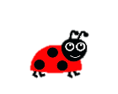
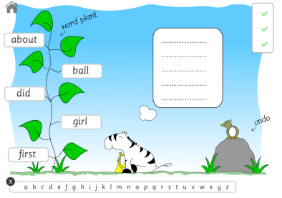
Literacy
LI: We are learning to put words into alphabetical order.
ABCDEFGHIJKLMNOPQRSTUVWXYZ
For todays activity, I would like you to read the words and then write them into your jotter (using your best handwriting) in alphabetical order. This means A words would be first, then B words…
four miss never these list most must high
late
Click the link to play: Alphabetical Order on Topmarks https://www.roythezebra.com/reading-games/alphabetical-order-1.html

Slide 3
Reading Comprehension
Using your reading book from Oxford Owl
Can you find the pages with:

Slide 4
Today’s Story- A Perfect Hug https://www.youtube.com/watch?v=ShxwjCkp5qU

Slide 5
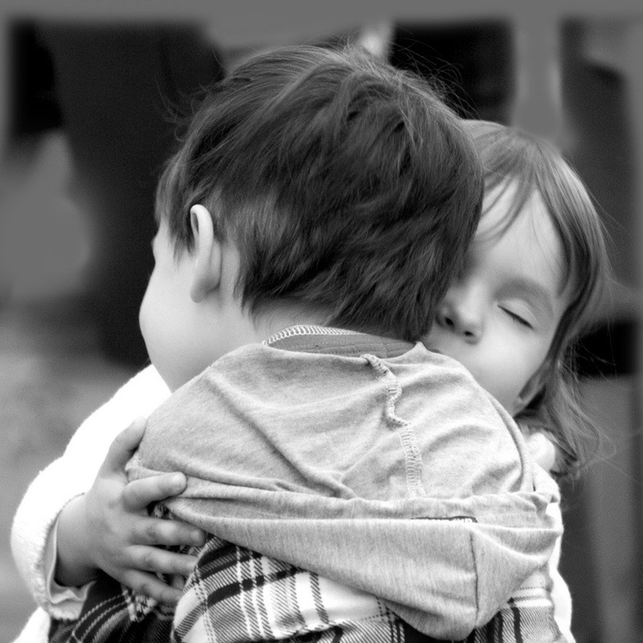
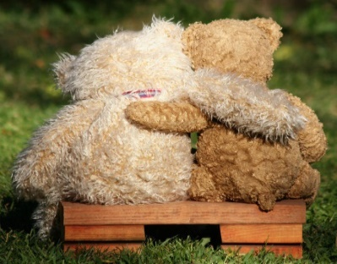
You are going to write about why you love hugs and who from. L.I.- I can write about my feelings. At the moment we have to be careful who we hug as we can only hug the people in our house. But thinking of hugs can cheer us up. Close your eyes and think about who or what you like to hug. When you like to hug and how does it feel. How do we make others feel when we give them a hug. Draw a picture to help you plan your piece of writing.
Writing- I Love Hugs
Think about WHO WHAT WHERE WHEN WHY, as you are composing your writing
Share YOUR IDEAS before you start.
Get help with tricky words but DON’T WORRY give the words a go!
Remember CAPITAL LETTERS, FULL STOPS AND FINGER SPACES

Slide 6
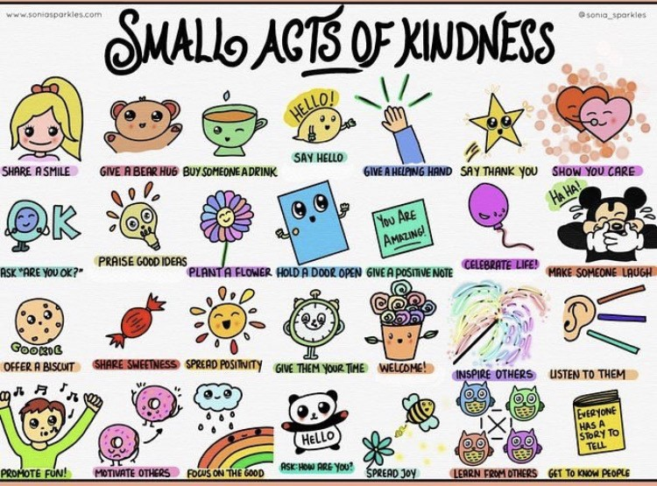
Health and Wellbeing
L.I - I am aware of others feelings and can show acts of kindness.
Can you choose another small act of kindness from above and show someone you care?

Slide 7
Numeracy – Warm Up
LI: To use mental strategies to solve maths problems and be able to explain my strategy
Splat

Slide 8
7
www.stevewyborney.com
Steve Wyborney

Slide 9
10
www.stevewyborney.com
Steve Wyborney

Slide 10
15
www.stevewyborney.com
Steve Wyborney

Slide 11
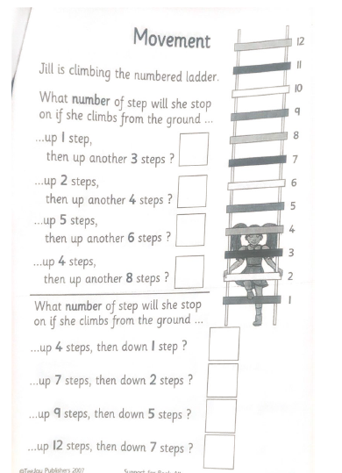
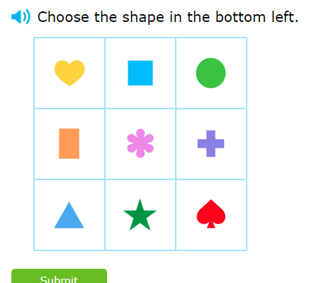
P2 Maths Activities
L.I – I can describe the position of an item using the correct language
Complete page 4 in your workbook
Play: Grid location
https://uk.ixl.com/math/year-1/location-in-a-grid

Slide 12
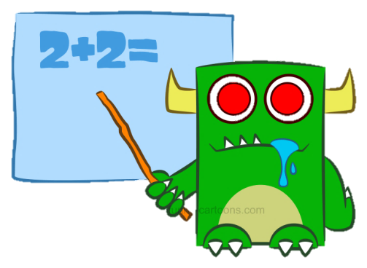
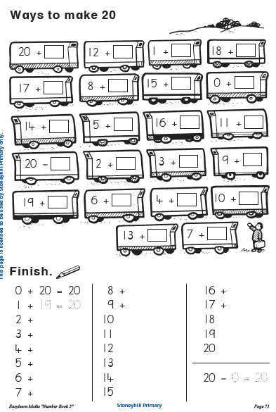
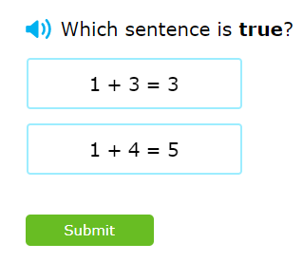
P3 Numeracy Activities
LI: To use counting on and addition strategies to find the total
Addition and Subtraction workbook
Please do this page of your
booklet.
2. IXL Maths: Addition true or false
https://uk.ixl.com/math/year-2/addition-sentences-true-or-false

Slide 13
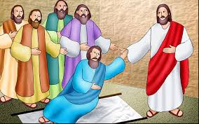
R.E.- Acts of Kindness
Jesus showed many act of kindness to others.
In this story four friends brought a man who was paralysed to see Jesus so he could be healed. Jesus healed the man to bring praise to God, not Himself. When we are kind, we should do it for others , not ourselves. For example, let's say you give some food to the food bank. God wouldn’t want us to brag about our generosity.
Watch: https://www.youtube.com/watch?v=OIvmqxUVQGA

Slide 14
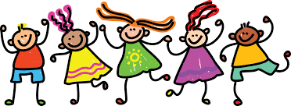
Leave a comment on the blog about what you learned today. Enjoy the rest of your day Primary 2/3!

