Slide 1
Wednesday 27th May
Good Morning Primary 4!
French: Bonjour la class! Ca Va?
Quelle est la date aujourd’hui?
Aujourd’hui cest Mercredi 27th Mai 2020

Slide 2
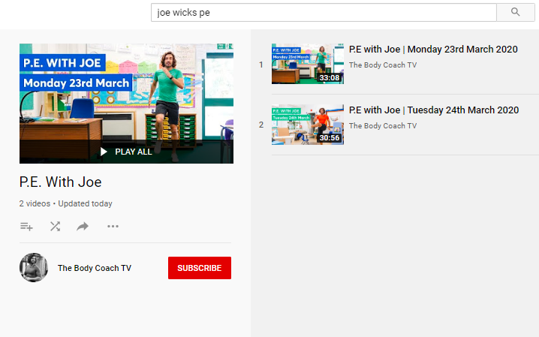
Health and Wellbeing
LI: We are learning to move our body well, exploring how to manage and control it, finding out how to use and share space.
P.E with Joe- Wednesday 27th May Video
(he is nearly as fun as Mr Martin, not quite, but nearly)
https://www.youtube.com/playlist?list=PLyCLoPd4VxBvQafyve889qVcPxYEjdSTl

Slide 3
Grammar (slide 1)
LI: I can use adverbs correctly
An adverb is simply a word that describes a verb (an action or a doing word).
•He ate his breakfast quickly.
The word 'quickly' is an adverb as it tells us how he ate (the verb) his breakfast.
Where to place adverbs?
Adverbs can come before or after a verb.
• He 'quickly' ate his lunch.
• He ate his lunch 'quickly'

Slide 4
Grammar (slide 2)
LI: I can use adverbs correctly
Watch this BBC clip all about adverbs!
https://www.bbc.co.uk/bitesize/topics/zwwp8mn/articles/zgsgxfr
Once you’ve watched the video, scroll down and try the activities!

Slide 5
Grammar (slide 3)
LI: I can use adverbs correctly
TASK: Download the adverbs worksheet from Teams or the Blog.
Your challenge is to copy out the sentences at the bottom of the sheet into your jotters and then add an adverb from the box to make your sentence more interesting!
Extension task: Write 4 more sentences of your own and add some other adverbs from the box?
Once you’ve watched the video, scroll down and try the activities!

Slide 6
Spelling slide 1 (Tom Fletcher & Roald Dahl groups)
LI: I can use strategies to help me spell common words
S.C. (what I need to do to be successful)
TASK: sentence builder
Write 5 sentences or a short story and try and include as many of your common words as possible. Underline any common words that you use.
e.g. my birthday is in the month of August. It is the most important month of the year!

Slide 7
Spelling slide 2 (Tom Fletcher & Roald Dahl groups)
LI: I can use strategies to help me spell common words
Common words set 5
January | August
February | September
March | October
April | November
May | December
June | quickly
July | important
 | mumbled

Slide 8
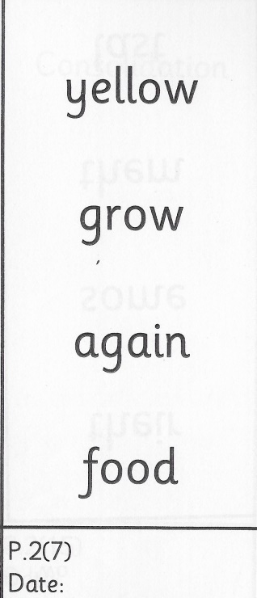
Spelling (David Walliams Group)
TASK:
You have got a new set of common words to practise today!
Remember to use the ‘Read, Write and Spell’ strategy to help you practise.
Example of how to practise your common words!

Slide 9
Reading
L.I I am using different reading strategies to help me understand my book
Reading:
David Walliams: Messy Magpie Litter Pick – You do not need to go around the school, you could go around your garden or do due it during a walk around your estate.
Roald Dahl: Chapter 3 – Research
Tom Fletcher: Chapter 9 – Main Ideas and Summarising – Write a summary of the chapter using your main points from yesterday

Slide 10
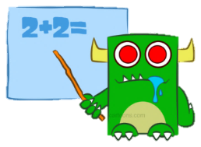
Maths
L.I. I am practising my mental maths
You’ve all been working so hard on fractions! Well done to everyone for trying so hard.
Today, I’d like you to spend a bit of time (at least 20 minutes) playing a little bit of Sumdog or Topmarks maths!
This is a good mid-week opportunity to have a break from fractions work and exercise our mental maths brains!

Slide 11
Religious Education (slide 1)
L.I. I am learning about the miracles of Jesus
Last week, we learned the story of Jesus healing the Centurion’s servant when he was sick. He healed the man without even touching him and many of us realised that this was a miracle!
Jesus performed many miracles. Download the PowerPoint from Teams or the Blog to read about some of the other miracles that Jesus performed!

Slide 12
Religious Education (slide 2)
L.I. I am learning about the miracles of Jesus
TASK: Create a comic book strip telling the story of one of the miracles that you have read about today!
You can download a template from Teams or the Blog or can draw a comic strip in your jotter.

Slide 13
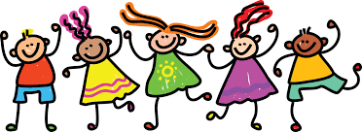
Feel free to leave comments / questions on Teams throughout the day and I will try my best to get back to you. Enjoy your day, Primary 4!

