Slide 1
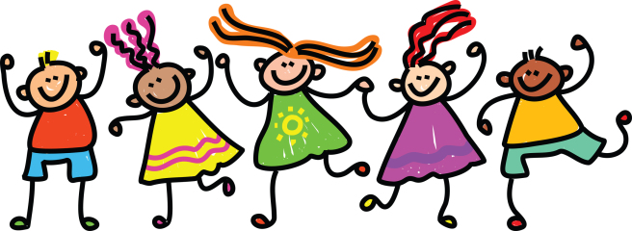
Wednesday 27th of May
Good morning primary 1!
Bonjour la class! Ca va?
https://www.youtube.com/watch?v=atNkI6QFZ50
L.I – I can say some simple greetings in French
Q.-Comment tu t’appelle?
(What is your name?)
Je m’appelle…….
(I am called ……..)
https://www.youtube.com/watch?v=6-32jNNr4pg
Practice asking you family their age in French.

Slide 2
Literacy
I can share ideas in pictures and print.
We are learning to recognise, read and make words containing the “oo” phoneme.
Sing and complete actions to jolly phonics alphabet songs
https://www.youtube.com/watch?v=U2HYM9VXz9k&t=630s
Break and blend oo words below
https://www.youtube.com/watch?v=ONgqoexO8gY
Complete activities for day 3 in pack.
Elkonin box example
Please use a whiteboard pen to write on the polypocket so you are able to wipe it clean and use it again next week.
s | p | oo | n

Slide 3
While we Can’t Hug
https://www.youtube.com/watch?v=2PnnFrPaRgY
Today’s story was recommended by Mrs Russell (Amelia’s mum). Thank you! ☺

Slide 4
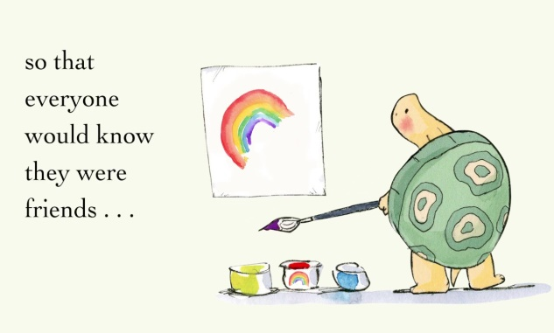
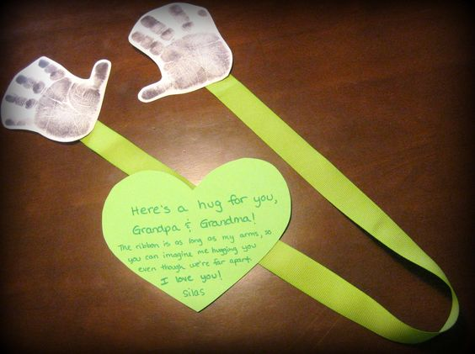
Health and Wellbeing
I am learning skills and strategies which will support me in challenging times.
You could give this a go…
Draw around your hands or use paint to make hand prints onto a piece of paper.
Cut them out then attach them together with a piece of string.
Post them to someone special to you.
I will attach a poem for you to print/write out to send along with it.
During this time we have been required to show love in different ways.
Can you think of your own way of showing a someone special to you that they are loved?
I would love to hear some of your ideas.

Slide 5
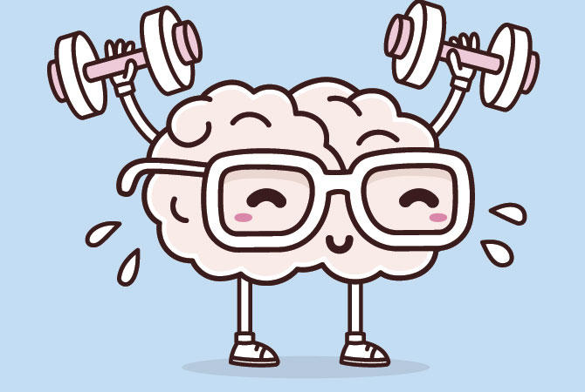
Mathematics Number Talk
Warm up - https://www.bbc.co.uk/teach/supermovers/ks1-maths-counting-with-john-farnworth/zbct8xs
*Remember – number talks are all about how you solve a task, mentally.

Slide 6
You are about to see a larger group of dots. Find as many ways as you can to show how you know what the total is.
www.stevewyborney.com

Slide 7
Now I’ll show you a large copy of your pattern. Then I’ll show you several smaller copies so you can find as many ways as possible of showing different ways of seeing the total. Here they are!
www.stevewyborney.com

Slide 10
Time!
We are learning to tell the difference between am and pm.
Watch
https://www.bbc.co.uk/bitesize/topics/zkfycdm/articles/zcrmqty
Play
https://www.splashlearn.com/time-games
There are 3 times games you can choose from. Give them a try.
Activity
Use day or night PowerPoint
2. Complete am or pm activity
3. Complete digital time page in your workbook.

Slide 11
Health and Wellbeing. Let’s dance
https://www.youtube.com/watch?v=ymigWt5TOV8

Slide 12
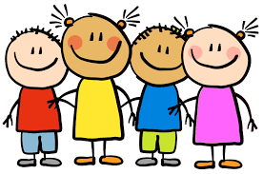
Enjoy the rest of your day Primary 1!

