Slide 1
Wednesday 27th of May
Good Morning Primary 3!
Bonjour la class! Ca Va?
Can you say todays date in French?
Aujourd’hui c’est (M…………………) 27th (M…………) 2020
LI: To say simple greetings in French
Watch: Bonjour! Bonjour!
https://www.youtube.com/watch?v=atNkI6QFZ50

Slide 2
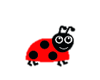
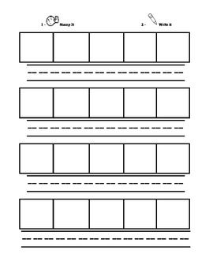
Literacy
LI: We are learning to spell words containing the ‘gn’ phoneme.
Reread the ‘gn’ phoneme story
Place each sound/ phoneme in the elkonin box.
Using the phoneme words, write 3 sentences.
Remember: a good sentence has
Capital Letters
Full Stops
Finger Spaces
s | i | gn

Slide 3
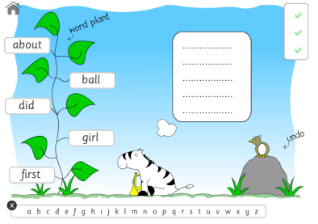
Literacy
LI: We are learning to put words into alphabetical order.
ABCDEFGHIJKLMNOPQRSTUVWXYZ
For todays activity, I would like you to read the words and then write them into your jotter (using your best handwriting) in alphabetical order. This means A words would be first, then B words…
home water
until page
letter must
began follow answer
Click the link to play: Alphabetical Order on Topmarks https://www.roythezebra.com/reading-games/alphabetical-order-1.html

Slide 4
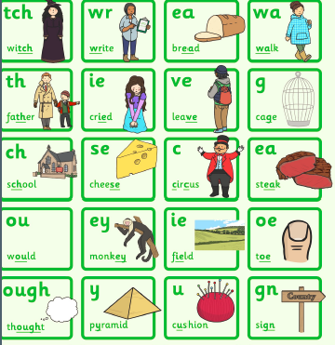
Stage 3 Sounds Revision
L.I. I can use knowledge of sounds, letters and patterns to read words.

Slide 5
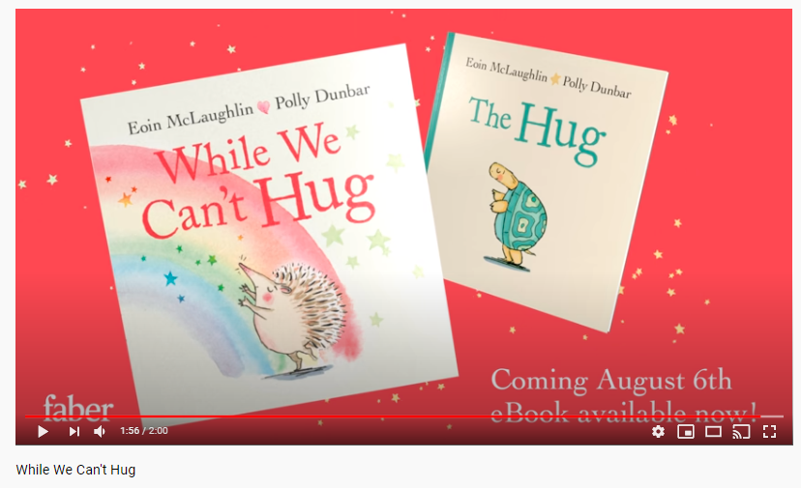
Story time
https://www.youtube.com/watch?v=2PnnFrPaRgY

Slide 6
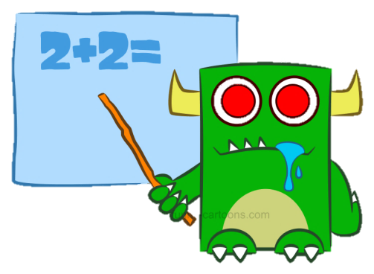
Number Talk
LI: We are learning to develop an understanding of number.
How many different ways can you think of that represent the number below?
Remember, this is a number talk, so you only need you brain. Tell an adult all the different representations you can think of.
Think about number bonds, subtraction sums, times tables, pictures, and words.
20

Slide 7
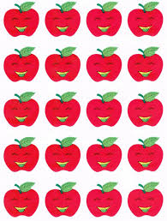
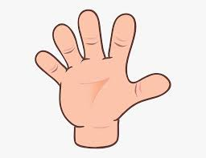
Number Talk
LI: We are learning to develop an understanding of number.
16+4=20
Here is my answer – I wonder if you managed to find more representations than me?
Twenty
100 divided by 5 = 20
5 X 4
4 X 5
20
30-10 = 20
100-80 = 20
16+4=20
10+10=20

Slide 8
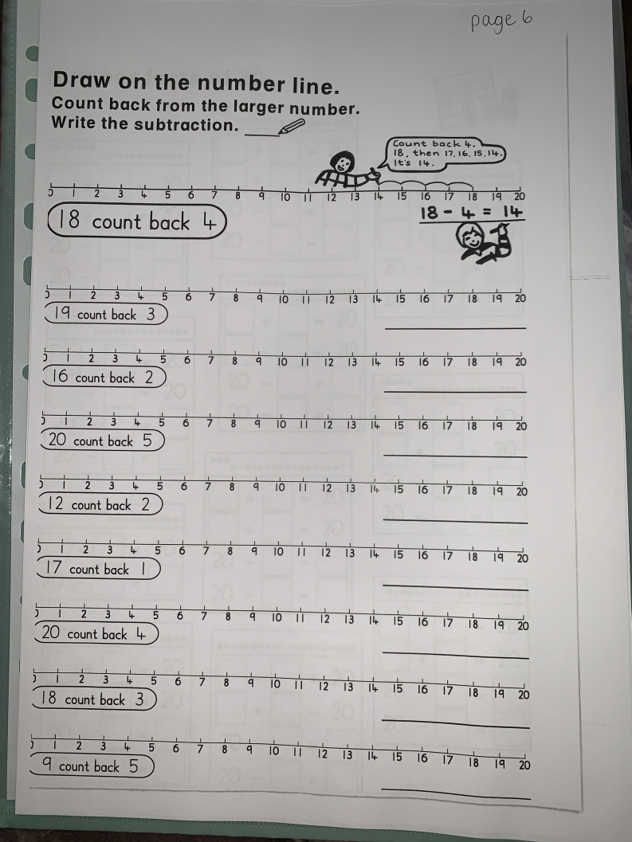
Numeracy Activities
LI: We are learning to develop a range of addition and subtraction strategies.
1. Addition and Subtraction Booklet – Page 6
2. Spend 20 mins on Sumdog practising your maths skills

Slide 9
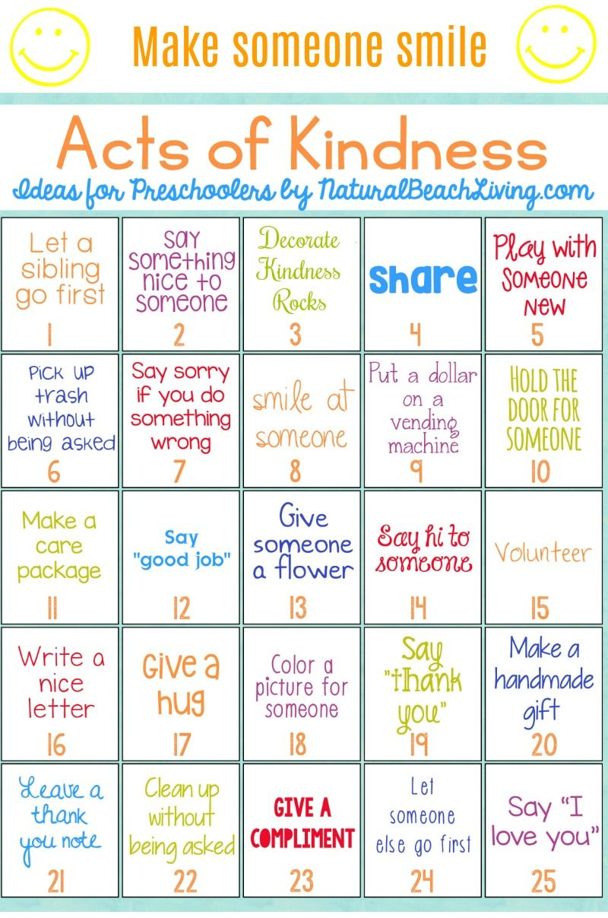
Health and Wellbeing
LI: We are learning to be aware of others feelings and show acts of kindness.
It is very easy to show someone you care.
Can you choose another act of kindness to complete today.

Slide 10
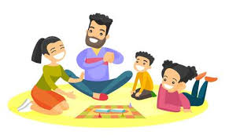
I hope you enjoyed your activities today! Now it’s time to have a play and get some fresh air! ☺

