Slide 1
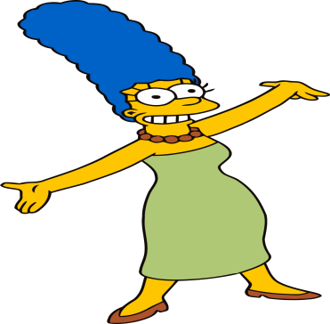
Wednesday 27-5-20
Good Morning Everyone!

Slide 2
Today’s Timetable
Morning Exercise
French
Morning Starter
Maths Lesson
Spelling Task
Literacy Task
R.E.
Topic
P.E.
Prayer

Slide 3
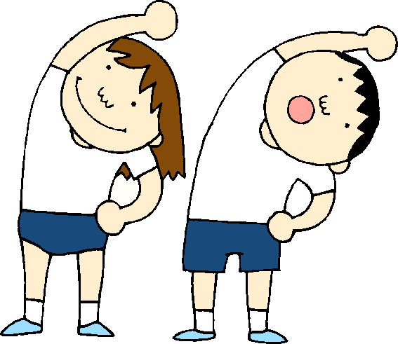
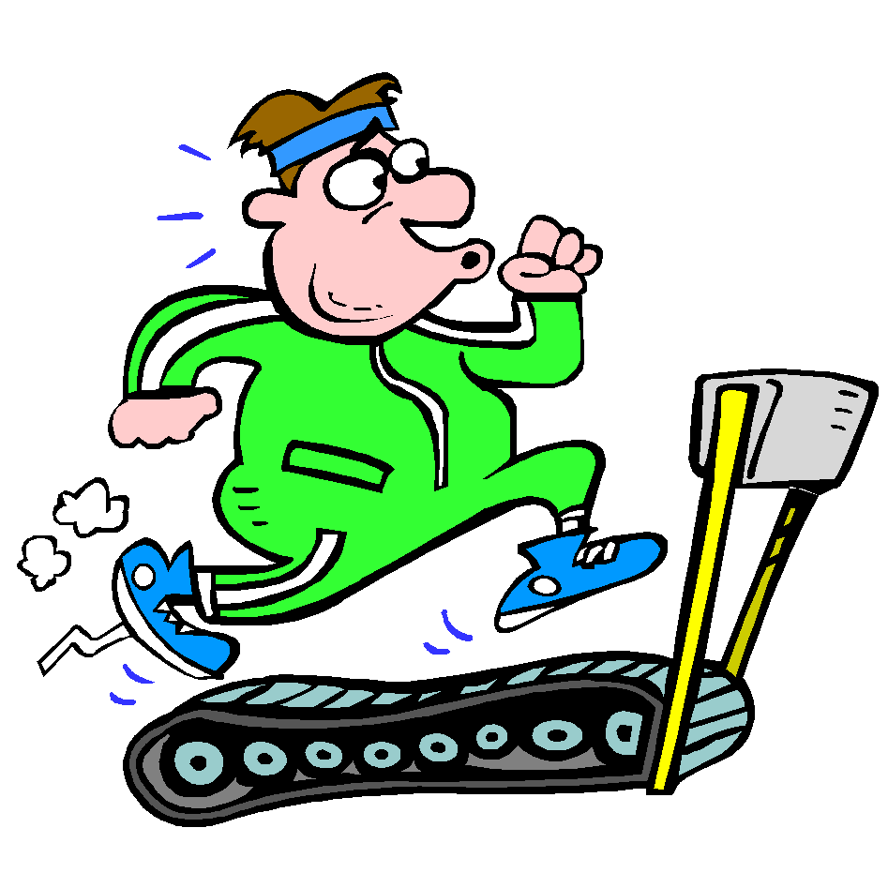
Daily Exercise
Try to do some form of exercise to start the day. This could be a walk or run with a family member or a workout in the house. Check with your parents that it is ok for you to do this.
Why not try this workout :-
https://www.popsugar.co.uk/fitness/photo-gallery/45644743/video/45644768/8-minute-Abs
Or join the Body Coach at 9am

Slide 4
A little bit of French to start the day
Quelle est la date aujourd’hui? Comment ca va?
e.g. C’est mardi vingt-six mai Je suis content(e)
Je ne suis pas content(e)
Quel temps fait-il? Qu’est ce-que tu veux pour le
e.g. Il y a du soleil dejeuner? eg.
Il pleut / Il fait beau/ Il fait froid/ Je voudrais un sandwich au thon
Il fait mauvais/ Il y a des nuages/ Je voudrais un sandwich au fromage
Il y a du soleil/ Il fait du vent Je voudrais un sandwich au jambon
Je voudrais un sandwich aux oeufs

Slide 5
Morning Starter
Today, everyone’s morning starter is 15-20 minutes on
Times TablesRockstars
If you normally do IDL Maths, please do this also for 15-20mins.

Slide 6
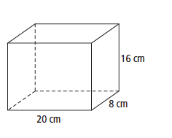
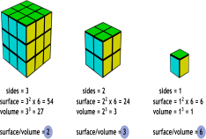
Maths Lesson
L.I. - Today, we are learning about Volume.
S.C. – To understand what we mean by volume.
- To know the formula for calculating volume.
- To be able to calculate volume problems.
There are 2 powerpoints to watch. First, watch the ‘Volume Powerpoint’ to understand what we mean by volume. Then watch the ‘Volume Activity Powerpoint’ to try out some questions.
Task :- Please also complete the written task attached to the blog.
Circles – Qu 1-3 Squares and Triangles – All questions.
The answers sheet is attached.

Slide 7
Spelling
Log in to Sumdog for your spelling task. I have set a new Challenge for those of you who have completed the original task – well done! You should be getting really good at spelling your words now. I know some of you had problems with accessing Sumdog Spelling yesterday. Please try again today even if this means doing some Maths first.
Please make sure you click on the task set for your group. However if it is too easy, try the next group up or if it is too hard, drop down a group.
Group 1 – Red Reading Group, Group 2 – Most of the Class
Group 3 – Super Spellers

Slide 8
Literacy
Your task today is to listen to the next 4 chapters of ‘Wonder’:- ‘Choose Kind’, ‘’Lunch’, ‘The Summer Table’ and ‘One to Ten’.
https://www.youtube.com/watch?v=X3ehxvw79b8
Once you have listened to it, your task is to think about who you are? What are your precepts in life? Write a short paragraph about what is important to you, what are your precepts in life?
L.I. - To be able to develop a good understanding of ourselves and what is important to us.
S.C. – To be able to listen to the text being read.
- To be able to understand what is important to
you.
- To be able to write a short paragraph about who you
are and what is important to you.
Circles : - List 3 precepts which are important to you.
If you do IDL please do 15-20 mins today.

Slide 9
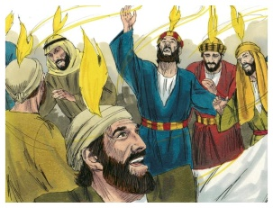
R.E.
Today we are going to learn about the Feast of Pentecost
Pentecost will be celebrated at Mass on Sunday 31st May
Watch the following short films:-
https://www.youtube.com/watch?v=FvLFQhQplKs
Task:- Your task is to draw or make a dove to represent the Holy Spirit. You also need to list the seven gifts of the Holy Sprit. If you can’t remember them from your Confirmation you will need to do a bit of research.
https://www.youtube.com/watch?v=Jq6MwsfHR9U

Slide 10
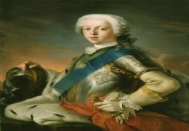
Bonnie Prince Charlie
In 1745 Charles Edward Stuart arrived from France on the island of Eriskay, off the West Coast of Scotland.
He arrived to start the next Jacobite rebellion.
Some thought his rebellion would be a lost cause and they told him to go home. He famously said ‘I am home’.
Task: - Your first task is to find Eriskay on a map of Scotland. Then, create a factfile of Bonnie Prince Charlie. Your factfile should include:-
a drawing of Bonnie Prince Charlie
what other name he is known by
a very basic family tree
when and where he was born
why he wanted to start a rebellion.

Slide 11
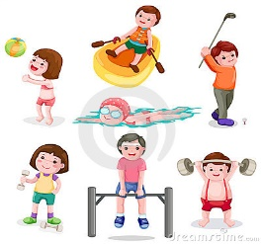
P.E.
You may wish to do some exercise outside with members of your family. However if this not possible perhaps you can persuade them to join you for a workout with the Body Coach. Click on the link below:-
https://www.youtube.com/watch?v=ADg5Nunkmow

Slide 12
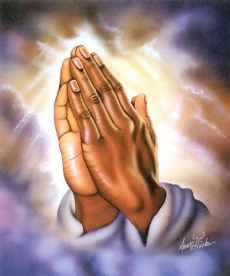
A prayer to end our day
Take a few moments to say a short prayer, thinking of those older members of our community who live in care homes.

Slide 13
Well done!
Well done for working hard today!

