Slide 1
Good Morning P5/4
Week 9 Home Learning
Wednesday 20th May 2020

Slide 2
Aujord’hui c’est mercredi vingt-sept mai.
Je suis content(e)
Je suis d’accord
Je suis mal
il y a du soleil.

Slide 3
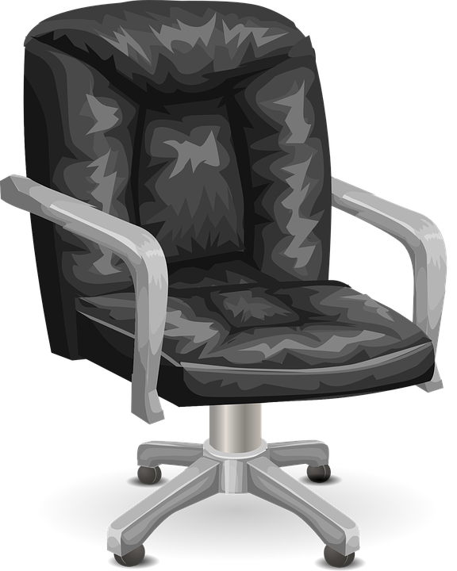
Morning Starter
52 windows in an office block have to be washed.
Bob, Bill and Ben decided to wash the same number of windows.
What is the most they each can wash and how many would that leave unwashed?
A cash and carry warehouse packs 260 packets of soap powder into 6 boxes,
How many go in each box and how many are left over?
A 7 mile taxi journey cost Walter £17.43.
What does that work out at per mile?

Slide 4
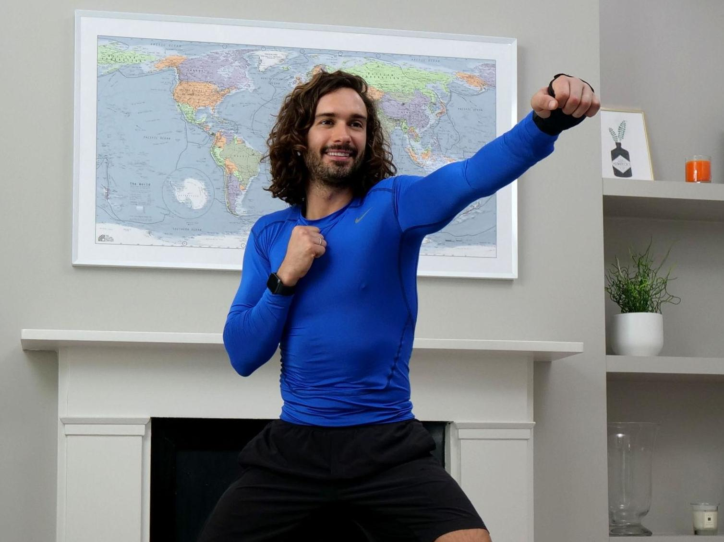
PE tasks
Wednesday is normally a PE day for us so here are some ways you can choose to get
active today:
(Some of these people are almost as fun as Mr Martin, but not quite!)
9am – Joe Wicks PE lesson –
11:30am – Dance Lesson with Oti Mabuse (Strictly professional) –
Any time – Cosmic Kids Yoga –

Slide 5
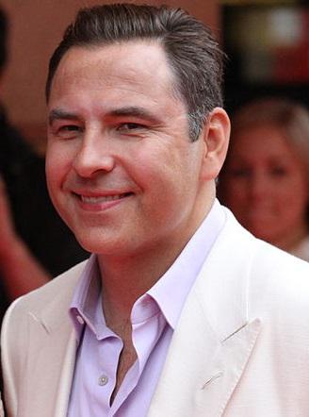
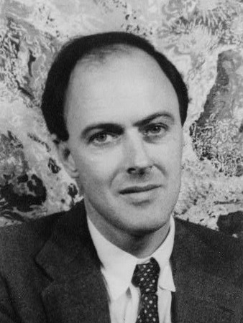
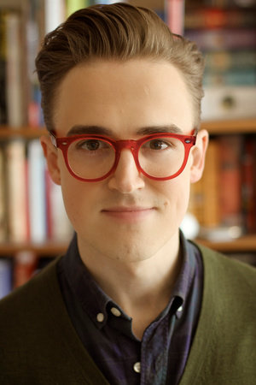
Spelling: Phonics Board
‘ew’
Read, Write, Spell – common words
Reading: Book!
Task – Litter Pick – You don’t need to do around school, could be your home.
Literacy Task Board
Spelling: Story of oo/ch
Primary 4 – unit 5
Primary 5 – unit 12
Reading:
Task – Research
Spelling: Story of oo/ch
Primary 4 – unit 5 Primary 5 – unit 12
Reading:
Task –
Summary

Slide 6
Maths Task Board
Click the circle for teaching video
Pick a few items from around your house and estimate how much you think they will weight.
Then use a set of scales to see if your estimate was correct.
Websites for all groups to use:
Click the triangle for teaching video.
Use a kitchen scale and see how many things you can combine together to make 1 kg.
For example, one bag of sugar weighing 400g plus one bag a flour weighing 600g would make 1kg
Click square for teaching video
Converting Worksheet.

Slide 7
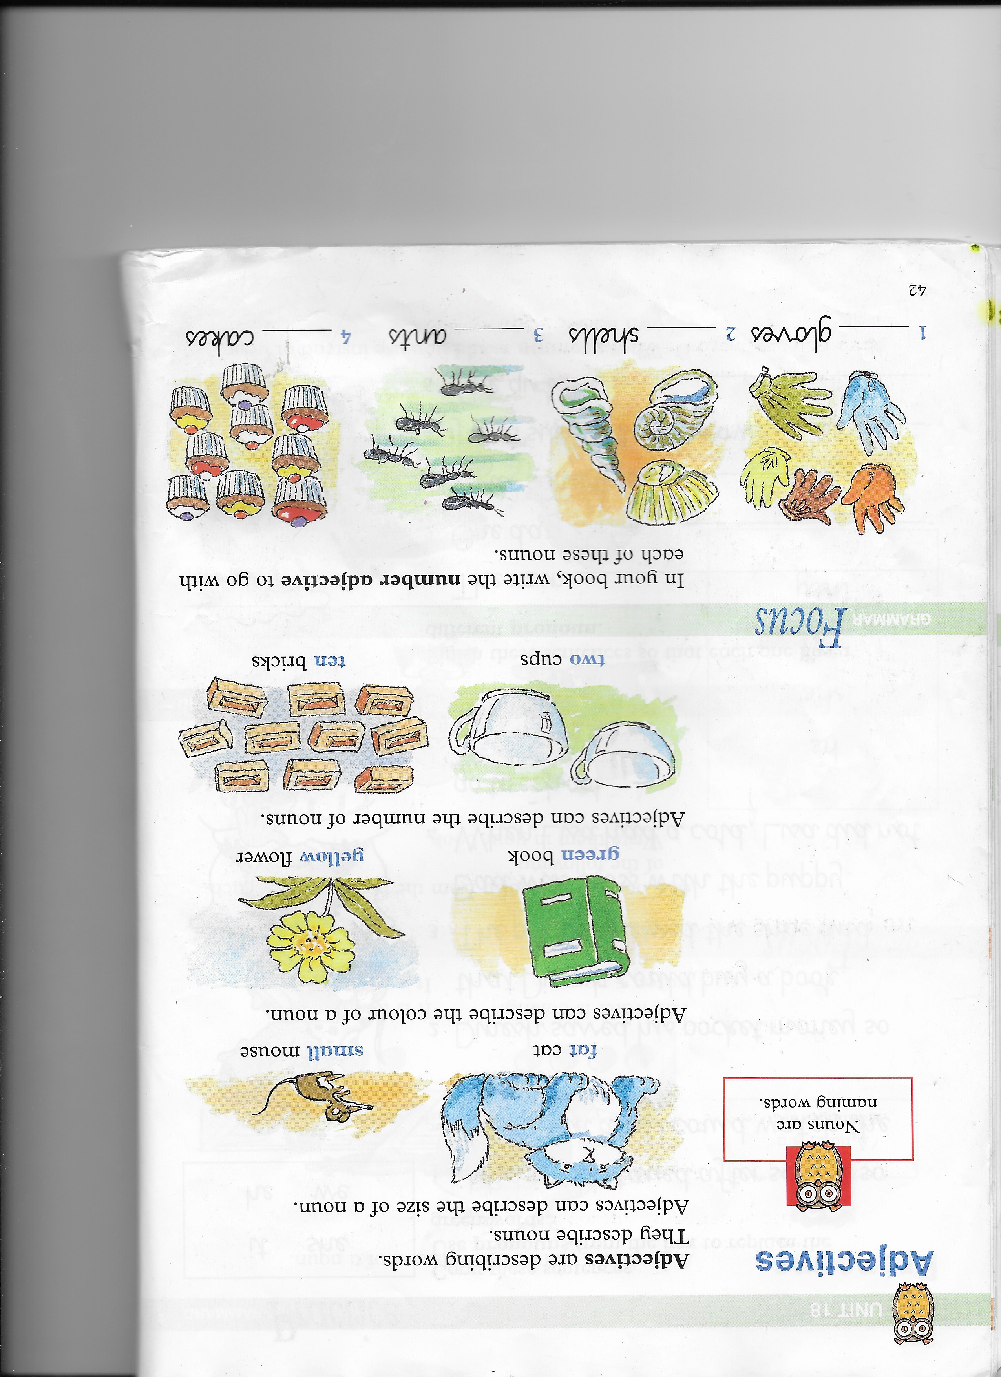
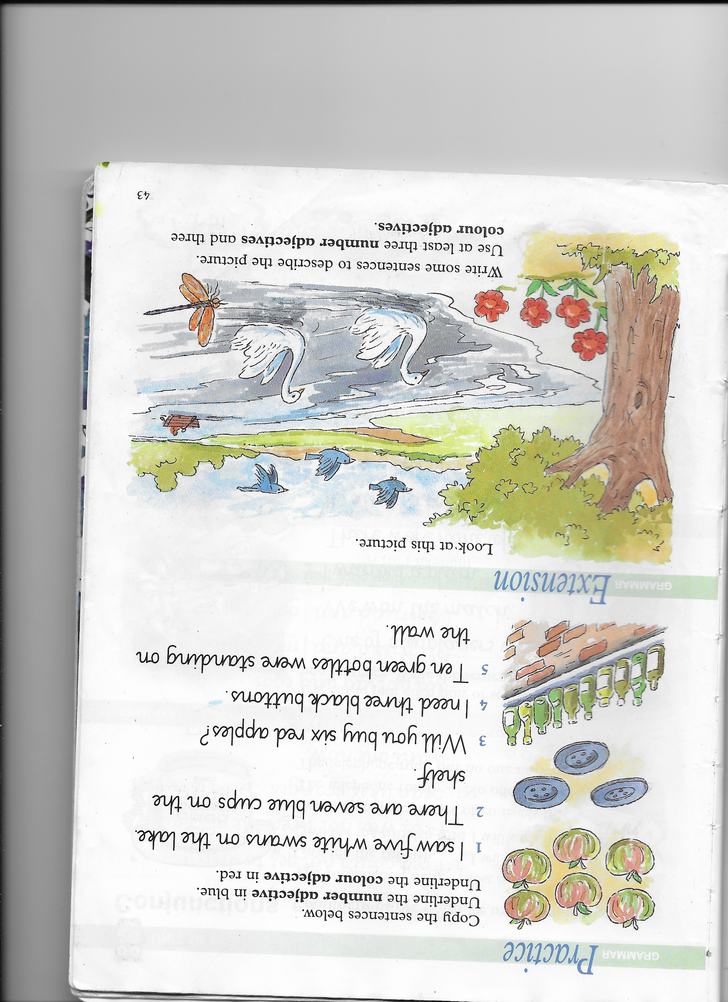
Grammar task – Group 1
Nelson Grammar Book 1 Unit 18.
L.I. I can revise adjectives.

Slide 8
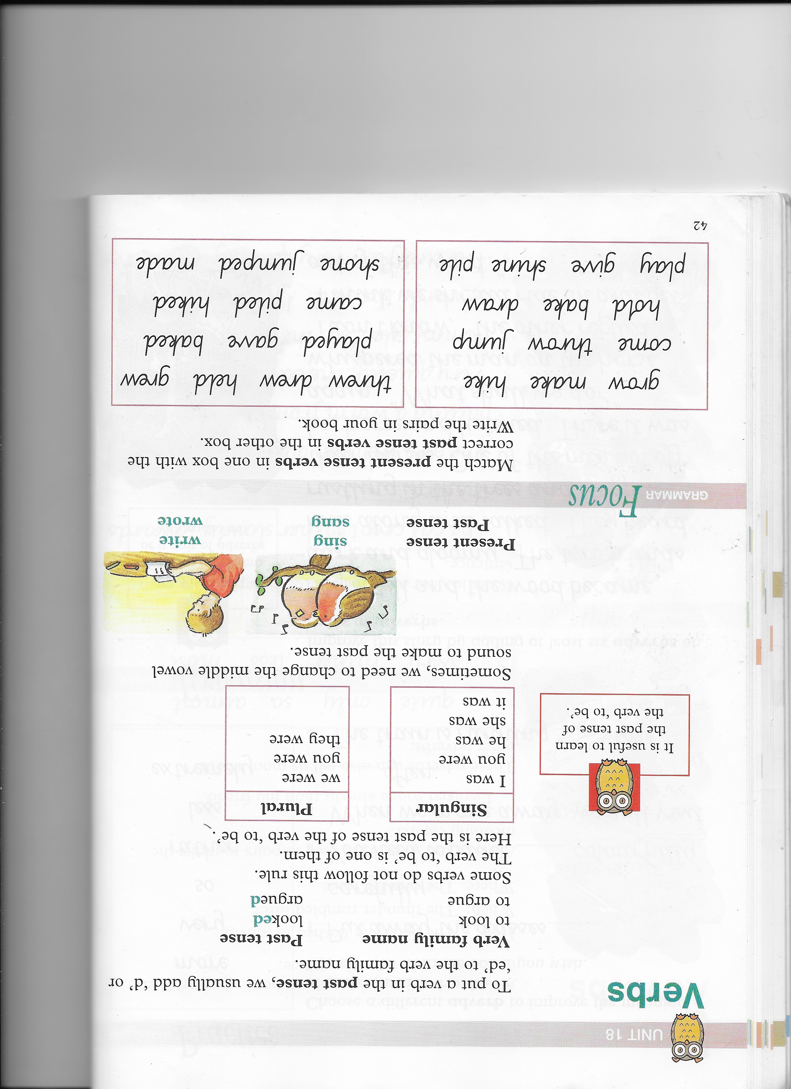
Grammar task – Group 2
Nelson Grammar Book 2 Unit 18.
L.I. I can revise verbs.

Slide 9
Health and Wellbeing Task
This week we will be looking at the responsible part of SHANARRI. Today is about Healthy Lifestyles.
P4
At home discuss all the people in the community who help create a safe and healthy environment for you to live in e.g. dog wardens/police
P5
What would make your community healthier and happier. Make something creative that could displayed in the community to get people to take responsibility for dog fouling/ dropping litter/parking on pavements. Share on Teams.

