Slide 1
Wednesday 27th of May
Good Morning Primary 2/3!
French: Bonjour la class! Ca Va?
Aujourd’hui cest Mercredi 27th Mai 2020
L.I- To introduce myself in French.
Bonjour! Comment tu t’appelle?
Bonjour! Je m’appelle _________.
Quelle age a tu?
J’ai _______ ans.

Slide 2
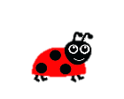
Literacy: Stage 2
LI: To recognise, read and make words containing the phoneme ss
Activities:
Watch: ss sound words https://www.youtube.com/watch?v=EAfmPtUvHE8
Roll and read on the next page.

Slide 4
Literacy: Stage 3
LI: To recognise, read and make words containing the phoneme gn
Activities:
Watch Mr Thorne: https://www.youtube.com/watch?v=e3PY4n5O0jA
Which word goes where? On the next page

Slide 5
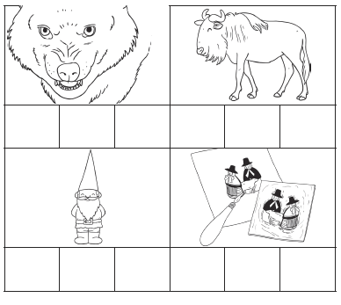
Gnu gnash gnarl gnome, sign gnat gnaw design

Slide 6
Reading
https://www.oxfordowl.co.uk/?sellanguage=en&mode=hub username: stantsps password:homelearning
Use the template on the next page (attached to the blog post) to make your own comprehension dice.
You can use it for any book not just the one you have this week!
Don’t worry if you don’t have a printer, you can still use the questions. You could even just number each question on the template and them use a normal dice to roll and whatever number you land on, you answer that question.

Slide 8
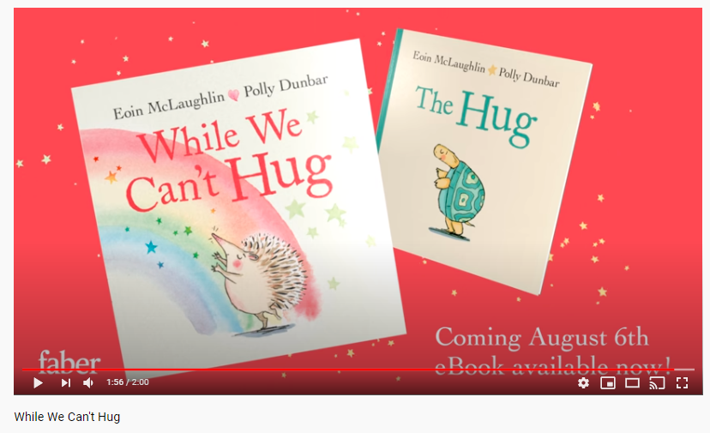
Story Time

Slide 9
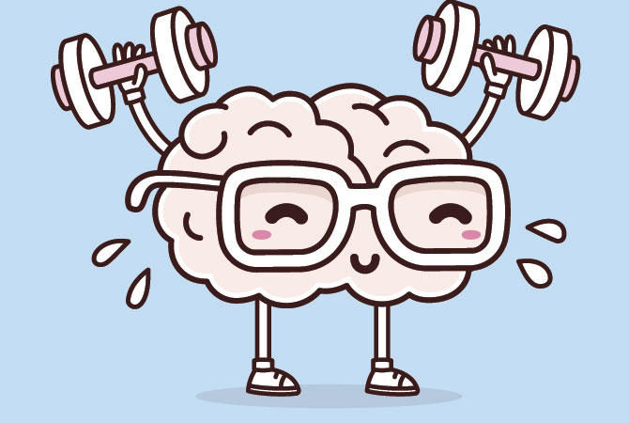
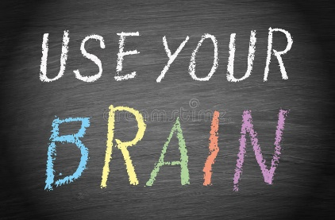
Mathematics Number Talk
Estimation- On the next couple of slides you are to estimate (sensibly guess) how many balls are in the glass.
As it is a number talk, tell your adult why you think it is the number that you are guessing each time.

Slide 10
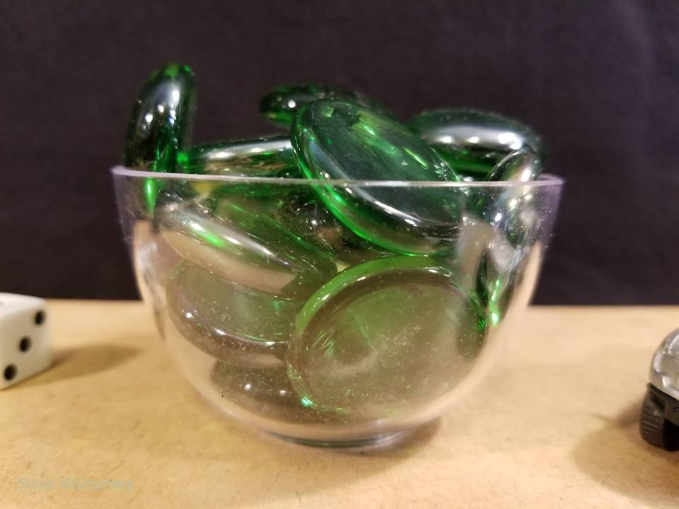
How many glass gems are in the bowl?
The Reveal
21 glass gems
www.stevewyborney.com

Slide 11
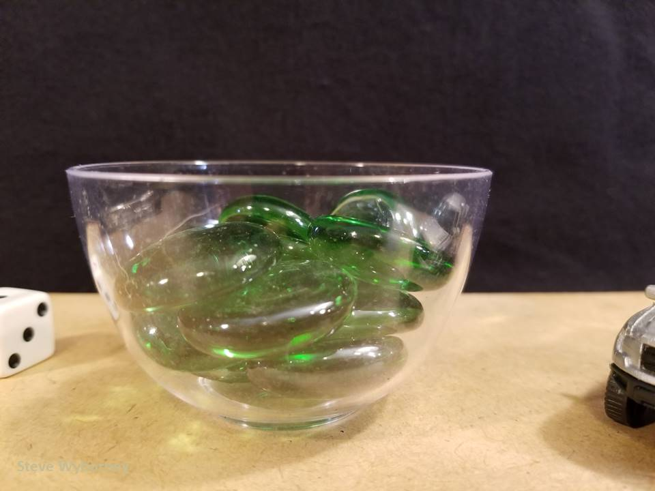
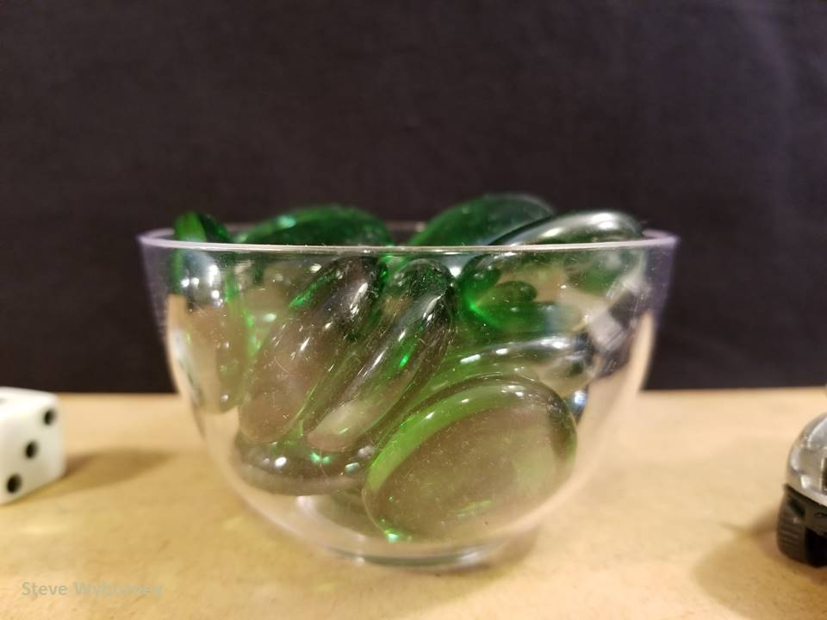
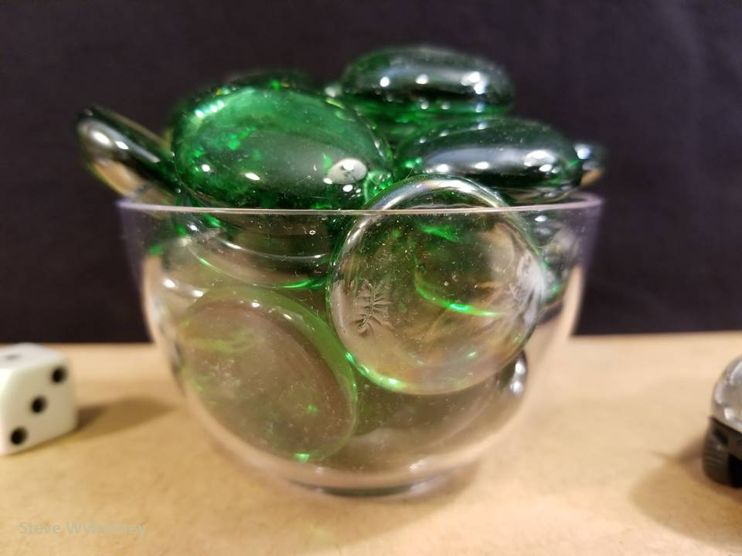
21 glass gems
10 glass gems
The Reveal
16 glass gems
The Reveal
27 glass gems
The Reveal
www.stevewyborney.com

Slide 12
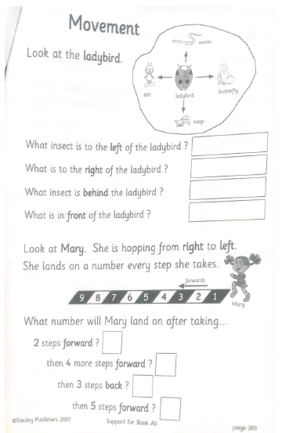
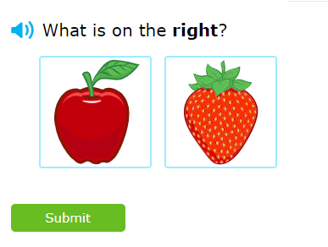
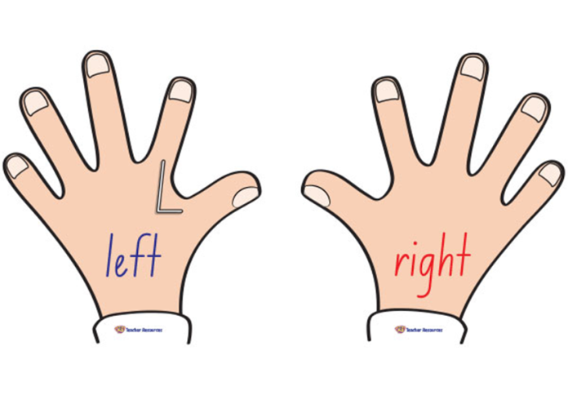
P2 Maths Activities
L.I – I can describe the position of an item using the correct language
Complete page 7 in your workbook
Play: IXL Maths https://uk.ixl.com/math/year-1/left-middle-and-right

Slide 13
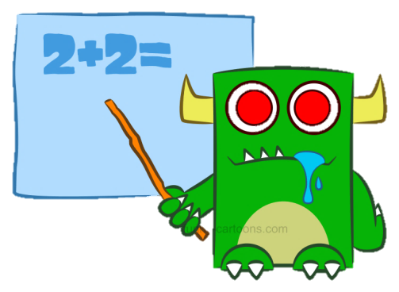
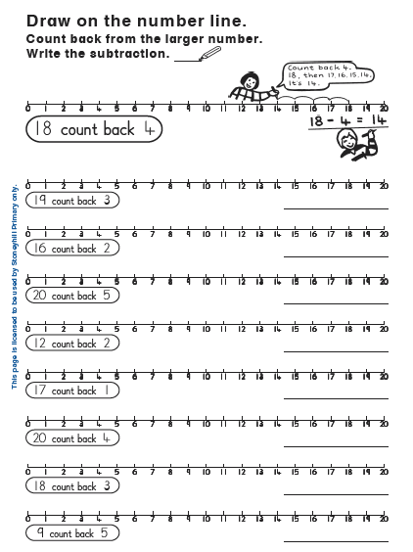
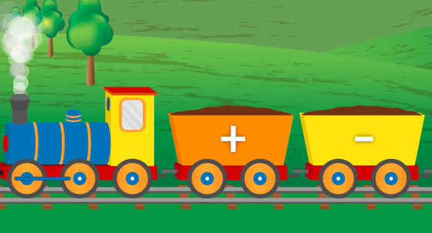
P3 Numeracy Activities
LI: To use counting on and addition strategies to find the total
Addition and Subtraction workbook
Please do this page of your
booklet.
2. Mental Maths Train- choose either + or -
https://www.topmarks.co.uk/maths-games/mental-maths-train

Slide 14
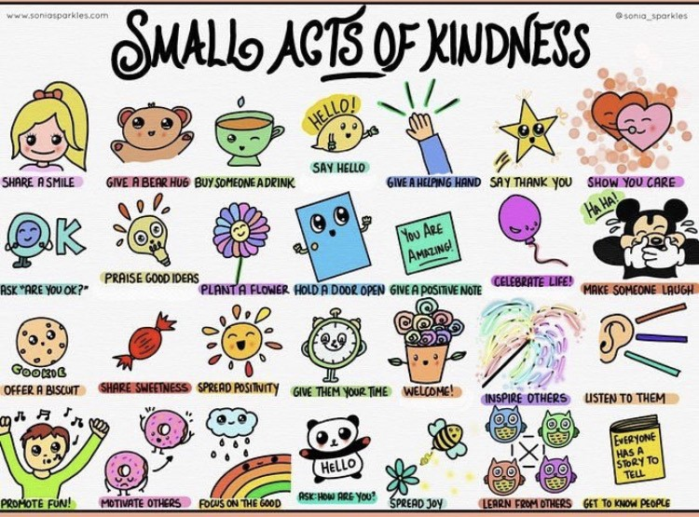
Health and Wellbeing
L.I - I am aware of others feelings and can show acts of kindness.
Can you choose another small act of kindness from above and show someone you care?

Slide 15
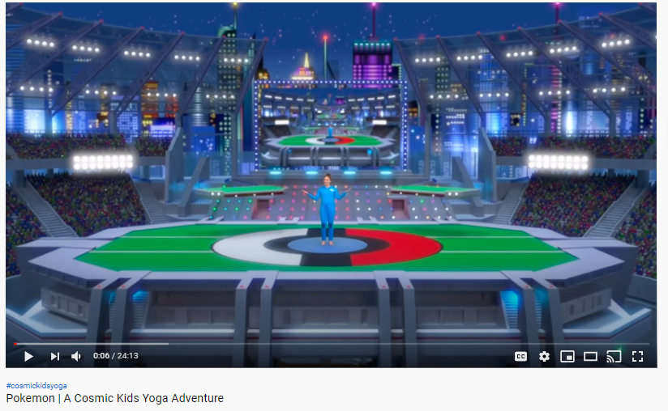
Health and Wellbeing
L.I – To link a series of movements using control and flow.
https://www.youtube.com/watch?v=tbCjkPlsaes

Slide 16
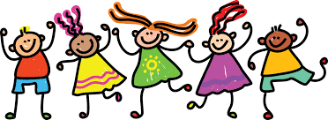
Leave a comment on the blog or upload a picture of what you have done or made today. Enjoy the rest of your day Primary 2/3!

