Slide 1
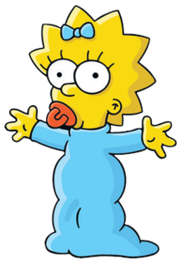
Tuesday 26-5-20
Good Morning Everyone!

Slide 2
Today’s Timetable
Morning Exercise
French
Morning Starter
Maths Lesson
Spelling
Literacy Task
Health and Well-being
Topic
Prayer

Slide 3


Daily Exercise
Try to do some form of exercise to start the day. This could be a walk or run with a family member or a work-out in the house. Check with your parents that it is ok for you to do this.
Why not try this workout:-
https://www.youtube.com/watch?v=L_A_HjHZxfI
Or join The Body Coach at 9am.

Slide 4

A little bit of French to start the day
Quelle est la date aujourd’hui? Comment a va?
e.g. C’est lundi vingt-cinq mai Je suis content(e)
Je ne suis pas content(e)
Quel temps fait-il? Qu’est ce-que tu veux pour le
e.g. Il y a du soleil dejeuner? eg.
Il pleut / Il fait beau/ Il fait froid/ Je voudrais un sandwich au thon
Il fait mauvais/ Il y a des nuages/ Je voudrais un sandwich au fromage
Il y a du soleil/ Il fait du vent Je voudrais un sandwich au jambon
Je voudrais un sandwich aux oeufs

Slide 5
Morning Starter
Your morning starter today, is to think of as many ways to get the answer 107
You must use at least 2 mathematical calculations to get the answer.
e.g. (2 x 55) - 3 = 107
4 x 25 = 100
100 + 7 = 107
If you normally do IDL Maths, please do this also for 15-20mins.

Slide 6
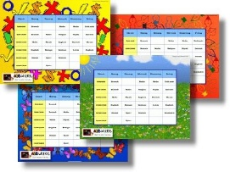

Maths Lesson
Today we are continuing to learn how to read a timetable.
The timetable is an example of what your school timetable might look like. It is not your actual timetable. You will use timetables throughout your time at high school so this is a really useful real life Maths lesson.
Please find your timetable and tasks attached to the blog. Today, please answer the questions in the blue and green sections.
I would like all groups to try this task. If you have any problems, please get in touch on Teams.

Slide 7

Spelling
Log in to Sumdog for your spelling task.
You will need to make sure you click on the task set for your group.
Group 1 – Red Reading Group, Group 2 – Most of the Class
Group 3 – Super Spellers
This task is set for the whole week. If you find the words too hard, drop down a group and if they’re too easy, try the next group up. The words are based on your spelling lists.

Slide 8


Literacy
Today, we’re going to read the next 2 chapters of ‘Wonder’. [‘Around the Room’, ‘Lamb to the Slaughter’]
Click on the link to listen to the story. Please listen from12mins 33 secs, to the end:-
https://www.youtube.com/watch?v=QsuagCNBt6o
‘Like a Lamb to the Slaughter’ is an expression that is used in every day life. At the start of the chapter the author explains what it means.
Your task, today, is to write a short paragraph explaining why August was the lamb being lead to the slaughter. What happened to August, how did he feel? Who was unkind to him?
Red Group: Try to write a few sentences about what happened to August then do your IDL.

Slide 9
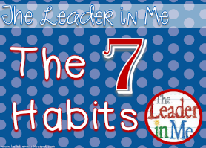
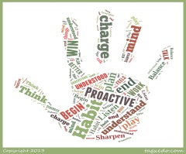
Health and Wellbeing
Today we are going to learn about habit 6.
This video gives some examples of how we are much better when we do things together’:-
https://www.youtube.com/watch?v=HQhuLQTuGko&t=14s
Habit 6 is Synergize but synergize is a word which we don’t use very often. It really means ‘2 heads are better than 1’. It is about working things out together – TEAMWORK!
Task:- .Your task is to try one of the team building games attached to the blog.

Slide 10
The Language of the Jacobites
In the 17th and 18th centuries the languages of Scotland were Scots and Gaelic. Scots was the language of the law and of the royalty and was also widely spoken in the Lowlands. However, in the Highlands the main language was Gaelic and therefore was the language spoken by most Jacobites. The Gaelic language is all around us – in surnames, place names etc. Sometimes we don’t realise it. Gaelic is currently undergoing a revival.
The prefix Mac- means son in Gaelic, so Macdonald means son of Donald and so on.
Duff is derived from the Gaelic dubh, which means dark.
Buchanan comes from a Scottish place name that means house of the canon.
Cameron means crooked nose (Gaelic: cam – crooked / sròn – nose).
Murray is derived from the Scottish region Moray and means seaboard settlement in Gaelic.
Task: - Your task is to spend 15-20mins on Duolingo to learn some basic Gaelic words and phrases. The app is free and very easy to use. https://www.duolingo.com/enroll/gd/en/Learn-Scottish%20Gaelic

Slide 11
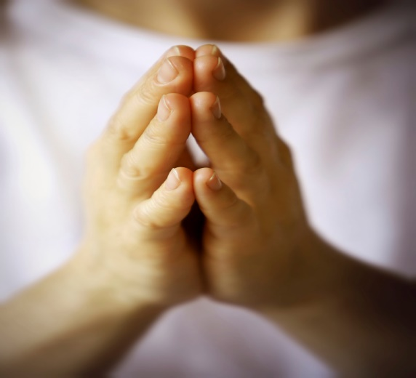
A prayer to end our day
Please take a few moments to say a prayer for all the doctors, nurses and care staff who are constantly working very hard to save lives.

Slide 12

Well done!
Well done for working hard today!

