Slide 1
Tuesday 26th May
Good Morning Primary 4!
French: Bonjour la class! Ca Va?
Quelle est la date aujourd’hui?
Aujourd’hui cest Mardi 26th Mai 2020

Slide 2
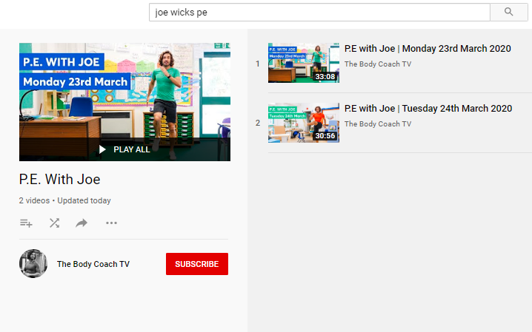
Health and Wellbeing
LI: We are learning to move our body well, exploring how to manage and control it, finding out how to use and share space.
P.E with Joe- Tuesday 26th May Video
(he is nearly as fun as Mr Martin, not quite, but nearly)
https://www.youtube.com/playlist?list=PLyCLoPd4VxBvQafyve889qVcPxYEjdSTl

Slide 3
Health and Wellbeing
LI: I am thinking about the skills that I have learned in life
As human beings, we are constantly learning new things and taking in new information. Even so, occasionally we put ourselves down and tell ourselves that we aren’t good enough! We all do it, so sometimes it is important to remind ourselves of everything that we CAN do and everything that we have achieved!
TASK: Write a list of things that you have learned since you were born. Some examples might be learning how to talk, learning how to write or learning a sport, like tennis!

Slide 4
Spelling slide 1 (Tom Fletcher & Roald Dahl groups)
LI: I can use strategies to help me spell common words
S.C. (what I need to do to be successful)
Find the ‘Range of Strategies’ help sheet in your work pack (it is on the following slide if you can’t find it!)
Today’s challenge is to use some of these strategies to help you spell your common words.
I will give you some examples in the following slides so that you know how to lay out the work in your jotters.

Slide 5
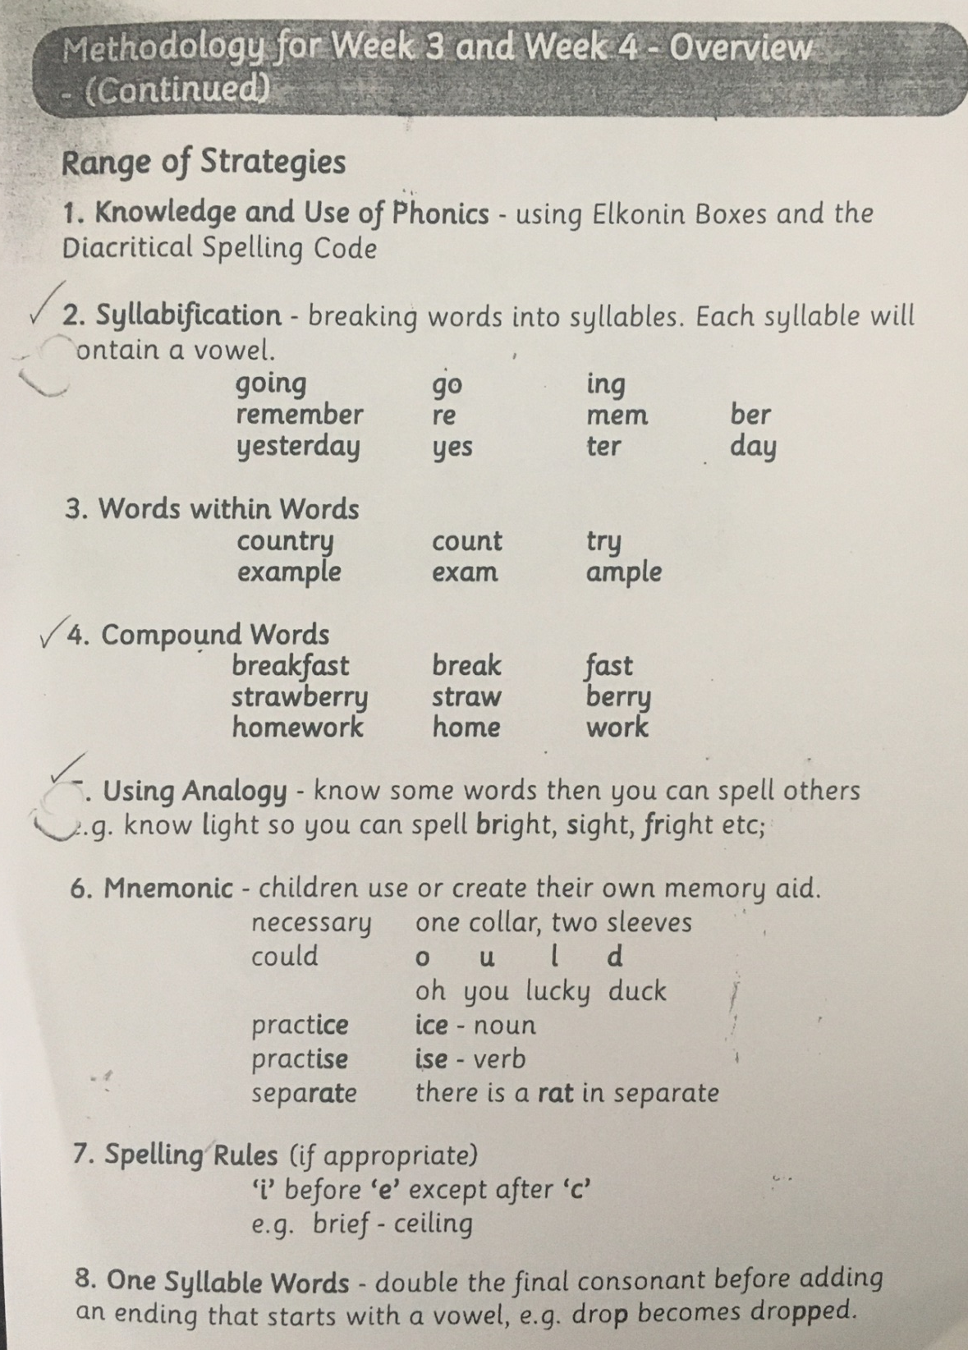

Slide 6
Spelling slide 3 (Tom Fletcher & Roald Dahl groups)
LI: I can use strategies to help me spell common words
Common words set 5
January | August
February | September
March | October
April | November
May | December
June | quickly
July | important
 | mumbled

Slide 7
Spelling slide 3 (Tom Fletcher & Roald Dahl groups)
LI: I can use strategies to help me spell common words
EXAMPLES:
January = Jan u ar y (syllabification)
quickly = quick ly (words within words)
Try and use as many different strategies as you can!

Slide 8
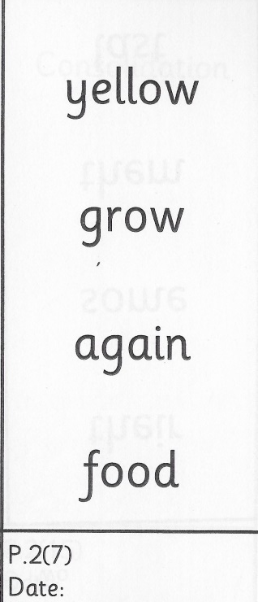
Spelling (David Walliams Group)
TASK:
You have got a new set of common words to practise today!
Remember to use the ‘Read, Write and Spell’ strategy to help you practise.
Example of how to practise your common words!

Slide 9
Reading
L.I I am using different reading strategies to help me understand my book
Reading:
David Walliams: Choose one of tasks below, depending on how much of a challenge you want.
Messy Magpie adding suffixes – Green
Messy Magpie adding suffixes – Green Answers
Messy Magpie adding suffixes – Amber
Messy Magpie adding suffixes – Amber Answers
Messy Magpie adding suffixes – Red
Messy Magpie adding suffixes – Red Answers
Roald Dahl: Chapter 2 – Visuliser
Tom Fletcher: Chapter 9 – Main Ideas and Summarising (Just do main ideas)

Slide 10
Maths (slide 1)
L.I. I am learning about fractions
Well done with your work on fractions word problems yesterday!
I’m going to give you a few more to try today.
Before you answer the questions (on slide 3), have a look at the RUCSAC method on the next slide. This will give you a few handy pointers about answering word problems!
I have put a YouTube video on the slide showing other pupils using the RUCSAC method to solve some problems of their own!

Slide 11
Maths (slide 2)
L.I. I am learning about fractions
First, watch the video! It will tell you all about the RUCSAC method for solving word problems! In this example, the children are solving problems about money, not fractions!
https://www.youtube.com/watch?v=zhs4Bx-k-wc

Slide 12
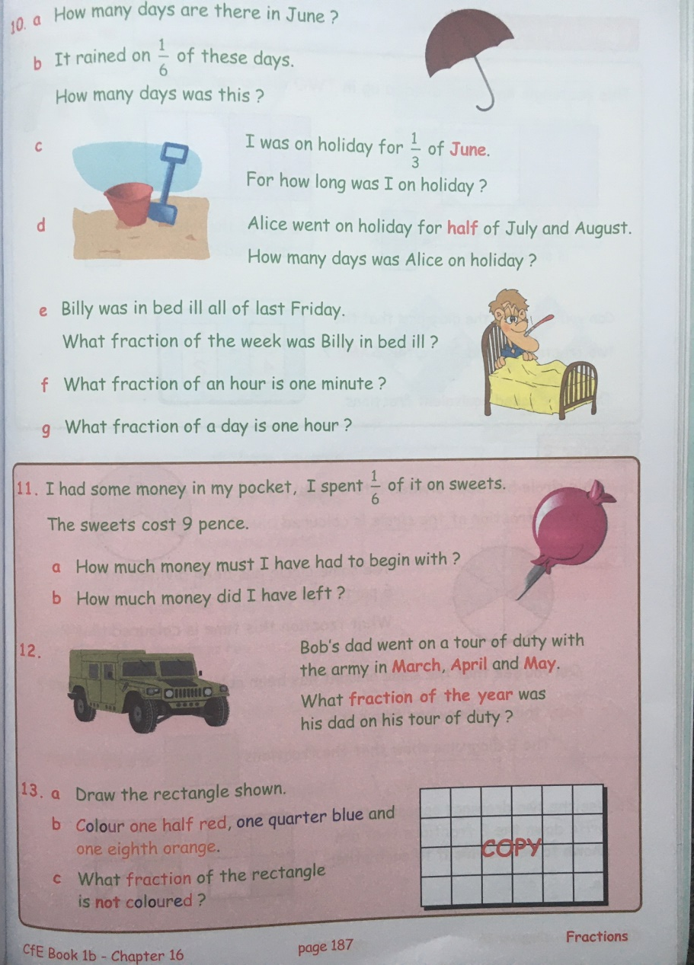
Maths (slide 3)
L.I. I am learning about fractions
Now, try and solve these problems. Remember to use the RUCSAC method as this might help you to understand the question!
Please download the question sheet from Teams or the Blog.

Slide 13
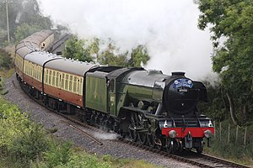
Topic
L.I. I am learning about ‘The Flying Scotsman’ train and can design a poster
Your topic work for today is the same as it was yesterday – I promised you two afternoons to complete it! See the following slides for a reminder of the task.
If you have finished, please fast forward to the last slide. There is an extension task there for this afternoon!
Enjoy!

Slide 14
Topic (slide 1) – Great Scots!
L.I. I am learning about ‘The Flying Scotsman’ train and can design a poster
This is a picture of a very famous steam train called
‘The Flying Scotsman’.
It was built in England in 1923 by a famous railway company called the LNER (London North Eastern Railway).
The train was used to transport people between London and Edinburgh (in only 8 hours!) This was at a time when EasyJet didn’t exist!

Slide 15
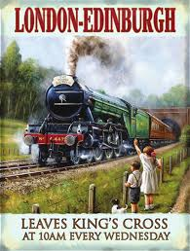
Topic (slide 2) – Great Scots!
L.I. I am learning about ‘The Flying Scotsman’ train and can design a poster
It made the first non-stop train trip between the 2 cities in 1928!
It was also the first steam train to be officially recorded travelling faster than 100 mph (miles per hour). This happened in 1934!

Slide 16
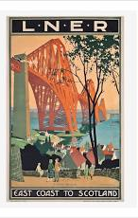
Topic (slide 3) – Great Scots!
L.I. I am learning about ‘The Flying Scotsman’ train and can design a poster
LNER – the company that owned the train and the railway line – designed lots of posters to promote their railway.
They wanted as many people as possible to pay to use the railway and travel to Scotland.
So, they designed lots of posters to encourage people to go! See some of their other posters on the next slides!

Slide 17
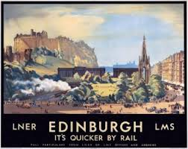
Topic (slide 4) – Great Scots!
L.I. I am learning about ‘The Flying Scotsman’ train and can design a poster

Slide 18
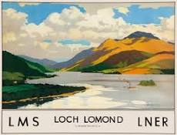
Topic (slide 5) – Great Scots!
L.I. I am learning about ‘The Flying Scotsman’ train and can design a poster

Slide 19
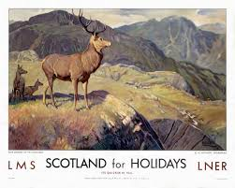
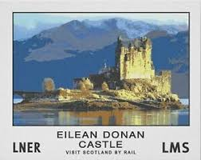
Topic (slide 6) – Great Scots!
L.I. I am learning about ‘The Flying Scotsman’ train and can design a poster

Slide 20
Topic (slide 7) – Great Scots!
L.I. I am learning about ‘The Flying Scotsman’ train and can design a poster
TASK
Design a poster in the style of the LNER posters seen on the previous slides.
Focus on one place in Scotland – it could be a city like Edinburgh or Glasgow or it could be a small town like Armadale! It could even be somewhere in the countryside.
Your poster must have ‘LNER’ on it somewhere. Pretend that you are being employed by the train company to design it!
Post your completed work on Teams!

Slide 21
Topic extension task!
L.I. I am learning about ‘The Flying Scotsman’ train and can design a poster
Do a research project all about steam trains!
How much information can you find out about them?
For example, who invented the steam engine? How do they work? When were they first used? Why do we not use them as much now?
Your report can take any form you wish – for example, a PowerPoint, a poster, a fact file…
Here is a great video clip to get you started!
https://www.bbc.co.uk/bitesize/clips/z8vb4wx

Slide 22
Feel free to leave comments / questions on Teams throughout the day and I will try my best to get back to you. Enjoy your day, Primary 4!

