Slide 1



Tuesday 26th of May
Good Morning Primary 3!
Bonjour la class! Ca Va?
Can you say todays date in French?
Aujourd’hui c’est (M…………) 26th (M…………) 2020
Watch ‘Quel temps fait il?” and see if you can describe todays weather.
Begin by saying - Aujourd’hui c’est …
https://www.youtube.com/watch?v=eBvJVOuBPXI

Slide 2

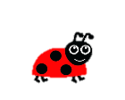

Literacy
LI: We are learning to read and spell this weeks common words.
Read this weeks common words and identify individual sounds and blends within the words.
Spell each word independently
Can you underline the vowels in your spelling words.
Look, cover, write, check

Slide 3

Literacy – Reading
LI: We are learning to read fluently and find common words in our reading books.
Oxford Owl Website – https://www.oxfordowl.co.uk/?sellanguage=en&mode=hub
Username – stantsps3
Password – primary3
Again, you can use a book you have at home also.
Using your reading book, can you complete the read to write task below in your jotter.
the | Page | and | Page | a | Page

Slide 4
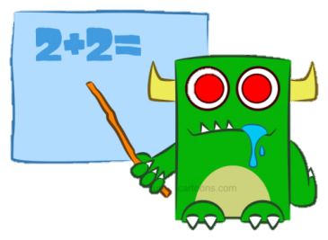

Numeracy – Warm Up
LI: We are learning to count in 2s, 5s and 10s.
https://www.youtube.com/watch?v=q_yUC1NCFkE
Jack Hartmann - Workout and Count

Slide 5
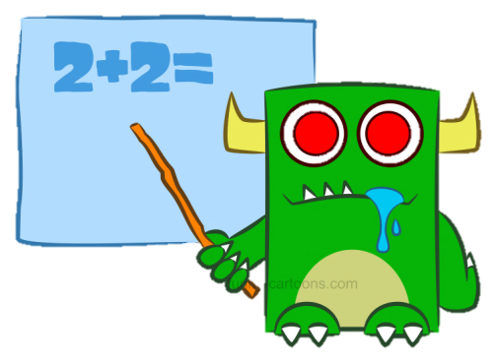
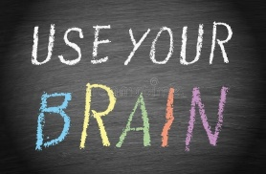
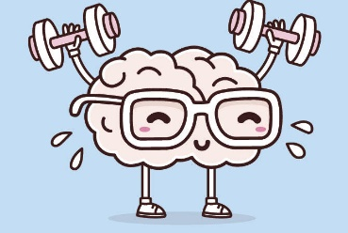
Number Talk
LI: We are learning to solve number problems mentally.
Remember – Number Talks are all about how you solve a task, mentally. For this activity, don’t use anything to help you, just use your brain!
8 times 3 =
18 divided by 3 =
12 + 13 =
8 + 7 =
What strategy did you use? Did your parent use the same one?

Slide 6
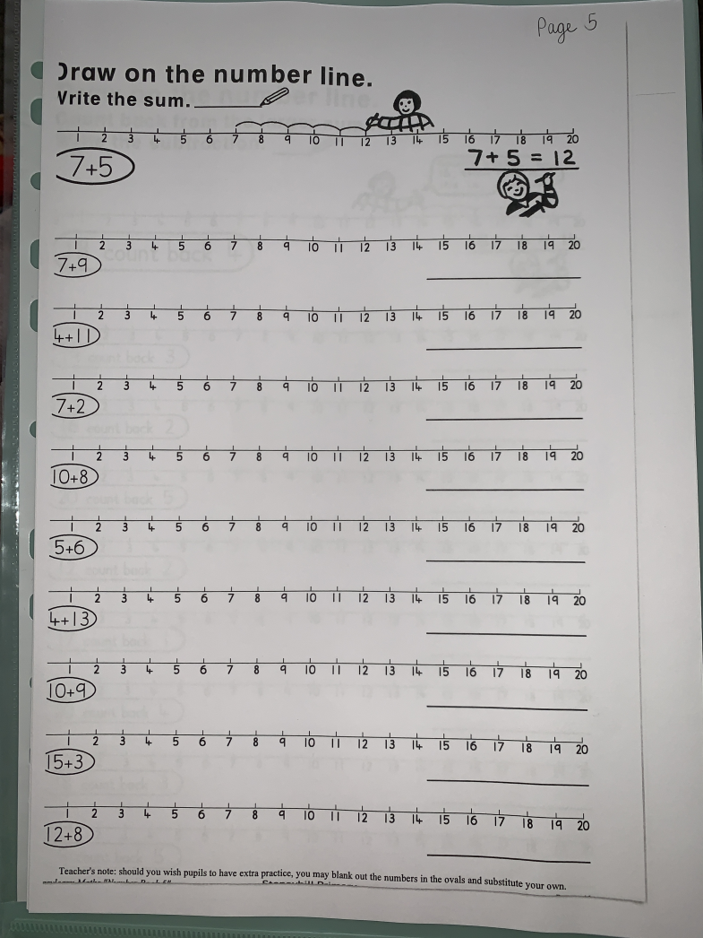
Numeracy Activities
LI: We are learning to develop a range of addition and subtraction strategies.
Addition and Subtraction Workbook
Please complete Page 5

Slide 7
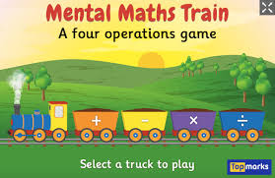
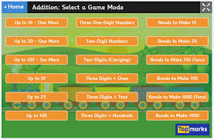
Numeracy Game
Mental Maths Train - https://www.topmarks.co.uk/maths-games/mental-maths-train
Click on either the + or – button.
When you click on addition, you can choose any category to complete.
Red Square – Easy
Blue Square – Medium
Yellow Square - Hard

Slide 8
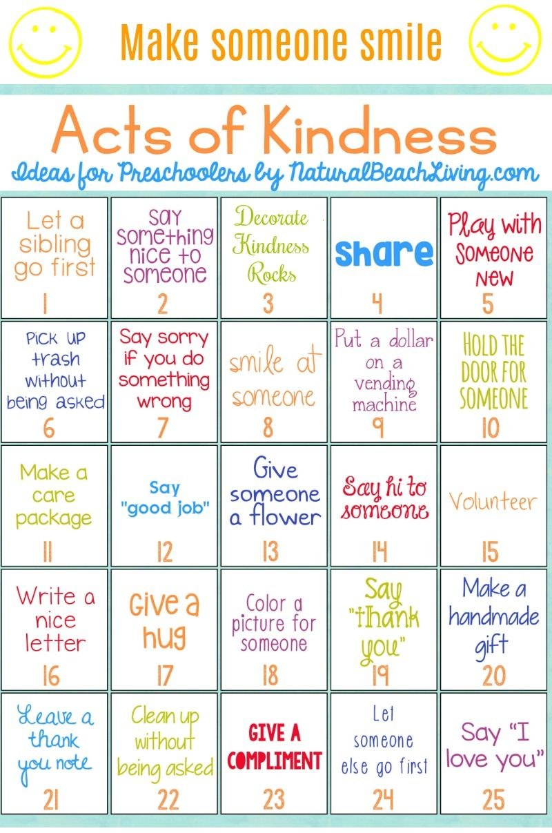
Health and Wellbeing
LI: We are learning to be aware of others feelings and show acts of kindness.
It is very easy to show someone you care.
Can you choose an act of kindness from the picture to complete today?

Slide 9
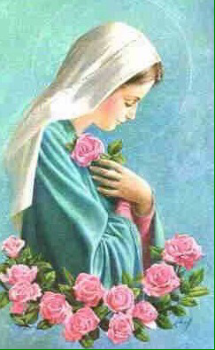
R.E
LI: I can recognise the importance of prayer and honour Mary as the mother of Jesus.
Images of Mary often show her among roses. These can remind us to thank God for all the beautiful things he created. Take a walk outside and take time to look closely at the flowers, tree and plants. Whisper a prayer of thanks to God our creator.
Sing along to a well known hymn dedicated to Mary:
https://www.youtube.com/watch?v=lPISwWu7IKA

Slide 10
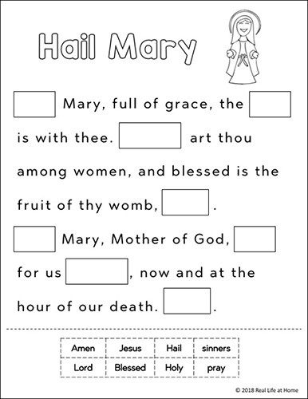
Handwriting
Can you complete this worksheet in your jotter.
Work out what words are missing from the prayer.
Copy the completed sentences into your jotter – remember this is a handwriting task so you should take your time to make sure the letters are formed correctly.
Now you should have a completed prayer I would like you to say the prayer with your family.

Slide 11
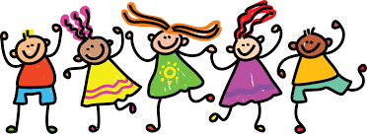
Great work P3!
Enjoy the rest of your day!
☺

