Slide 1


Tuesday 26th of May
Good Morning Primary 1!
Bonjour la class! Ca Va?
https://www.bbc.co.uk/cbeebies/watch/presenters-daysoftheweekmonday
Sing the months of the year song
Sing days of the week in French
https://www.youtube.com/watch?v=Lpwf5N0rfVE

Slide 2


French
Consolidation Week
Please access the Linguascope website where you will be able to find French games, video clips and worksheets to do with your child.
Please choose a topic from the following list.
All of these topics have been covered in class.
French greetings
Numbers to 10
Colours
https://www.linguascope.com/
student username- stanthonys
student password – stant123

Slide 3

Literacy
We are learning to read and spell our common words.
Sing the alphabet and vowel song
Sing and complete actions to jolly phonics alphabet songs
https://www.youtube.com/watch?v=U2HYM9VXz9k&t=630s
Watch- https://www.youtube.com/watch?v=JwKzRjFRPk0
Task
Can you roll and spell these words
across and table with a partner?
Example: m oo n
Boom
room
doom
pool
soon

Slide 4
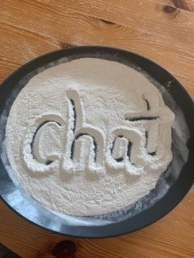
Active Spelling Challenge
Stone Words
Write sounds on stones and make some of your spelling words. Take a photo.
Play no look
Jumping Sounds
Say the word then jump for each sound, shouting them out as you jump.
Extra Challenge
Can you write a silly sentence using your common words this week.
Remember your core writing targets.
Flour/Salt/Sand Writing
Spell words using finger or paintbrush. Put coloured paper under the flour, salt or sand to make the letters stand out.
If possible try one of these activities and send me a photo.

Slide 5

Reading
Using your online reading book from yesterday can you
complete the read to write task below in your jotter.
Book title – ________________
Can you find any of these words in your book? Remember to write the word then the page number.
https://www.oxfordowl.co.uk/?sellanguage=en&mode=hub
username: stanothnysp12 password: homelearning*1
play | page | no | page | look | page | the | page

Slide 6

Story time
https://www.youtube.com/watch?v=E_-QFAfKZ3s

Slide 7
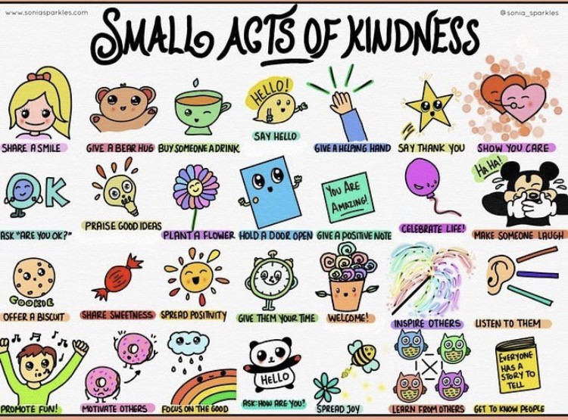
Health and Wellbeing
L.I - I am aware of others feelings and can show acts of kindness.
Can you choose a small act of kindness from above and show someone you care?

Slide 8


Mathematics
Warm up
L.I – I can read and recognise the number names to 10 or to 20.
Watch: https://vimeo.com/420569607
Play: http://www.sheppardsoftware.com/mathgames/earlymath/fruitShootNumbersWords.htm

Slide 9
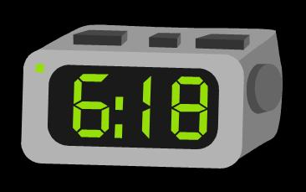
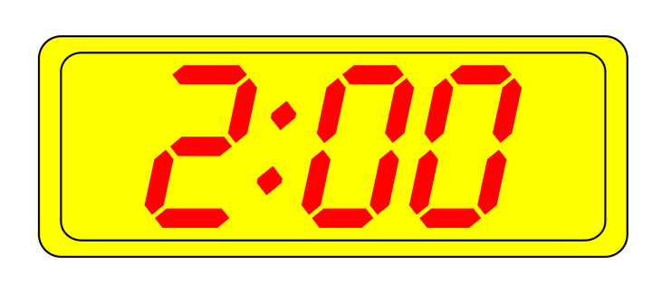
Digital Time
We are learning to read time on a digital clock
Play
https://mathsframe.co.uk/en/resources/resource/116/telling-the-time
Watch
https://www.youtube.com/watch?v=ENOYemdWU08
Write
Complete workbook page on digital time.

Slide 10
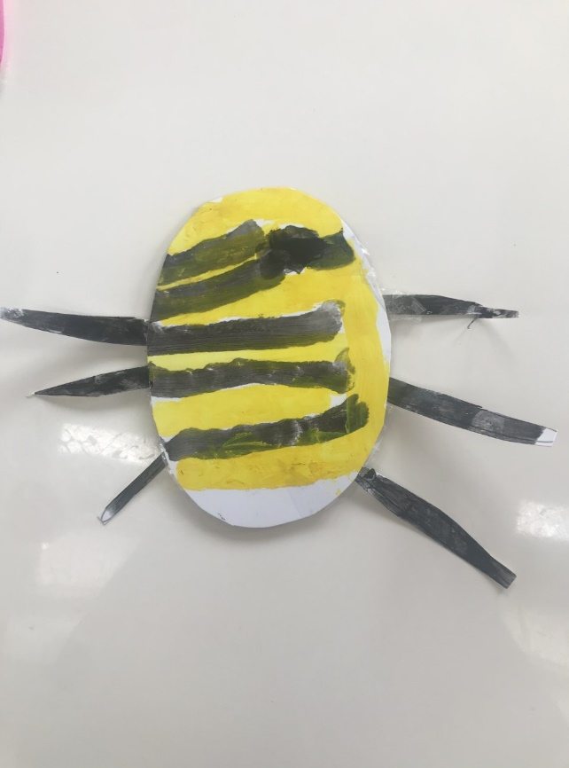
Topic - play
Today we are going to make our own moving toy!
You will need:
Sturdy paper/ cardboard
String
Straw
Sticky tape
Steps:
1 . Draw your own design onto the card, colour and cut out.

Slide 11
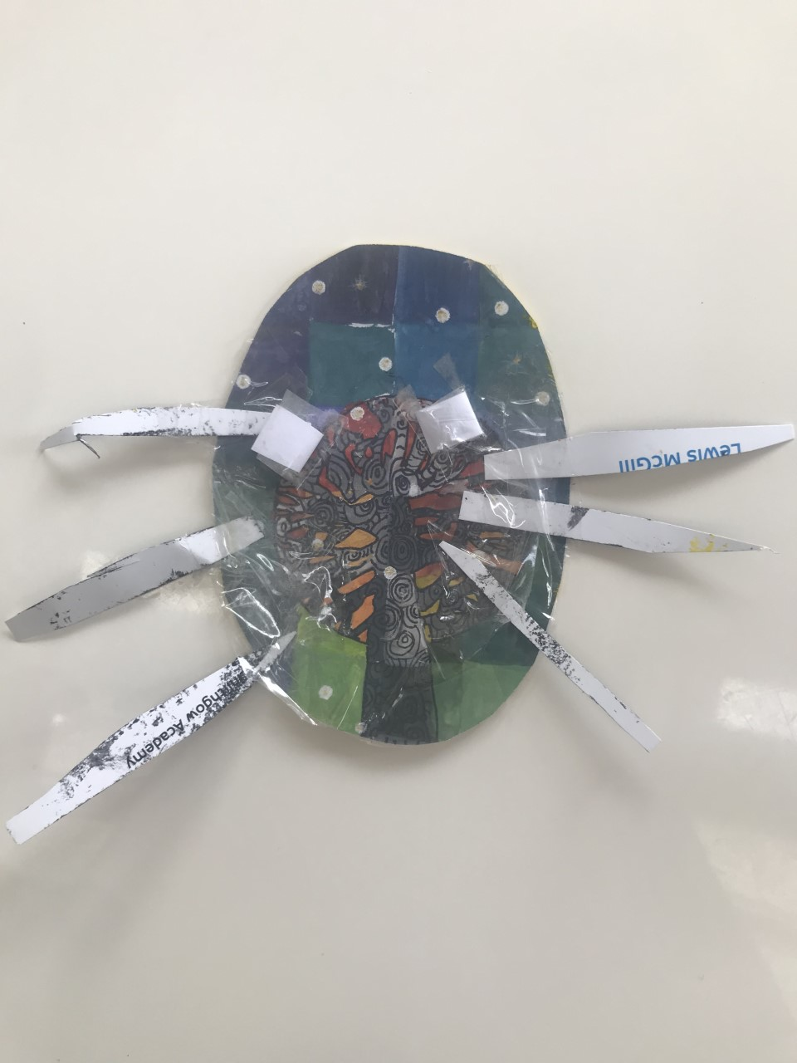
2. Cut two 1.5 inch pieces off your straw. Tape them onto the back of your design at a slight angle (so they are pointing closer together at the top)

Slide 12
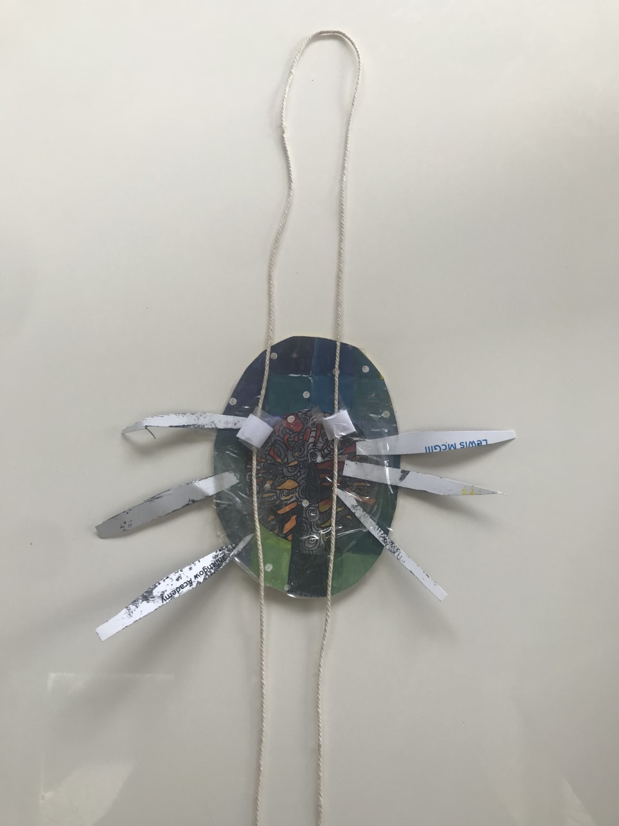
3. Take a piece of string about 4 feet long and thread both ends through the two straw pieces so that you form a giant loop above your design.

Slide 13
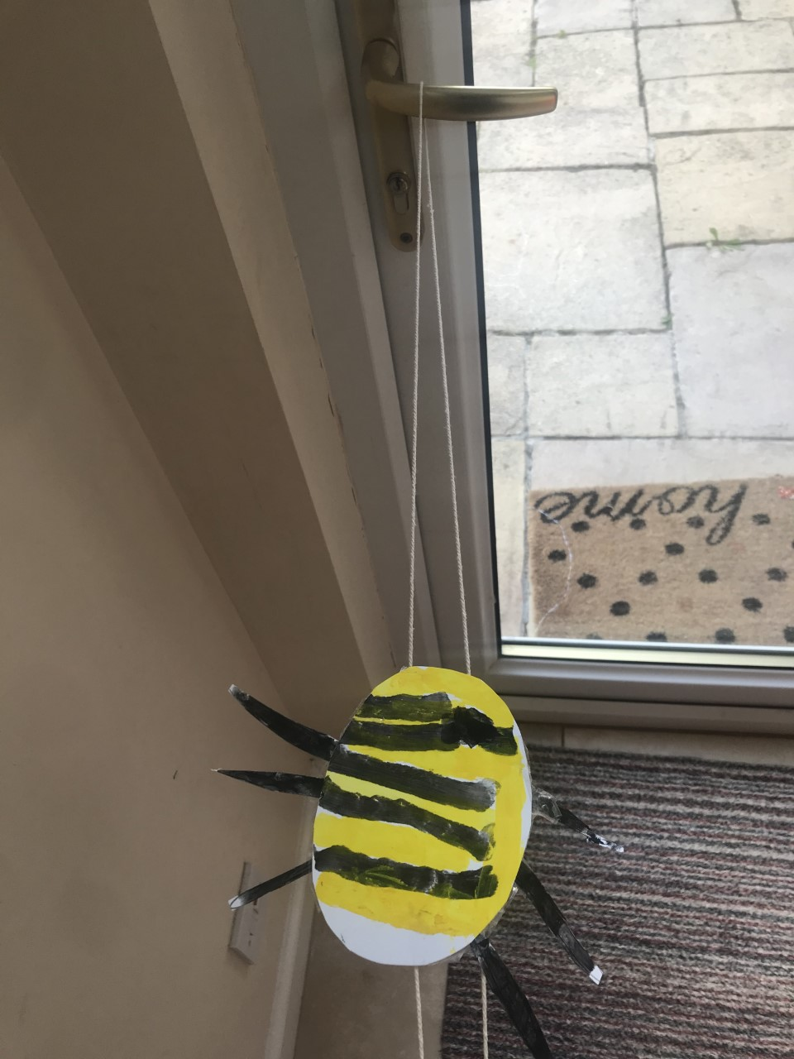
4. Hang your gliding toy onto a doorknob or from the ceiling.

Slide 14
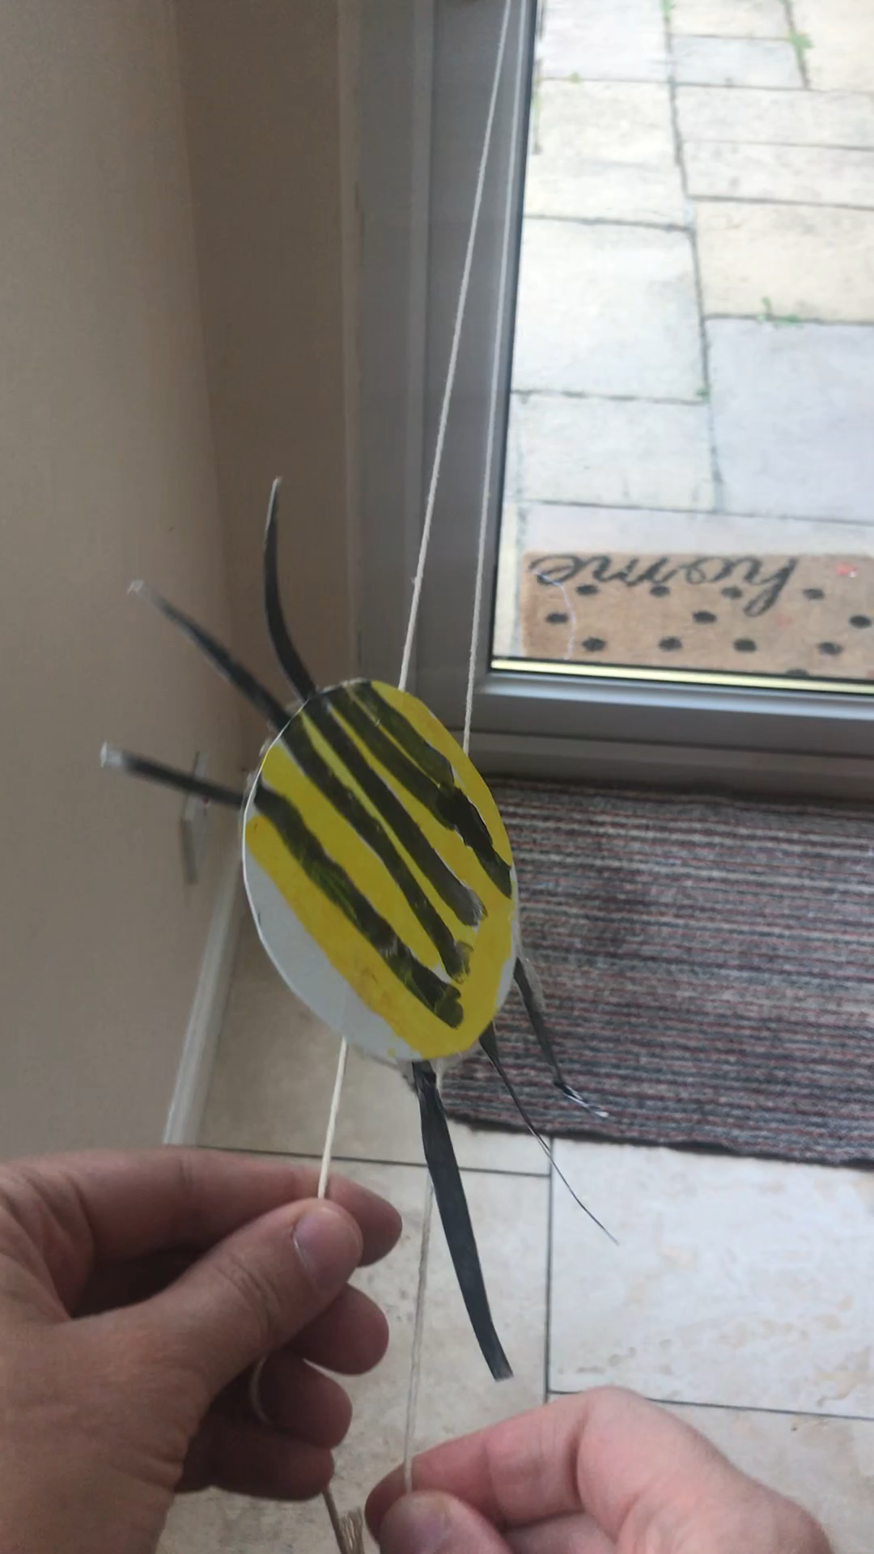
5. Grab one end of the string in each hand and pull out and away from the design
We can’t wait to see your homemade toys!! Remember to upload your pictures on twitter

Slide 15
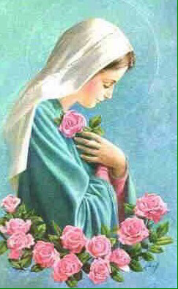
R.E
L.I – I recognise the importance of prayer and honour Mary as mother of Jesus
Images of Mary often show her among roses. These can remind us to thank God for all the beautiful things he created. Take a walk outside and take time to look closely at the flowers, tree and plants. Whisper a prayer of thanks to God our creator.
Sing along to a well know hymn dedicated to Mary:
https://www.youtube.com/watch?v=lpiswwu7ika
* A worksheet has been attached to the blog if you want to print off and complete.

