Slide 1
Good Morning P5/4
Week 9 Home Learning
Tuesday 26th May 2020

Slide 2
Aujord’hui c’est mardi vingt-six mai.
Je suis content(e)
Je suis d’accord
Je suis mal
Il fait beau.

Slide 3
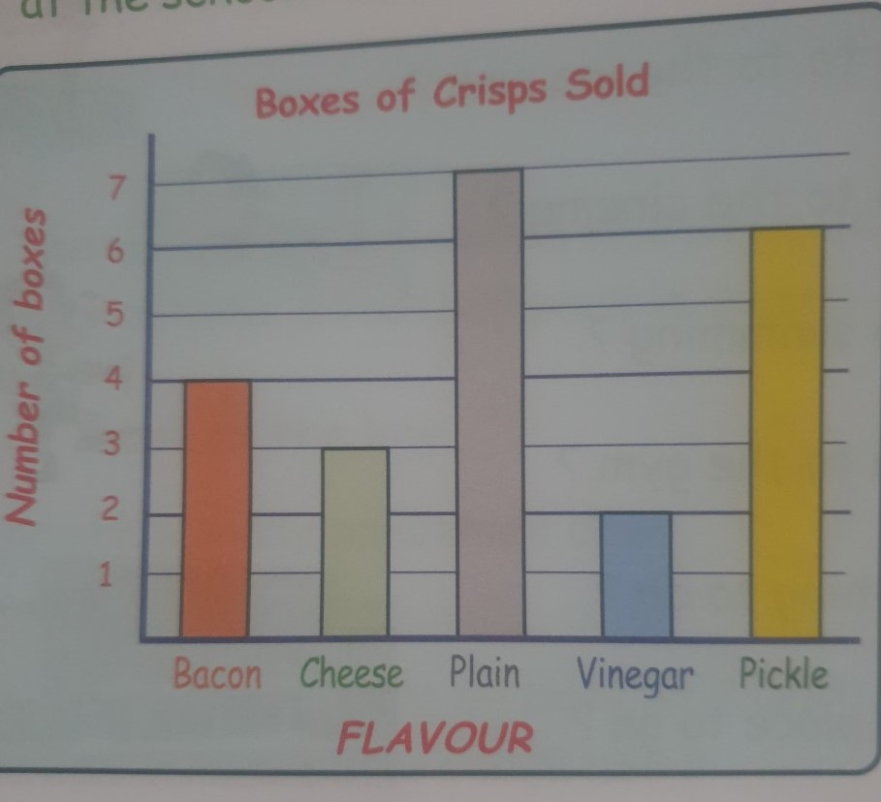
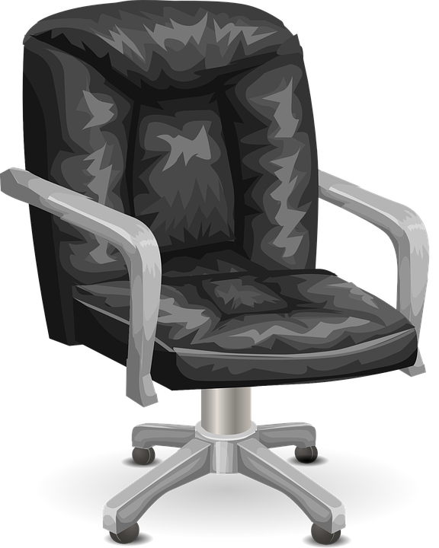
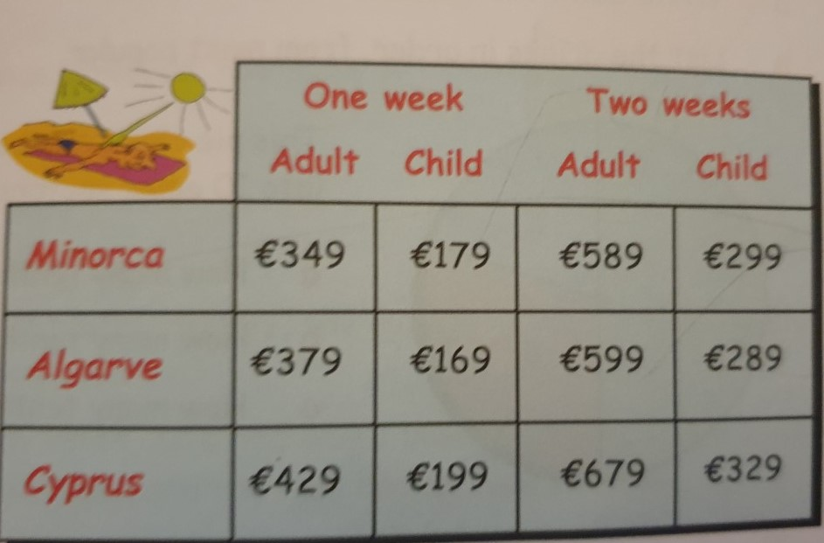
Morning Starter
This bar graph shows the number of boxes of crisps eaten at the school disco.
a. How many boxes of each were eaten?
b. What was the most popular flavour of crisp?
c. What was the least popular flavour?
Trev has 9 pairs of socks in his drawer.
2 pairs are red and 7 pairs are white.
Which colour is he less likely to choose?
This holiday table shows the prices for each adult and each child.
How much would it cost for each of the following holidays:
a. Minorca, 1 adult for 1 week.
b. Cyprus, 1 adult for 2 weeks.
c. Mr Stewart, his wife and 3 children for two weeks in the Algarve?

Slide 4
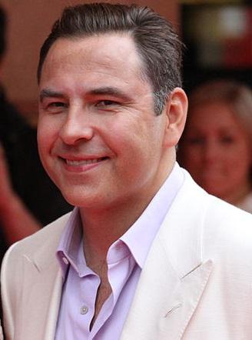
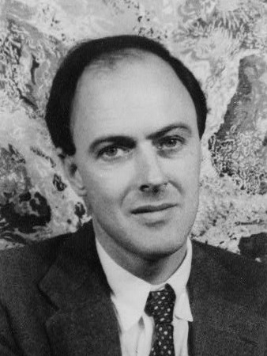
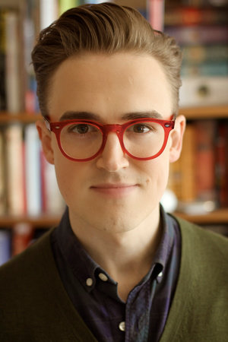
Spelling: Phonics Board
‘au’
Reading: The Messy Magpie
Task – Adding suffixes
There is a green, amber and red to choose from depending on how you want to challenge yourself.
Literacy Task Board
Spelling: Diacritical marking
Primary 4 – unit 5 ‘oo’ - Core
Primary 5 – unit 12 ‘ch’ - Core
Reading:
Task - Visuliser
Spelling: Diacritical marking
Primary 4 – unit 5 ‘oo’ - Core
Primary 5 – unit 12 ‘ch’ - Core
Reading:
Task – Main
Ideas

Slide 5
Use this Scavenger Hunt on your daily exercise walk
You will need an adult helper for today’s task:
Kitchen Measuring
Remember to check sumdog for groups!
Websites for all groups to use:
You will need an adult helper for today’s task:
Kitchen Measuring

Slide 6
Bridges!
Complete this booklet with the relevant information.
I know some of the countries in it are not European, feel free to just focus on the European ones and when it asks you to find other bridges in other countries, please pick European countries.

