Slide 1

Tuesday 26th May
Good morning primary 2!
Bonjour la class! Ca va?
https://www.youtube.com/watch?v=nxkj88ygpy0
L.I – I can say some simple greetings in French

Slide 2
Literacy
ss
L.I – We are learning to read and write this weeks common words
Can you read the following common words?
four miss never these
Spelling Tasks
Copy out your spelling words and underline the vowels
Select one or two of your spelling words and write an interesting sentence then illustrate it!

Slide 3
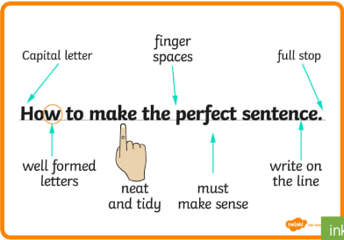
Jumbled Sentences
funny a The blue hat. clown has
red The ran the across rabbit road.
having My a dog treat. yummy is
Can you unjumbled the sentences above and write them carefully in your jotter?

Slide 4

Reading
https://www.oxfordowl.co.uk/?sellanguage=en&mode=hub
username: stanothnysp12 password: Homelearning*1
L.I - I can use my knowledge of sounds, letters and patterns to read words.
* Task - Using your online reading book from yesterday draw a new front cover for your book.

Slide 5

Story time
https://www.youtube.com/watch?v=E_-QFAfKZ3s

Slide 6
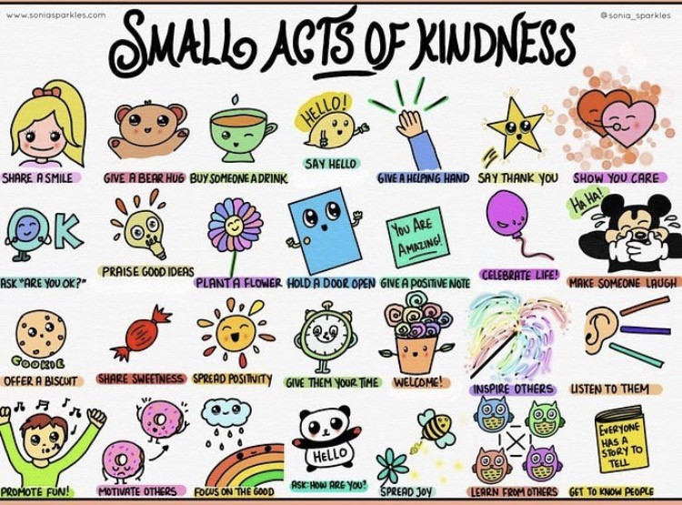
Health and Wellbeing
L.I - I am aware of others feelings and can show acts of kindness.
Can you choose a small act of kindness from above and show someone you care?

Slide 7


Mathematics
Warm up
Numbers names to 20
L.I – I can read and recognise the number names to 20.
Watch: https://vimeo.com/420569607
Play: http://www.sheppardsoftware.com/mathgames/earlymath/fruitShootNumbersWords.htm

Slide 8
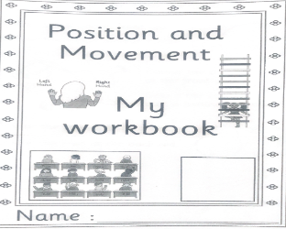
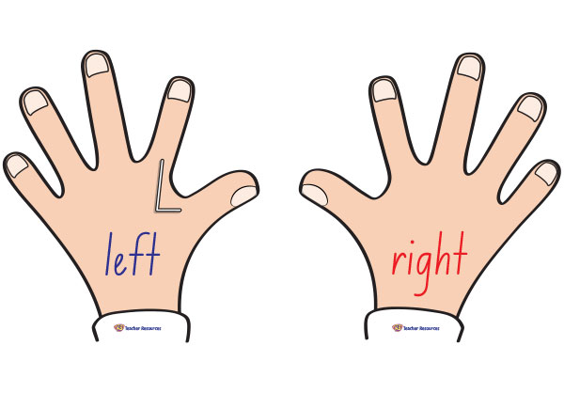
Mathematics
Position and Movement
L.I – I can describe the position of an item using the correct language
Watch -https://www.youtube.com/watch?v=p5ercdnonkg
Position and Movement workbook – Complete page 300 ‘left and right’ in your workbook.

Slide 9
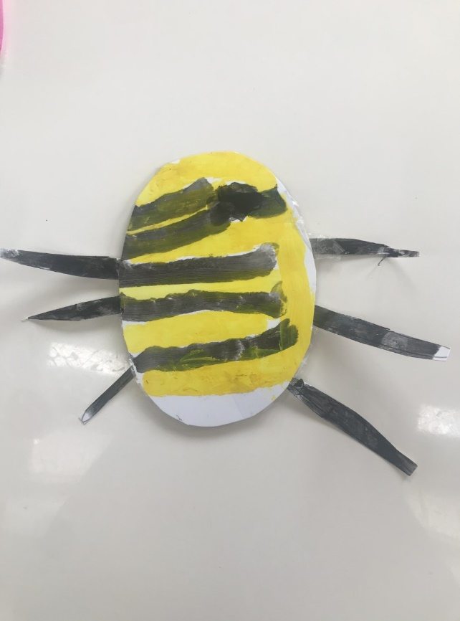
Topic - play
Today we are going to make our own moving toy!
You will need:
Sturdy paper/ cardboard
String
Straw
Sticky tape
Steps:
1 . Draw your own design onto the card, colour and cut out.

Slide 10
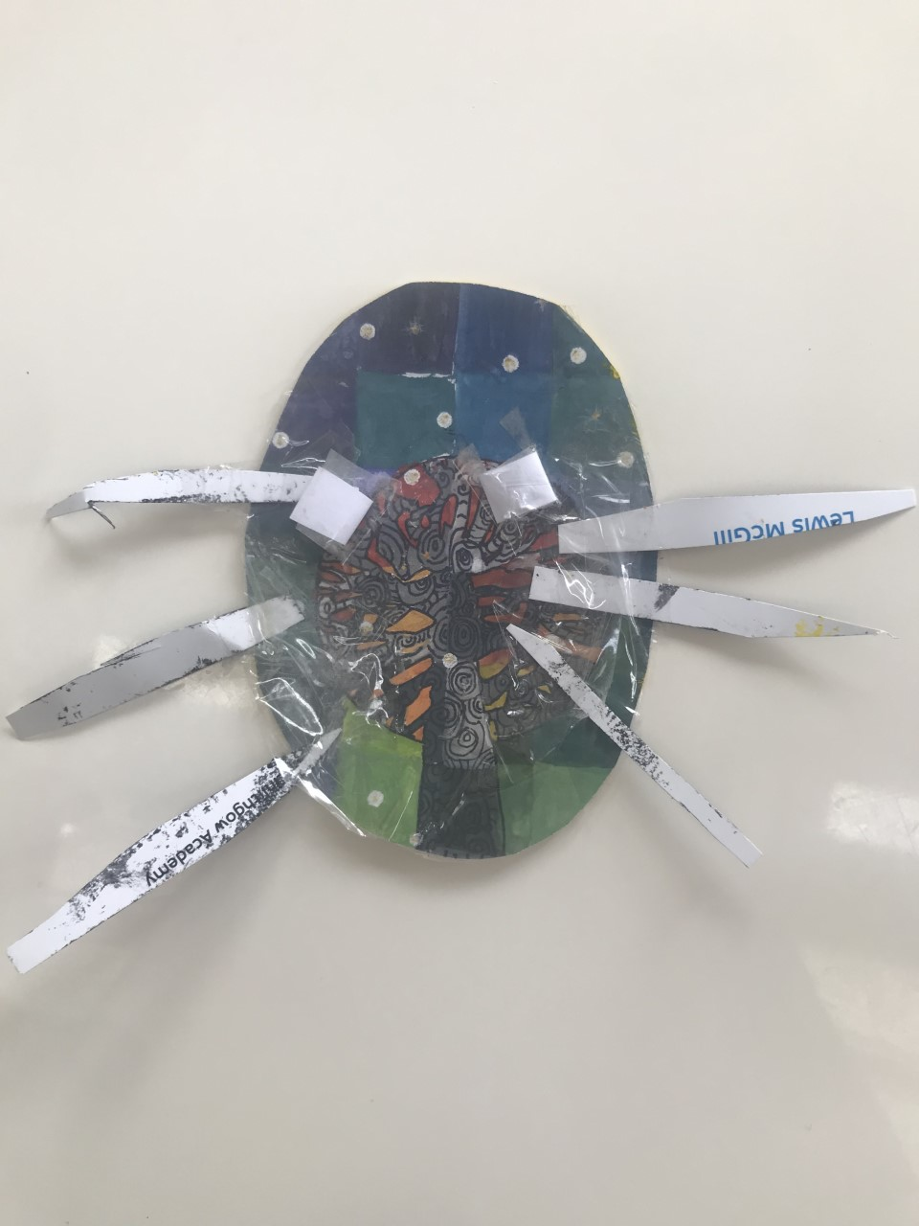
2. Cut two 1.5 inch pieces off your straw. Tape them onto the back of your design at a slight angle (so they are pointing closer together at the top)

Slide 11
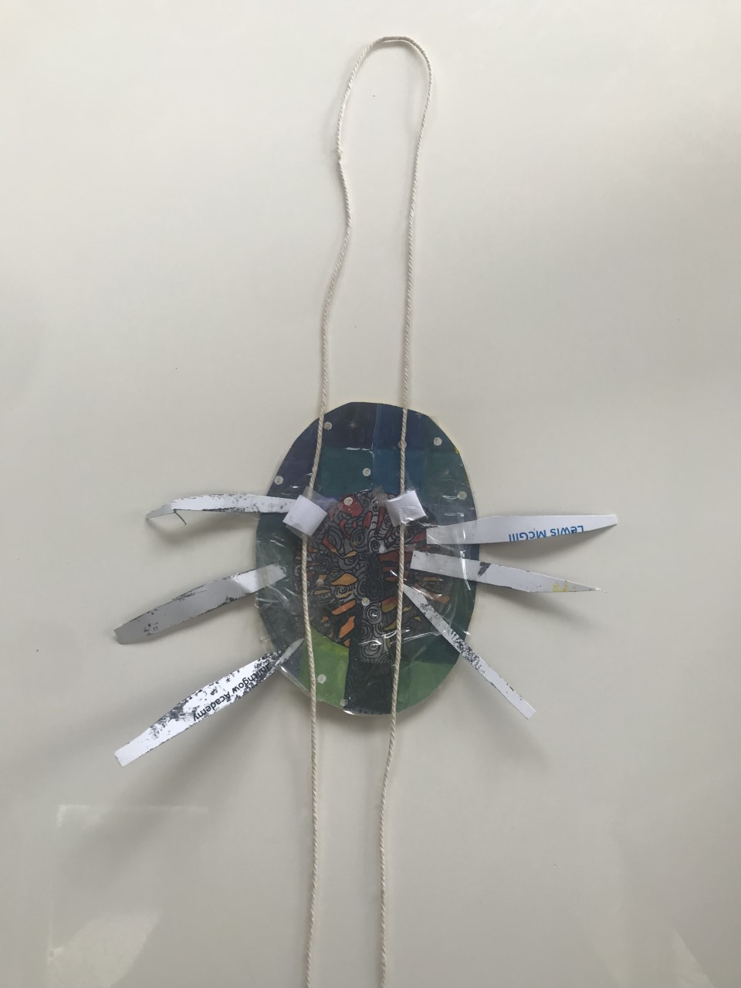
3. Take a piece of string about 4 feet long and thread both ends through the two straw pieces so that you form a giant loop above your design.

Slide 12
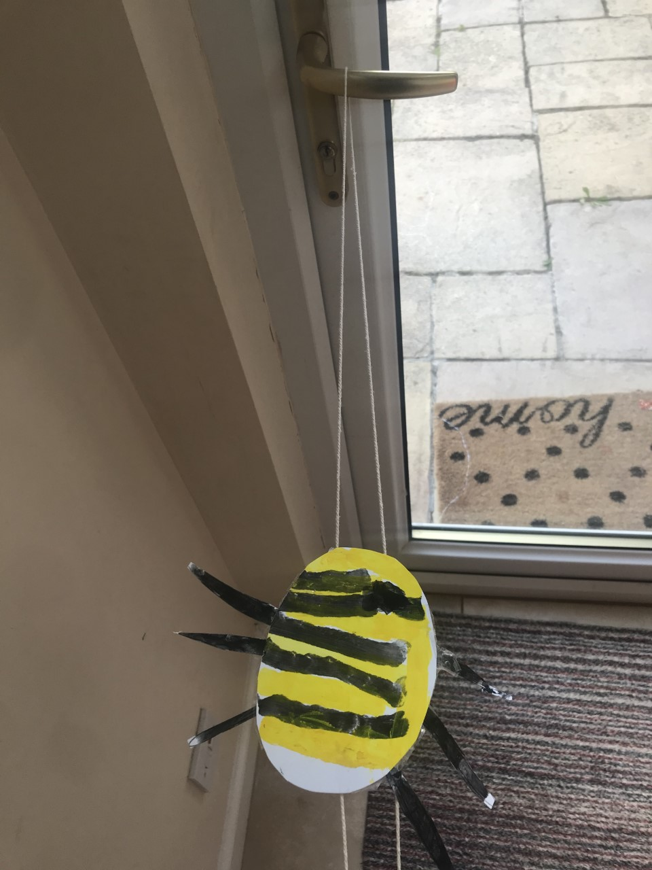
4. Hang your gliding toy onto a doorknob or from the ceiling.

Slide 13
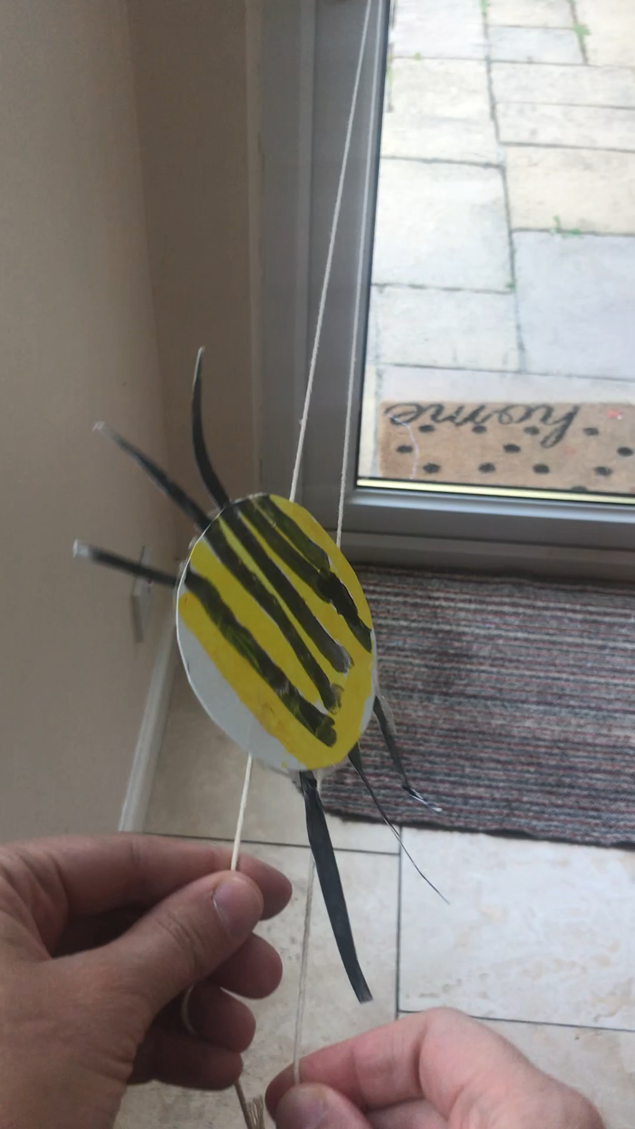
5. Grab one end of the string in each hand and pull out and away from the design
We can’t wait to see your homemade toys!! Remember to upload your pictures on twitter

Slide 14
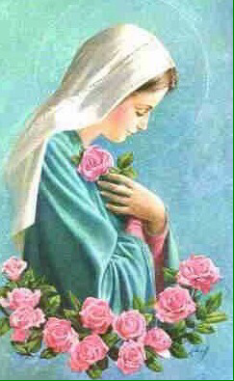
R.E
L.I – I recognise the importance of prayer and honour Mary as mother of Jesus
Images of Mary often show her among roses. These can remind us to thank God for all the beautiful things he created. Take a walk outside and take time to look closely at the flowers, tree and plants. Whisper a prayer of thanks to God our creator.
Sing along to a well know hymn dedicated to Mary:
https://www.youtube.com/watch?v=lpiswwu7ika
* A worksheet has been attached to the blog if you want to print off and complete.

