Slide 1
Tuesday 26th May

Slide 2
Timetable
French
Daily exercise
Spelling
Reading
Maths
Leader in me.

Slide 3
French Starter
Can you write today’s date in French?
Quelle est la date aujourd’hui?
e.g. C’est lundi vingt avril
Can you also write today’s weather in French?
Quel temps fait-il?
Il pleut/ Il fait beau/ Il fait froid/ Il y a du vent/
Il fait mauvais/ Il y a des nuages/ Il y a du soleil

Slide 4
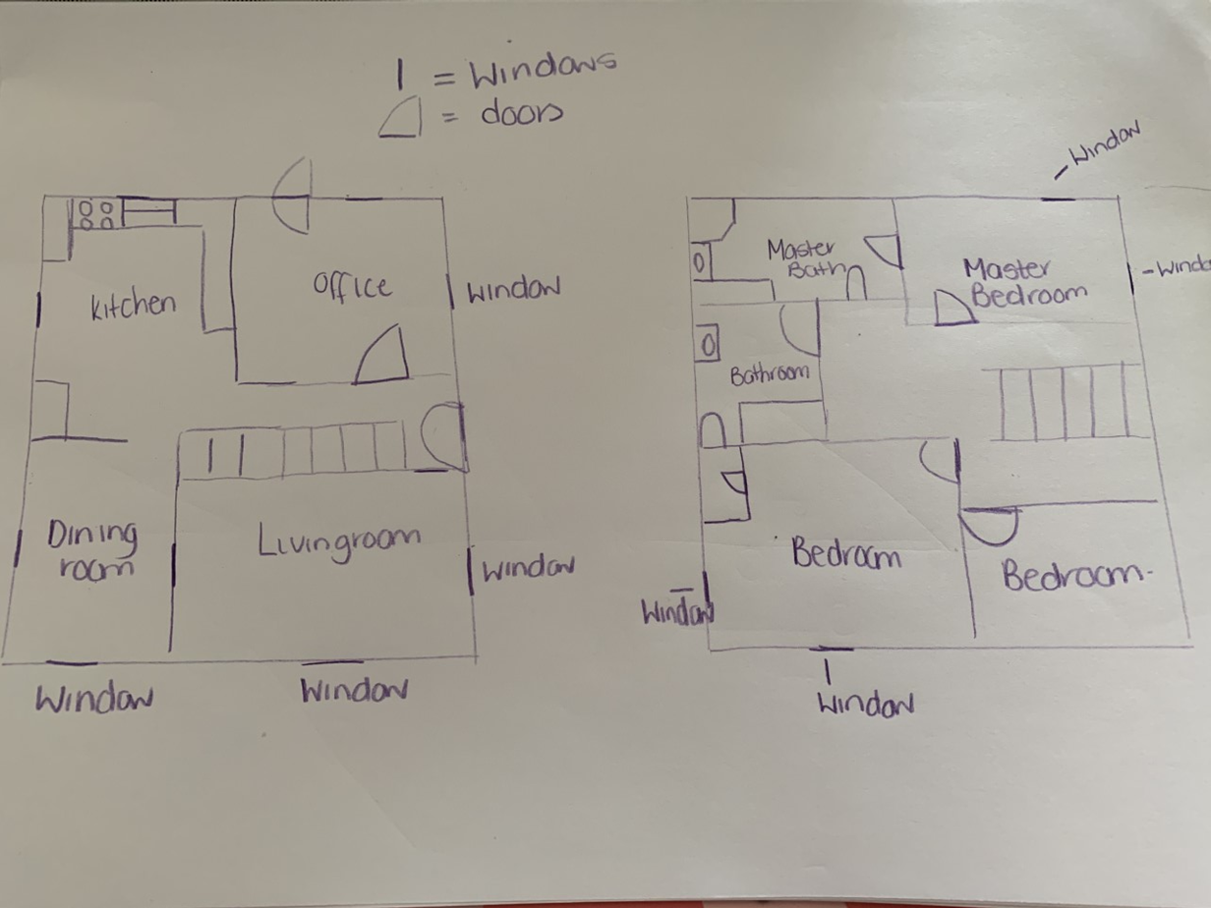
French continued
The other week we drew a bird’s eye view of our ideal home. Can you use your ideal plan to label the rooms in French?
Bedroom – La chamber
Kitchen – la cuisine
Garden – le jardin
Bathroom – la salle de bains
Dinning room - la salle a manger
Livingroom – le salon
Office – le bureau

Slide 5
Daily exercise
I am learning to move our body well, exploring how to manage and control it, finding out how to use and share space.
I have been going out a daily walk to look at the new plants growing. If you can get outside for some fresh air that would be great. Remember to only do this if it is okay with parents. If not I have attached below the link to Joe Wicks workouts. I have been trying these myself at home!
https://www.youtube.com/watch?v=Na1rzigYlSU

Slide 6
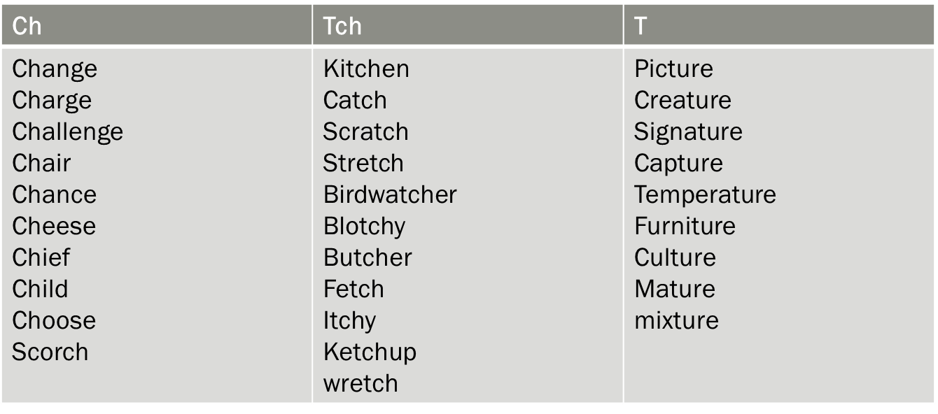
Spelling – I am learning to use various spelling strategies.
Syllabification – choose 6 – 8 words from the lists below. Remember each break needs to contain a vowel.

Slide 7
Reading Starter
Log on to Sumdog and complete grammar challenge. This will be live till Thursday.

Slide 8
Reading – I am learning to decipher the meaning of a word.
Read the next chapter from your book at home. Select 6 tricky words or words that you are not familiar with.
Use the metalinguistic strategies to work out the meaning of these words.
Once you have written down what you think each word means, check its meaning in a
dictionary. Remember that some words have more than one definition, so you need to
select the most appropriate meaning for the word in the context of the text you are
reading.
Copy down the most appropriate definition of the word into your jotter.
Remember to use the correct spelling, punctuation and neat handwriting and presentation
at all times.
If you cannot remember how to use the strategies select 6 words, write what you think, what someone else thinks and then dictionary definition.
Strategies – RO – Read on, RB – Read back, FW – Familiar word, RW – Replace word, PD – Partner discuss

Slide 9
Maths Starter
https://mathsbot.com/#Question%20Generators

Slide 10
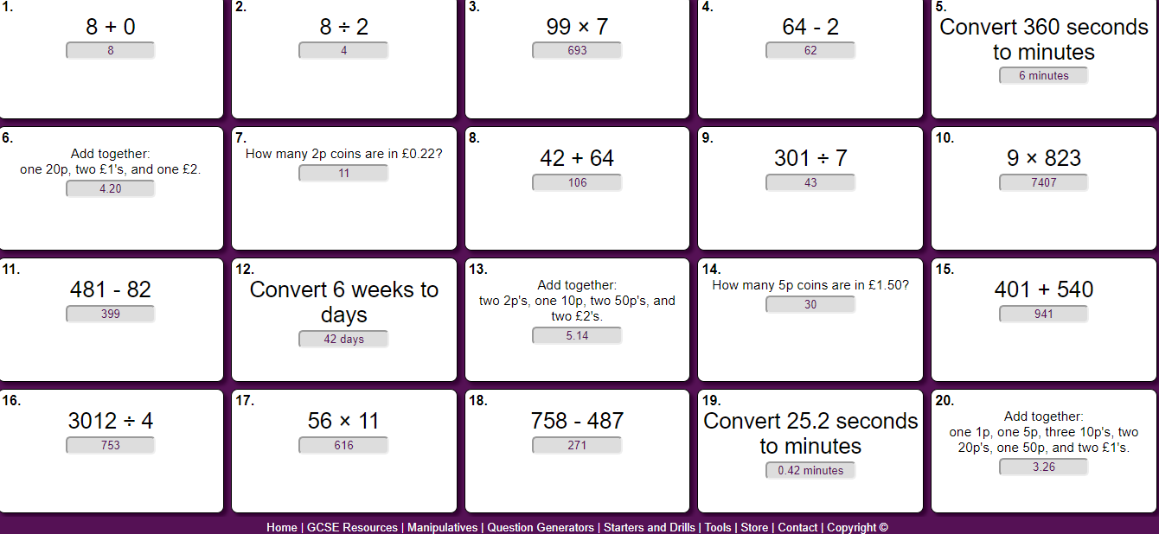
Maths answers
https://mathsbot.com/

Slide 11
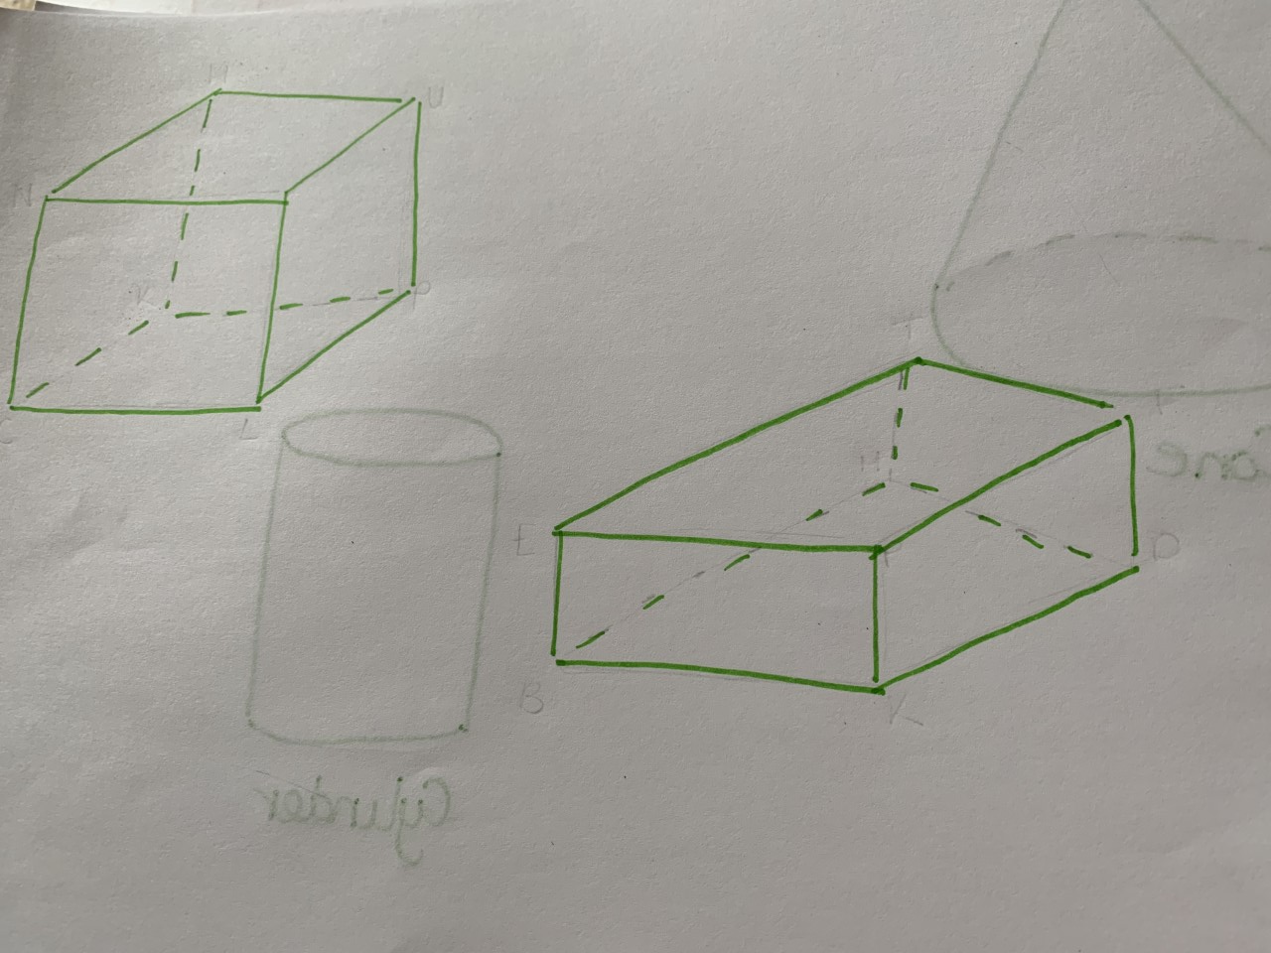
Maths – 3 shapes.
I can identify what makes a 3d shape – vertices, edges and faces.
Look a the two shapes-
a) Name the shapes
b) How many faces does it have?
c) How many vertices (corners)?
d)How many edges does it have?
Do you notice anything similar about them?

Slide 12
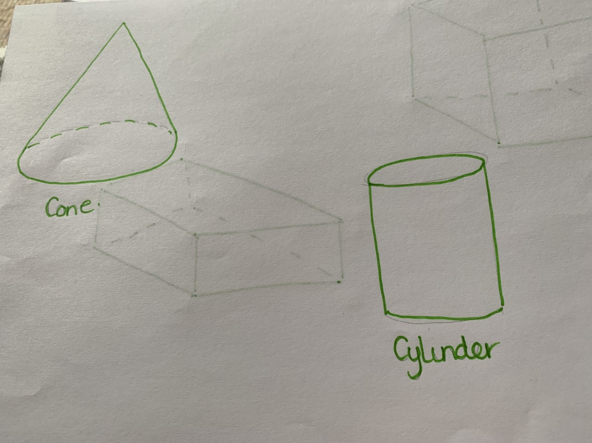
Maths – 3 shapes
A sphere has only one face(surface) and it is curved. Look at the two shapes below, describe the faces of the shapes.

Slide 13
Answers
Cube – 6, 8,, 12
Cuboid – 6, 8, 12.
A cone has one curved surface that goes right round it. It also has one flat face.
Cylinder - has one curved surface and 2 flat surfaces(faces) in the shape of a circle.

Slide 14
Leader in me
Habit 5 Is all about the power of listening.
We know that everybody wants to be listened to. When people feel like you listen, they feel appreciated.
What are some ways you can show you are listening? | What is a good listener? Create a list of people you know that listen well.

