Slide 1
Tuesday 26th of May
Good Morning Primary 2/3!
French: Bonjour la class! Ca Va?
Aujourd’hui cest Mardi 26th Mai 2020
L.I- To ask someone’s age and give a response.
Watch: https://www.youtube.com/watch?v=6dtoYs-2TDs
Quelle age a tu?
What age are you?
Jai six/sept/huit ans. Et toi?
I am six/seven/eight years old.And you?
Jai ________ ans.

Slide 2
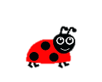
Literacy
LI: We are learning to read and spell this weeks common words.
Sing with Mr Mac- Boom shake the Alphabet https://www.youtube.com/watch?v=Emb2yvwAHtc
Common words:
Stage 2 words- four, miss, never, these
Stage 3 words-list, most, must, high, late
Write your words out and underline the vowels in red.
Choose a couple of your words and write a sentence for each one.

Slide 3
Jumbled Sentences
funny a The blue hat. clown has
red The ran the across rabbit road.
having My a dog treat. yummy is
mess in There bedroom. a the was
Can you unjumbled the sentences above and write them carefully in your jotter?

Slide 4
Reading
https://www.oxfordowl.co.uk/?sellanguage=en&mode=hub username: stantsps password:homelearning
Use this week’s reading book:
Create a new front cover for the book you are reading.

Slide 5
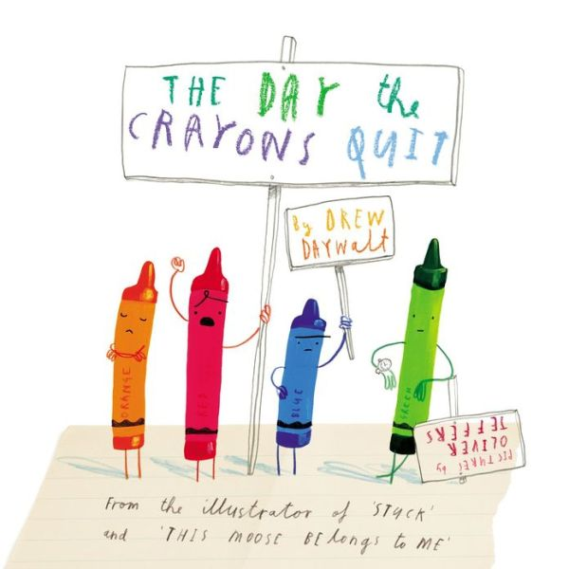
Story time https://www.youtube.com/watch?v=489micE6eHU

Slide 6
Numeracy – Warm Up
LI: To use mental strategies to solve maths problems and be able to explain my strategy

Slide 7
2 + 3 + 2 = 7
2 + 3 + 2 = 7
4 + 4 – 1 = 7
9 – 2 = 7
5 + 2 = 7
3 + 3 + 1 = 7

Slide 8
www.stevewyborney.com

Slide 9
www.stevewyborney.com
www.stevewyborney.com

Slide 10
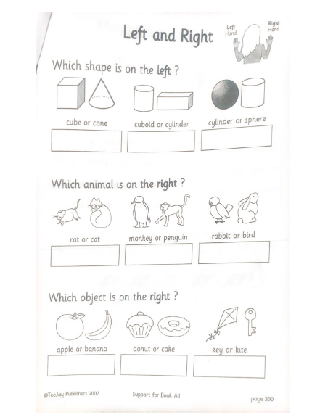
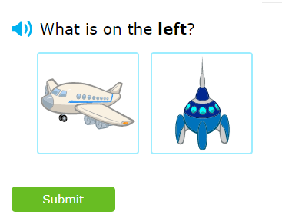
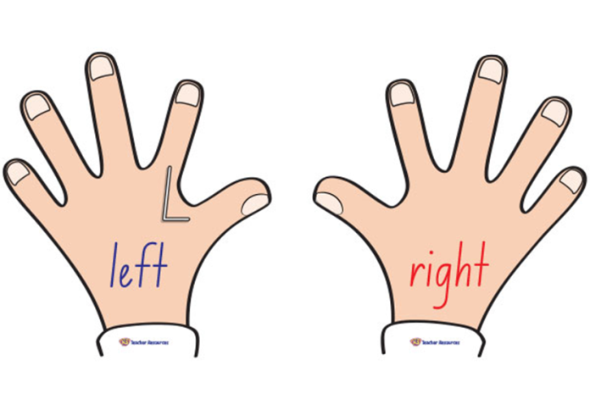
P2 Maths Activities
L.I – I can describe the position of an item using the correct language
Complete page 6 in your workbook
Play: IXL Maths https://uk.ixl.com/math/year-2/left-middle-and-right

Slide 11
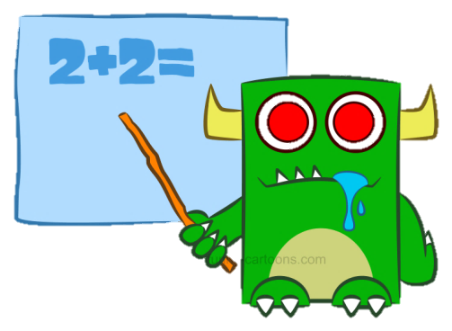
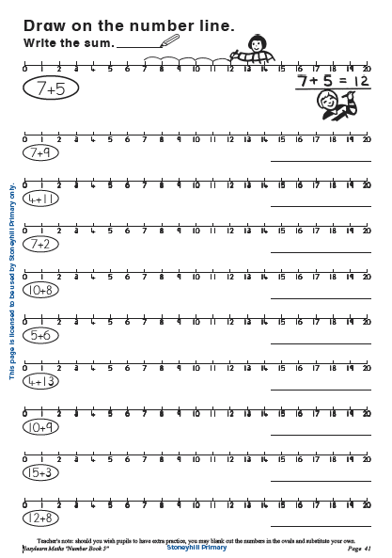
P3 Numeracy Activities
LI: To use counting on and addition strategies to find the total
Addition and Subtraction workbook
Please do this page of your
booklet.
2. Missing addend
https://toytheater.com/missing-addend/

Slide 12
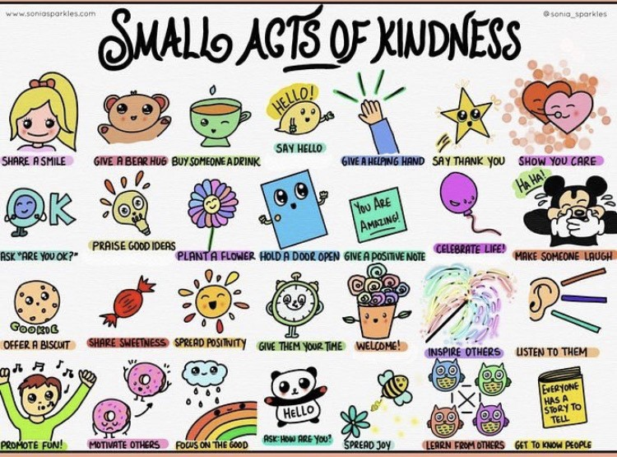
Health and Wellbeing
L.I - I am aware of others feelings and can show acts of kindness.
Can you choose a small act of kindness from above and show someone you care?

Slide 13
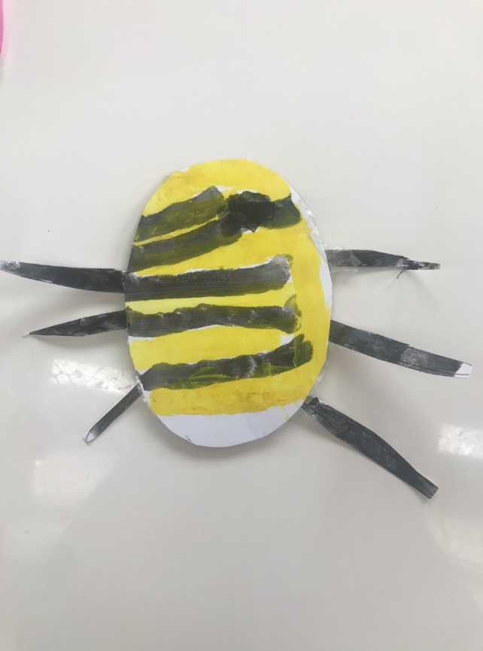
Topic - play
Today we are going to make our own moving toy!
You will need:
Sturdy paper/ cardboard
String
Straw
Sticky tape
Steps:
1 . Draw your own design onto the card, colour and cut out.

Slide 14
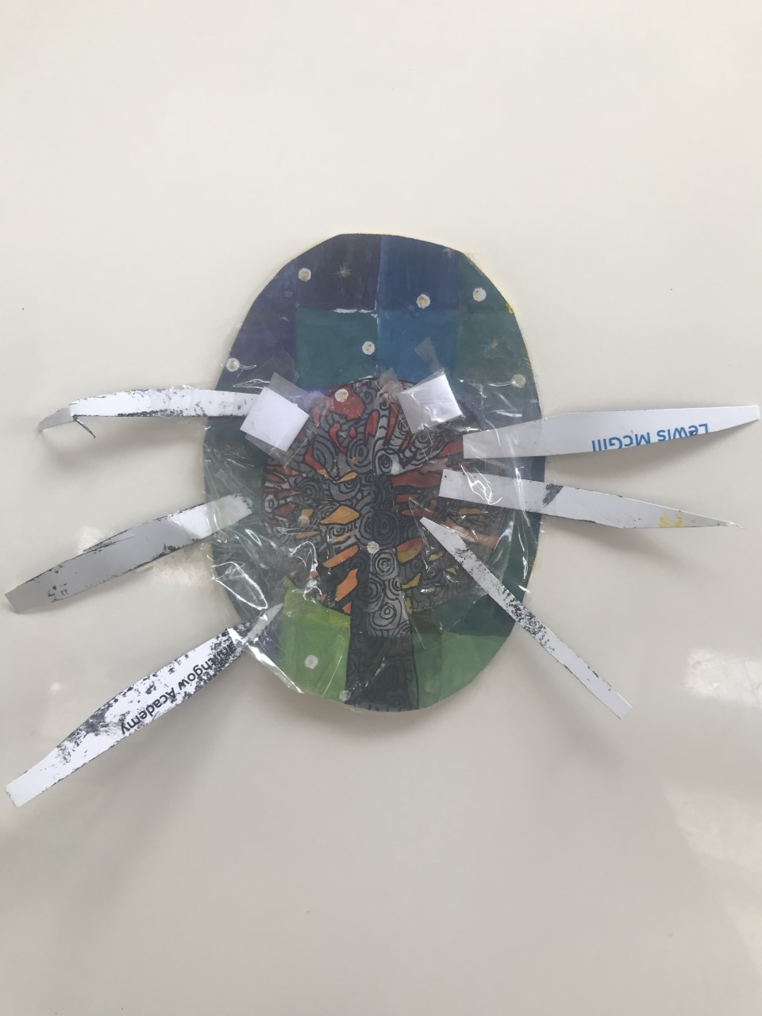
2. Cut two 1.5 inch pieces off your straw. Tape them onto the back of your design at a slight angle (so they are pointing closer together at the top)

Slide 15
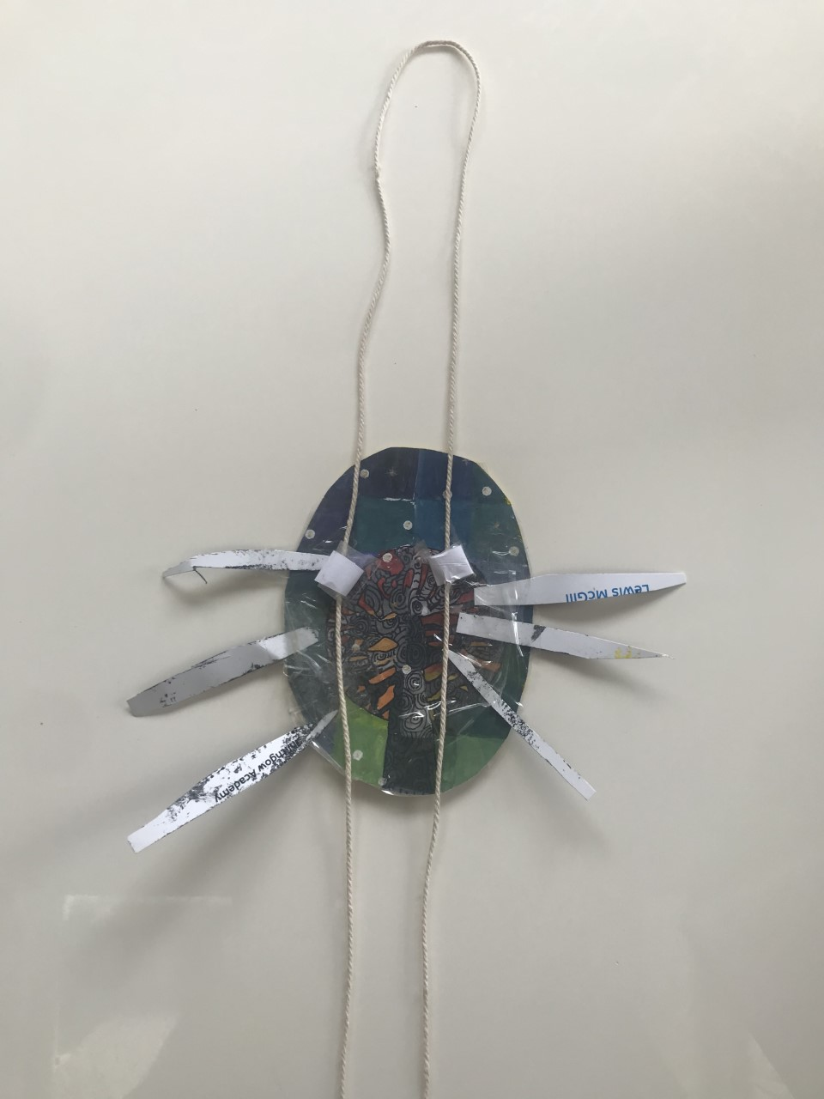
3. Take a piece of string about 4 feet long and thread both ends through the two straw pieces so that you form a giant loop above your design.

Slide 16
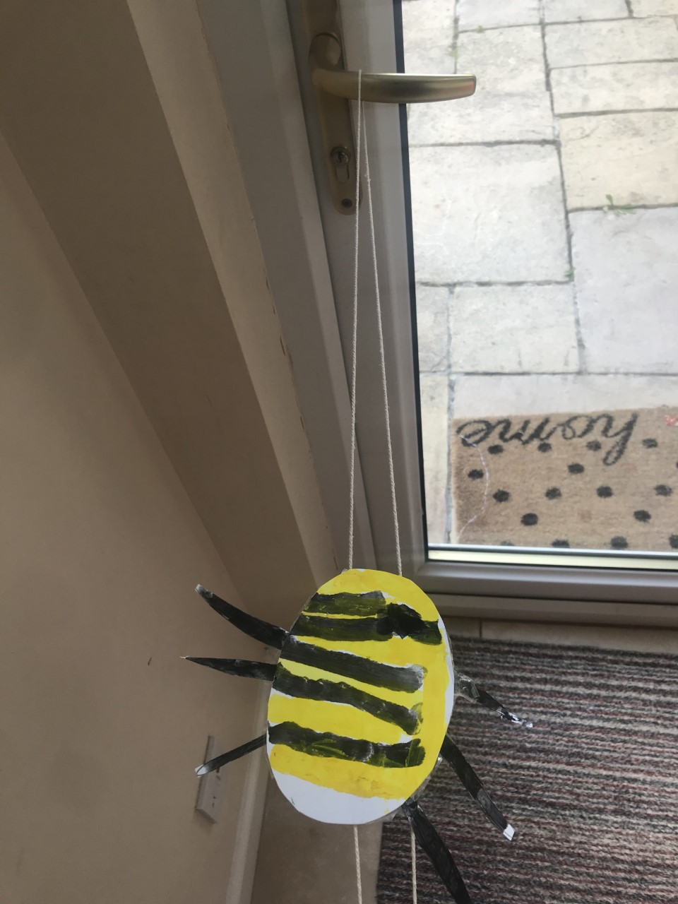
4. Hang your gliding toy onto a doorknob or from the ceiling.

Slide 17
5. Grab one end of the string in each hand and pull out and away from the design
We can’t wait to see your homemade toys!! Remember to upload your pictures on twitter

Slide 18
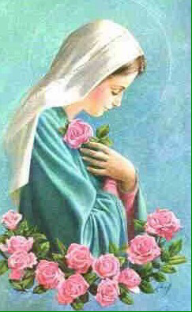
R.E L.I – I recognise the importance of prayer and honour Mary as mother of Jesus
Images of Mary often show her among roses. These can remind us to thank God for all the beautiful things he created. Take a walk outside and take time to look closely at the flowers, tree and plants. Whisper a prayer of thanks to God our creator.
Sing along to a well know hymn dedicated to Mary:
https://www.youtube.com/watch?v=lpiswwu7ika
* A worksheet has been attached to the blog if you want to print off and complete.

Slide 19
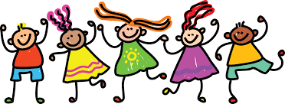
I hope you have enjoyed your lessons today. It would be lovely to hear how you got on. Enjoy the rest of your day Primary 2/3!

