Slide 1
Monday 25th May
Good Morning Primary 4!
French: Bonjour la class! Ca Va?
Quelle est la date aujourd’hui?
Aujourd’hui cest Lundi 25th Mai 2020

Slide 2
French
LI: I am learning the parts of the body
On Friday, we reminded ourselves of how to say some of the parts of the body in French!
Click on the link below and then click ‘Full Tutorial’. Go through the online lesson (it features some body parts we haven’t learned yet!)
Next, play some of the games to practise your skills (pong is my favourite!)
https://www.french-games.net/frenchlessons?topic=Body%20-%20parts%20of%20the%20body&level=primary

Slide 3
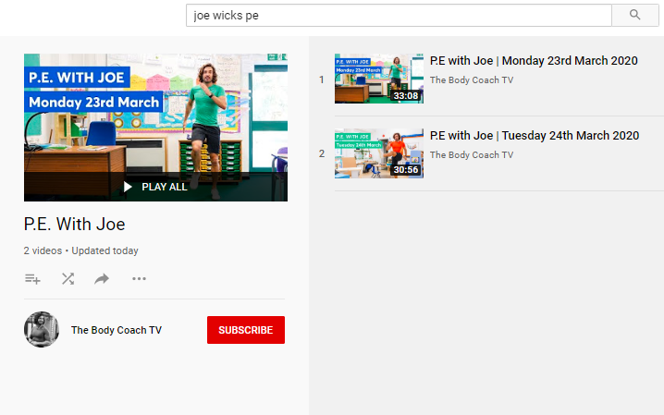
Health and Wellbeing
LI: We are learning to move our body well, exploring how to manage and control it, finding out how to use and share space.
P.E with Joe- 25th May Video
(he is nearly as fun as Mr Martin, not quite, but nearly)
https://www.youtube.com/playlist?list=PLyCLoPd4VxBvQafyve889qVcPxYEjdSTl

Slide 4
Spelling slide 1 (Tom Fletcher & Roald Dahl groups)
LI: I can recognise and spell common words
We are moving onto a new set of common words today!
This is set 5. We have looked at these words briefly in class but this week we will refresh our knowledge of them and have a practise!
Go to the next slide to see the list of common words.

Slide 5
Spelling slide 2 (Tom Fletcher & Roald Dahl groups)
LI: I can recognise and spell common words
Common words set 5
January | August
February | September
March | October
April | November
May | December
June | quickly
July | important
 | mumbled

Slide 6
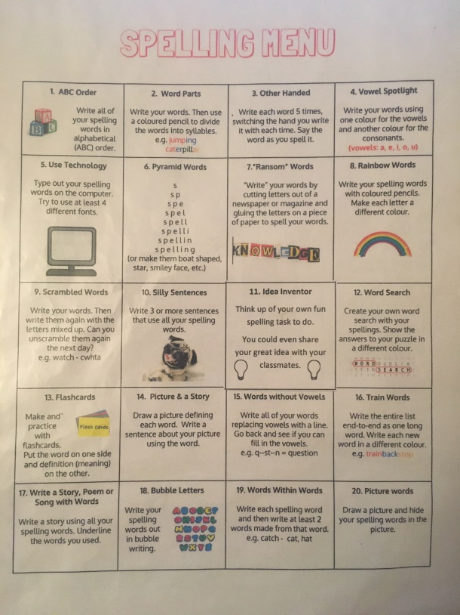
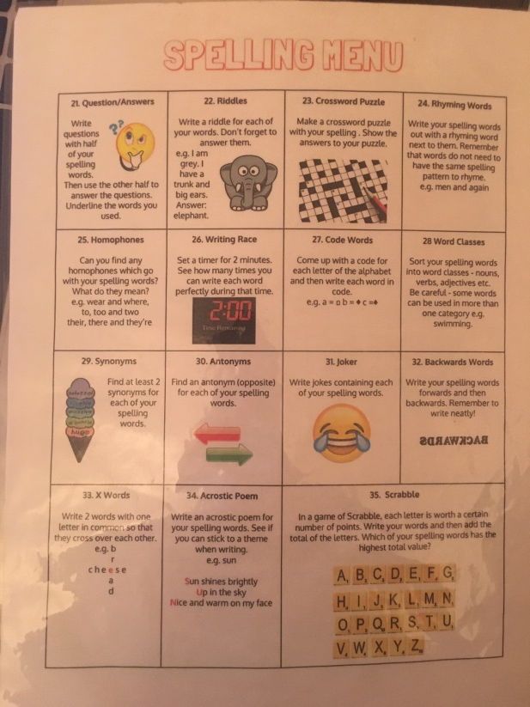
Spelling slide 3 (Tom Fletcher & Roald Dahl groups)
LI: I can recognise and spell common words
TASK: Today, I’d like you to practise your common words using a fun strategy from your spelling menu! You can download this on Teams or the school Blog.
Do this in your jotters please.

Slide 7
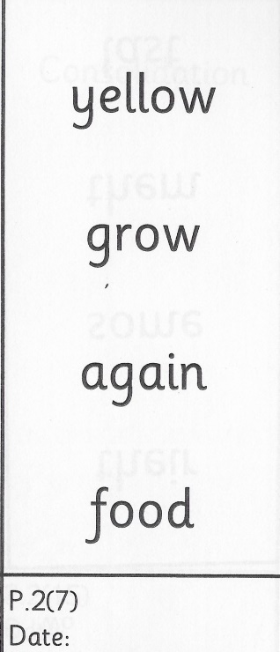
Spelling (David Walliams Group)
TASK:
You have got a new set of common words to practise today!
Remember to use the ‘Read, Write and Spell’ strategy to help you practise.
Example of how to practise your common words!

Slide 8
Reading
L.I I am using different reading strategies to help me understand my book
David Walliams – t-l-54603-the-messy-magpie-story-powerpoint_ver_3
Task – t-l-54587-the-messy-magpie-differentiated-reading-comprehension-activity_ver_3
t-l-54587-the-messy-magpie-differentiated-reading-comprehension-activity_ver_3 Answers
Roald Dahl – Chapter 1 – Prior Knowledge
Tom Fletcher – Chapter 8 – Visualiser

Slide 9
Maths (slide 1)
L.I. I am learning about fractions
Last week, we learned how to find the fractions of an amount by using division. Remember, we divide the amount by the bottom digit of the fraction (the denominator)!
e.g. $\frac{1}{3} of 27=9$
We did this by dividing 27 by 3 (27 into 3 equal portions), like this…
27 ÷ 3 = 9
Another way of looking at this is, 3 x ? = 27…
3 x 9 = 27

Slide 10
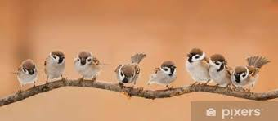
Maths (slide 2)
L.I. I am learning about fractions
Today, we are going to practise this a little bit more!
This time, we are going to look at a few word problems and see if we can read them and solve them.
EXAMPLE:
16 birds are sitting on a branch. $\frac{1}{4}$ of the birds fly away!
How many birds flew away?
How many birds are left on the branch?

Slide 11
Maths (slide 3)
L.I. I am learning about fractions
SOLVING THE EXAMPLE
We know that there are 16 birds on the branch, so this is our amount.
We know that $\frac{1}{4}$of the birds fly away.
So, the first part of our calculation is $\frac{1}{4}$ of 16
OR
16 ÷ 4 = 4
We know this because 4 x 4 = 16!

Slide 12
Maths (slide 4)
L.I. I am learning about fractions
SOLVING THE EXAMPLE
So, if 4 birds flew away and there were 16 birds to begin with, how many birds are left on the branch?
Our calculation is 16 – 4 = 12
So, the answer to the second question is…
There are 12 birds left on the branch!

Slide 13
Maths (slide 4)
L.I. I am learning about fractions
Confused?!
Don’t worry!
Have a go at solving the word problems on the following slide. Just try your hardest.
ALWAYS read the question all the way through before even trying to answer it!

Slide 14
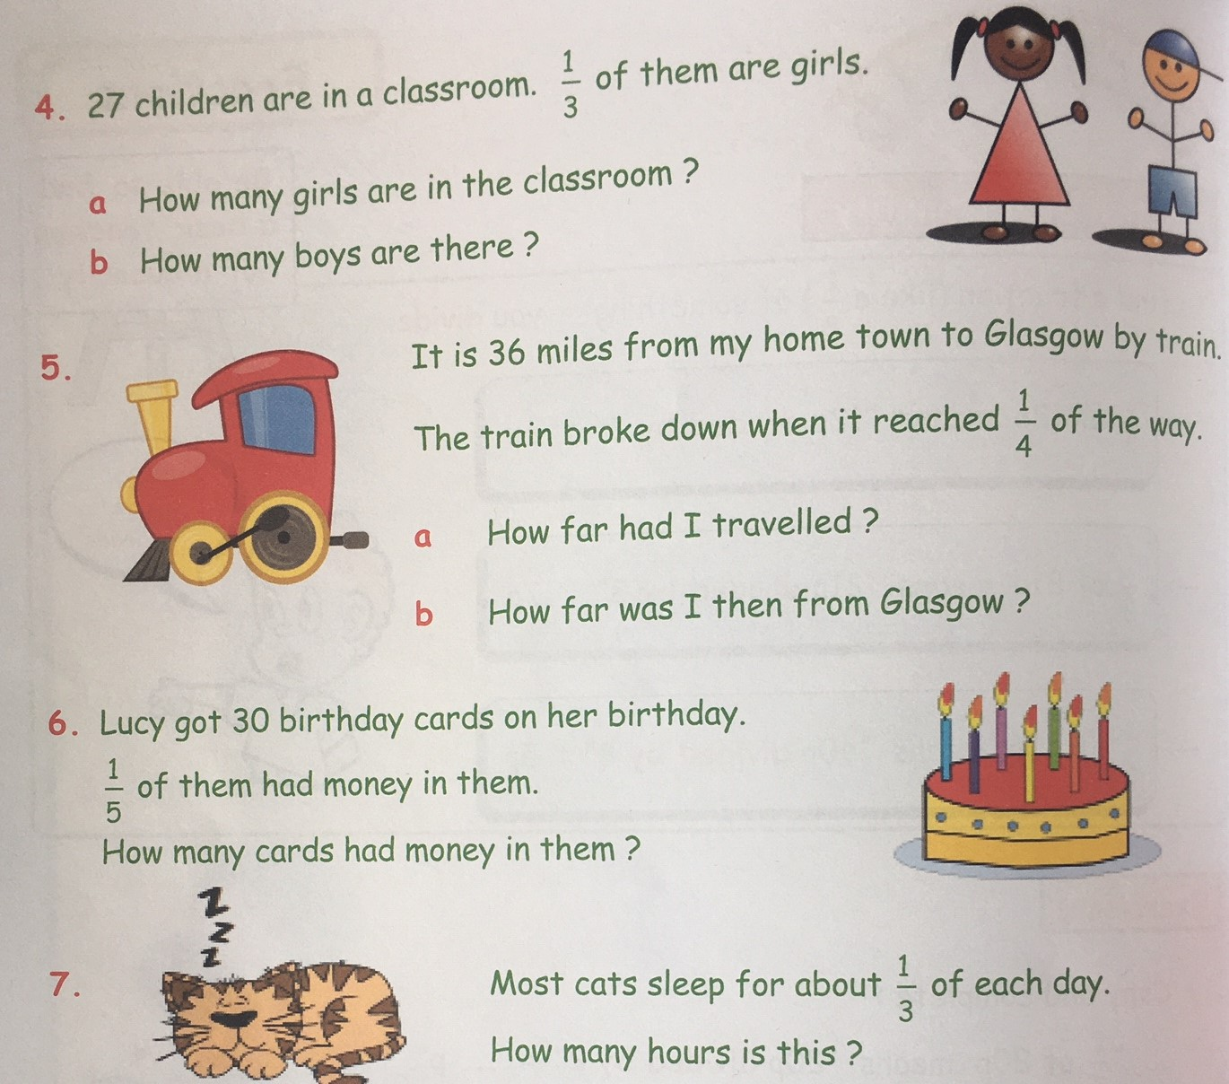
Maths (slide 5)
L.I. I am learning about fractions

Slide 15
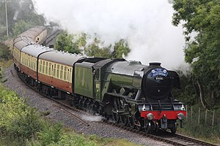
Topic (slide 1) – Great Scots!
L.I. I am learning about ‘The Flying Scotsman’ train and can design a poster
This is a picture of a very famous steam train called
‘The Flying Scotsman’.
It was built in England in 1923 by a famous railway company called the LNER (London North Eastern Railway).
The train was used to transport people between London and Edinburgh (in only 8 hours!) This was at a time when EasyJet didn’t exist!

Slide 16
Topic (slide 2) – Great Scots!
L.I. I am learning about ‘The Flying Scotsman’ train and can design a poster
It made the first non-stop train trip between the 2 cities in 1928!
It was also the first steam train to be officially recorded travelling faster than 100 mph (miles per hour). This happened in 1934!

Slide 17
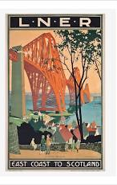
Topic (slide 3) – Great Scots!
L.I. I am learning about ‘The Flying Scotsman’ train and can design a poster
LNER – the company that owned the train and the railway line – designed lots of posters to promote their railway.
They wanted as many people as possible to pay to use the railway and travel to Scotland.
So, they designed lots of posters to encourage people to go! See some of their other posters on the next slides!

Slide 18
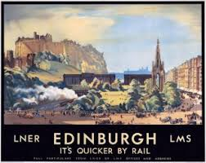
Topic (slide 4) – Great Scots!
L.I. I am learning about ‘The Flying Scotsman’ train and can design a poster

Slide 19
Topic (slide 5) – Great Scots!
L.I. I am learning about ‘The Flying Scotsman’ train and can design a poster

Slide 20
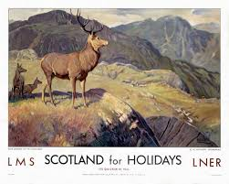
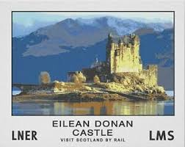
Topic (slide 6) – Great Scots!
L.I. I am learning about ‘The Flying Scotsman’ train and can design a poster

Slide 21
Topic (slide 7) – Great Scots!
L.I. I am learning about ‘The Flying Scotsman’ train and can design a poster
TASK
Design a poster in the style of the LNER posters seen on the previous slides.
Focus on one place in Scotland – it could be a city like Edinburgh or Glasgow or it could be a small town like Armadale! It could even be somewhere in the countryside.
Your poster must have ‘LNER’ on it somewhere. Pretend that you are being employed by the train company to design it!
Post your completed work on Teams. Don’t rush – I will make this your task for this afternoon and tomorrow afternoon so that you have some time. You could even use paints (if you have them).

Slide 22
Feel free to leave comments / questions on Teams throughout the day and I will try my best to get back to you. Enjoy your day, Primary 4!

