Slide 1
Monday 25th May

Slide 2
Timetable
French
Daily Exercise
Spelling
Reading Starter
Reading
Maths Starter
Maths
Health and wellbeing

Slide 3
French
Click on the link below to sing along to the number song in French?
https://www.youtube.com/watch?v=UsEz58BblMY
Can you write today’s date in French?
Quelle est la date aujourd’hui?
e.g. C’est lundi vingt avril
Can you also write today’s weather in French?
Quel temps fait-il?
Il pleut/ Il fait beau/ Il fait froid/ Il y a du vent/
Il fait mauvais/ Il y a des nuages/ Il y a du soleil

Slide 4
Daily Exercise
I am learning to move our body well, exploring how to manage and control it, finding out how to use and share space.
I have been going out a daily walk to look at the new plants growing. If you can get outside for some fresh air that would be great. Remember to only do this if it is okay with parents. If not I have attached below the link to Joe Wicks workouts. I have been trying these myself at home!
https://www.youtube.com/watch?v=Na1rzigYlSU

Slide 5
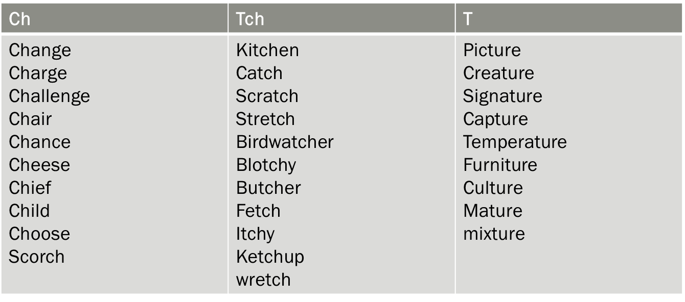
Spelling – I can use a variety of spelling strategies.
Partner spell

Slide 6
Reading Starter
I have created a challenge on Sumdog for you to complete. This will be live as of today and can be completed up until Thursday.

Slide 7
Reading – I can tell the difference between fiction and non – fiction.
Watch the video on BBC Bitesize about fiction and non fiction
https://www.bbc.co.uk/bitesize/topics/z4j8rj6/articles/zty8xfr
Look at the following statements/questions tell me if it is fiction or non fiction.
What is an insect ? - a small arthropod animal that has six legs and generally one or two pairs of wings.
The Super Cat – Emily had a cat called Mog. One day when Emily came home from school Mog was floating above her bed.
Journey to the Past– John set his timer on his watch to 1951. When he stepped through the portal, he saw people riding in horse and carriages.
Queen Victoria – Queen Victoria was the Queen of the United Kingdom (1837-1901). He reign was the longest in the British Monarch until Queen Elizabeth.
Attack of the Aliens – every since the uprising of the green men on the planet Zoom. Jean has lived in the forest, foraging for metal to make weapons.
Challenge – what is the book you are currently reading at home? Is it fiction or non fiction.

Slide 8
Maths starter
https://mathsbot.com/#Question%20Generators

Slide 9
Maths starter answers

Slide 10
Maths – I am learning about nets of shapes.
Look at the 3d shapes and think what net if you cut it out would make the shape.
Would it be 1 or 2?

Slide 11
Maths – I am learning about nets of shapes.
Look at the nets, can you tell me what 3d shape it would make?

Slide 12
Maths answers
Slide 1 - 1, 2,1
Slide 2 – Triangular prism, cuboid, square based pyramid, cone.

Slide 13
Health and Wellbeing
I am learning about road safety.
Cycle Safety: research road signs and be able to describe them and explain what they are and what you need to do at them if you are out on your bike.
For example: what does the sign for “No Left Turn” look like? What about the sign for a mini roundabout? What do you need to do when you approach one?

