Slide 2
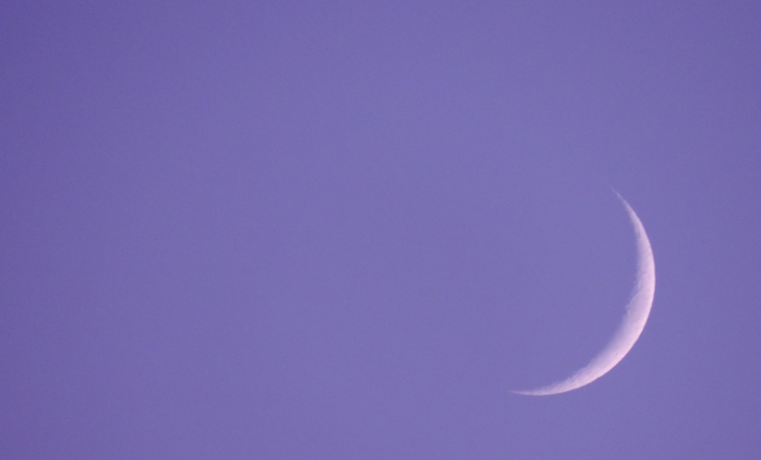
What Is Ramadan?
Ramadan is an important event for Muslim people. It takes place in the ninth month of the Islamic calendar. This calendar is based on the moon.
Ramadan begins the morning after people see the crescent moon. It can last for 29 or 30 days. This is about one month.

Slide 3
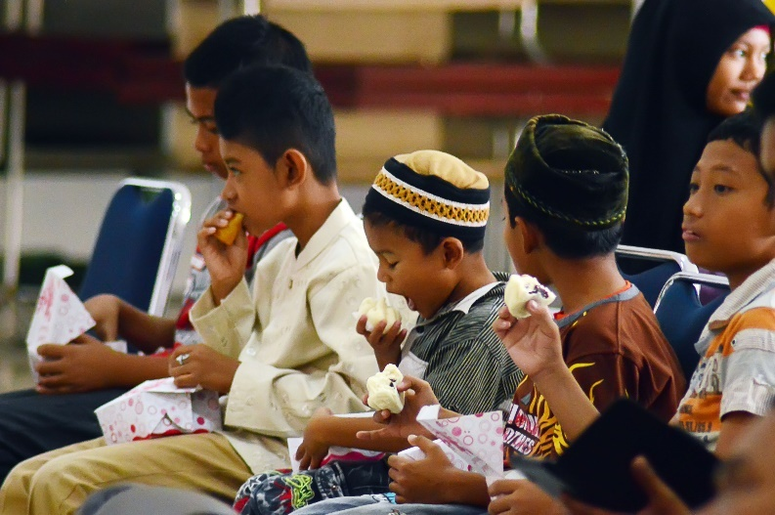
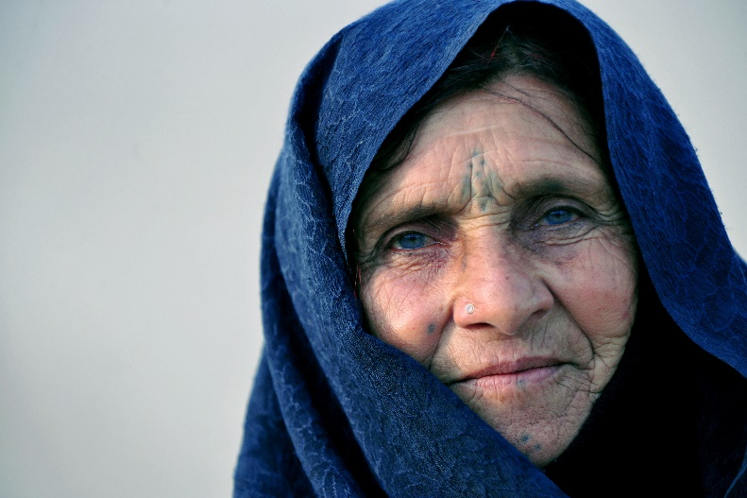
Fasting
During the month of Ramadan, Muslim people will fast. This means that they cannot eat or drink anything between sunrise and sunset.
Muslims believe that fasting reminds them of people who have less than they do, as well as making them think more about their actions.
Not every Muslim person is expected to fast. Young children and older people are not expected to fast, although sometimes, they do.

Slide 4
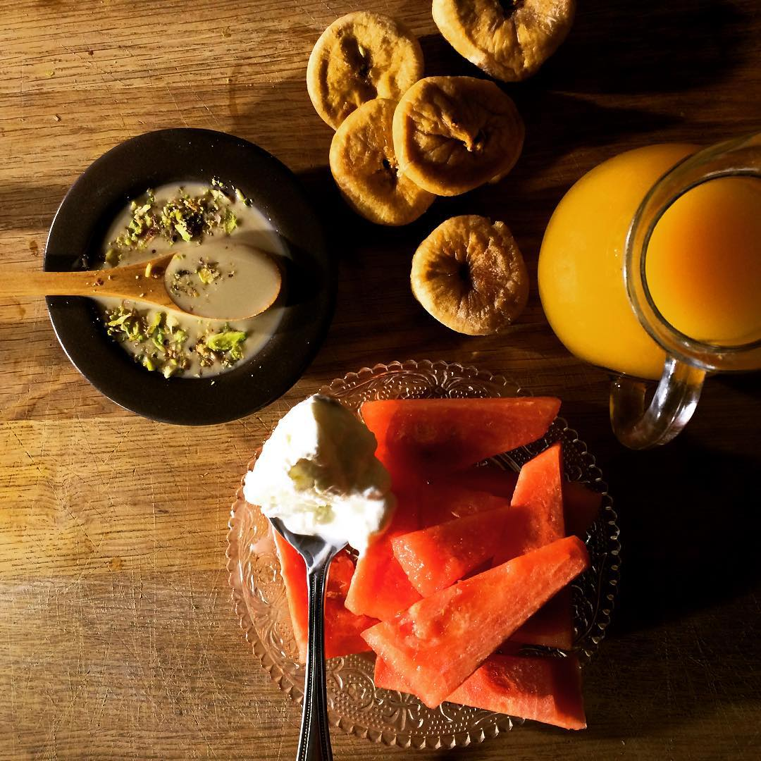
Suhoor
Suhoor is the meal Muslim people eat before their day of fasting starts.
This meal is very important. The people who are fasting have to make sure they eat the right kinds of foods to give them energy for the rest of the day.
Muslims will get up very early in the morning, before the sun comes up (around 4 a.m.).
Foods eaten during Suhoor include eggs, bread, rice, fruit and vegetables.
“Suhoor” by [Alazat] is licensed under CC BY 2.0

Slide 5
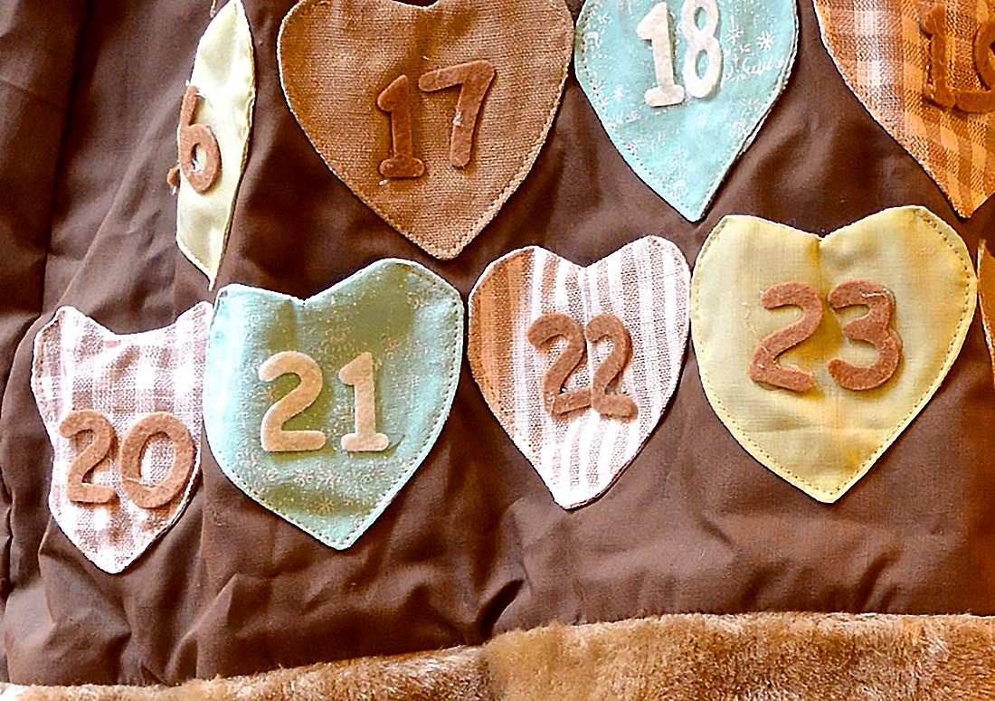
Ramadan Calendar
Some Muslim children will have a Ramadan advent calendar.
The calendar is usually made from fabric or cardboard and will have 29 or 30 doors or pockets to open, each with a number to 30 on.
Inside each one is an action to complete. These are usually ways you can help other people and treat them with kindness.

Slide 6
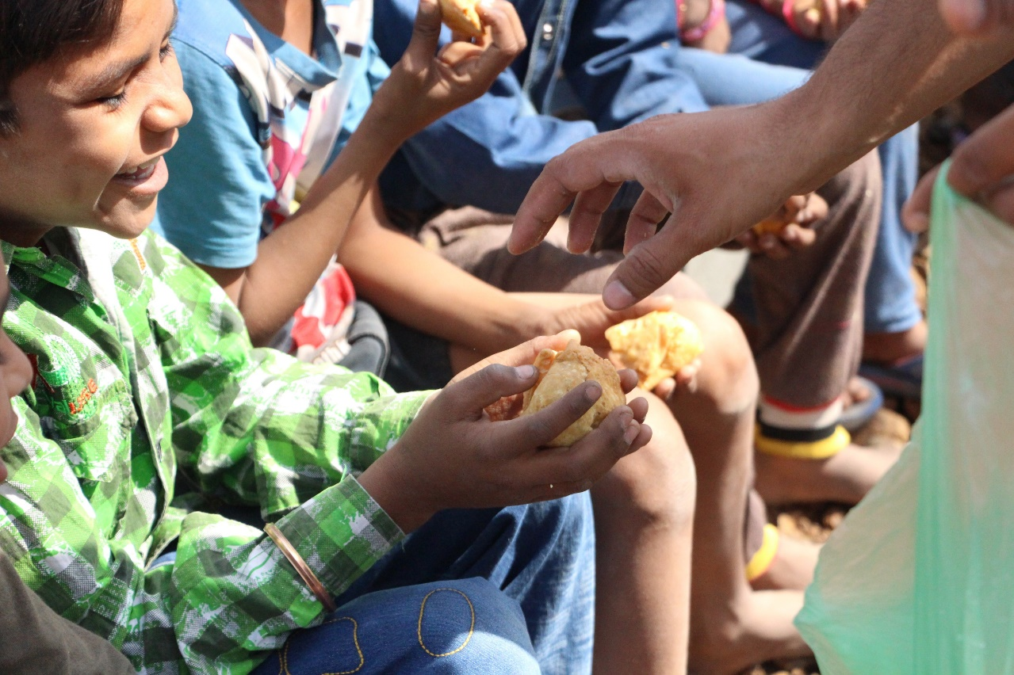
Helping Others
Helping others and doing good deeds is an important part of Ramadan. Sometimes, this means giving money to charities or people that need help. It can also mean being kind, giving your time and sharing what you have.

Slide 7
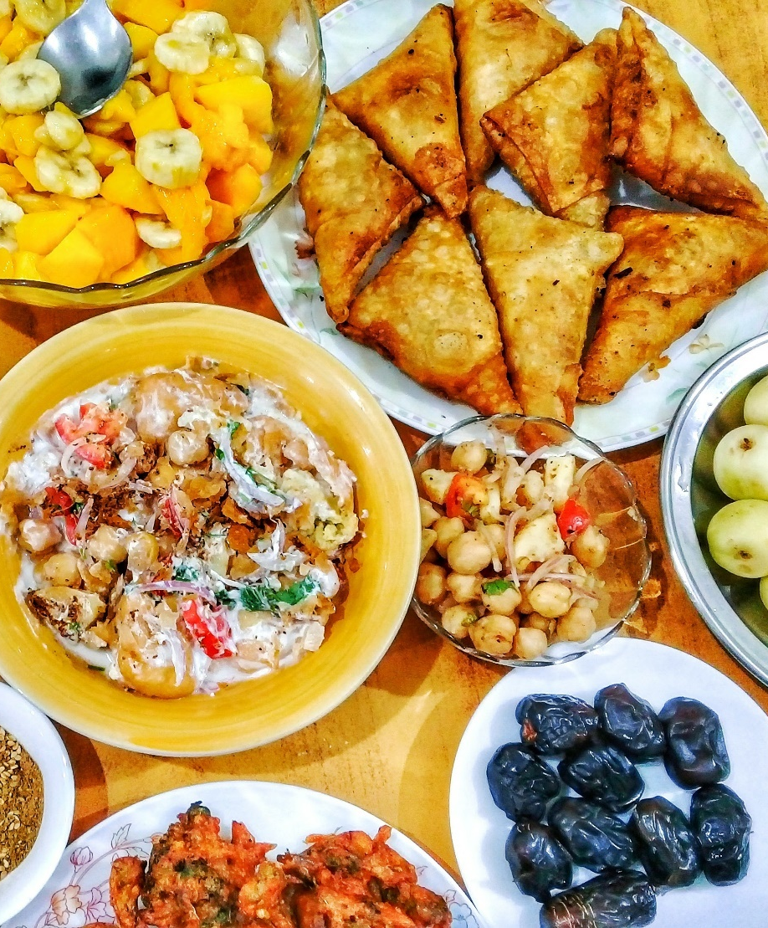
Iftar
Iftar is a very important meal during Ramadan. This is the time when Muslims will break their fast and are able to eat again.
As the sun goes down, Muslims will break their fast with something small, like dates and water. Then, they will say the Maghrib prayer. Once the sun has completely gone down, they will eat a larger meal.
Usually, Iftar meals will include rice, chicken or beef, yoghurt, samosas, roti and desserts, such
as sweet rice.

Slide 8
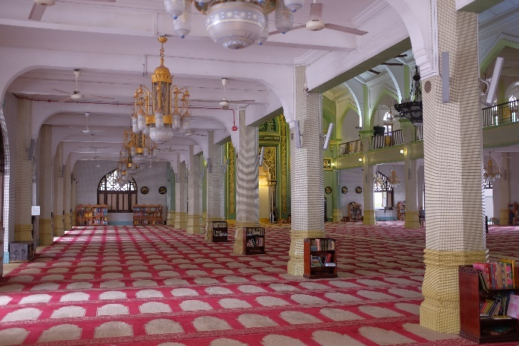
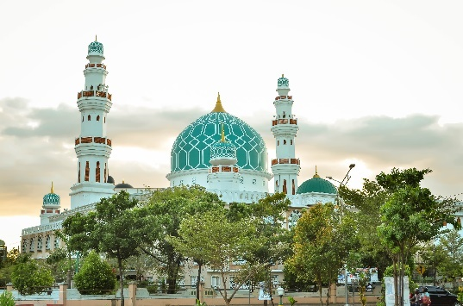
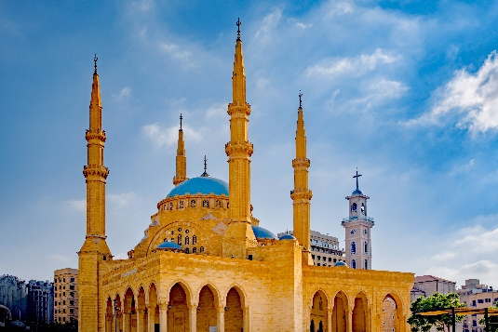
Going to Mosque
Going to mosque is an important part of both Ramadan and Eid.
Muslims will pray in a room called a ‘musallah’. This is a big open space. The carpet usually has a pattern with spaces for each person to sit. Everyone must take off their shoes inside the mosque.
The special prayer during Ramadan is called the ‘Taraweeh’.
“Sultan Mosque Prayer Hall” by [Jnzl’s Photos] is licensed under CC BY 2.0

Slide 9
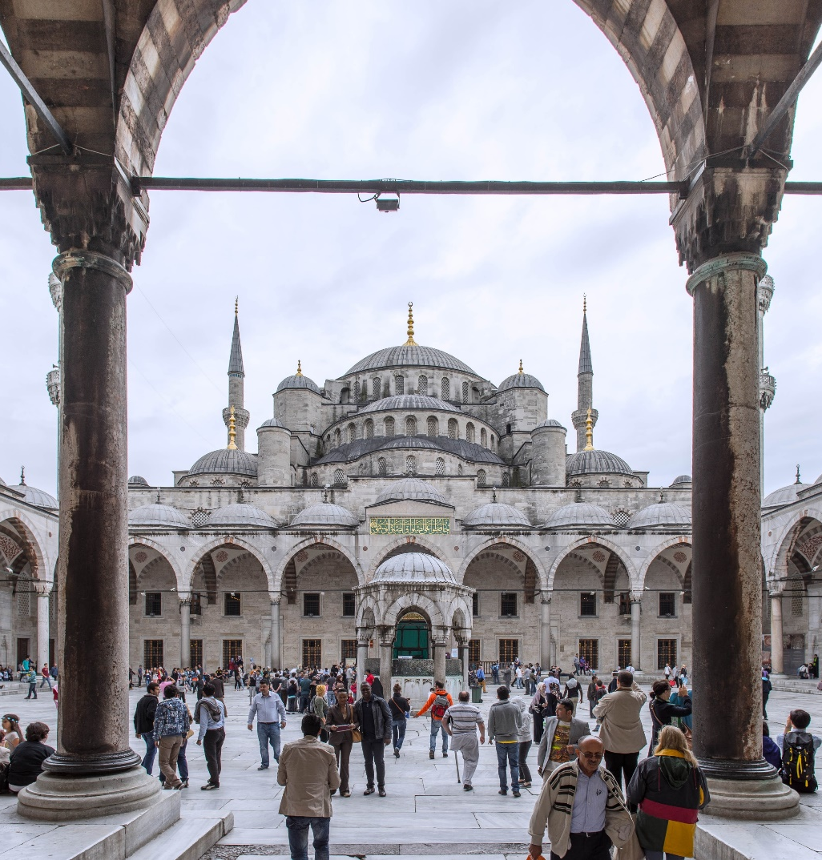
Eid al-Fitr
Eid al-Fitr is the festival that marks the end of Ramadan and the fast. It lasts for three days.
During Eid, Muslims thank Allah for the help and strength he gave them when they fasted.
The festival starts when the new moon is seen in the sky.

Slide 10
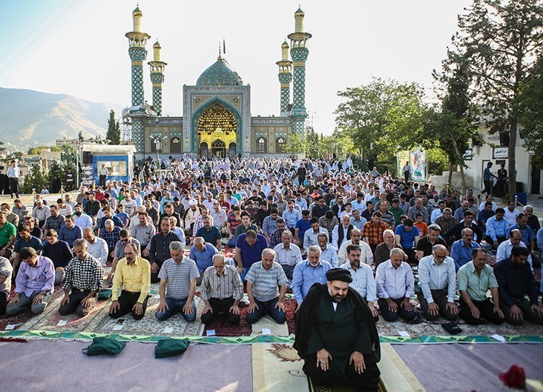
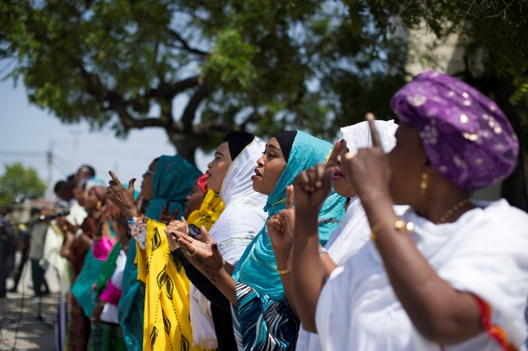
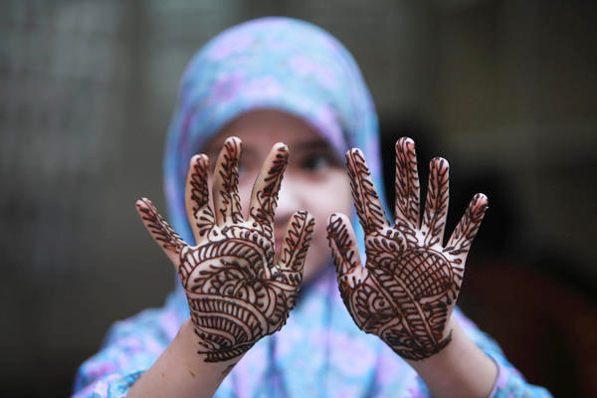
Eid Celebrations
Muslims take part in many activities to celebrate Eid.
They will often buy new clothes and decorate their hands with henna designs.
There will be special prayer services at the mosque and people will say special prayers in their homes.
Muslim people will say ‘Eid Mubarak!’, which means ‘Have a blessed Eid!’.
“Ramadan Festival” by [Lakpuratravels] is licensed under CC BY 2.0, “Iranians holding Eid al-Fitr Prayer” by [M.Hasan Miremadi] is licensed under CC BY 4.0

Slide 11
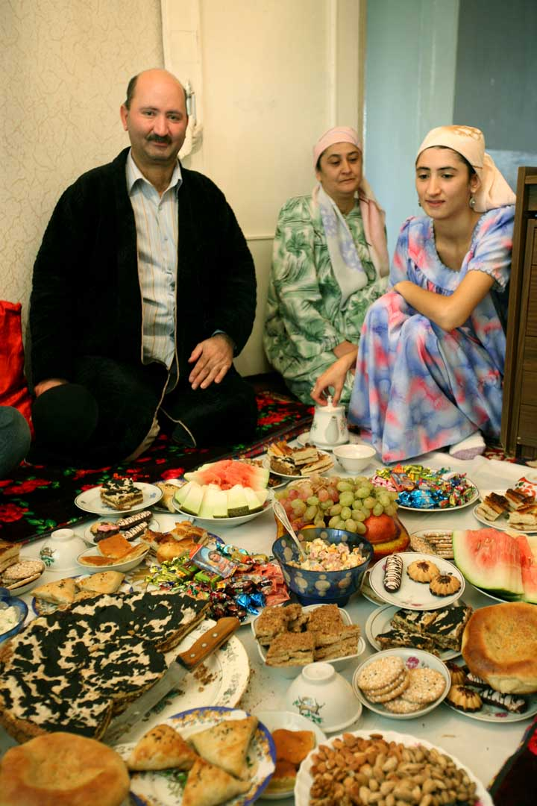
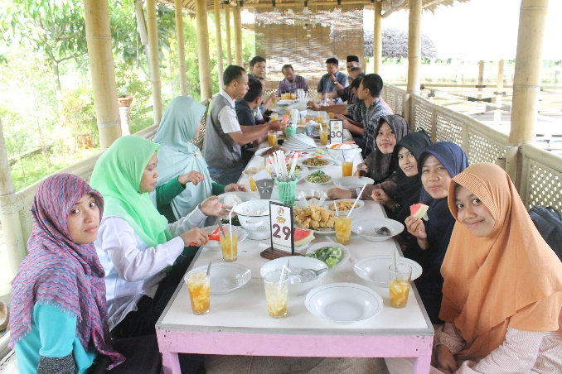
Eid Celebrations
Muslims will visit their families and have a large feast for lunch or dinner.
Some people will also celebrate with a firework display on the first night of Eid.
The rest of Eid is then spent seeing family and helping others.
“Celebrating Eid” by [Steve Evans] is licensed under CC BY 2.0

