Slide 1
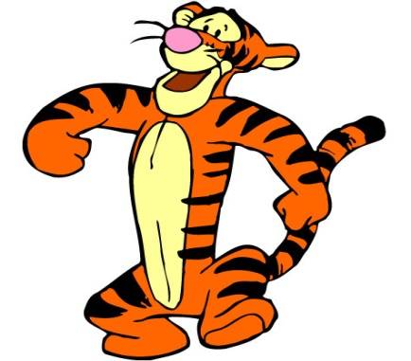
Monday 25-5-20
Good Morning Everyone!

Slide 2
Today’s Timetable
Morning Exercise
French
Morning Starter
Maths Lesson
Spelling
Literacy
R.E.
P.E.
Prayer

Slide 3
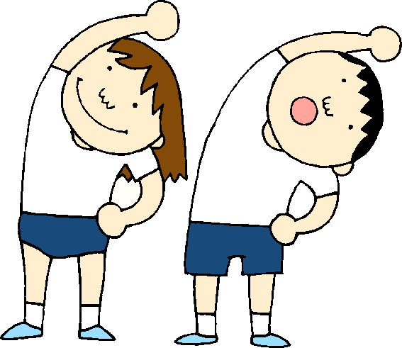
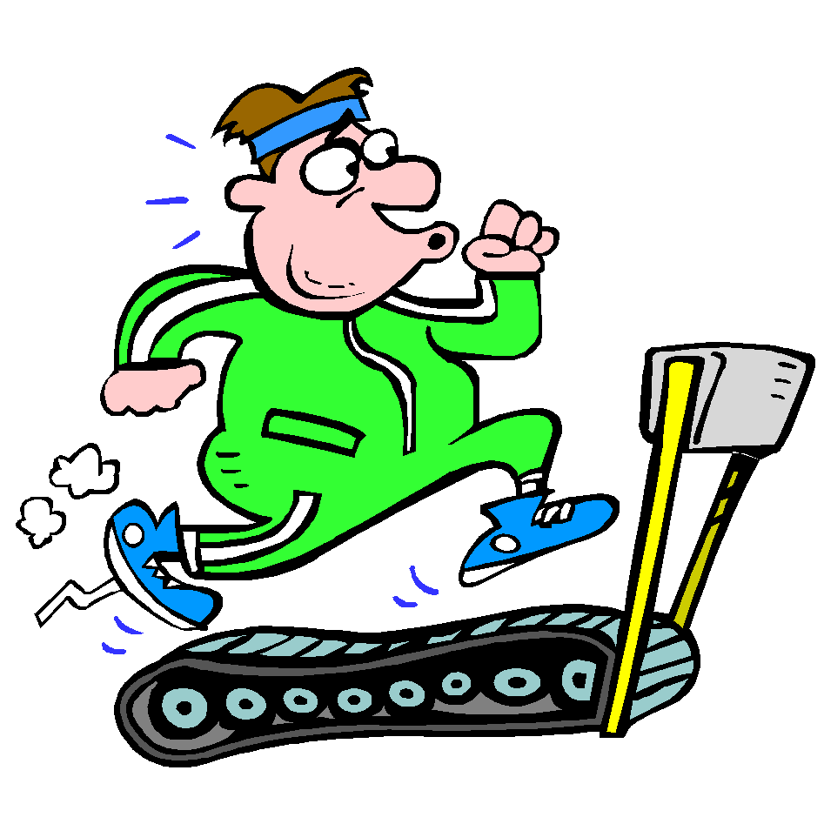
Daily Exercise
Try to do some form of exercise to start the day. This could be a walk or run with a family member or a workout in the house. Check with your parents that it is ok for you to do this.
Why not try disco en francais:-
https://www.youtube.com/watch?v=KVhfIgghOPw
Or join the Body Coach live at 9am

Slide 4
A little bit of French to start the day
Click on the link below to sing along to the weather song in French?
https://www.youtube.com/watch?v=eBvJVOuBPXI
Can you write today’s date in French?
Quelle est la date aujourd’hui?
C’est ……………………..
Can you also write today’s weather in French?
Quel temps fait-il?
Il pleut/ Il fait beau/ Il fait froid/ Il y a du vent/
Il fait mauvais/ Il y a des nuages/ Il y a du soleil

Slide 5
Morning Starter
Today, everyone’s morning starter is 15-20 minutes on Sumdog. Well done to those of you who are doing your Sumdog tasks. I can see who is working on Sumdog through the weekly report. I will be rewarding every students who logs on for at least 15mins with 50 coins. The top 3 students [students who spend the most time] will get 100 coins.
If you have log-in details for IDL Maths please continue to access this as normal.
SUMDOG

Slide 6
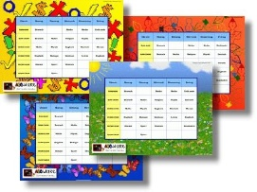
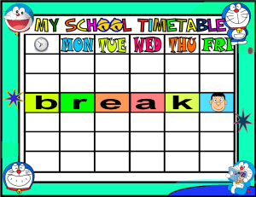
Maths Lesson
Today we are learning to read a timetable.
The timetable is an example of what your school timetable might look like. It is not your actual timetable. You will use timetables throughout your time at high school so this is a really useful real life Maths lesson.
Please find your timetable and tasks attached to the blog. Today, please answer the questions in the peach and lilac sections only.
I would like all groups to try this task. If you have any problems, please get in touch on Teams.

Slide 7
Spelling
Log in to Sumdog for your spelling task.
You will need to make sure you click on the task set for your group.
Group 1 – Red Reading Group, Group 2 – Most of the Class
Group 3 – Super Spellers
This task is set for the whole week. If you find the words too hard, drop down a group and if they’re too easy, try the next group up. The words are based on your spelling lists.
At the end of the week, I will be able to view how you got on with your work

Slide 8
Literacy
Today, we’re going to do read the next 3 chapters of ‘Wonder’. [‘Home’, ‘First-Day Jitters’ & ‘Locks’]
Click on the link to listen to the story. Please listen up to 12mins 33 secs, no further!:-
https://www.youtube.com/watch?v=QsuagCNBt6o
Hopefully, you will have noticed by now that August is incredibly observant. He is very aware of people’s body language which tells him whether they like him or not without them even saying anything to him.
Your task, today, is an inference task. You need to find the quotes from the chapter ‘Locks’ which tell you that people don’t like August or don’t want to be near him.
I have attached copies of the chapter, ‘Locks’.
Red Group: Try to find 2 quotes then do your IDL

Slide 9
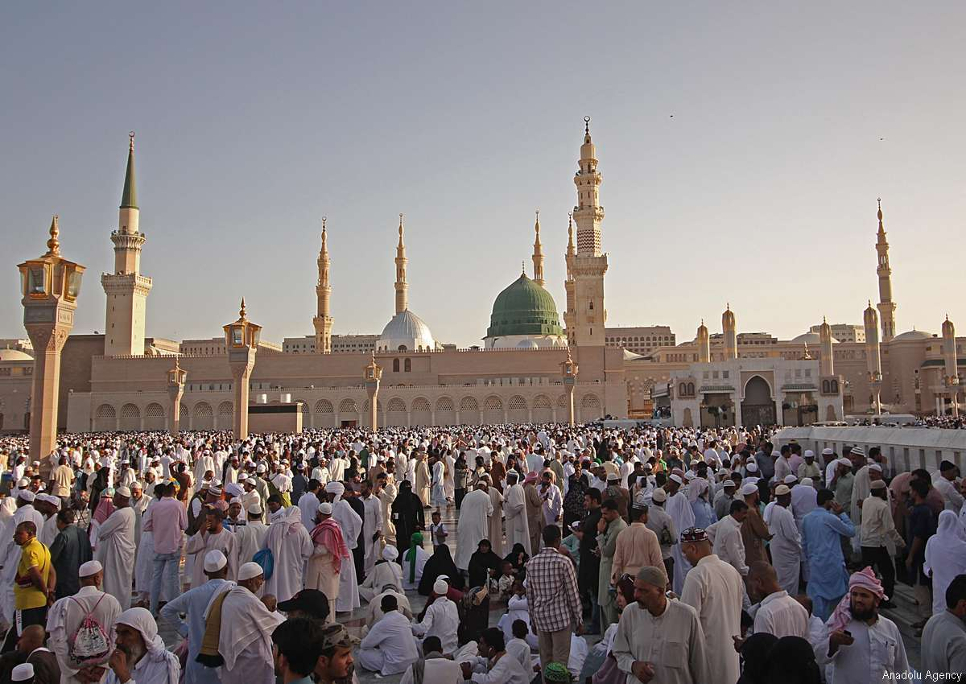
R.E.
Today we are going to learn about the Islamic Faith.
At the weekend, Muslims all over the world celebrated the festival of Eid which marks the end of Ramadan.
Click on the link to find out more:-
https://www.youtube.com/watch?v=W94SdiWhtr8#action=share
Please now watch the attached powerpoint.
Your task is to complete the Ramadan Activity sheet attached to the blog. There is no need to print off the activity sheet. You can answer the questions from the activity sheet on blank paper.

Slide 10
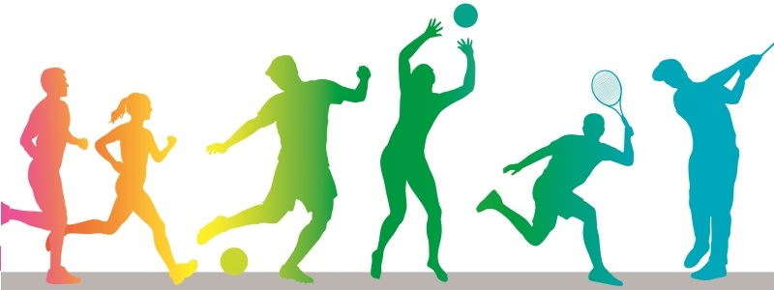
P.E.
Click on the following link for today’s P.E. session
https://www.youtube.com/watch?v=MNFdY4cZtWY
Alternatively, join family members for a walk, run or cycle.

Slide 11
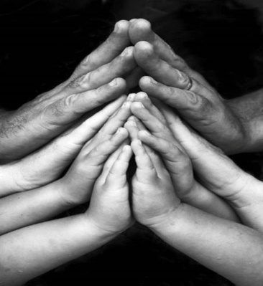
A prayer to end our day
Take a few moments to say a short prayer. You might like to dedicate your prayer to someone in your family who is unwell or who just needs your prayers.

Slide 12
Well done!
Well done for working hard today!

