Slide 1
Thursday 21-5-20
Good Morning Everyone!

Slide 2
Today’s Timetable
Morning Exercise
French
R.E.
Maths Lesson
Grammar
Lunch – picnic time?
Writing Task
Health and Wellbeing
French Main Lesson
Prayer

Slide 3
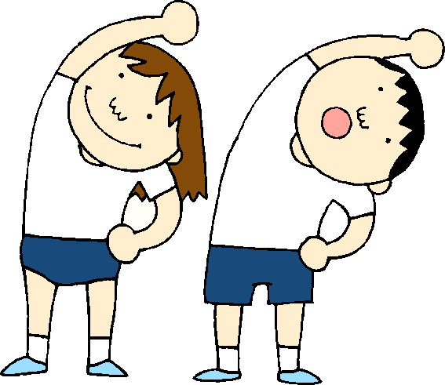
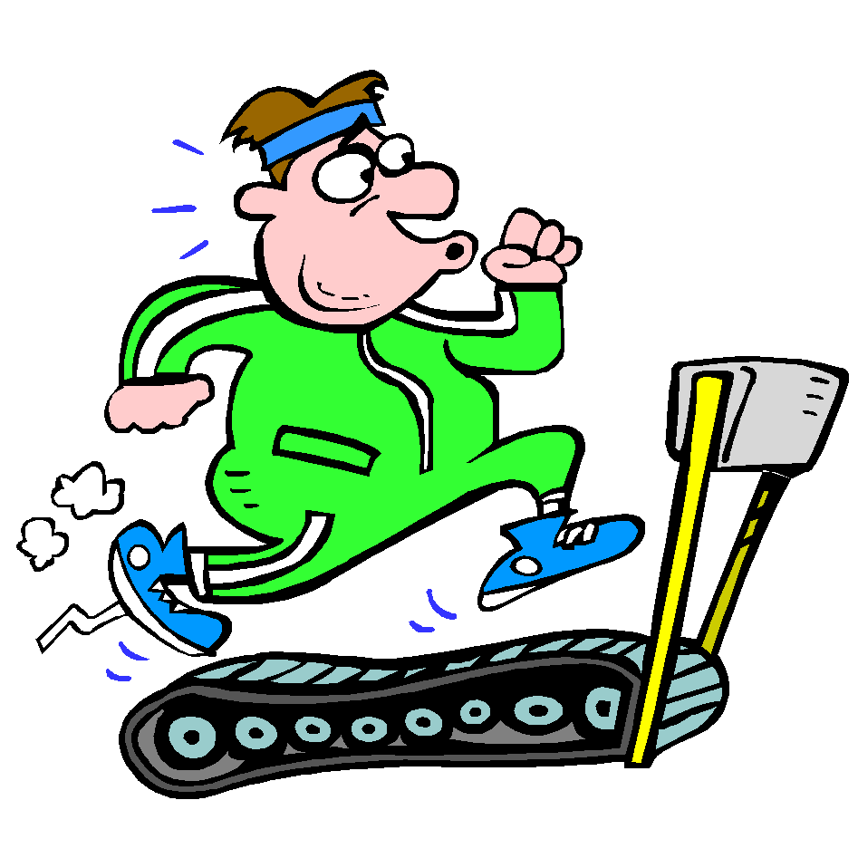
Daily Exercise
Try to do some form of exercise to start the day. This could be a walk or run with a family member or a workout in the house. Check with your parents that it is ok for you to do this.
Why not try this circuit workout this morning :-
https://www.youtube.com/watch?v=_97QFX3w1E4

Slide 4
A little bit of French to start the day
Quelle est la date aujourd’hui? Comment a va?
e.g. C’est mercredi vingt mai Je suis content(e)
Je ne suis pas content(e)
Quel temps fait-il? Qu’est ce-que tu veux pour le
e.g. Il y a du soleil dejeuner? eg.
Il pleut / Il fait beau/ Il fait froid/ Je voudrais un sandwich au thon
Il fait mauvais/ Il y a des nuages/ Je voudrais un sandwich au fromage
Il y a du soleil/ Il fait du vent Je voudrais un sandwich au jambon
Je voudrais un sandwich aux oeufs

Slide 5
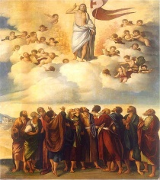
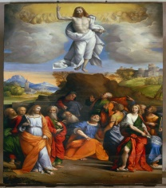
The Feast of The Ascension
Today is Ascension Thursday. If we were in school, we would be attending Mass together. On Facebook, Father Sebastian will be streaming Mass live from St Joseph’s at 10am.
The Feast of the Ascension celebrates the time when Jesus left the disciples to join His Father in Heaven. Watch this clip to learn more about The Ascension [watch from 18mins] :-
https://www.youtube.com/watch?v=uokrGye6Xfc
Task: - Draw a picture of Jesus ascending to Heaven with the disciples watching him.
Underneath write down the following passage:-
Then Jesus approached and said to them, “All power in heaven and on earth has been given to me. Go, therefore, and make disciples of all nations, baptizing them in the name of the Father, and of the Son, and of the Holy Spirit, teaching them to observe all that I have commanded you. And behold, I am with you always, until the end of the age.”

Slide 6
Sumdog Maths Competition
Mrs Wilson has entered the whole school into the West Lothian Sumdog Competition.
This is the last day of the competition so it is our last chance to help our class and our school do well.
I’d like you to do a minimum of 15mins on Sumdog Maths this morning. If you can do more –fantastic!
The more correct answers you get, the more points you score. The competition ends tonight at 8pm.
Go Team St Anthony’s!!!

Slide 7
Maths Lesson
Today we are continuing our learning on ratio.
This is the first question on the worksheet:-
A number was shared in the ratio 2:5. The larger share was 50. What was the smaller amount?
Ratio 2 : 5 Equivalent fractions $\frac{2}{5}$ = $\frac{?}{50}$
? : 50
Remember when we made equivalent fractions? We had to work out what the numerator or denominator had been multiplied by.
We have to do the same here. What did we do to 5 to get 50?
We multiplied it by 10. Therefore to keep the ratio the same and to find the answer, we need to multiply 2 by 10. The answer is 20.
Task – Please complete the task attached to the blog.
Circles – Qu. 1 -3
Squares – Qu 1-5
Triangles – All questions

Slide 8
Grammar
This is the last day to finish your challenge on Sumdog Grammar. I’ll log in this afternoon to see how you all got on.
Your task is set up according to your reading group.
Red Group – Group 1, Blue Group – Group 2
Green Group – Group 3
Remember to please let me know how you
found it.
SUMDOG

Slide 9
Picnic Time
If you are able to, why not have your lunch outside today. Perhaps you could organise it and prepare the food for your family.
We’d love to see your pictures – please post your picture on the school Twitter page.

Slide 10
Writing
Task:- Your task is to write a short speech.
Imagine you are a Jacobite leader. Your speech is to persuade ordinary men across the highlands to join the Jacobite army.
Jacobite leaders gave speeches in inns in towns and villages across Scotland where people were sympathetic to the Jacobite cause. Their aim was to raise an army large enough to fight the British government forces.
S.C. - you must include persuasive language.
- you must include facts and information.
- you must talk about the benefits of a Jacobite
victory.
I have attached a checklist for persuasive writing as well as a wordmat to help you.

Slide 11
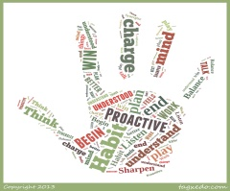
Health and Wellbeing
Today, we are trying to encourage you to do some of your learning outdoors.
For today’s Health and Wellbeing task, try to choose an activity which you find relaxing and calming which does not involve technology eg. computer screens, games or phones. Try to do this activity outside.
Drawing/colouring –in
Gardening/planting.
Go for a walk to collect several different objects and observe/describe how each feels.
Sit or lie in your garden [if you have one], close your eyes and remember your best day ever.
Try a yoga session [you can use your phone for this]
Or think of your own mindfulness activity.

Slide 12
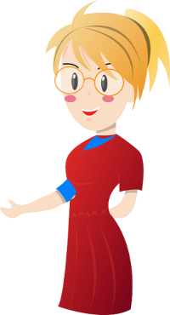
French
Today, as a starter, we’re going to revise the numbers in French. Play the games for numbers 1-10 and the multiples of 10 on linguascope.
https://www.linguascope.com/
Transition task:- If you have not have already completed your new mini Transitions Booklet, please try to complete it by Thursday 28th May.
Today’s task:- Please complete the page ‘Freres et Soeurs’ in the original paper Transition booklet. You can use the S1 vocabulary booklet which I gave you, to help you with this task. If you have any problems, please let me know on Teams.

Slide 13
A prayer to end our day
Take a few moments to say a short prayer for all the key workers who are keeping all our vital services going.

Slide 14
Well done!
Well done for working hard today!

