Slide 1
Today is Outdoor Classroom Day Wednesday 20th of May
Good Morning Primary 1/2
French: Bonjour la class! Ca Va?
L.I- To know simple greetings in French
https://www.youtube.com/watch?v=atNkI6QFZ50
See if you can respond in french:
Bonjour! Comment ca va?
Ca va bien, comme ci, comme ca
2. Comment tu t’appelle?
Je m’appelle ________

Slide 2
Why don’t we take our French outside?
L.I. – I can recognise and use the names of
colours in French.
Let’s look at colours
Rouge vert jaune bleu brun noir rose
Watch
https://www.youtube.com/watch?v=-4kNeFGBAcw
Today outside you are going to point out things and say
there colour.
C’est vert.

Slide 3
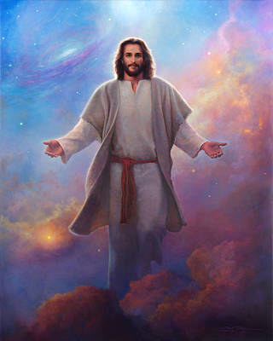
Today is Ascension Day Father Sebastian will be saying mass online ay 10.00am if you would like to join him.
Today we remember the ascent of Jesus Christ into heaven on the 40th day after his Resurrection.
https://www.youtube.com/watch?v=UcFw8pLBSIo

Slide 4
Reading- Common Words
These are some common words you had at the beginning of
P.2. Can you remember them?
because week keep when
what many soon book
Choose a book, a comic , a newspaper etc
To see if you can find them in the text.
Using your reading book from Oxford Owl think about these questions and try and answer them. Don’t write them down just tell someone what you think.
Do you know the name of the Author?
Do you know the name of the illustrator?
What did you like about the book?
Is there anything you didn’t like about the book?
What was your favourite part?
Today why don’t you do your reading outside?

Slide 5
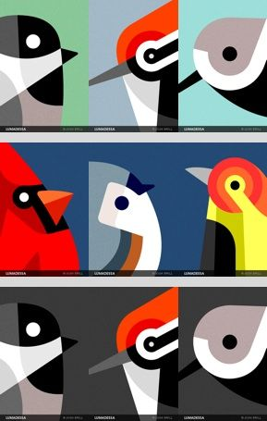
Today you are going to write about the bird you created. Give the bird a name and create a short fact file about it- think about: 1. Where does it live? Does it live there all year round? 2. What kind of habitat does this bird like to make it’s home in? 3. Can it fly? How does it get around? 4. What does it eat? It could be unusual things. 5. Is there any animal who would like to eat it?
Writing- My Exotic Bird
Think about WHO WHAT WHERE WHEN WHY,
as you are composing your fact file.
Share YOUR IDEAS before you start.
Get help with tricky words but DON’T WORRY give the words a go!
Remember CAPITAL LETTERS, FULL STOPS AND FINGER SPACES
A fact file does not need to be laid out like a story.

Slide 6
Todays story is about being outside https://www.youtube.com/watch?v=8au_mPa0TKc

Slide 7
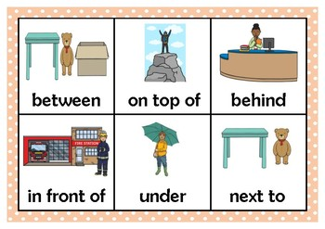
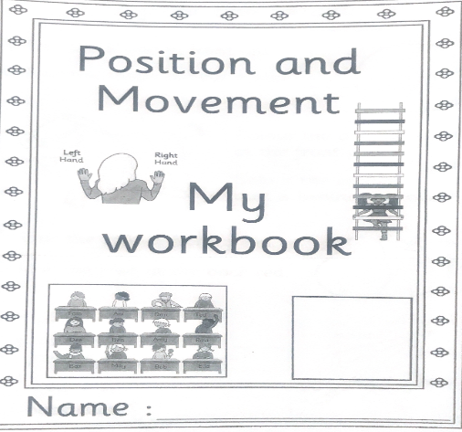
Mathematics Position and Movement
L.I – I can describe the position of an item using the correct language
Watch -https://www.bbc.co.uk/bitesize/clips/zvxhyrd
https://www.youtube.com/watch?v=_reCz6HJ3gs
Position and Movement workbook – Complete page 298 in your workbook
about above and below.

Slide 8
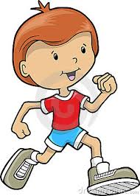
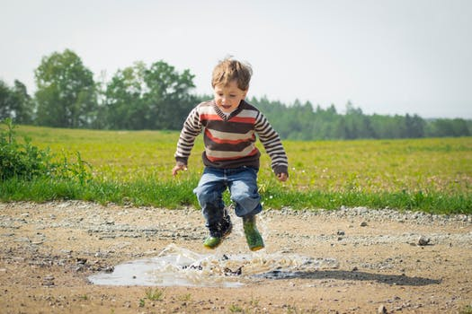
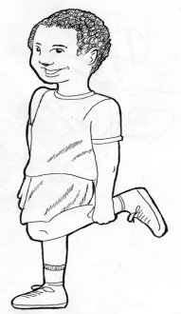
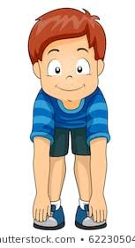
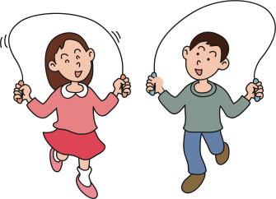
Maths Outdoors
L.I. – to use my knowledge of numbers to count.
How many of these can you do in one minute?
It is a new minute for every activity.
Jumps
Hops
Starjumps
Touch your toes
Skips
Record your score each time.
Can you jog on the spot or round the garden for
one minute?
Good Luck

Slide 9
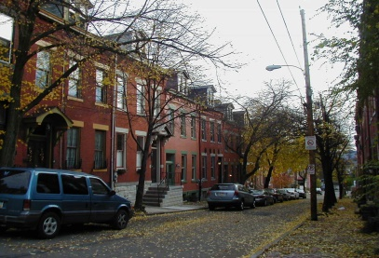
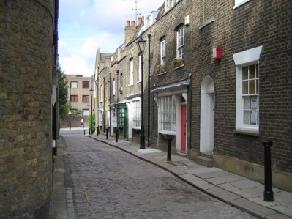
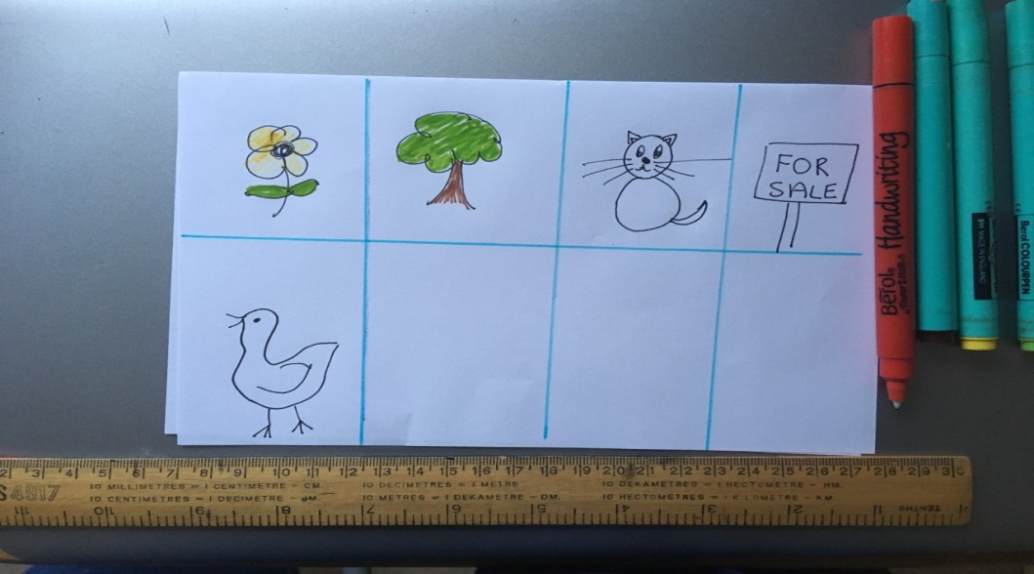
Street Bingo
Today you are going to make a game of Bingo to play with your family. Instead of using numbers, you are going to use things you would find outside. Draw a grid with eight parts and in each part draw something you might see outside. Make enough cards for everyone in your family. Don’t make them all the same.
Once you have finished the cards go outside and look for the things on your card. You can go for a walk or do it from your garden. Cross them off when you see them. The winner is the first person to have crossed of all the pictures.
Good Luck!

Slide 10
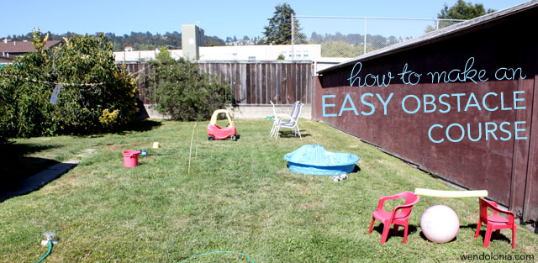
Play Topic: Obstacle Course
*Your challenge today is to make another at home obstacle course*
You can set up your obstacle course either indoors or outdoors in your garden.
Your obstacle course should be made using only what you already have at home.
Today is Outdoor Classroom Day so we thought it would be a great chance to make another obstacle course outside. Change the layout, time yourself, get your grown ups taking part too.

Slide 11
I hope you have enjoyed today’s learning and managed to go outdoors to learn.

