Slide 1
Today is Outdoor Learning Day

Slide 2
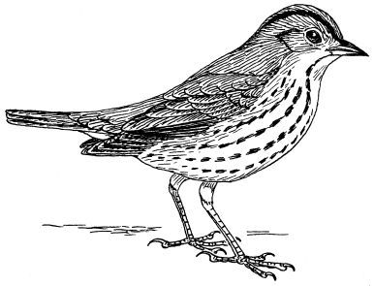
Thursday 21st of May
Good Morning Primary 2/3!
French: Bonjour la class!
Today we are going to take French outdoors with a wee French counting activity to practise the numbers you were doing last week.
L.I- To know the number names to 20
Go out into the garden or street with a grown up and count in French how many:
Birds you can see
Cars you can see
Windows on your house
People you can see

Slide 3
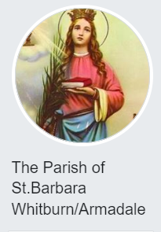
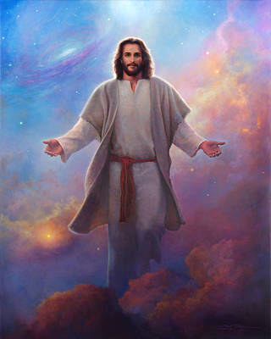
Today is Ascension Day Father Sebastian will be streaming mass live online at 10.00am of the Parish Facebook page, if you would like to join him.
Today we remember the ascent of Jesus Christ into heaven on the 40th day after his Resurrection.

Slide 4
Reading Comprehension
Using your reading book from Oxford Owl think about these questions and try and answer them. Don’t write them down just tell someone what you think.
Could this story be true? Why or why not?
What 4 words could you use to describe the main character?
Is there anyone you know in your life who is like a character in your book?
Can you make up a new title that would suit the book?
Who would you recommend this book to, and why?

Slide 5
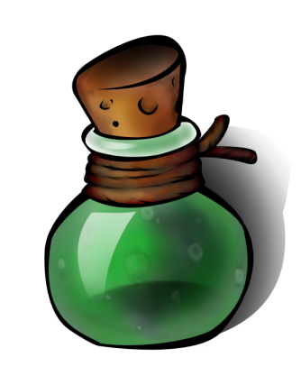
Writing – Potions
L.I- To write instructions for my potion/pie.
Today you are going to make a potion out of natural resources you find outdoors.
Once you have gathered everything you need. Begin to carefully make the potion making sure you remember each of the things you have added and what order you have put them into the potion.
Now you are going to write recipe for your potion!
Helpful reminders
Include a name for your unique potion
List all of the ingredients you will need
Write numbered steps that tell others what you add and how much of it.
*Challenge* Can you write a short explanation about what magical effect your potion has on anyone who takes it?

Slide 6
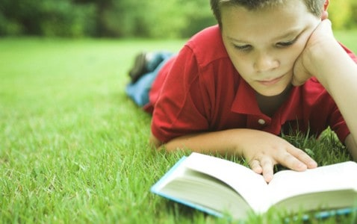
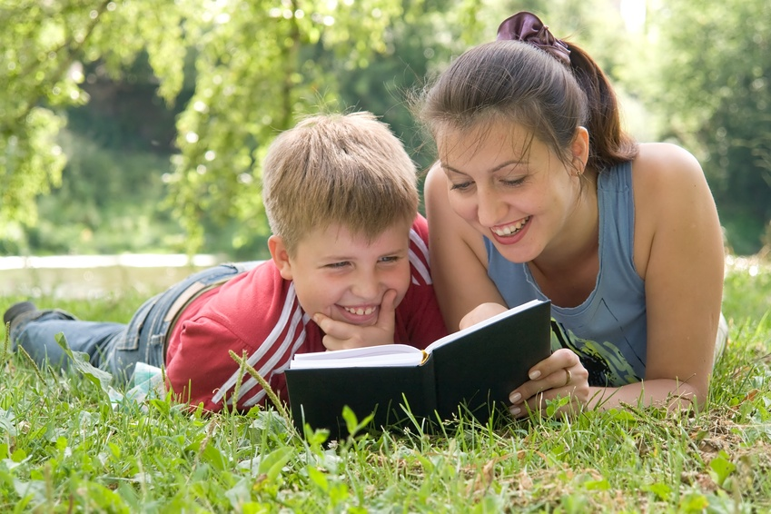
Story time
Today, instead of watching a story online, and as it is Outdoor Classroom Day, why don’t you choose one of the books you have at home and take it into the garden to read or out on a walk to a quiet spot where you can sit and read in peace with your grown up.

Slide 7
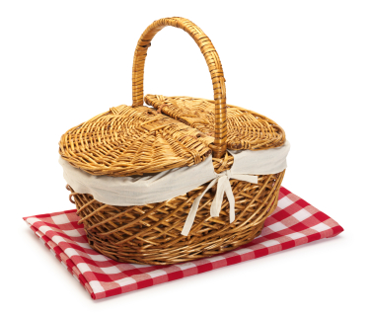
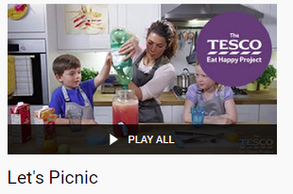
Family Picnic
As part of Outdoor Classroom Day we thought it would be lovely if we, as a whole school, has a picnic for our lunches today!
Tesco’s “Let’s Eat” Project, they have developed a lovely playlist of simple picnic recipes that you might like to try out.
In the playlist there are recipes for:
Fruit Quencher Drink
Fruit Kebabs
Delicious Tortilla
Yummy Cheesy Rolls with Apple Slaw
Easy Peasy Bread in a Bag in 8 minutes
The link to make any of these delicious picnic treats is here: https://www.youtube.com/playlist?list=PLbPWPsvL8htl0gxYIoihAU0O6dZQCdTfb

Slide 8
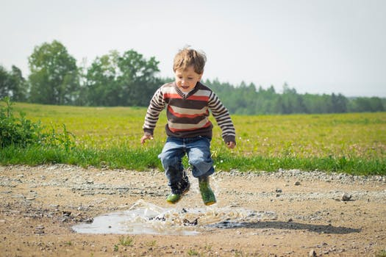
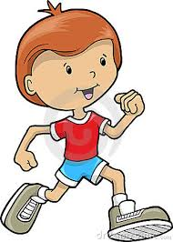
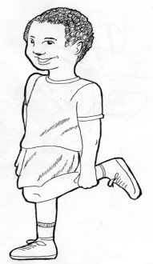
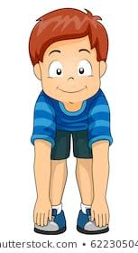
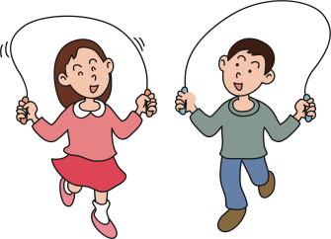
Maths Outdoors
L.I. – to use my knowledge of numbers to count.
How many of these can you do in one minute?
It is a new minute for every activity.
Jumps
Hops
Starjumps
Touch your toes
Skips
Record your score each time.
Can you jog on the spot or round the garden for
one minute?
Good Luck

Slide 9
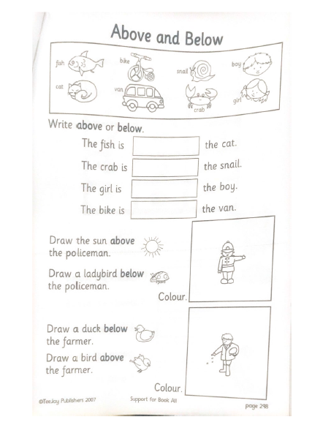
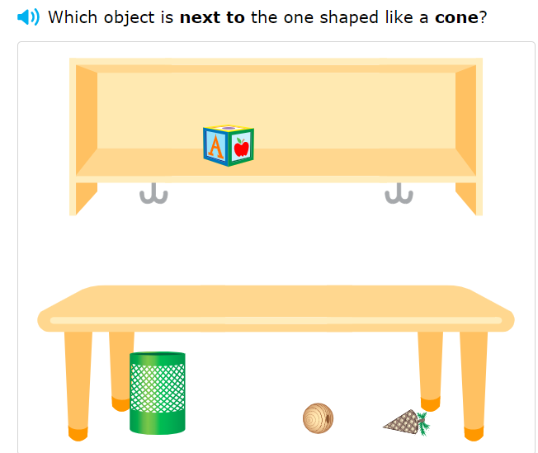
P2 Maths Activities
L.I – I can describe the position of an item using the correct language
Complete page 4 in your workbook
Play: Beside and Next to
https://uk.ixl.com/math/year-1/beside-and-next-to-find-solid-figures

Slide 10
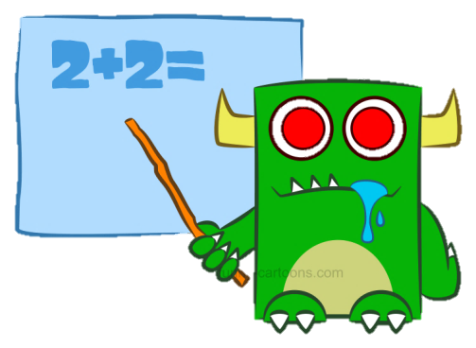
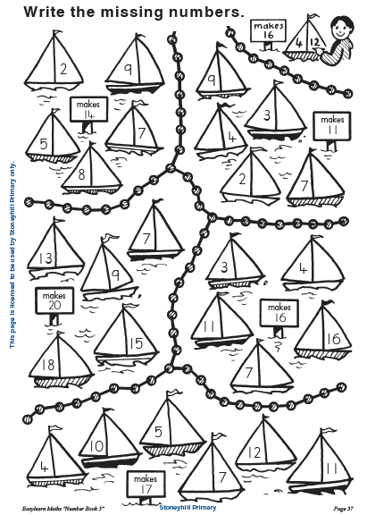
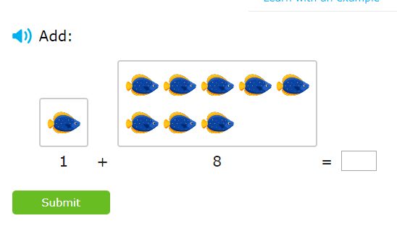
P3 Numeracy Activities
LI: To use counting on and addition strategies to find the total
Addition and Subtraction workbook
Please do the third page of your
booklet.
2. IXL Maths: Addition to 20
https://uk.ixl.com/math/year-2/add-with-pictures-sums-up-to-20

Slide 11
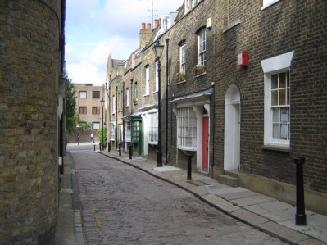
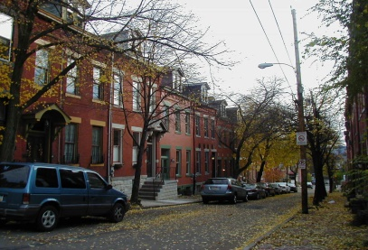
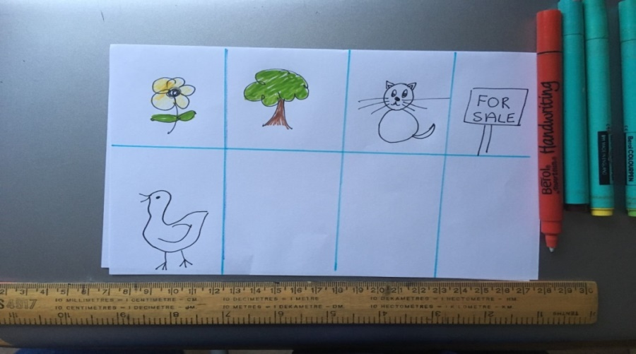
Street Bingo
Today you are going to make a game of Bingo to play with your family. Instead of using numbers, you are going to use things you would find outside. Draw a grid with eight parts and in each part draw something you might see outside. Make enough cards for everyone in your family. Don’t make them all the same.
Once you have finished the cards go outside and look for the things on your card. You can go for a walk or do it from your garden. Cross them off when you see them. The winner is the first person to have crossed of all the pictures.
Good Luck!

Slide 12
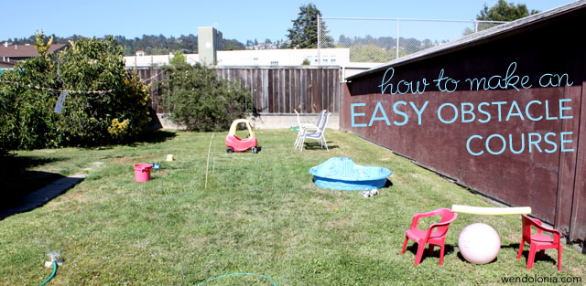
Play Topic: Obstacle Course
*Your challenge today is to make another at home obstacle course*
You can set up your obstacle course outdoors in your garden.
Your obstacle course should be made using only what you already have at home.
Today is Outdoor Classroom Day so we thought it would be a great chance to make another obstacle course outside.
Change the layout, time yourself, get your grown ups taking part too.

Slide 13
Leave a comment on the blog about what you learned today. Enjoy the rest of your day Primary 2/3!

