Slide 1
Good Morning P5/4
Week 9 Home Learning
Thursday 21st May 2020
Outdoor Classroom Day!

Slide 2
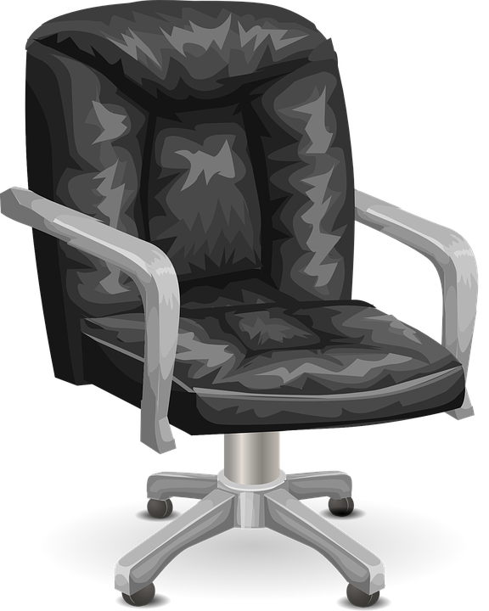
Morning Starter
Claire's mum bought 38 bags of crisps for a party.
If everyone ate 3 bags each, how many people were at the party and how many extra bags of crisps were there?
Tickets for a concert are priced at £6.
How many can be bought for £48?
84.3 grams of aspirin powder is packed equally into 100 capsules.
What is the weight of powder in each capsule?

Slide 3
Morning Starter - Outdoor version
Because there’s less traffic around and fewer planes overhead, sounds like birdsong seem even louder at the moment. Listen from your window, in your garden or on a walk, then name and talk about the sounds you can hear - this is a great way to develop your listening skills.

Slide 4
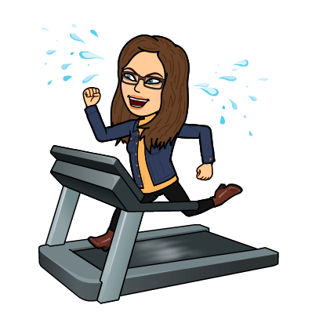
PE tasks
Thursday is normally a PE day for us so here are some ways you can choose to get
active today:
9am – Joe Wicks PE lesson –
11:30am – Dance Lesson with Oti Mabuse (Strictly professional) –
Any time – Cosmic Kids Yoga –

Slide 5
Ascension Thursday
Today, as much as it is outdoor classroom day, it is also Ascension Thursday, and we would of been going to celebrate mass as a school.
You can join Father Sebastian online though and still celebrate mass at 10am on this important day.
https://www.facebook.com/The-Parish-of-StBarbara-WhitburnArmadale-376019749131572
You could also watch this video

Slide 6
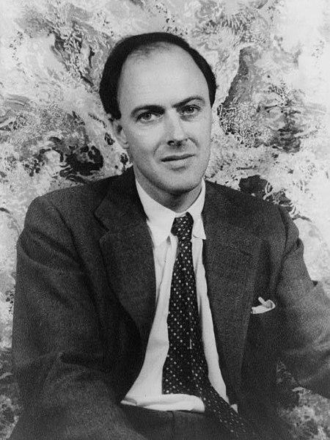
Reading Task - Comprehension Questions
Reading Task -
Book Review
Reading Task -
Inference

Slide 7
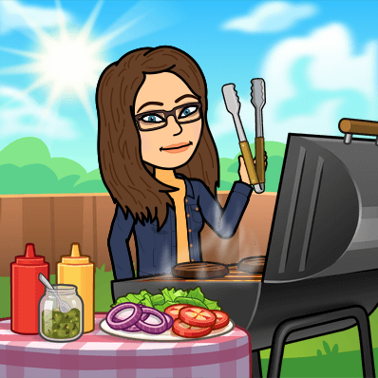
Have a picnic
We would love for all our families to join us today for an outdoor (or indoor) picnic!
Even though we can't be together physically as a school community we can unite and mark 'Outdoor classroom day' by enjoying the outdoors together while having lunch!
We ask that you tweet your photographs to teams or the St Anthony's twitter page.

Slide 8
Maths
We have came to the end of our fractions topic.
Please complete the assessment on Sumdog.

Slide 9
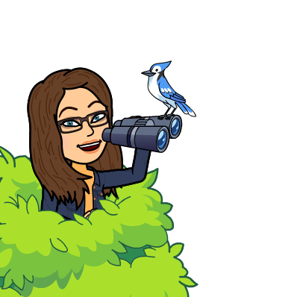
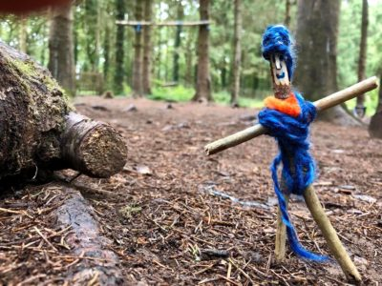
Tool-less woodworking
You don’t need saw, drills or saw horses to do a bit of basic woodworking, or at least crafting out of wood.
You may have trees in your garden to provide twigs and small branches but if not, just make sure you gather some if you can on your daily exercise. Teemed with some string or wool and the contents of your recycling bin, the world is then your oyster!
You could do anything from making a big, natural knots and crosses board to stick people to mini tee-pees. If you’re feeling particularly ambitious you could try and make a bug house.

Slide 10
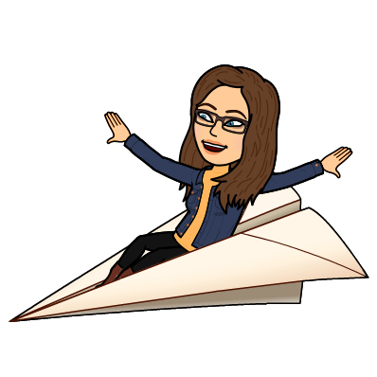
A final bit of fun!
I know how much you guys like to make paper airplanes so here is a fun little task for you to finish with.
Spend time making paper planes together with the people in your house and then see who can fly their plane the furthest. You could even measure the distance that your planes fly.

