Slide 1
Thursday 21st May

Slide 2
Timetable
Daily exercise
French
Spelling
Outdoor learning
Writing
Maths

Slide 3
Daily exercise
I am learning to move our body well, exploring how to manage and control it, finding out how to use and share space.
I have been going out a daily walk to look at the new plants growing. If you can get outside for some fresh air that would be great. Remember to only do this if it is okay with parents. If not I have attached below the link to Joe Wicks workouts. I have been trying these myself at home!
https://www.youtube.com/watch?v=Na1rzigYlSU

Slide 4
French
Click on the link below to sing along to the number song in French?
https://www.youtube.com/watch?v=UsEz58BblMY
Can you write today’s date in French?
Quelle est la date aujourd’hui?
e.g. C’est lundi vingt avril
Can you also write today’s weather in French?
Quel temps fait-il?
Il pleut/ Il fait beau/ Il fait froid/ Il y a du vent/
Il fait mauvais/ Il y a des nuages/ Il y a du soleil

Slide 5
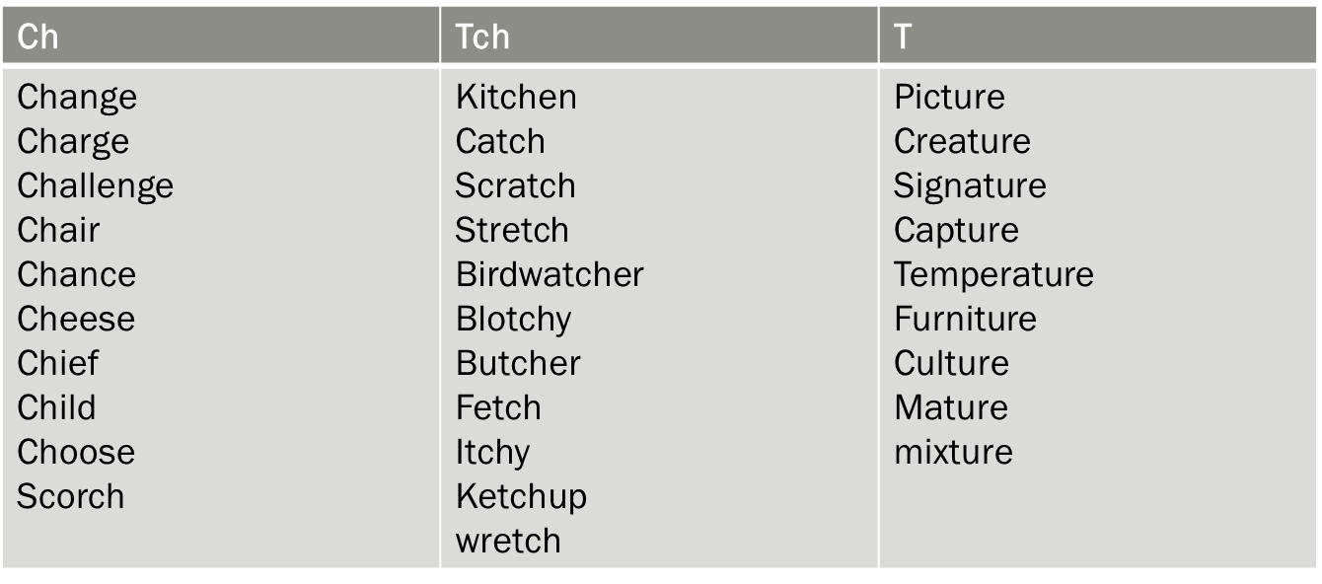
Spelling – I can use various strategies to help me spell tricky words.
Since we missed Monday’s spelling task – choose 10 words a mixture from each column and diacritically mark your spelling words.

Slide 6
Outdoor learning Day!
We would love our families to join us today for an outdoor( or indoor) picnic. Even though we cannot be physically together as a school community we can unite and mark outdoor classroom learning day by enjoying the outdoors together while having lunch! If you would like to share your photos, please tweet them to the ST Anthony’s Twitter page – no names please.
Other activities you could do are:
Create your own nature picture using outdoor objects like leaves, flowers.
View from your window – create a landscape drawing .
Cloud watch – how many different shapes do you see?

Slide 7
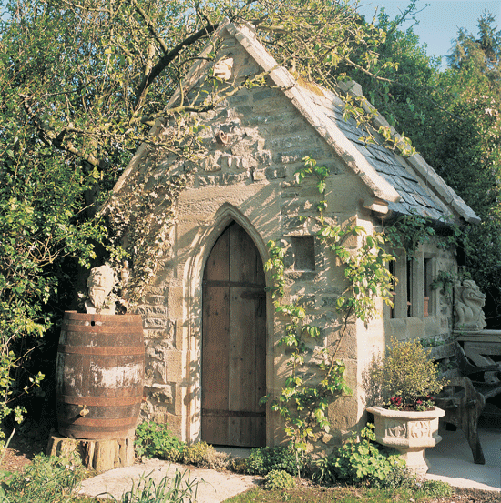
Writing – The Magical Shed
I know we have been looking at creating leaflets but we will continue with that next week. I thought this would link nicely with the outdoor learning day.
Imagine you discover this 'shed' at the bottom of your garden, What is inside? I can imagine it's magical inside, much bigger than it seems on the outside. Who does it belong to? Where does it take you?
Write 2 – 3 paragraphs – describing the setting. Remember to use descriptive words for example instead of big you could say large or enormous.
1st paragraph set the scene for the reader
2nd – where does it take you, who does it belong to?
https://www.literacyshed.com/home.html

Slide 8
Maths Starter
Remember we are able to take part in the West Lothian Maths challenge on Sumdog and today is the last day to compete. ( You can do this as your starter)
If you do not wish to do this as your starter either complete one of the speed times table sheets or go on to hit the button for 15 minutes.

Slide 9
Maths Lesson
We have been working our way through the Theme park maths. We are now on Task 5 in the work booklet. I have attached this for you to complete.

