Slide 1
Wednesday 20th May
Good Morning Primary 4!
French: Bonjour la class! Ca Va?
Quelle est la date aujourd’hui?
Aujourd’hui cest Mercredi 20th Mai 2020
Listen to the days of the week song!
https://www.youtube.com/watch?v=Lpwf5N0rfVE

Slide 2
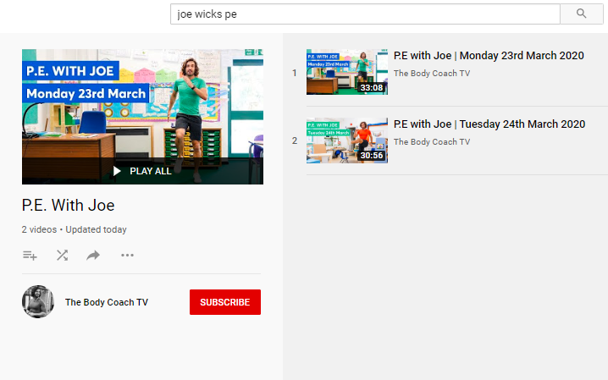
Health and Wellbeing
LI: We are learning to move our body well, exploring how to manage and control it, finding out how to use and share space.
P.E with Joe- Tuesday
Wednesday 20th May Video
(he is nearly as fun as Mr Martin, not quite, but nearly)
https://www.youtube.com/playlist?list=PLyCLoPd4VxBvQafyve889qVcPxYEjdSTl

Slide 3
Spelling (Tom Fletcher & Roald Dahl groups)
LI: I can recognise and spell words that use the ‘oe’ phoneme
S.C. (what I need to do to be successful)
Look at the Story of the ‘oe’ Phoneme and the list of ‘oe’ words – you can find these in your work packs or on the following slides.
Choose 4 different coloured pens or pencils.
Highlight or underline all the of ‘oe’ words – use a different colour for each representation.
EXAMPLE:
o-e words = red
oa words = blue
ow words – green
oe words = yellow
“Look on the next slide for an extension task!”

Slide 4
Spelling (Tom Fletcher & Roald Dahl groups)
LI: I can recognise and spell words that use the ‘oe’ phoneme
S.C. (what I need to do to be successful)
Once, you have finished underlining your ‘oe’ words, it’s time to practise them.
Look, Cover, Write, Check.
Look – look carefully at a word in the story.
Cover – cover it with your hand – no peeking!
Write the word down in your jotter, without peeking!
Check – take your hand off the covered word and check that you have spelled it correctly!
“Look, Cover, Write, Check!”

Slide 5
Spelling slide (Tom Fletcher & Roald Dahl groups)
LI: I can recognise and spell words that use the phoneme ‘oe’
o-e | oa | ow | oe
whole | road | know | toe
alone | coast | bowl | goes
telephone | groan | shallow | potatoes
those | coal | tomorrow | tomatoes
wrote | soak | window | foe

Slide 6
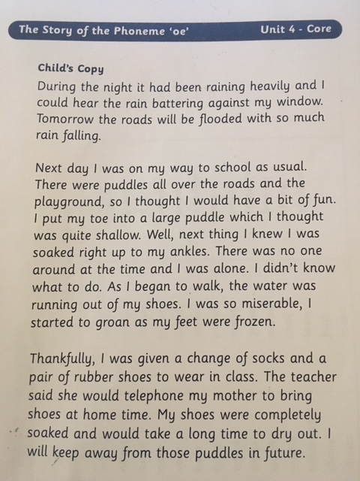

Slide 7
Spelling (David Walliams Group)
L.I. I am learning to spell ‘ea’ words
You have worked really hard on your ‘ea’ words over the last couple of weeks. Lets have one last look at some different ‘ea’ words before we explore a new sound!
TASK: click on the link below to see some more words that use the ‘ea’ phoneme.
Click the green football at the bottom of the page and play some of the ‘ea’ online games!

Slide 8
Reading
L.I I am using different reading strategies to help me understand my book
David Walliams: t-tp-6874-the-zoo-vet-home-learning-challenges-reception-fs2 – Select one or two tasks to do.
Roald Dahl: Chapter 15 – Comprehension Questions
Tom Fletcher: Chapter 6 – Metalinguistics

Slide 9
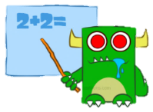
Maths (slide 1)
L.I. I am learning how to use division to find the fraction of an amount
Yesterday, you learned that to find a fraction of an amount, you divide the amount by the denominator (bottom number) of the fraction!
When we divide a number, we split it into equal parts.
For example: $\frac{1}{2} of 10 is really asking us to divide 10 by 2.$
÷ 2 =

Slide 10
Maths (slide 2)
L.I. I am learning how to use division to find the fraction of an amount
Remember, to divide it is useful to know our times tables!

Slide 11
Maths (slide 3)
L.I. I am learning how to use division to find the fraction of an amount
For example:
$\frac{1}{3}$ of 21 really means 21 divided by 3
To answer this think of your 3 times table! How many 3s can I fit into 21? Count along in 7s!
3, 6, 9, 12, 15, 18, 21
3 x 7 = 21 so our answer is… 7!
Look at some more examples of using division on the next slides!

Slide 12
Finding a Quarter (¼)
You need to divide by 4 to find one quarter.
Count the number of bones.

Slide 13
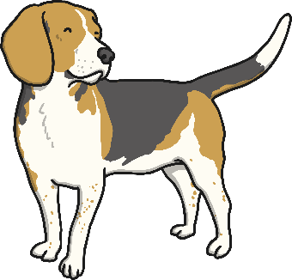
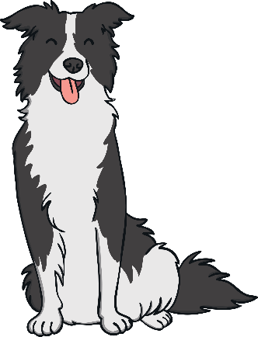
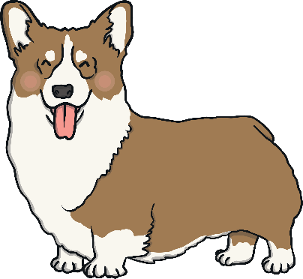
Finding a Quarter (¼)
There are 8 bones. Divide the bones between the four dogs so that they have the same number each. How many bones does each dog have?

Slide 14
Finding a Quarter (¼)
How many bones does each dog have?
Each dog has 2 bones.
So quarter of 8 is 2.
¼ of 8 = 2

Slide 15
Finding One Third (⅓)
We divide by 2 to find half (½), and four to find one quarter (¼).
What do you think we need to divide by to find one third? Have a look at the one third fraction…
⅓
You need to divide by 3
to find one third.

Slide 16
Finding One Third (⅓)
Here are 9 butterflies. Divide them between the three flowers so that the same number is on each flower. How many butterflies are on each flower?

Slide 17
Finding One Third (⅓)
How many butterflies on each flower?
Each flower has 3 butterflies.
So one third of 9 is 3.
⅓ of 9 = 3

Slide 18
Finding One Third (⅓)
Try another one. This time there are 12 butterflies. If we divide them between three, how many butterflies will be on each flower?

Slide 19
Finding One Third (⅓)
How many butterflies are on each flower this time?
Each flower has 4 butterflies.
So one third of 12 is 4.
⅓ of 12 = 4

Slide 20
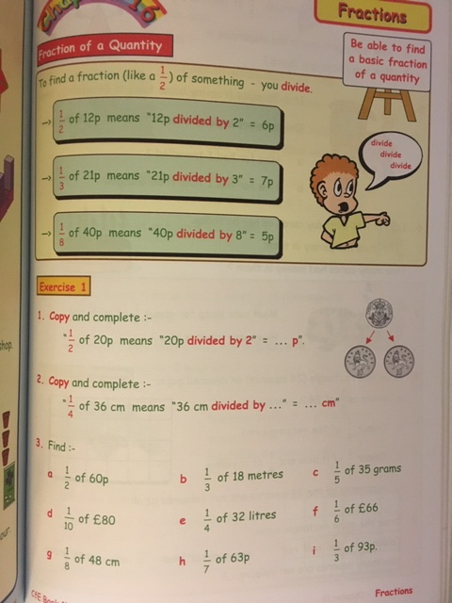
Maths
L.I. I am learning how to use division to find the fraction of an amount
Have a look at this Teejay page and try and answer the questions in your jotters! You can download the activity on Teams or the Blog.
If you are struggling with division, you are welcome to use a calculator to help!

Slide 21
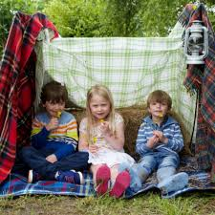
Challenge Afternoon
L.I. I am learning how to use my imagination to build something
Using things around your house / bedroom / garden, try and built the best den that you can! It can be inside or outside (enjoy the sun!)
Post a picture of your finished den on Teams for your friends to see!

Slide 22
Feel free to leave comments / questions on Teams throughout the day and I will try my best to get back to you. Enjoy your day, Primary 4!

