Slide 1
Wednesday 20th May

Slide 2
Timetable
Daily exercise
French Starter
Spelling
Reading
Maths
Health and wellbeing

Slide 3
Daily exercise
Try to do some form of exercise to start the day. This could be a walk or run with a family member or a workout in the house. Check with your parents that it is ok for you to do this.
Why not try a bit of Joe Wicks: 9 am on Youtube

Slide 4
French – I can describe what I am wearing.
Draw a picture of yourself wearing clothes. Label the picture in French.
Examples of words:
La jupe – skirt
La robe – dress
Le pantalon – trousers
La chemise – shirt
Le pull – jumper
Le jean – jeans
Le short – shorts
Les baskets – training shoes.
Les sandales – sandals
La cravat – tie
Les chaussettes

Slide 5
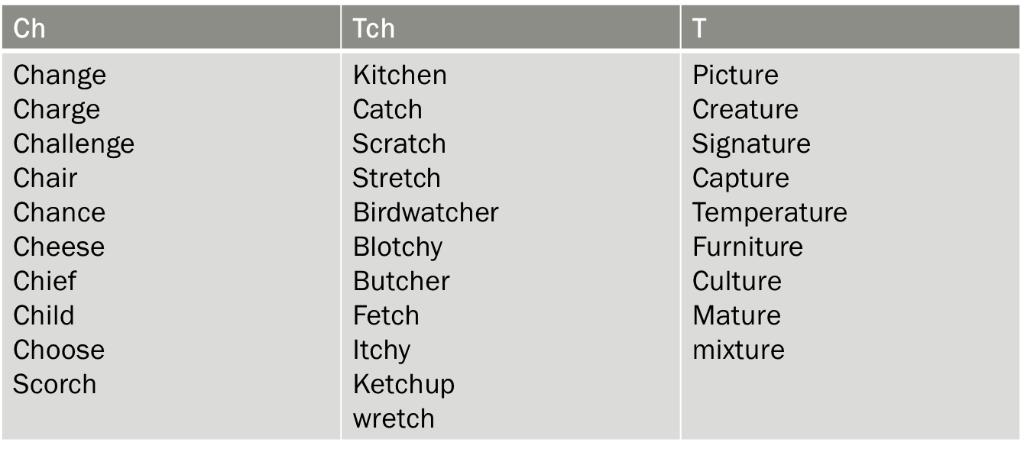
Spelling – I am learning to use various spelling strategies
Wednesday –Mnemonics e.g B–big E-elephants C–can’t A–always U-use S-small E–entrances. Choose 6 words to complete the task.

Slide 6
Reading starter
How many words can you make out the following words in 10 minutes.
Beautiful sunrises.

Slide 7
Reading – I can summarise the main points of the text in my own words.
Read the next chapter in your book from home and summarise the main points of the text in your own words.

Slide 8
Number talks – Division
Remember number talks is about the mental strategies you use to complete a task.
Once you have an answer draw/write how you worked the sum out.
Look at the division sentences. What mental strategy did you use to work out the problem?
52 divided by 4
128 divided by 8
144 divided by 4
from - FVWLricNumeracyAcademy
@FVWLricNumerac1 – Twitter.

Slide 9
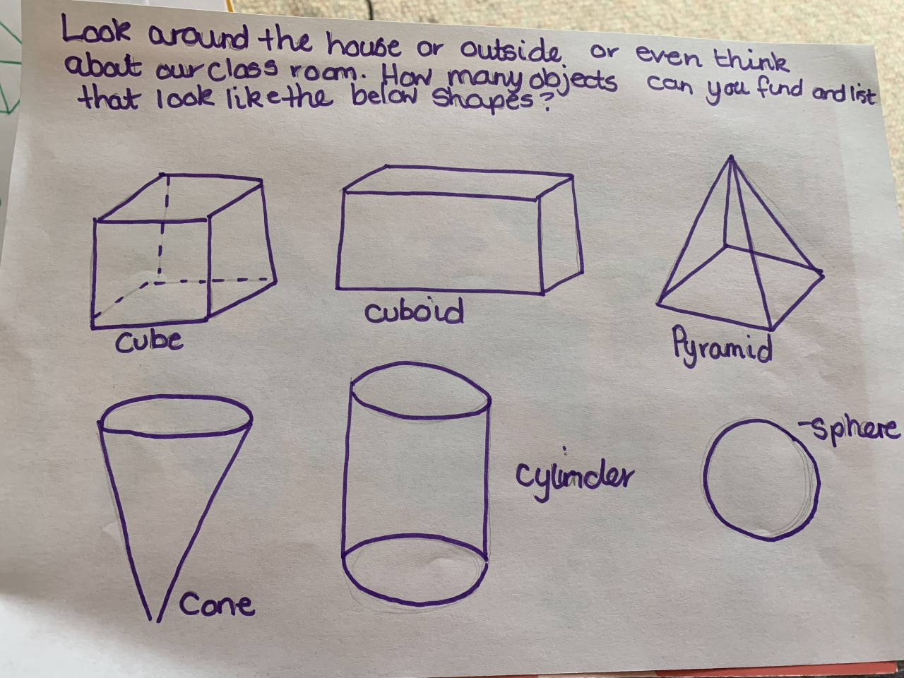
Maths – 3d shapes
Look around the house or outside or even think of our classroom. How many objects can you find and list that look like the shapes to the left?
Remember you have the option to join in on the West Lothian Sumdog competiton.

Slide 10
Health and wellbeing
I am learning about what keeps me healthy.
Calcium is essential for strong healthy bones. Do some research to find out which foods are rich in calcium. How many do you currently eat and how many would you like to try?

