Slide 1
Wednesday 20th of May
Good Morning Primary 3!
Bonjour la class! Ca Va?
Can you say todays date in French?
Aujourd’hui c’est (M…………………) 20th (M…………) 2020
LI: To say simple greetings in French
Watch: Bonjour! Bonjour!
https://www.youtube.com/watch?v=atNkI6QFZ50

Slide 2
Literacy
LI: We are learning to read and spell our common words correctly.
Warm-Up: Sing with Mc Mac – Boom Shake the Alphabet https://www.youtube.com/watch?v=Emb2yvwAHtc
Common Word Spelling
Write your words out and underline the vowels using a coloured pencil.
Choose a couple of your words and write a sentence for each one.

Slide 3
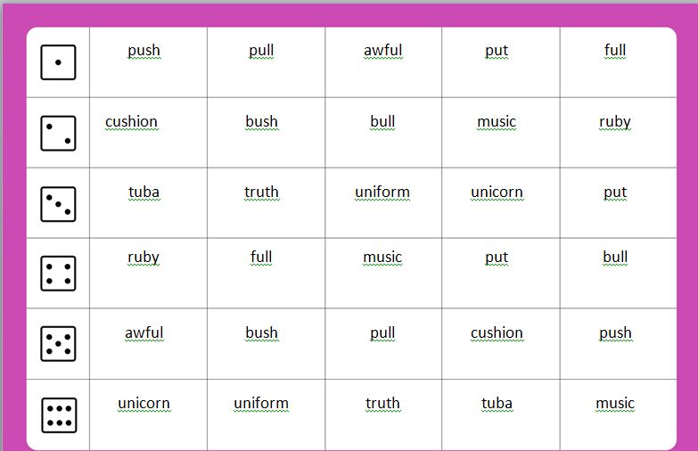
Stage 3- Roll and Read
L.I -I can read words containing the ‘u’ phoneme.
Task: Roll the dice, read a word from the line of the number you rolled. First to get 4 in a row wins.

Slide 4
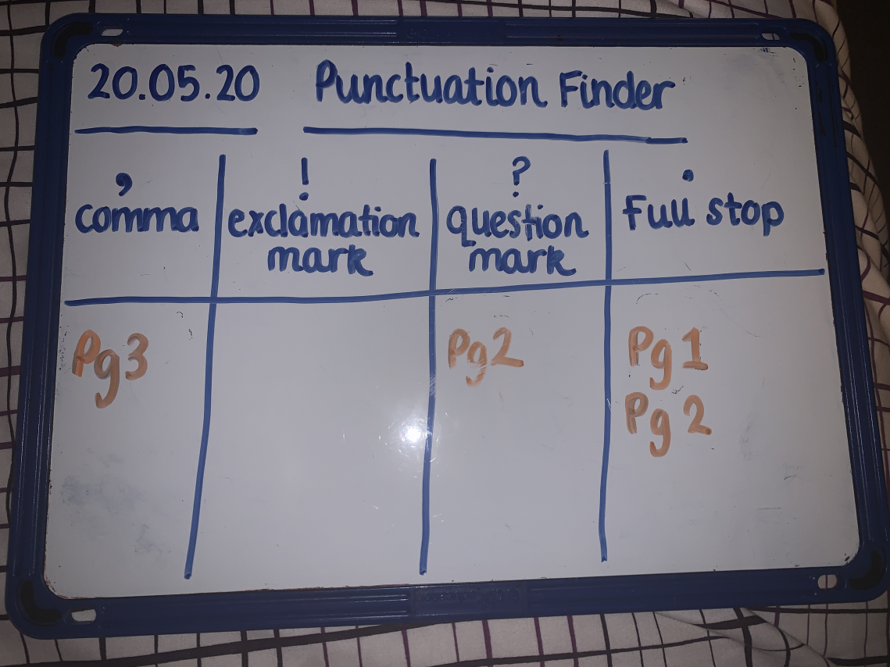
Reading Comprehension
LI: We are learning to read fluently and locate information.
Using the book you have been reading this week, or a new book from the Oxford Owl Website (username – stantsps3 password – primary3) copy and complete this punctuation finder task in your jotter.

Slide 5
Numeracy – Warm Up
LI: To use mental strategies to solve maths problems and be able to explain my strategy
Cube Conversions

Slide 6
Numeracy – Warm Up
On the next slide you will see some shapes made of cubes.
You need to work out how many cubes make up the shape.
You also need to see how many different ways you can see the shape.
Maybe a cube shape made of 5 cubes you see as 3 and 2 cubes or 4 and 1 cubes to make the 5 cube shape.

Slide 7
How many unit cubes make up this structure? Explain how you know.
How else can you think about this structure? Is there another way to see it?
Are there even more ways you can picture or think about this structure?
You may have seen some groups like these:
It’s time to reveal the answer. Let’s find out the total number of unit cubes.
The Reveal
8 unit cubes
www.stevewyborney.com
Steve Wyborney

Slide 8
Before we see the answer, describe several different ways you can see this structure.
10 unit cubes
The Reveal
www.stevewyborney.com
Steve Wyborney

Slide 9
Before we see the answer, describe several different ways you can see this structure.
12 unit cubes
The Reveal
www.stevewyborney.com
Steve Wyborney

Slide 10
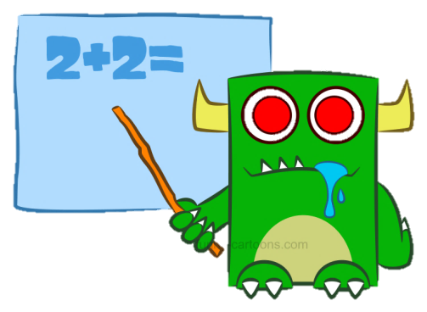
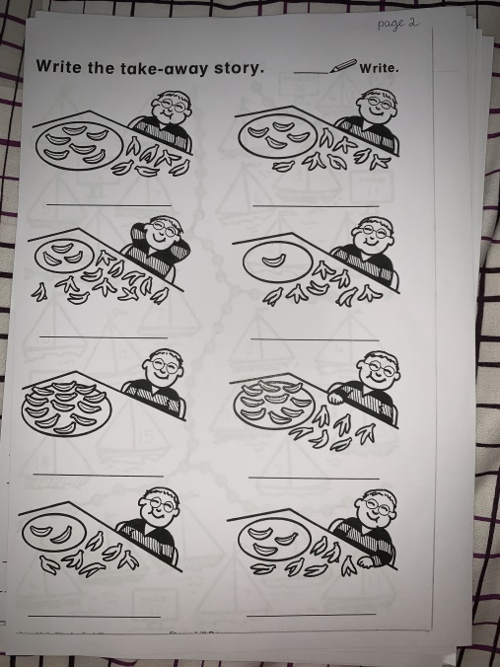
Numeracy Activities
LI: We are learning to develop a range of addition and subtraction strategies.
1. Addition and Subtraction Booklet – Page 2
2. IXL Maths – ‘add using doubles minus one’
https://uk.ixl.com/math/year-2/add-using-doubles-minus-one

Slide 11
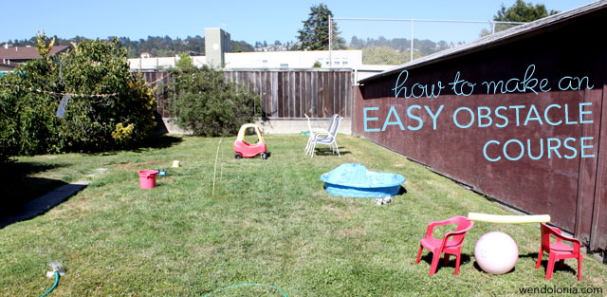
Play Topic: Obstacle Course
*Your challenge today is to make an at home obstacle course*
You can set up your obstacle course either indoors or outdoors in your garden.
Your obstacle course should be made using only what you already have at home.
There are some obstacle course videos that might help you come up with your own ideas on the next slide.

Slide 12
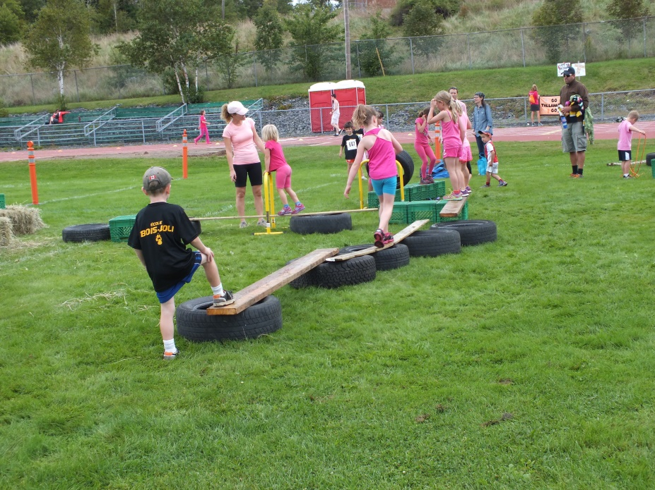
Indoor Obstacle Courses: https://www.youtube.com/watch?v=FKF6iPL3kTc https://www.youtube.com/watch?v=0vLvoEXLApA https://www.youtube.com/watch?v=8o4CQkSGZoQ Garden Obstacle Courses: https://www.youtube.com/watch?v=_NdJtdfYoMc https://www.youtube.com/watch?v=wkPUqZ5fEHo https://www.youtube.com/watch?v=pVfuTsu31ms

Slide 13
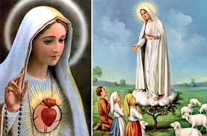
R.E.- Mary is Our Mother Mary appeared to children to show her love.
In 1858 while she was gathering firewood Bernadette was visited by Mary. At first no one would believe that Our Lady was visiting Bernadette. Our Lady appeared several times to Bernadette and eventually she was believed. Now people from all over the world go to Lourdes to visit the spot she appeared at. They go to pray to Mary and ask for help.
In 1917 Our Lady visited three shepherd children in Fatima Portugal. She visited them several times teaching them special prayers. Once again they were not believed. The children never changed their story and people began to believe them and pray too. A church was also built on the spot where Mary appeared and people visit to pray.
Remember Mary will always listen to your prayers.

Slide 14
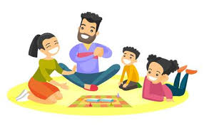
I hope you enjoyed your activities today! Now it’s time to have a play! ☺

