Slide 1
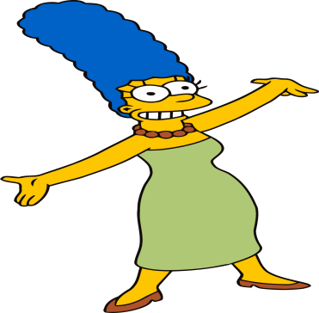
Wednesday 20-5-20
Good Morning Everyone!

Slide 2
Today’s Timetable
Morning Exercise
French
Morning Starter
Maths Lesson
Grammar Task
Literacy Task
R.E.
Topic
P.E.
Prayer

Slide 3
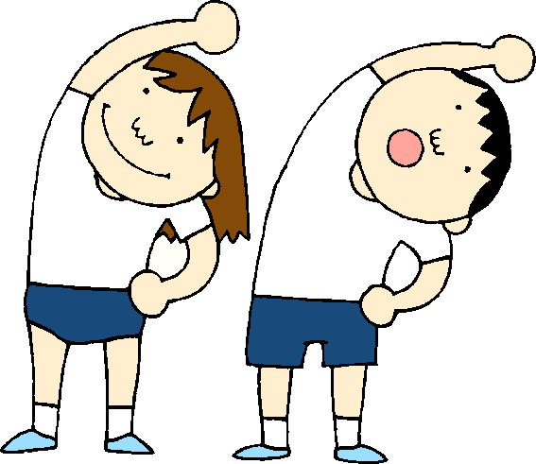
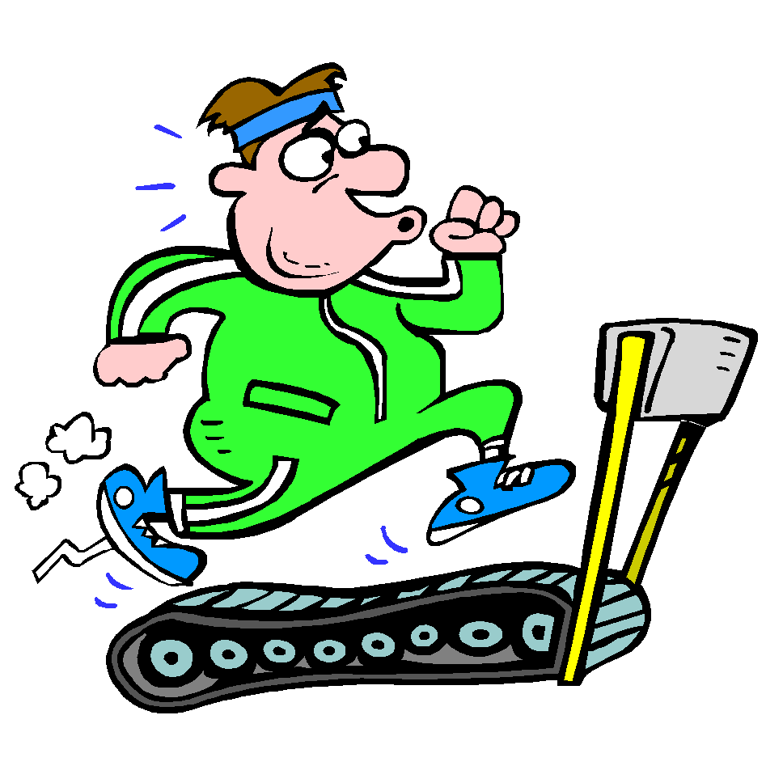
Daily Exercise
Try to do some form of exercise to start the day. This could be a walk or run with a family member or a workout in the house. Check with your parents that it is ok for you to do this.
Why not try this workout :-
https://www.youtube.com/watch?v=pLuM18p9zbM
Or join the Body Coach at 9am

Slide 4
A little bit of French to start the day
Quelle est la date aujourd’hui? Comment ca va?
e.g. C’est mardi vingt-neuf mai Je suis content(e)
Je ne suis pas content(e)
Quel temps fait-il? Qu’est ce-que tu veux pour le
e.g. Il y a du soleil dejeuner? eg.
Il pleut / Il fait beau/ Il fait froid/ Je voudrais un sandwich au thon
Il fait mauvais/ Il y a des nuages/ Je voudrais un sandwich au fromage
Il y a du soleil/ Il fait du vent Je voudrais un sandwich au jambon
Je voudrais un sandwich aux oeufs

Slide 5
Morning Starter
Today, everyone’s morning starter is 15-20 minutes on
Times TablesRockstars
If you normally do IDL Maths, please do this also for 15-20mins.

Slide 6
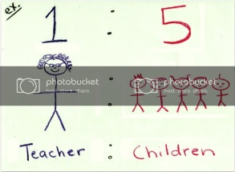
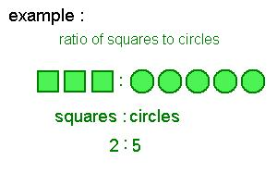
Maths Lesson
L.I. - We are learning again about ratios.
S.C. – To understand what we mean by ratio.
- To know that ratios and fractions are related.
- To be able to calculate ratio problems.
If you need to watch the video again, watch it up until 6mins:-
https://www.youtube.com/watch?v=URMZHUnc8OQ
Task :- Please see the attached sheet for your task.
Circles, please do the first sheet, Squares, do the second sheet and triangles , the third sheet. The answers are listed at the end.
Please do the task first before looking at answers.

Slide 7
Grammar
Your task is to continue your challenge on Sumdog Grammar. Remember, this task lasts until Thursday.
Your task is set up according to your reading group.
Red Group – Group 1, Blue Group – Group 2
Green Group – Group 3
Remember to please let me know how you found it
e.g. too easy, too hard etc. by posting a message on
Teams.
SUMDOG

Slide 8
Literacy
Your task today is to listen to the next chapter of ‘Wonder’,The Deal’. Listen from 11mins 42secs to the end.
https://www.youtube.com/watch?v=JlPV2bcfLsQ
Once you have listened to it, your task is to write a diary entry. Imagine that you are August when you are writing this diary entry. You are writing about what happened/how you feel about the visit to the school. Diary entries reveal what you are really thinking so be completely honest. I have attached examples of diary entries to help you.
L.I. - To be able to develop a good understanding of what the character, August, feels.
S.C. – To be able to listen to the text being read.
- To be able to understand the character of
August.
- To be able to write a diary entry from the viewpoint of
August.
Circles : - Try your best to write a short diary entry.
If you do IDL please do 15-20 mins today.

Slide 9
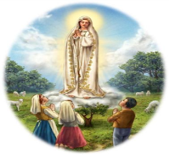
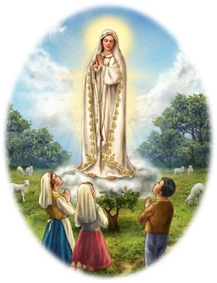
R.E.
Today we are going to learn about the appearance of Our Lady to a group of children in a town called Fatima in Portugal.
The apparitions happened in 1952 .
Nowadays thousands of pilgrims visit Fatima every year.
Watch the following short films:-
https://www.youtube.com/watch?v=P9lnLusZ6h0
One of the messages of Fatima is that Our Lady asks us to pray for peace in the world by saying the rosary.
Task:- Find Fatima on a map of Portugal.
- Draw a picture of the 3 children of Fatima and
underneath write your own prayer for peace in the
world.

Slide 10
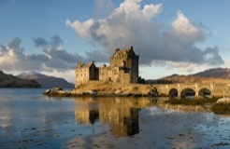
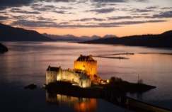
The Battle of Glenshiel
In 1719 Spain got involved in the support for a Jacobite rebellion.
Spanish troops arrived in Scotland and stayed at Eilean Donan Castle in the North West of Scotland.
They joined Scottish Jacobites in the Battle of Glenshiel but lost the battle.
Task: - Eilean Donan is one of the most picturesque castles in Scotland and as a result is a tourist hotspot. Draw a picture of the castle and find 5 facts about the castle.
https://www.eileandonancastle.com/about/history/
https://www.youtube.com/watch?v=fv24PzQ-8Qo&list=PLR87hyNnQ77zn1Leh1KgBwurcfdoZibn6&index=122

Slide 11
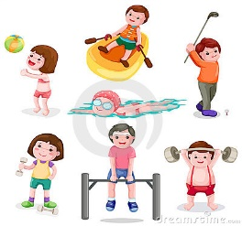
P.E.
You may wish to do some exercise outside with members of your family. However if this not possible perhaps you can persuade them to join you for a workout with the Body Coach. Click on the link below:-
https://www.youtube.com/watch?v=plBUgyWd3Ug

Slide 12
A prayer to end our day
Take a few moments to say a short prayer, thinking of those older members of our community who live in care homes.

Slide 13
Well done!
Well done for working hard today!

