Slide 1
LO: To tell the time using hours and minutes hand
Success Criteria:
1 – I can show different o’clock times on my clock.
2 – I can write what time is shown on the clock.
3 – I can draw different o’clock times on the clock.
Extension:
I can draw a half past the hour time.

Slide 2
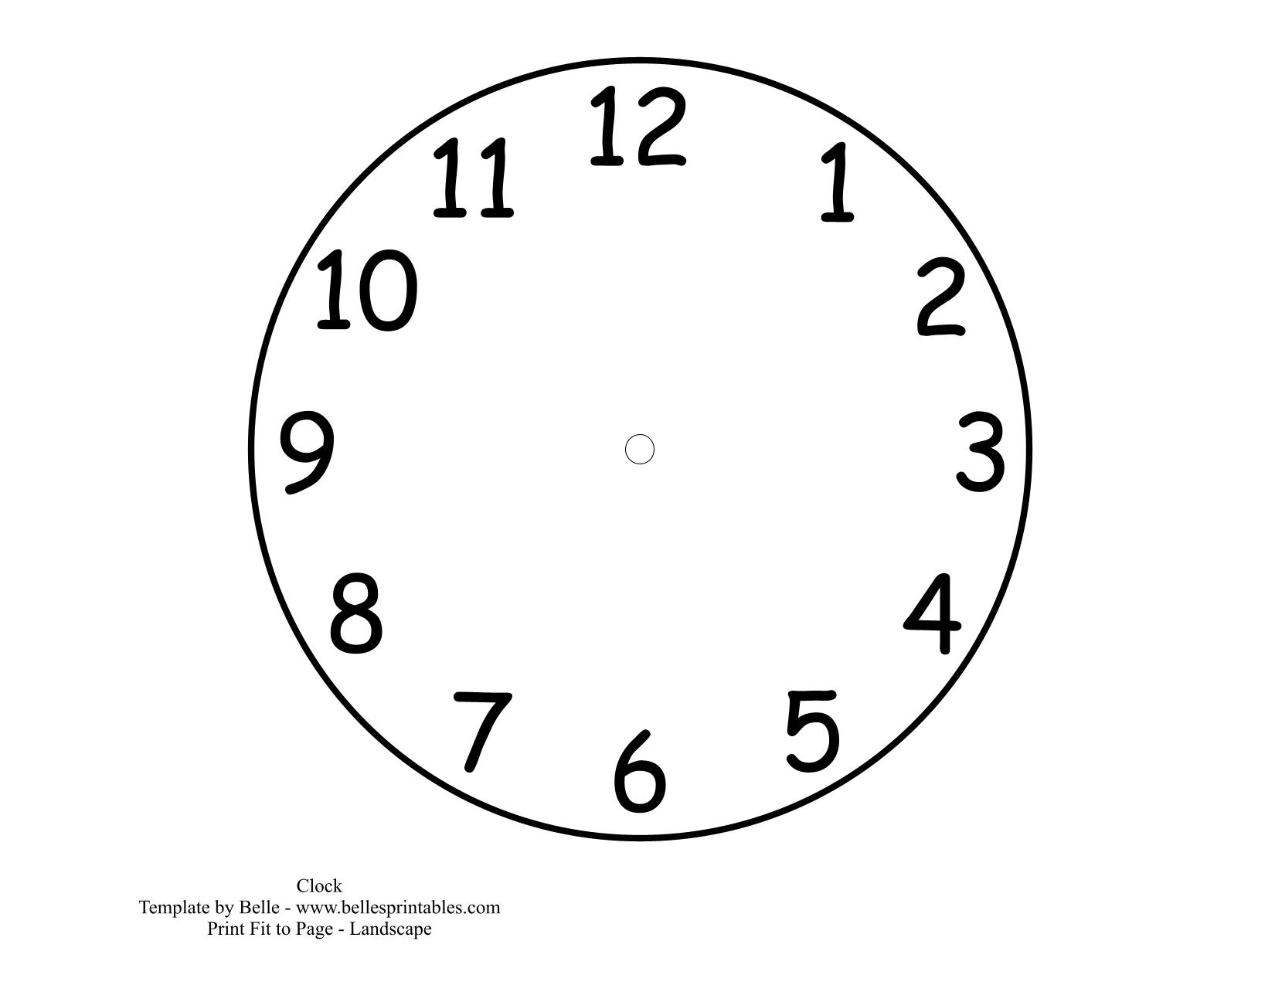
O'clock The minute hand points to 12

Slide 3
7 o’clock

Slide 4
9 o’clock

Slide 5
2 o’clock

Slide 6
5 o’clock

Slide 7
11 o’clock

Slide 8
12 o’clock

Slide 9
Half Past The minute hand points to 6

Slide 10
Half past 7

Slide 11
Half past 3

Slide 12
Half past 12

Slide 13
Half past 5

Slide 14
Half past 9

